Slide 1


Community Waters School Guide:
Edna Travis Elementary
How to Use This Guide
This School Guide supports the Community Waters Science Unit Teacher Manual with information, maps, and images specific to your school and neighborhood.
It is written for teachers - its goal is to provide a better understanding of what is happening with stormwater in and around your school.
All content within may change, and can be adapted as desired.
If you have any questions about these maps, accompanying lessons, or stormwater around your school, contact IslandWood staff at communitywaters@IslandWood.org.

Slide 2
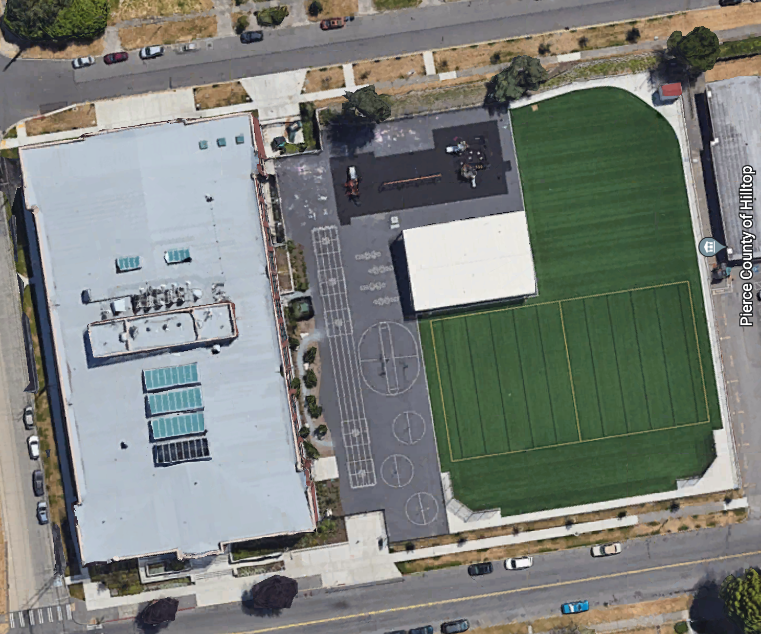
Stormwater in Our Schoolyard from Lesson 2
This map and points of interest (photos and info) can be used to guide your class' exploration of the schoolyard; questions included are intended for students as desired. The student worksheet for this lesson is separate.​
A
B
A

Slide 3
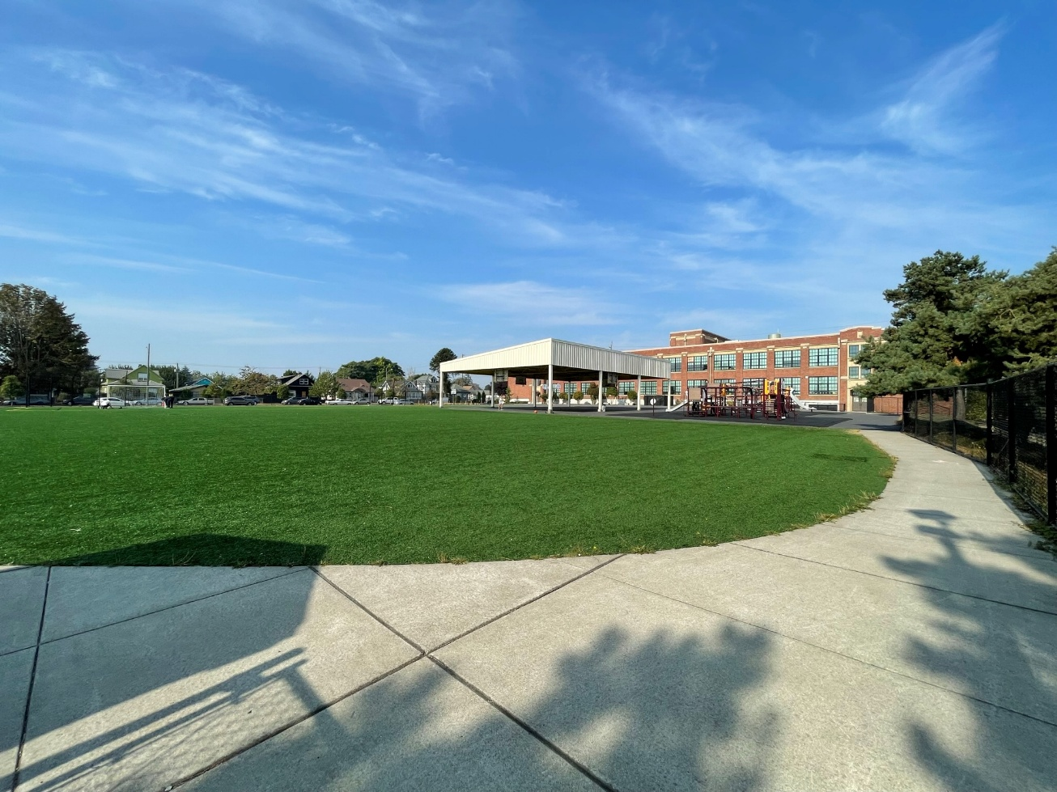
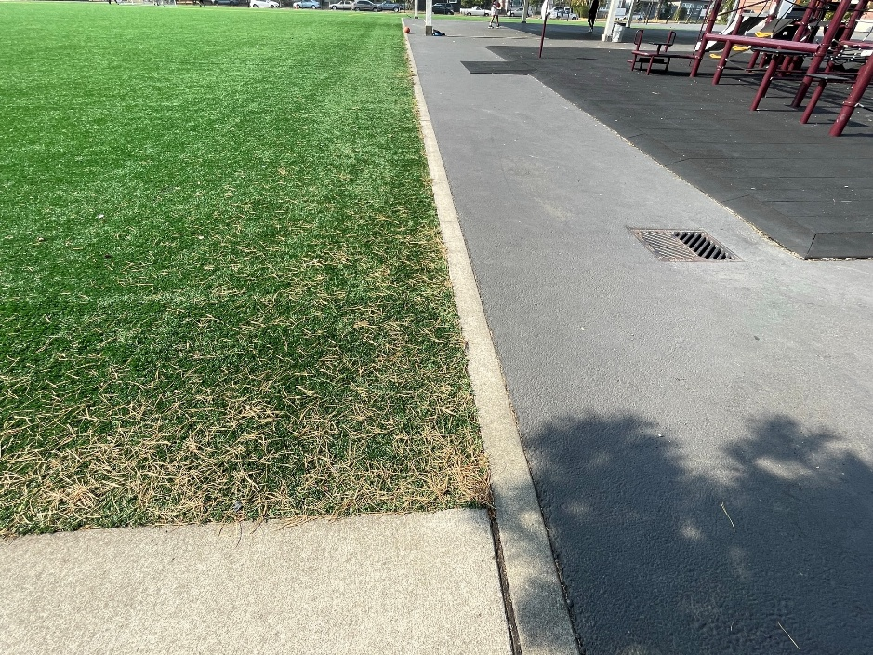
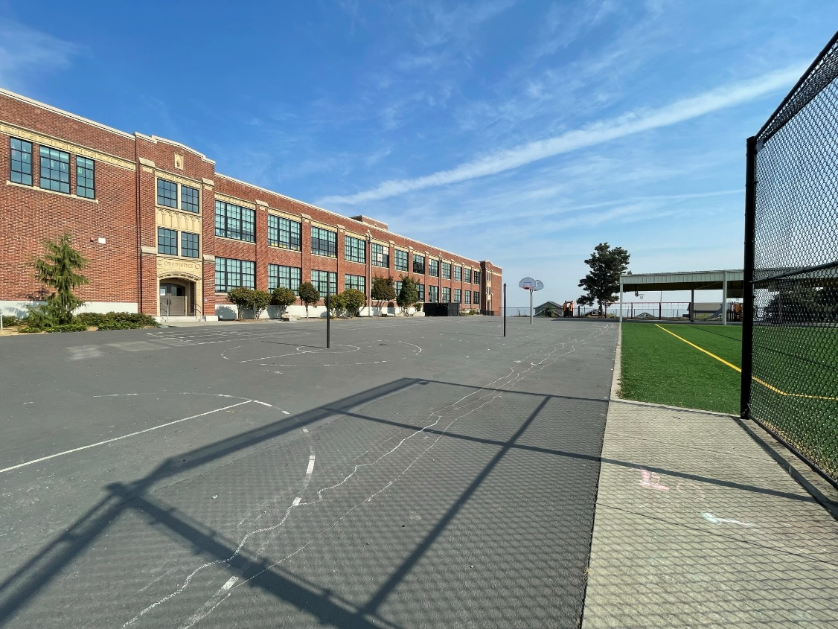
Schoolyard stormwater points of interest
A
B. Playground surfaces – Note what directions water flows off these different surfaces. Are they pervious or impervious?
Can you find where the water would collect or puddle or drain in a heavy rain?
B
B
A. Field surfaces - How pervious is this soil? Test it with some water – If it doesn’t soak in quickly, is it mostly impervious because of being compacted?
Do puddles often form here at the bottom of the hill or other low places?
Notes:
Schoolyard surfaces – what types of surfaces are present? Are they pervious or impervious? What direction does water flow throughout the schoolyard? Can you find where water collects (puddles) or drains in a heavy rain? Test it out with some water.

Slide 4
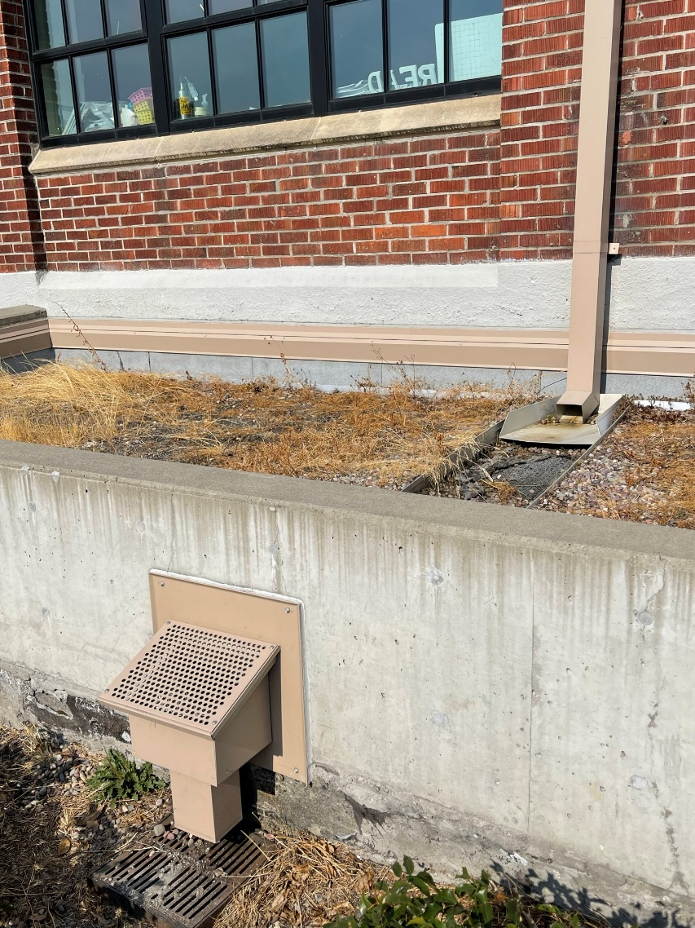
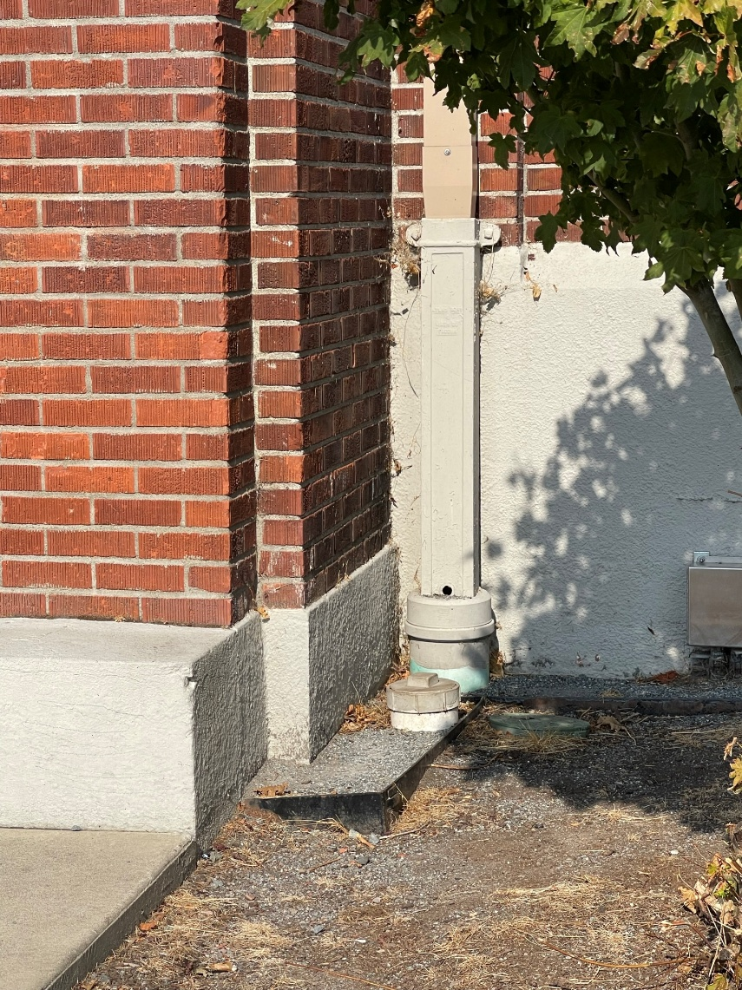
Schoolyard stormwater points of interest
Retaining wall, outflow, swale and drain – This area is a good example of engineering with water in mind! ​
There is a pipe at the base of the retaining wall that presumably lets out water in heavy rains, into this low area next to the building. This ditch or “swale” seems like it was designed for catching stormwater. There is a stormdrain at one end, but there may be others.​
How does this area interact with heavy rain? Are there other areas that might help water soak into the ground instead of going into drains? How is this area used? What do students notice here?
Disconnected Downspout – this downspout is not connected to pipes underground. How can disconnected downspouts help with stormwater runoff problems?
Downspouts - where does water flowing through this downspout go? Where does the water start?

Slide 5
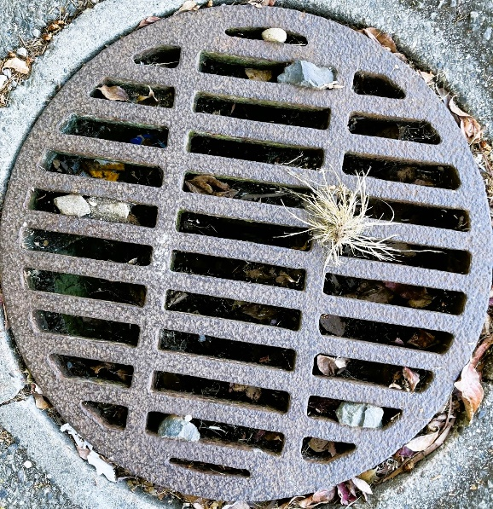
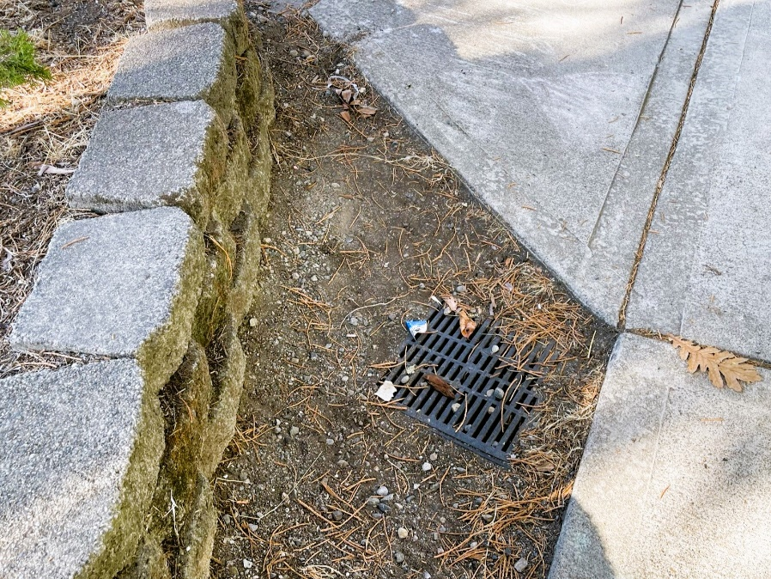
Schoolyard Stormwater Points of Interest
Storm Drains - notice the placement of these drains and the surfaces around them. Where else can you find storm drains? What will be picked up by water that falls as rain as it flows into the storm drains?
Notes:
Images are not from this school as of Jan 2026 but may be used to prompt discussion and further research around the school.

Slide 6
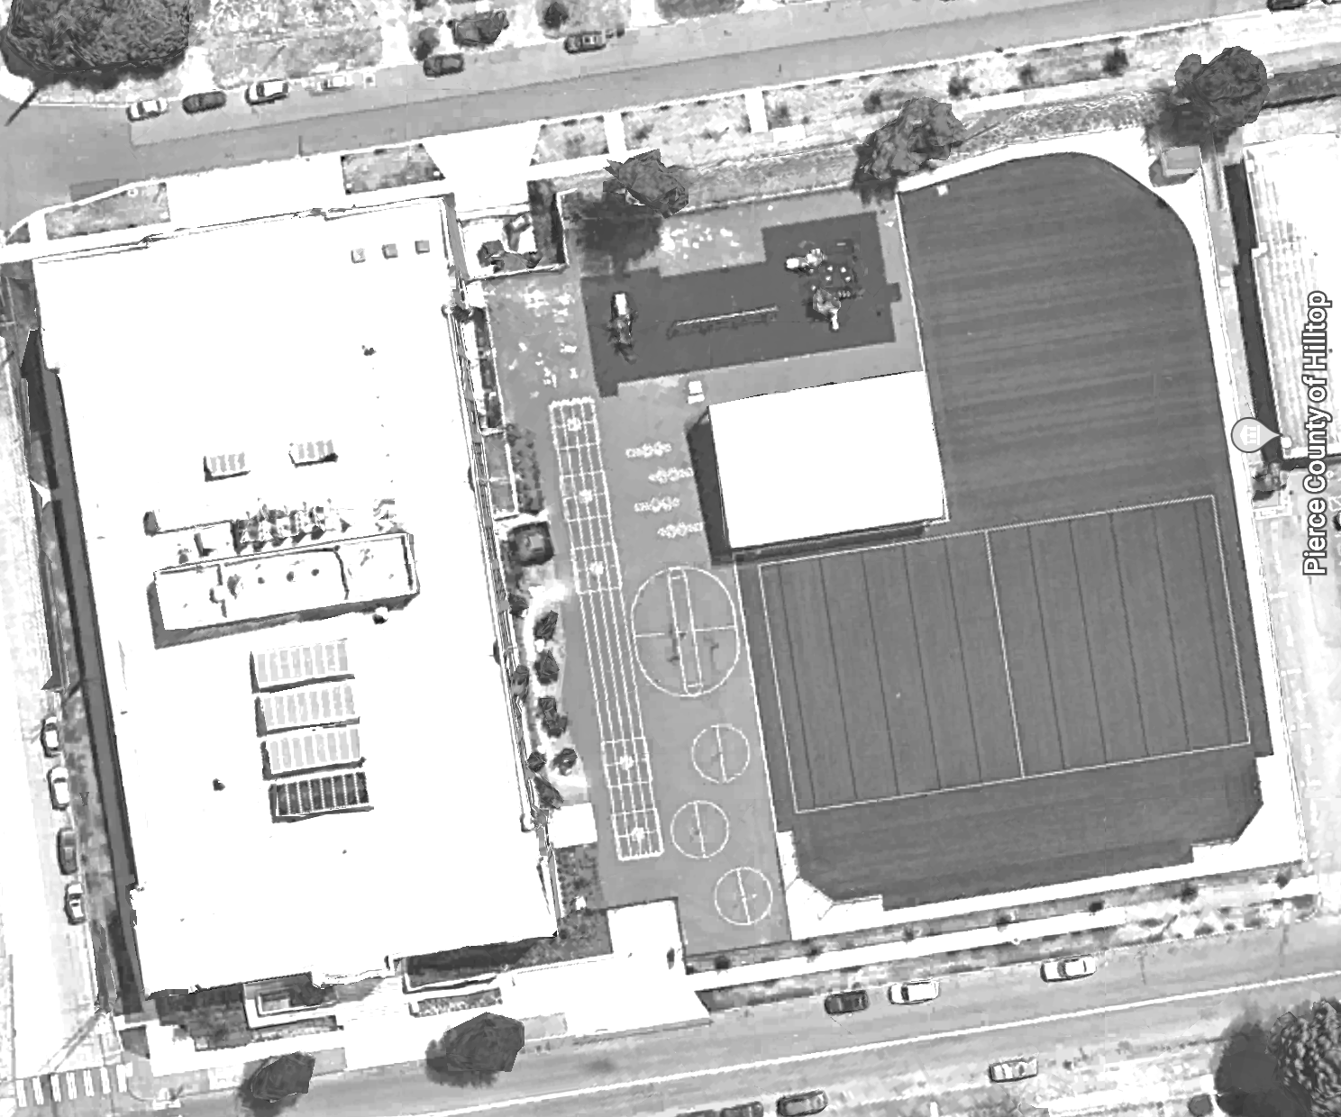


Mapping Your Schoolyard – Travis Elementary Name: ____________ Date: _________
Include on your map:
Symbols from the Key including flow of water, erosion, and storm drains.
Show where you see any evidence of possible stormwater problems (this could be places where there's lots of erosion or big puddles, or oil from cars, etc).
Add larger plants and bushes if they are there.
Notes:
STUDENT WORKSHEET
An 8.5x11” version of this is available to print for students

Slide 7
Local Stormwater Systems
What happens with the stormwater around your school?
Where does your stormwater runoff end up?
Stormwater begins travelling east on South 21st Street and continues east. It then travels under Interstate 705 and discharges in Commencement Bay and/or Puget Sound nearby 21st Street Park.
Your school is in Foss Waterway Watershed.
Foss Waterway is a subwatershed of the Puyallup watershed. Covering 5,781 acres in south-central Tacoma this subwatershed is mostly residential but contains Tacoma’s industrial businesses located in the Tideflats and Nalley Valley.
The Thea Foss and Wheeler-Osgood waterways became designated Superfund cleanup sites in 1983. Waterway cleanup and construction was finished in 2006. The City will monitor the waterway for the next 10 years. Learn more about the Thea Foss Waterway Cleanup.
https://www.cityoftacoma.org/cms/One.aspx?portalId=169&pageId=2860#Foss%20Waterway
Notes:
Please Note: The pipes information provided here is our best estimate of the stormwater flow in your community based on the information we have currently. If you encounter more information in the course of your investigation, please let us know so we can update future versions of this document.

Slide 8
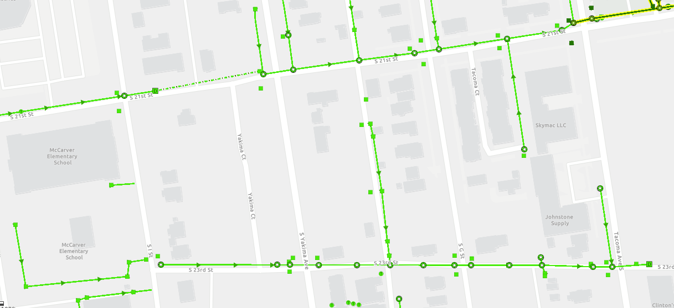
Travis Elementary Where does your school’s stormwater go?
Follow the lines and arrows!
Travis Elementary

Slide 9
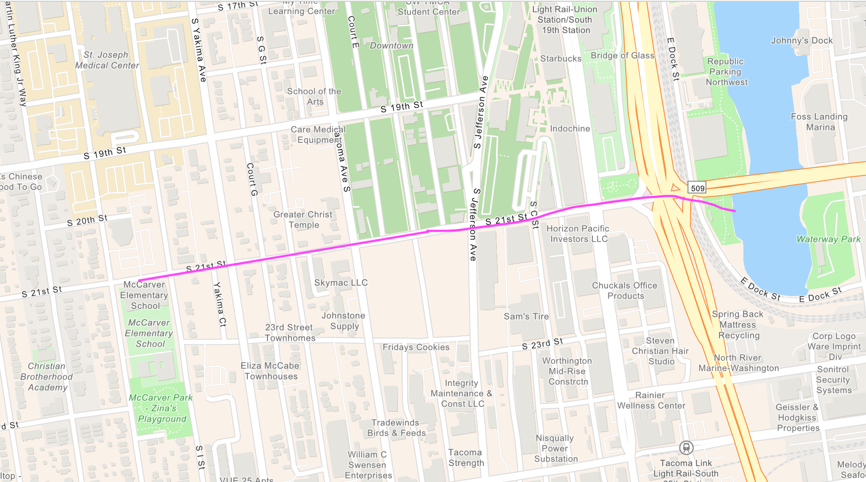
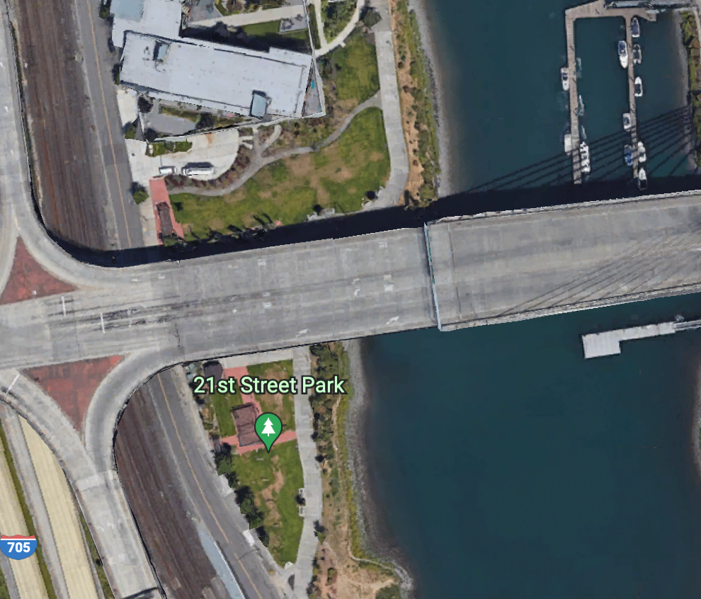
Now follow the pink line away from your school (find your school by looking for the star) to see how it gets to the Salish Sea!

Slide 10


How did we figure this out?
To view this map on your own, go here:
https://tacoma.maps.arcgis.com/home/webmap/viewer.html?layers=23e9a402b47d46058193362cb6c27a9e
View in “Map Classic”
Check “Surfacewater Network” box
Put in the name of the school
Zoom IN to see the green lines

