Slide 1

Community Waters School Guide:
Lowell Elementary @ Skyline
How to Use This Guide
This School Guide supports the Community Waters Science Unit Teacher Manual with information, maps, and images specific to your school and neighborhood.
It is written for teachers - its goal is to provide a better understanding of what is happening with stormwater in and around your school.
All content within may change, and can be adapted as desired.
If you have any questions about these maps, accompanying lessons, or stormwater around your school, contact IslandWood staff at communitywaters@IslandWood.org.

Slide 2
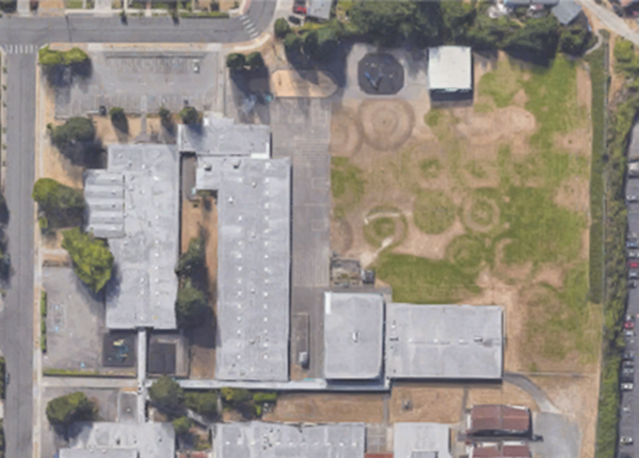
Stormwater in Our Schoolyard (lesson 2)
This map and points of interest (photos and info) can be used to guide your classes’ exploration of the schoolyard. You will find the student worksheet for this lesson following the teacher guide version. Please use the extra space on the pages to add your own notes and questions!
D
D
A
F
B
A
C
E
D

Slide 3
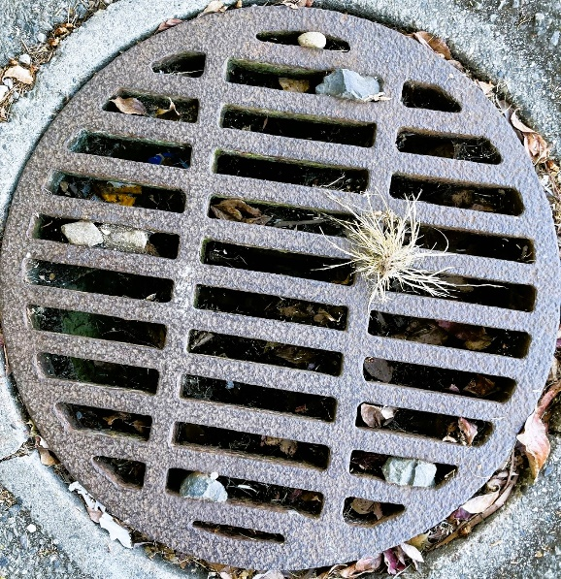
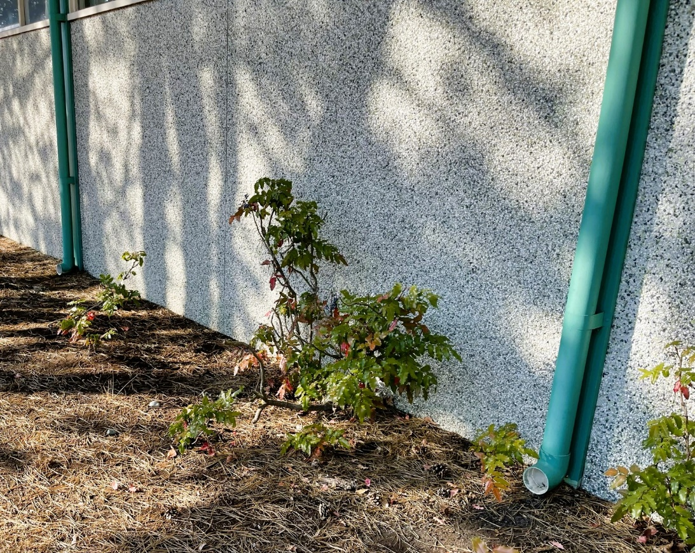
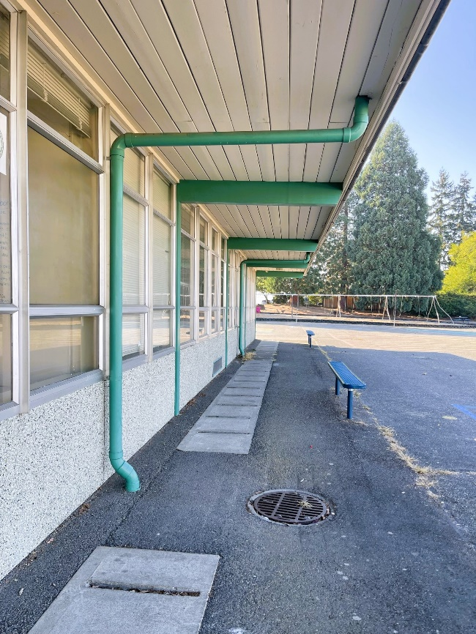
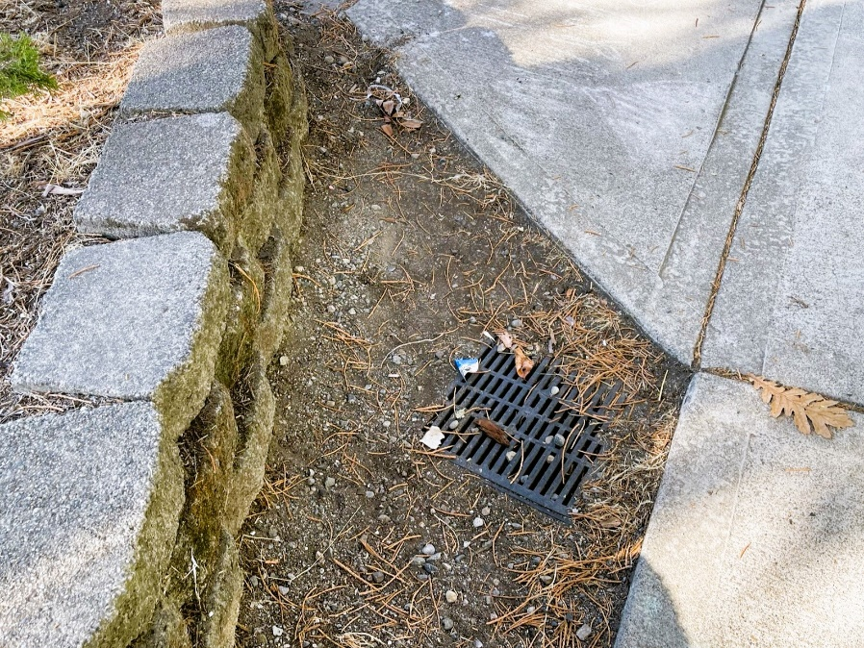
Schoolyard Stormwater Points of Interest
A. Storm Drains - notice the placement of these drains and the surfaces around them. Where else can you find storm drains? What will be picked up by water that falls as rain as it flows into the storm drains?
B. Downspout - where does water flowing through this downspout go? Where does the water start?
C. Disconnected Downspout – this downspout is not connected to pipes underground. How can disconnected downspouts help with stormwater runoff problems?

Slide 4
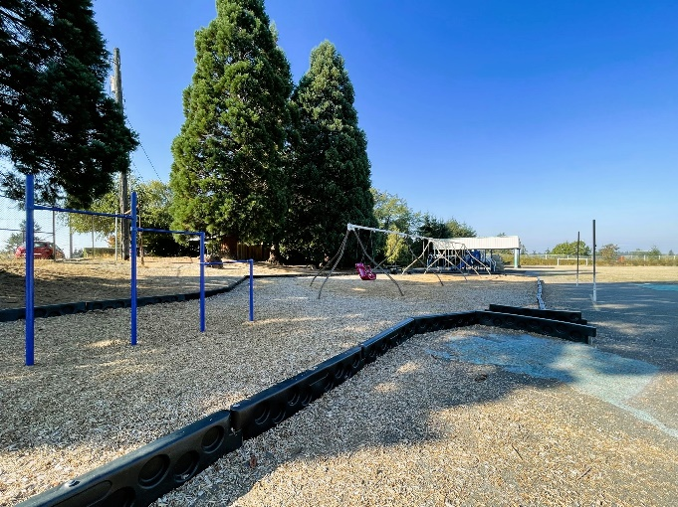
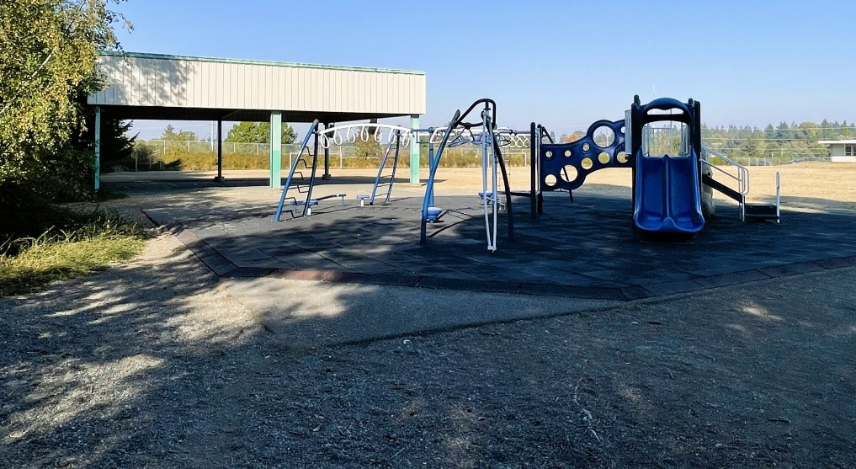
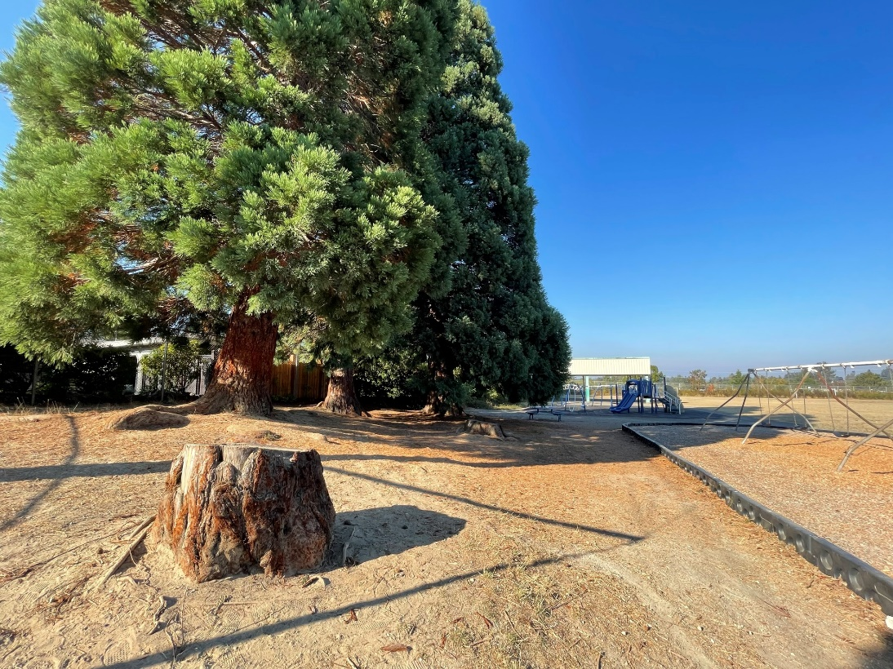
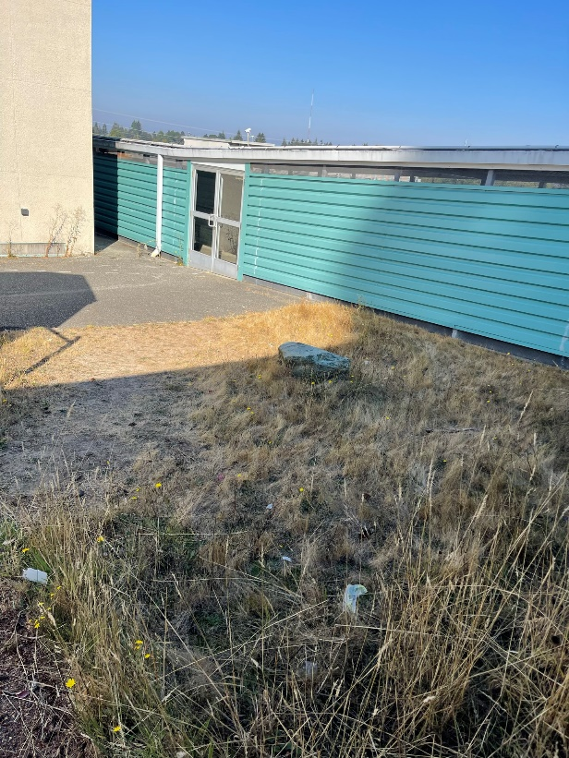
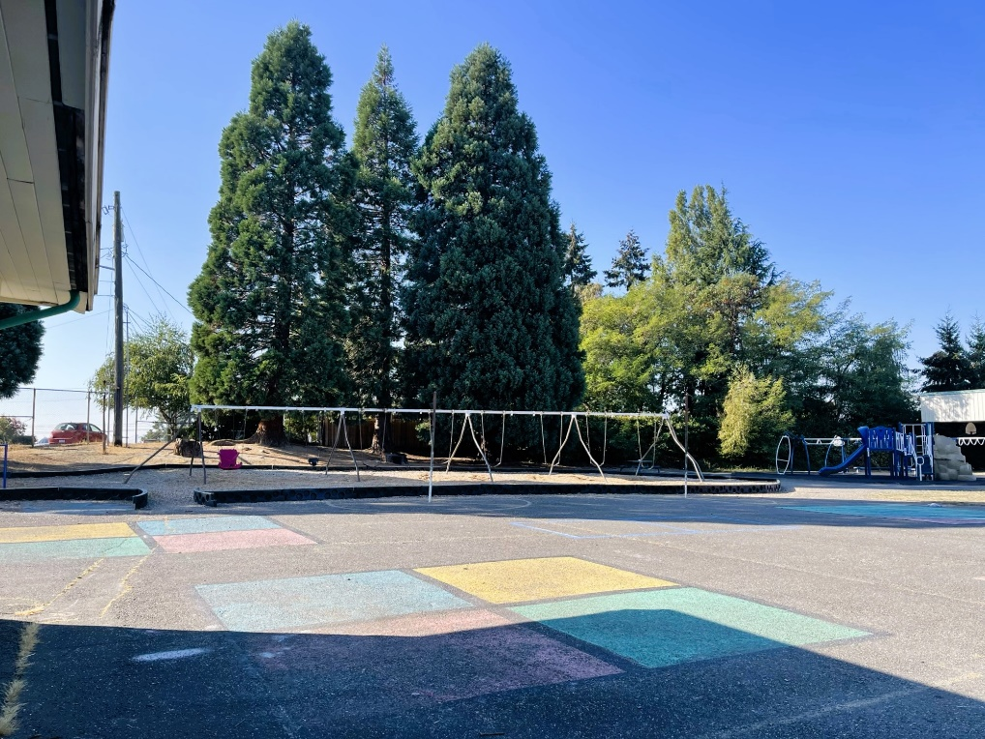
Schoolyard Stormwater Points of Interest
D. Schoolyard surfaces – what types of surfaces are present? Are they pervious or impervious? What direction does water flow throughout the schoolyard? Can you find where water collects (puddles) or drains in a heavy rain? Test it out with some water.

Slide 5
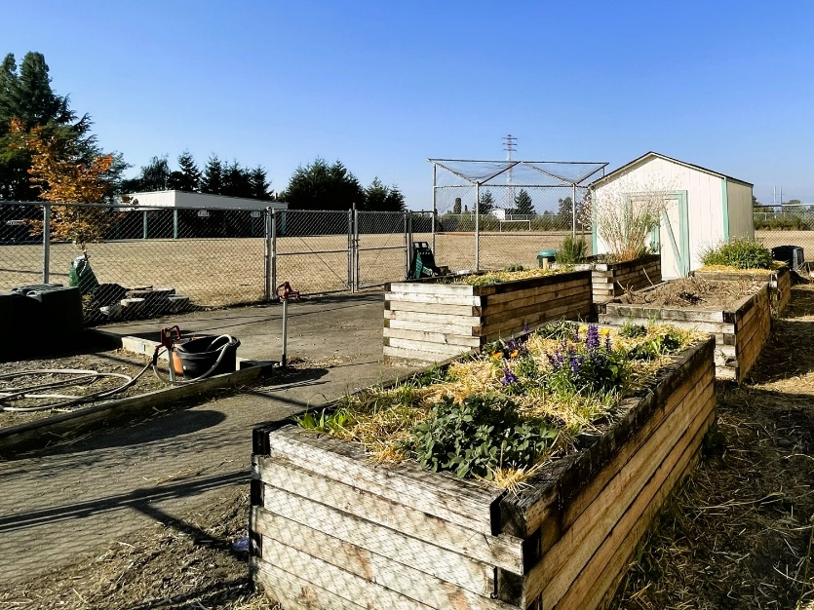
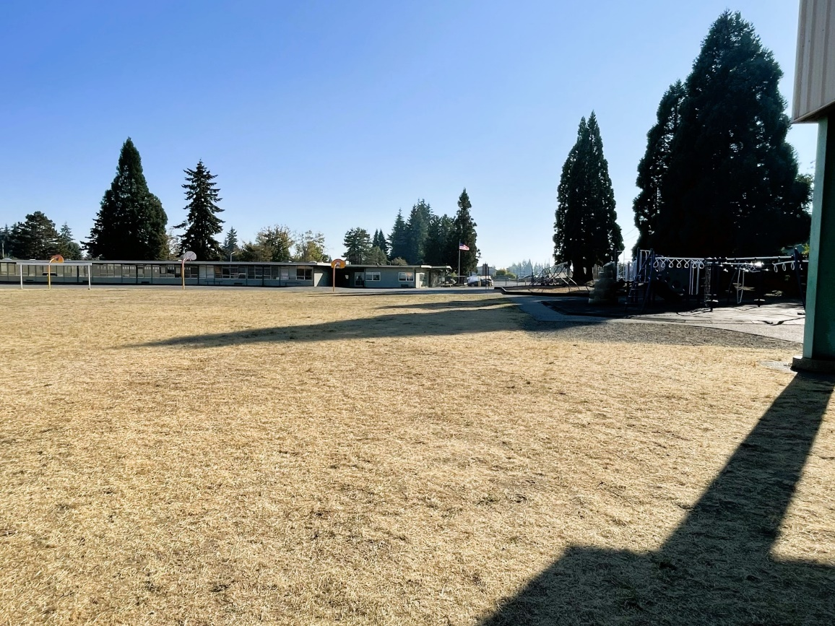
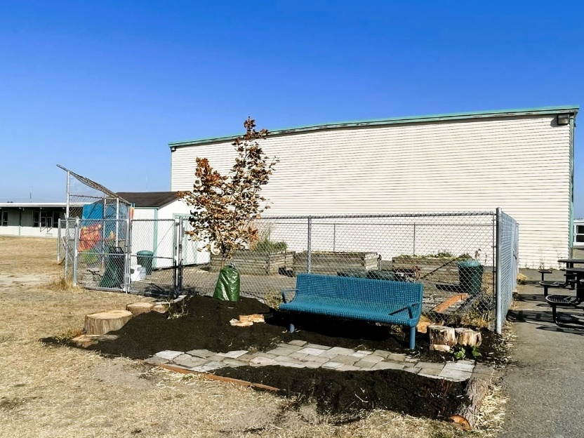
Schoolyard Stormwater Points of Interest
E. Garden Beds - how does this area interact with heavy rain? Are there other areas that might help water soak into the ground instead of going into drains? How is this area used? What do you notice here?
F. Field surface – Do puddles often form here? How pervious is the soil in the field? Test it with some water. If water doesn’t soak in quickly, why might that be?

Slide 6
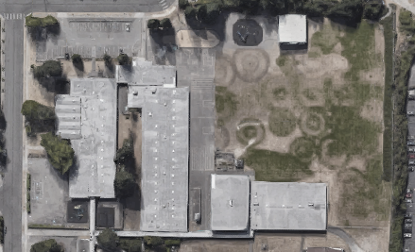


Mapping Your Schoolyard – Lowell @ Skyline Name: ____________ Date: _________
Include on your map:
Symbols from the Key including flow of water, erosion, and storm drains.
Show where you see any evidence of possible stormwater problems (this could be places where there's lots of erosion or big puddles, or oil from cars, etc).
Add larger plants and bushes if they are there.
Notes:
PRINT THIS PAGE for the STUDENT WORKSHEET

Slide 7
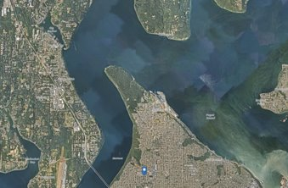
Local Stormwater Systems (lesson 3)
What happens with the stormwater around your school?
Water that flows into the storm drains and catch basins near your school empties into stormwater pipes underground. The water travels east towards North Vassault. The stormwater then continues north to 26th St and west to N. Narrows. The last stretch is northwest to Gold Creek, where it enters the Narrows.
The school is in the Western Slopes watershed. Western Slopes is a subwatershed of the Clover-Chambers Creek watershed. Covering 2,090 acres, Western Slopes is located in northwest Tacoma. Although mostly residential with steep slopes it also contains part of the 6th Avenue commercial area as well as Point Defiance Park.
Underground springs and groundwater near the surface are characteristic of
the steep slopes in this area. The Western Slopes subwatershed drains directly
to the Narrows Passage via two small creeks - Gold Creek and Narrows Creek.
This image shows where the Narrows flows into the Salish Sea (Puget Sound).
Note the color difference in the water, likely from sediment and other
pollutants flowing out from Commencement Bay to the east.
(City of Tacoma website:
https://www.cityoftacoma.org/cms/One.aspx?portalId=169&pageId=2860#Northeast%20Tacoma )
Notes:
Please Note: The pipes information provided here is our best estimate of the stormwater flow in your community based on the information we have currently. If you encounter more information in the course of your investigation, please let us know so we can update future versions of this document.

Slide 8
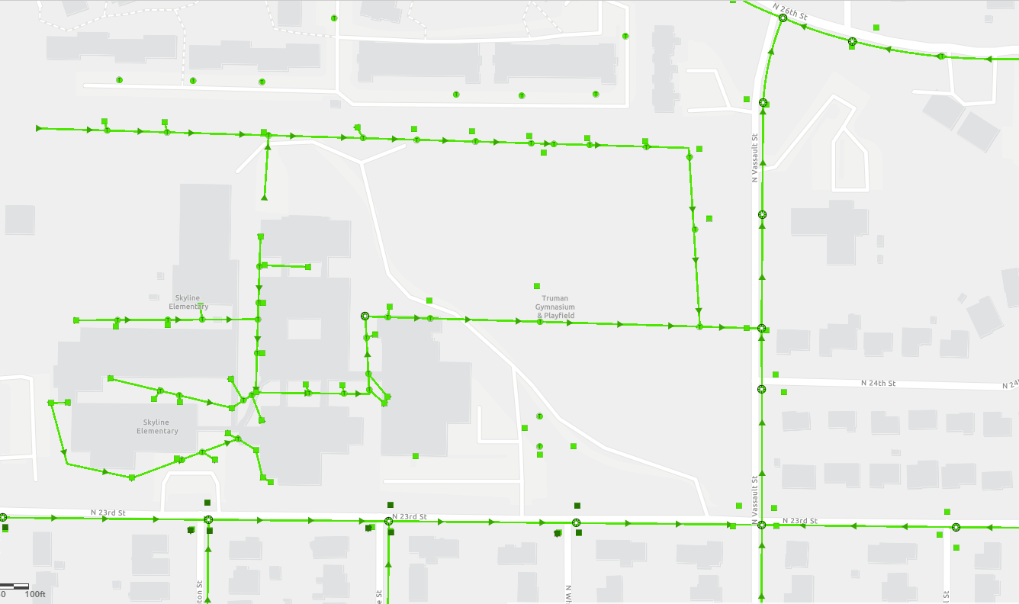
Lowell Elementary at Skyline
Where does your school’s stormwater go? Follow the lines and arrows!
Notes:
water travels east towards North Vassault. The stormwater then continues north to 26th St and west to N. Narrows. The last stretch is northwest to Gold Creek, where it enters the Narrows.

Slide 9
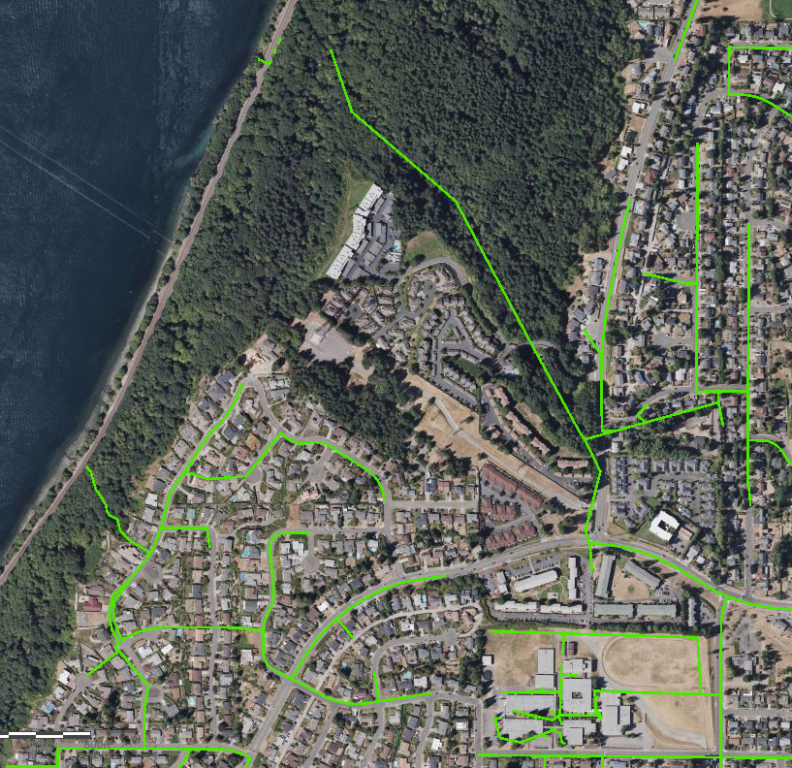
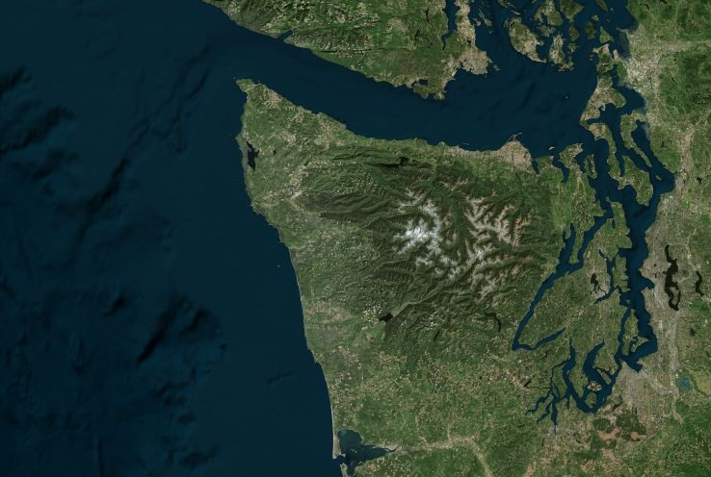


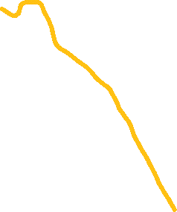
Now follow the yellow line away from your school (find your school by looking for the star) to see how it gets to the Narrows!​
Can you figure out how the stormwater from your school and neighborhood gets from the Narrows to the Salish Sea to the Pacific Ocean?​
Notes:
water travels east towards North Vassault. The stormwater then continues north to 26th St and west to N. Narrows. The last stretch is northwest to Gold Creek, where it enters the Narrows.

Slide 10


How did we figure this out?
To view this map on your own, go here:
https://tacoma.maps.arcgis.com/home/webmap/viewer.html?layers=23e9a402b47d46058193362cb6c27a9e
View in “Map Classic”
Check “Surfacewater Network” box
Put in the name of the school
Zoom IN to see the green lines

