Slide 1

Community Waters School Guide:
Bryant Montessori
How to Use This Guide
This School Guide supports the Community Waters Science Unit Teacher Manual with information, maps, and images specific to your school and neighborhood.
It is written mostly for teachers - its goal is to provide a better understanding of what is happening with stormwater in and around your school.
All content within may change, and can be adapted as desired.
If you have any questions about these maps, accompanying lessons, or stormwater around your school, contact IslandWood staff at communitywaters@IslandWood.org.

Slide 2
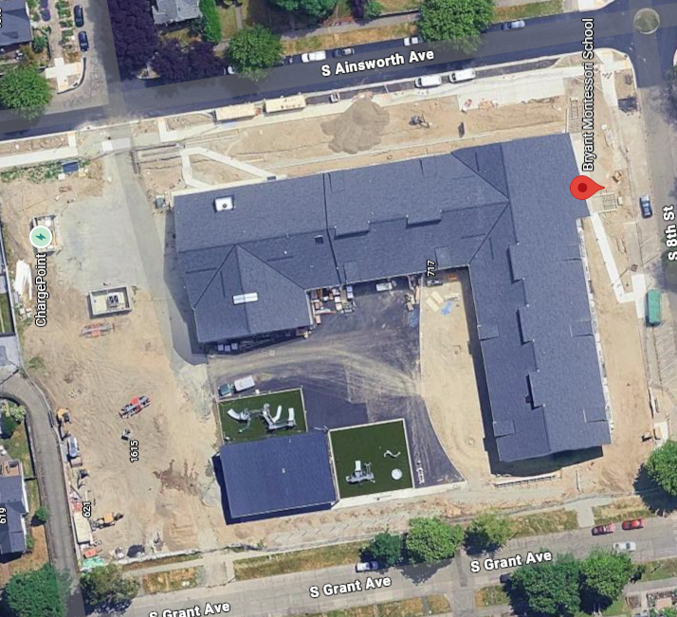
Stormwater in Our Schoolyard (lesson 2)
This map and points of interest (photos and info) on the next slides can be used to guide your classes’ exploration of the schoolyard. Add your own images in your own copy as you wish!
You will find the student worksheet on slide 6.
NOTE: This Guide was updated in January 2026 after the new Bryant building was constructed, but Google Maps does not show any landscaping.
A
B
C
D
F
E

Slide 3
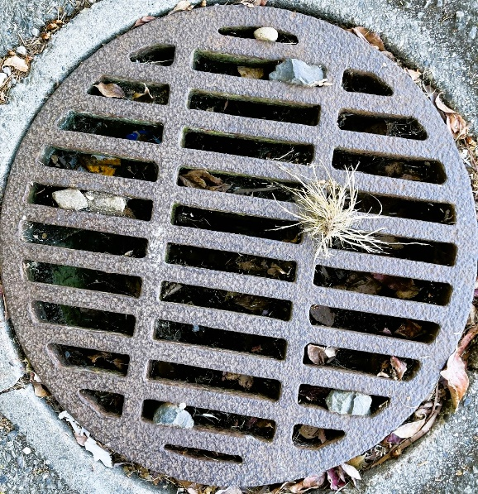
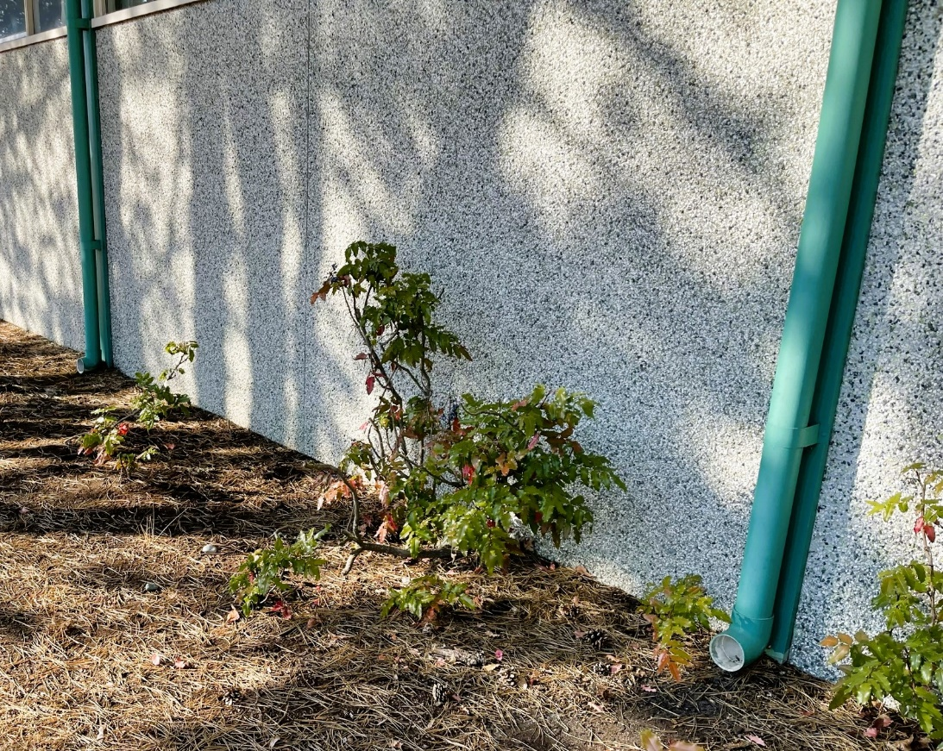
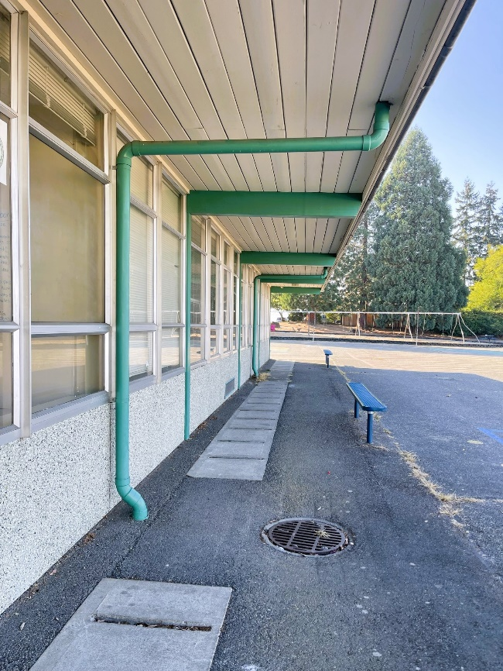
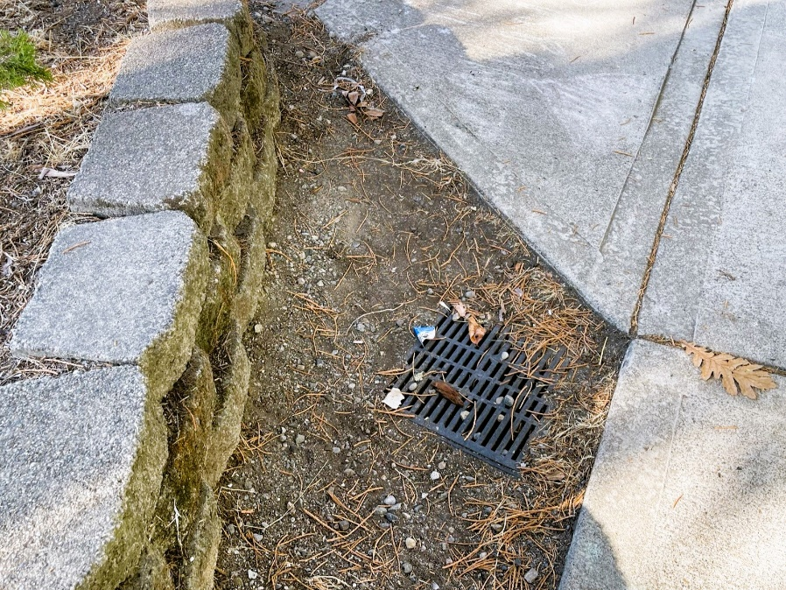
Schoolyard Stormwater Points of Interest
Storm Drains - notice the placement of these drains and the surfaces around them. Where else can you find storm drains? What will be picked up by water that falls as rain as it flows into the storm drains?
Downspouts - where does water flowing through this downspout go? Where does the water start?
Disconnected Downspout – this downspout is not connected to pipes underground. How can disconnected downspouts help with stormwater runoff problems?
Notes:
Images are not from Bryant as of Jan 2026 but may be used to prompt discussion and further research around the school.

Slide 4
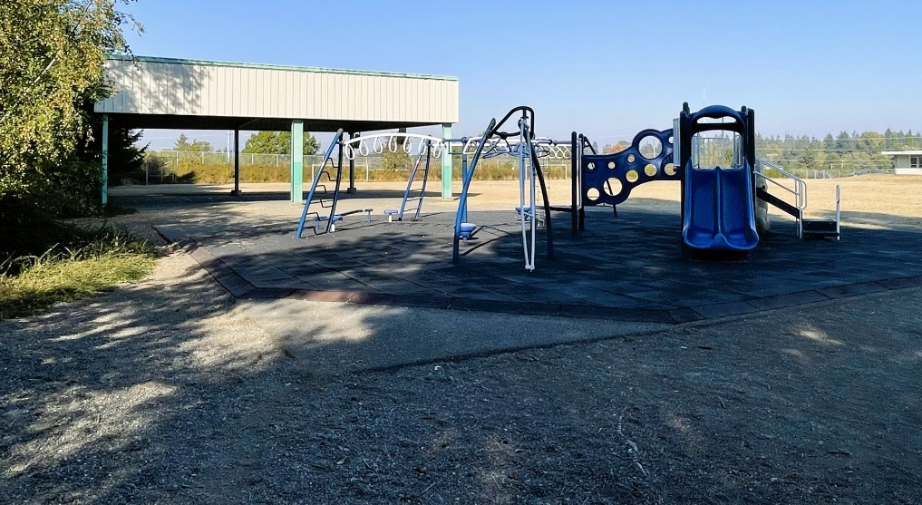
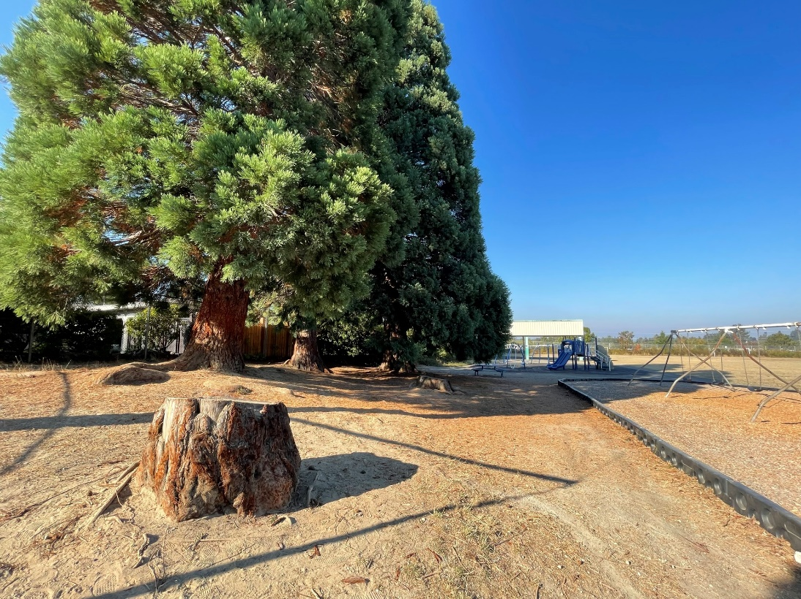
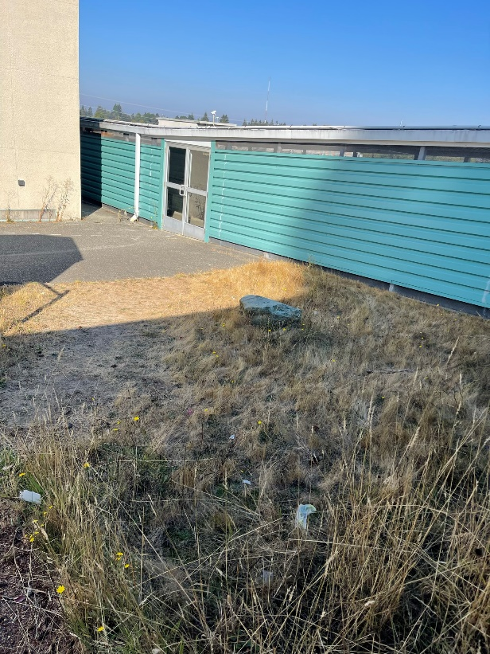
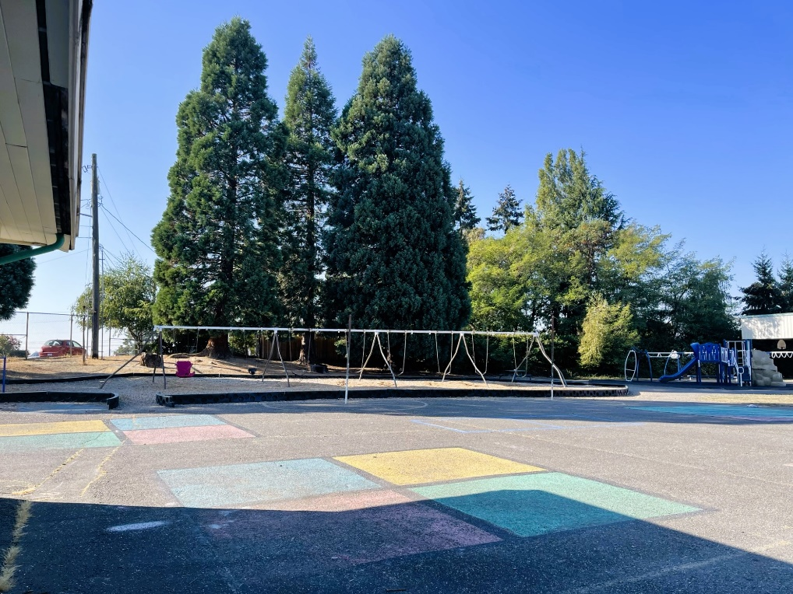
Schoolyard Stormwater Points of Interest
Schoolyard surfaces – what types of surfaces are present? Are they pervious or impervious? What direction does water flow throughout the schoolyard? Can you find where water collects (puddles) or drains in a heavy rain? Test it out with some water.
Notes:
Images are not from Bryant as of Jan 2026 but may be used to prompt discussion and further research around the school.

Slide 5
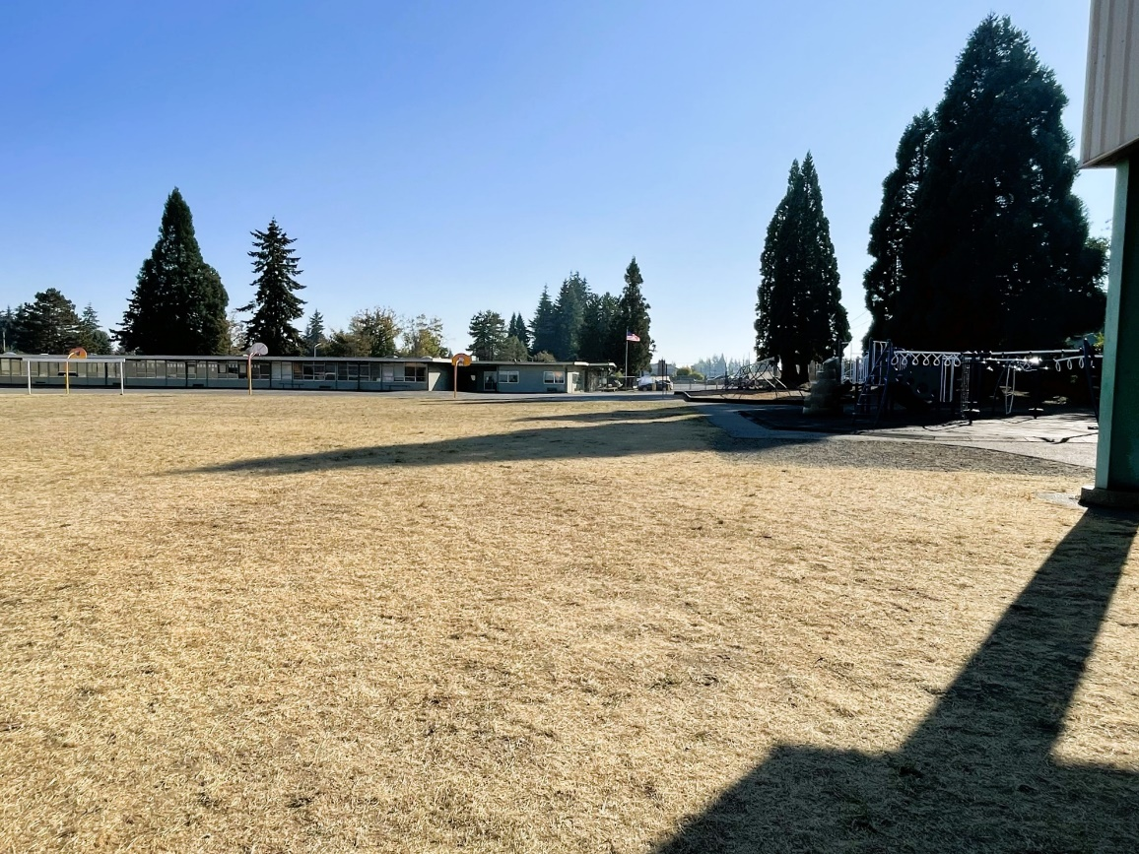
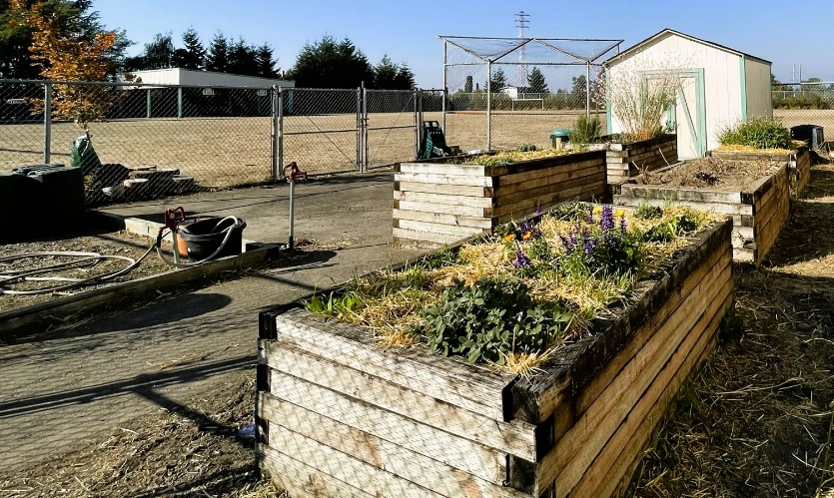
Schoolyard Stormwater Points of Interest
Gardens - how does a garden interact with heavy rain? Are there other areas that might help water soak into the ground instead of going into drains?
Field surface – Do puddles often form here? How pervious is the soil in the field? Test it with some water. If water doesn’t soak in quickly, why might that be?
Notes:
Images are not from Bryant as of Jan 2026 but may be used to prompt discussion and further research around the school.

Slide 6

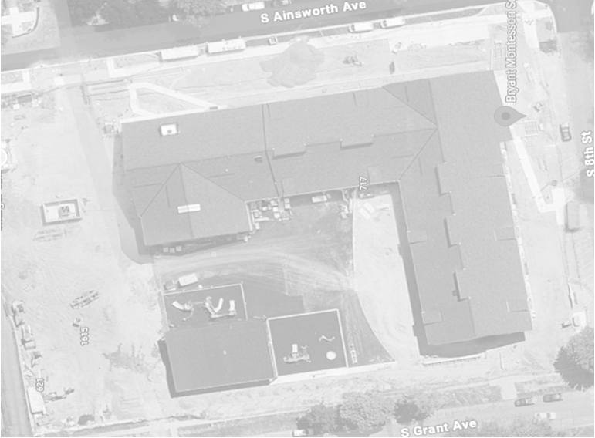

Mapping Your Schoolyard – Bryant Name: ____________ Date: _________
Include on your map:
Symbols from the Key including flow of water, erosion, and storm drains.
Show where you see any evidence of possible stormwater problems (this could be places where there's lots of erosion or big puddles, or oil from cars, etc).
Add gardens, larger plants and bushes if they are there.
Notes:
STUDENT WORKSHEET
An 8.5x11” version of this is available to print for students

Slide 7
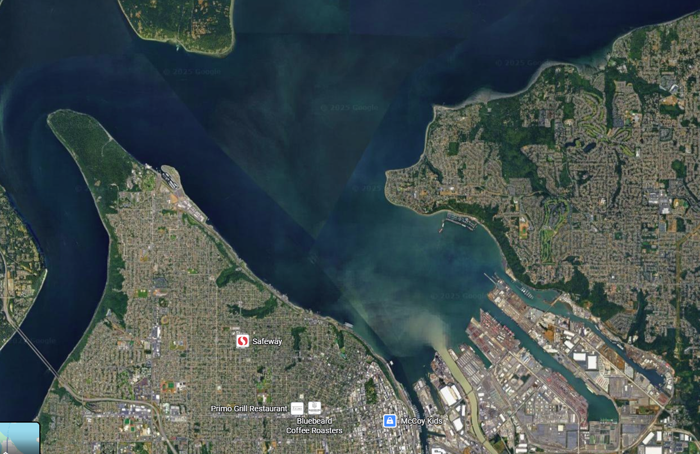
Local Stormwater Systems (lesson 3)
What happens with the stormwater around your school?
In the following two slides, there are screenshots of maps that show where the stormwater goes. Water that flows into the storm drains and catch basins near your school empties into stormwater pipes underground. The water travels east under S 8th Street towards S L Street (slide 8). The stormwater then continues north and east, going underneath the center of Wright Park. The last stretch is past Stadium High School and the Washington State Historical Society, then out into Commencement Bay (slide 9).
The school is in the North Tacoma watershed. Covering 5,001 acres, this watershed includes North Tacoma along the west side of Commencement Bay. This watershed is very heavily urbanized and industrial, which means there is a lot of stormwater runoff!
The red star in this slide show roughly where water from the school goes into the Bay.
Source of watershed info: City of Tacoma website
https://www.cityoftacoma.org/cms/One.aspx?portalId=169&pageId=2860#Northeast%20Tacoma
Notes:
Please Note: The pipes information provided here is our best estimate of the stormwater flow in your community based on the information we have currently. If you encounter more information in the course of your investigation, please let us know so we can update future versions of this document.

Slide 8
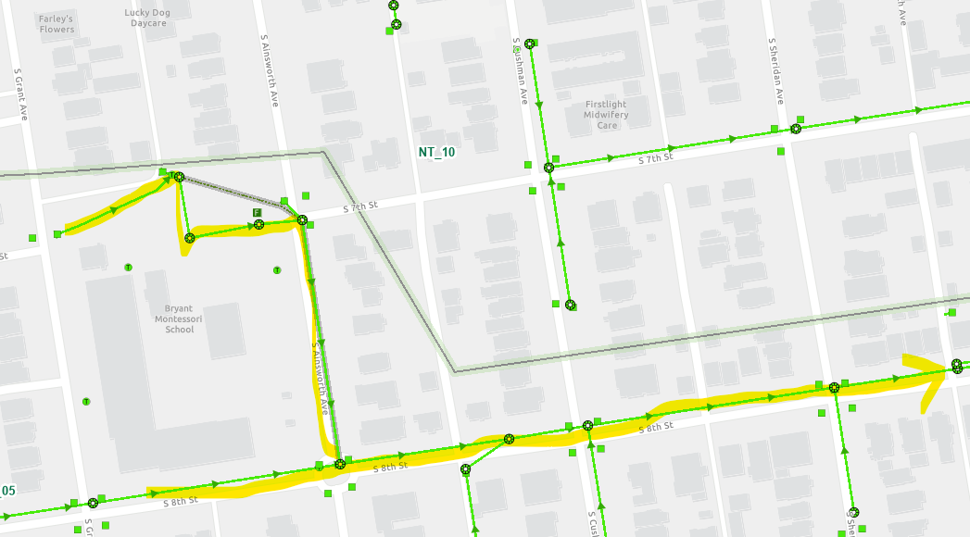
Bryant Montessori
Where does your school’s stormwater go? Follow the lines and arrows!
Notes:
Water travels underneath S 8th St. east toward S L St – it zig zags north east and then goes
North under Wright Park,
Past the southwest corner of Stadium High school following N Stadium Way,
Cuts northeast just north of the WA state historical Society going under Schuster Parkway and railroad tracks
Discharges directly NE of museum

Slide 9
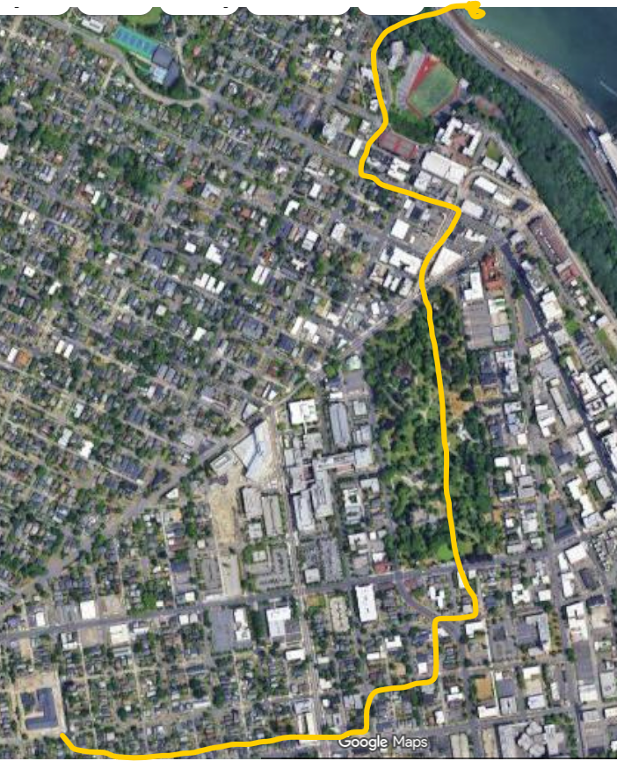
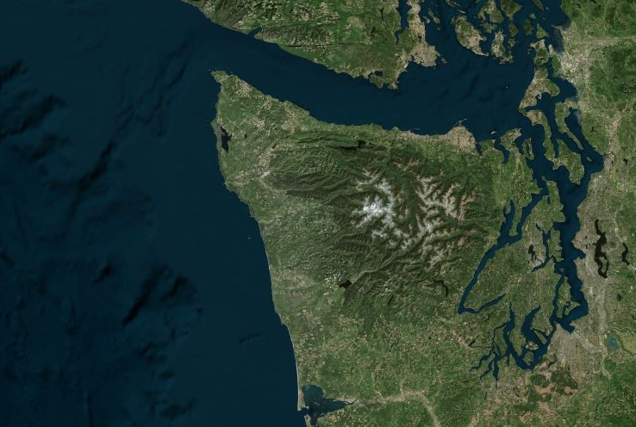
Now follow the yellow line away from your school (find your school by looking for the star) to see how it gets to the Commencement Bay!​
Can you figure out how the stormwater from your school and neighborhood gets from the the Bay to the Salish Sea to the Pacific Ocean?​
Notes:
Water travels underneath S 8th St. east toward S L St – it zig zags north east and then goes
North under Wright Park,
Past the southwest corner of Stadium High school following N Stadium Way,
Cuts northeast just north of the WA state historical Society going under Schuster Parkway and railroad tracks
Discharges into Commencement Bay directly NE of museum

Slide 10


How did we figure this out?
To view this map on your own, go here:
https://tacoma.maps.arcgis.com/home/webmap/viewer.html?layers=23e9a402b47d46058193362cb6c27a9e
View in “Map Classic”
Check “Surfacewater Network” box
Put in the name of the school
Zoom IN to see the green lines

