Slide 1




Community waters Science unit
4th grade

Slide 2

Testing solutions
Community Waters Science Unit: Lesson 9
Notes:
https://communitywaters.org/teaching-community-waters/lesson-9-testing-solutions/

Slide 3
Teacher background/context
Objectives & Overview:
Student groups adjust the solution models they built in the previous lesson. Then they run the same procedure as was used for the teacher’s model earlier to record data about the runoff that occurs with the solution in place.
Materials:
Measuring Stormwater Runoff Investigation Procedure from lesson 6
Data Table (in the student packet)
See list on page 146 (nearly all materials from your kit)
  Optional: create and print Team Observation Sheet
  Optional: colored pen
Notes:
--Curriculum: https://communitywaters.files.wordpress.com/2022/11/tacoma-community-waters-manual-sy2022-23.pdf
--Data Table: https://communitywaters.files.wordpress.com/2017/12/l09-measuring-stormwater-runoff-data-table.pdf

Slide 4
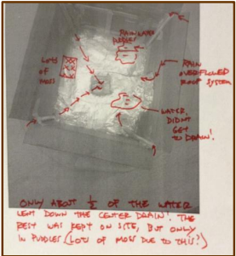
Decision point
Optional: create team observation sheets
  Take a digital picture of the solution built by each engineering team and print it for the team to record observations. If you do this, make one also of the teacher’s example model to use as a demo.
Notes:
List of Solution Suggestions (pg 147) & Discussion Diamonds (pg 95): https://communitywaters.files.wordpress.com/2022/11/tacoma-community-waters-manual-sy2022-23.pdf

Slide 5
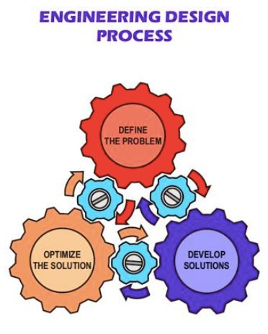
Testing solutions
Focus Question: How can we improve our solution?
Learning Target: I can run an investigation to improve my solution.

Slide 6
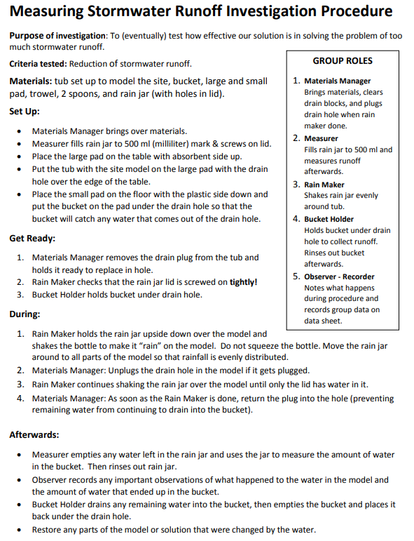
Why is it important to follow the procedure exactly?
In your engineering team, look over the solution you modeled. Are there any adjustments you want to make before running the test?
Run the test and record your observations on your data table.
Notes:
https://communitywaters.files.wordpress.com/2018/11/l09_measuring-stormwater-runoff-investigation-procedure.pdf

Slide 7
Back-Pocket questions
Maintaining focus on the problem:
What is the problem you are trying to solve?
What are the criteria for success we are focused on?
How are the criteria being measured when we test our solutions in the model?

Slide 8
Optional: Team observation sheets
If you created the optional team observation sheets (printed photographs described on slide 4), have an observer add to the teacher model version as an example.
Provide each team’s observer the sheet and a brightly colored pen to record observations. Other team members can add to the observations after the procedure is complete.

Slide 9
Analyze test results
Questions to consider:
How did your results compare to the results from the teacher model?
Did you reduce the amount of ml? If so, by how much? (Add this to #1 at the bottom of the data table.)
What did you observe during the procedure?
Does anything you observed help explain the results of the trial?
Does anything you learned earlier in the unit help explain your results?
Are there changes you could make that would help your solution work better?
Notes:
This optimizing stage of the engineering design process is about looking at how the tests went and considering what failures can tell you about what needs to be improved or redesigned.

Slide 10
Back-pocket questions
Observations
Where did you observe runoff occurring?
Was there a certain point that the solution stopped working?
Was your solution able to handle the amount of water added to the model?
What happened when there was more water added than your solution could handle?
Optimizing
Does you model seem to be working?
What worked well?
Were there failure points you would want to fix?
Did the solution cause any new problems?
What would you want to do to improve your design?

Slide 11

Personal reflection
Answer questions 2 & 3 on your Measuring Stormwater Data Sheet:
2. If we were to make changes to our model, I would…
3. A lesson from our investigation to share with the class is…
Notes:
https://communitywaters.files.wordpress.com/2018/11/l09_measuring-stormwater-runoff-investigation-procedure.pdf

Slide 12
Examining Student work
Consider the test results and learnings and whether they will be able to support choosing a “best” solution in the next lesson. Have students been able to identify what they learned? Will their data support making a decision? Do you need to revisit the test, data, or learnings before proceeding?

