Slide 1



Community Waters Science Unit
4th grade

Slide 2

COMMUNICATING OUR RESULTS
Community Waters Science Unit: Lesson 11

Slide 3
Teacher background/context
Objectives & Overview:
Evaluating and communicating solutions is an important part of the engineering process. Engineers share their design solutions with each other and stakeholders to evaluate the solutions based on how well they meet specific criteria or consider constraints. This lesson will provide an opportunity for students to share their proposed solutions for their site and discuss them with their classmates.
Materials (per group):
Problem site explanatory model
Stormwater solution conclusion
Materials for product – may include large paper, markers, etc.

Slide 4
Teacher preparation
Decision points:
  How much time to spend? Determining the product and how you wish them to share it will determine how much time this will take.
  Who will be in the audience?
  What will be present? Will students share a poster they create, or a poster and their models?
  How will the room be arranged?
  How will presentations be shared?
Additional ideas instead of a poster can be found on pg. 173 in the manual

Slide 5
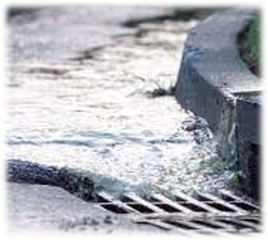
COMMUNICATING OUR RESULTS
Focus Question: What should we know about the stormwater solution your team tested?
Learning Target: I can share with others about my groups' stormwater solution and why it might or might not work.

Slide 6
EXPLORE AND INVESTIGATE
In your engineering team, create an explanation of the solution you developed. Your job is not to convince others that the solution you tested is the right or wrong solution; it is to give people all the information they need to be able to consider the advantages and disadvantages of your solution.
If creating a poster, be sure to include:
A diagram or image of the current problem area (like a "before" picture). It should show:
  Surfaces in the area that contribute to stormwater runoff.
  Arrows showing how water moves through the site when it rains.
Diagram or image of solution (like an "after" picture), showing the proposed solution and its features.
Key (if using symbols in diagram)
Claim about effectiveness of solution with at least two pieces of evidence.

Slide 7
EXPLORE AND INVESTIGATE
Additional things to include:
The criteria for success and constraints that were considered.
A description of the solution you tested and how it would work to help slow or absorb stormwater.
How the solution would address each of the criteria and constraints.
Why you chose the solution to test in the first place (using evidence from multiple sources).
Stakeholder needs for the site.

Slide 8
CREATE AND PRACTICE THE PRESENTATION
You will have approximately 5 minutes to present. During the presentation, your group could share:
An introduction to the problem – what's the issue and why does it matter?
How you researched solutions and stakeholders
Description of criteria for success and constraints
Description of the solution
Results of testing the solution or the CER

Slide 9

Congratulations!
You completed the unit and learned about engineering and stormwater!

