Slide 1




Community waters Science unit
4th grade

Slide 2
Modeling solutions
Community Waters Science Unit: Lesson 8
Notes:
https://communitywaters.org/teaching-community-waters/lesson-8-modeling-solutions/

Slide 3
Teacher background/context
Objectives & Overview:
In this lesson the engineering teams plan now they are going to model the solution they have chosen and then add it to the site model they created earlier.
Materials:
Measuring Stormwater Runoff Investigation Procedure from lesson 6
Site model created in lesson 6
See list on page 146 (nearly all materials from your kit.)
Notes:
Curriculum: https://communitywaters.files.wordpress.com/2022/11/tacoma-community-waters-manual-sy2022-23.pdf

Slide 4
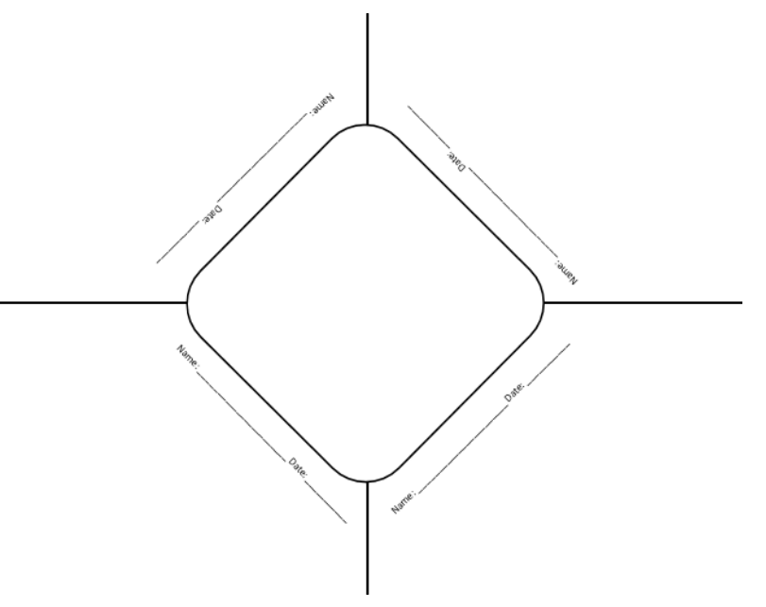
Teacher prep
Print Discussion Diamonds for each team, ideally larger than 8.5x11” paper (pg 95).
Queue up the engineering design process graphic and the materials set up directions to be projected.
Create Distribution Area and lay out materials that students can use to model their solutions.
Review list of Solution Suggestions (pg 147):
  Bioswale/bioretention
  Improve Soils
  Pervious Concrete
  Pervious Pavers
  Planting Trees
  Rain Garden
  Rainwater Harvesting
Notes:
List of Solution Suggestions (pg 147) & Discussion Diamonds (pg 95): https://communitywaters.files.wordpress.com/2022/11/tacoma-community-waters-manual-sy2022-23.pdf

Slide 5
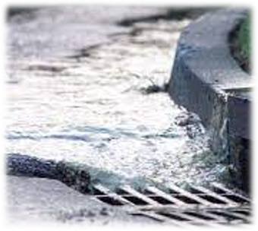
Modeling solutions
Focus Question: How do we model our solution?
Learning Target: I can design and create a model of a solution that represents how it would function in the real world.

Slide 6
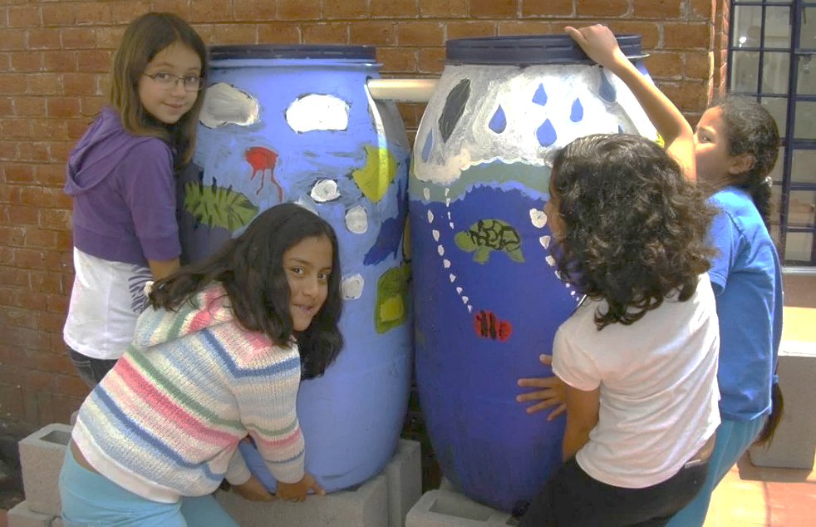
Which solution did your team choose?
Green Stormwater Solutions
Improving Soils
Planting Trees
Collecting Rainwater
Rain Gardens
Biorention
Pervious Surfaces

Slide 7
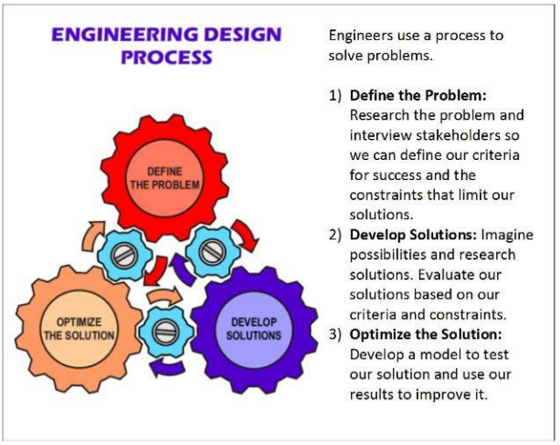
Engineering design process
Testing different solutions is an important part of developing and optimizing solutions.
While developing a solution, our tests can help us figure out which parts of the solution could be improved.
You may find “failure points” in your design; if so, you can make changes.
Notes:
Remind students of constraints that could impact their solution’s location or size within the model. Also remind students that they may not create a perfect representation of their solution, only to the best of their ability.

Slide 8
Discussion diamond
Steps:
Take three minutes for silent thinking and writing time. Draw or write ideas for how to model your solution in your corner of the paper.
Share what you wrote or drew with your engineering team. Take time to ask questions, add on, or make connections.
Discuss which ideas you want to incorporate into your model.
When you are ready, prepare to share your plan.
How should we model our solution?
After hearing everyone’s ideas, come to a group consensus!
Notes:
Students should be in their engineering teams.

Slide 9
Back-Pocket Questions
Maintaining Focus on the Problem
What is the problem you are trying to solve?
What are the criteria for success we are focused on?
How are the criteria being measured when we test this model?
Modeling
What solution are you modeling?
How does that solution help with stormwater?
How are you going to represent your solution?
What materials are you going to use?
How will those materials help with the problem?
Notes:
This is a good place to pause the lesson.

Slide 10
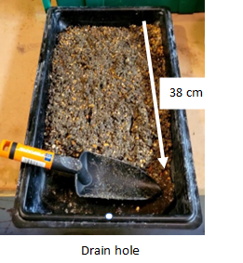
Materials set up
Do all of the following before working on modeling your solution:
  Materials Manager brings materials to work area.
  Place one absorbent pad on the table.
  Put the site model on the pad with the drain hole over the edge of the table.
  Place the other pad on the floor and put the basin on the pad under the drain hole so that it will catch any water that comes out of the drain hole.
  Make sure the drain plug is in the hole.
Leave the rain jar in materials area.
Once your model is set up, let an adult know what additional materials you will need from the class supply.
Notes:
1. Each team of engineers adds their solution to their model.

Slide 11
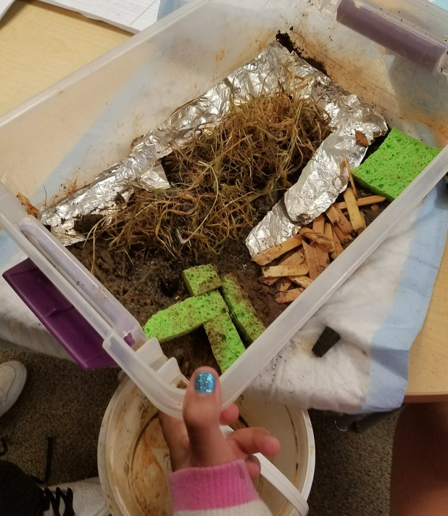
& Run an initial test
Build your solution!
Needed: rain jar with 100 ml water
Observe where the water is flowing – no need to record this data.
Is the water flowing into the solution you modeled?
Discuss Results:
What happened to your solution as the water was added?
Did any “failure points” come up in your initial tests?
How could you adjust your design to do a better job of collecting stormwater runoff?
Foil = impervious surface
Sponges or moss from outside = soil and/or plants
Cup = rain barrel
Notes:
If 100 ml water is not enough to see movement of water, students could add another 100 ml. Be careful to not keep adding water, as it’s important to NOT oversaturate the soil.

Slide 12
Examining Student work
Look over the student models and consider whether their solution design is likely to interact with stormwater in the way intended. Will it soak up water or help it soak in?
Examples of designs that won’t function as intended include trees represented by toothpicks and rain barrels that aren’t going to get runoff from a roof.

