Slide 1




Community waters Science unit
4th grade

Slide 2
Pre-unit
Take Home Interview
Community Waters Science Unit: Before starting Lesson 1
Notes:
https://communitywaters.org/before-starting-the-unit/

Slide 3
Teacher prep
Have TAKE HOME INTERVIEW (1 per student) separated from the Student Packet so it can go home with students.
  Translations into some languages are available on website.
  Would recording the interview be an option?
If not done yet, schedule a school-based planning session with IslandWood.
Review what’s available and next lesson information on www.communitywaters.org
Optional: Schedule outdoor investigation of L2 with IslandWood.
Decision points:
  Will you use a “wondering wall” or other public record of student questions?
  Will you use other public records for student understanding?
  When do you plan on setting up the models and where will they go? (not needed until L6)

Slide 4
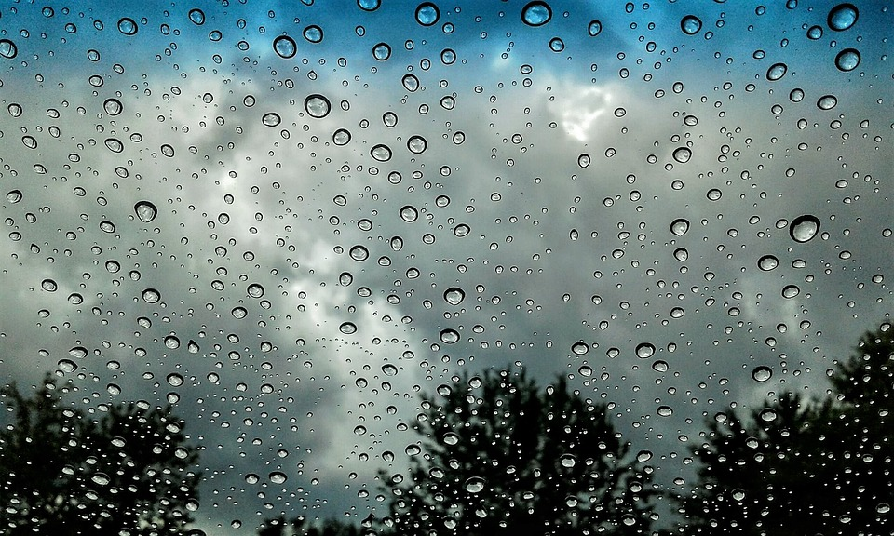
Community Waters
Focus Question: What experiences has your family or community had with rain water?
In this lesson:
Students will interview a family or community member about their experiences with rain and/or flooding to surface funds of knowledge and prior experience that may appear on the L1 explanatory model, or elsewhere in the unit.

Slide 5
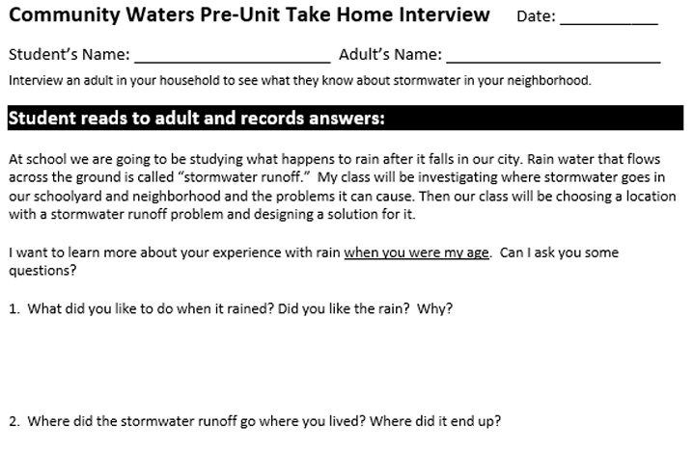
Take-home interview
Be sure to put your name, the adult’s name and the date at the top
Stormwater might be a new word for lots of people!
STORMWATER is rainwater that falls onto the ground usually from rain storms or melting snow.
Do your best to write some notes from what the adult says.
Don’t forget the other side of the paper! The adult will ask YOU some questions!
Notes:
Review the questions and instructions with students, helping with vocabulary as needed.

Slide 6
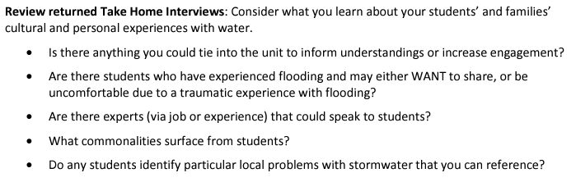
Teacher next steps
Notes:
See page 46 in Teacher Manual

