Slide 1




Community waters Science unit
4th grade

Slide 2
Teacher context and lesson outline
LESSON 2a
Part 1 – “initial encounter” – students pour some water on the ground and observe results (10-15 m)
Part 2 – students share their observations, learn key terms, and learn about the investigation (45 m)
Part 3 – students conduct investigation (this can be led by IslandWood educators if scheduled in advance) (30-45 m)
LESSON 2b (45 m)
Students will ANALYZE AND INTERPRET their data from lesson 2a
… and…
Read informational text and view a video that will provide further information or help them understand and explain their findings.

Slide 3
Investigating effects of stormwater
Community Waters Science Unit: Lesson 2a
Lesson 2a
Notes:
https://communitywaters.org/teaching-community-waters/lesson-2-2/
Lesson 2a and 2b slides are in this ONE slideshow

Slide 4
Teacher prep
Word Wall cards ready
Watch “Investigating stormwater in your schoolyard” teacher video
Familiarize yourself with schoolgrounds (which you may have done during planning session) and the maps and info in your School Guide PPT.
Print off Schoolyard Mapping Worksheet Data Sheet, and digital camera (if using) - 1 of each per group
Fill water bottles and/or rain jars (have lots of water available!)
Determine groups of 4-5 students.
Secure at least 1 other adult to act as support for outside lessons.
Optional: Schedule outdoor investigation (part 3 of L2a) with IslandWood.
Prepare CLASS DATA TABLE (lesson 2b) on paper or online.
Decision points:
  Consider how you want to break up these lesson parts over multiple days.
  Decide where to do your investigation.
  Do you want support from IslandWood? Reach out to celinas@islandwood.org

Slide 5
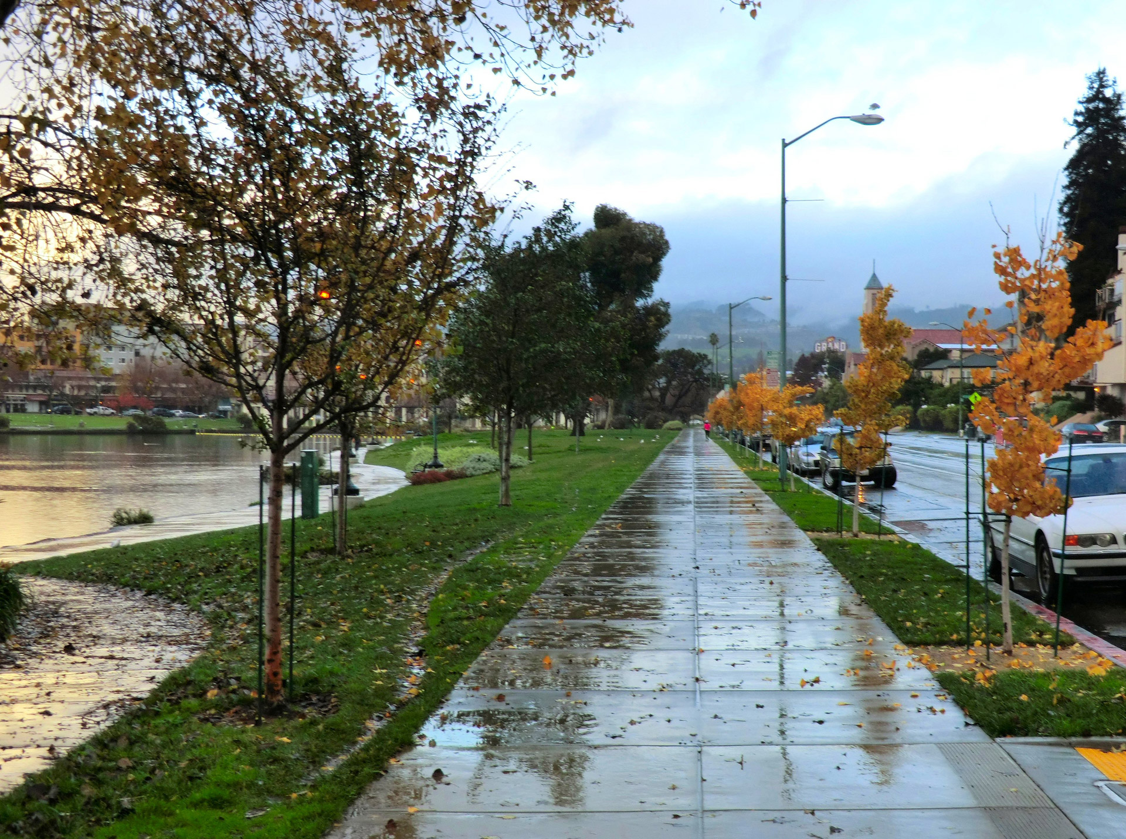
Investigating effects of stormwater at our school
Focus Question: What happens when rain falls in our schoolyard?
Learning Target: I can make observations in an investigation to understand what happens when rain falls on various surfaces.

Slide 6
Part 1
We will be going outside with water.
You will pour water on different surfaces outside.
Observe what happens when the water contacts different surfaces.
When we come back in, be ready to share!

Slide 7

Expectations for being outside during science
This is not recess time, we are scientists right now
We have a task we must complete
Your voice is off when directions are being given
Stay within the boundaries
The water stays in the bottle, only goes on the ground, and only for observation
Notes:
EDIT AS YOU WISH! ☺

Slide 8
Back Pocket Questions
Where is the water you poured going to?
I’m not seeing the water you poured, what happened to it?
Are you seeing any signs of erosion? What would erosion look like?
Why do you think the water is doing that?
Where else could you pour the water to have it do something different?
Is anything getting carried in the water if it flows downhill?

Slide 9
TEACHER PREPARATION
Remind students of the water pouring they did outside.
Show your school's Mapping your Schoolyard worksheet with your document camera (found in your school specific manual)
Discuss what students see, orient the map with them, and show them where they were on the map during pouring.
Have students share out loud the locations they poured water and show where some of them are on the map.
Add erosion and groundwater to your Word Wall Cards
Decision point
How do you want students to discuss the questions on slide 11?

Slide 10
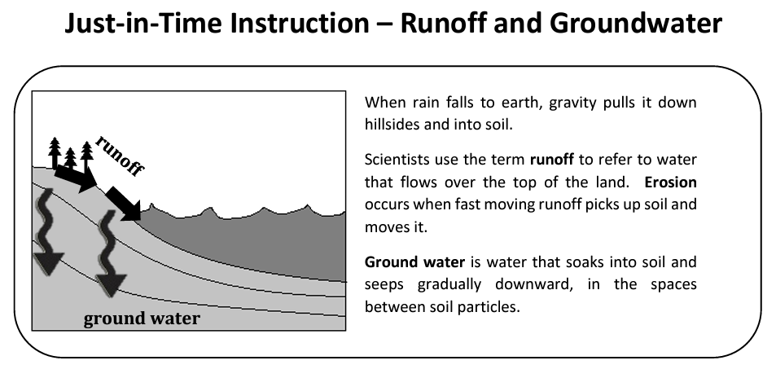
Part 2

Slide 11

discussion
When you poured water outside, what did it look like when runoff was happening?
Did the water flow faster in some areas than in others?
If the ground is flat and hard like concrete, what happens to the water?
What did it look like when water was soaking into the groundwater?
Did you see any erosion when you were pouring your water?
Where could rain run off the ground, cause erosion, or soak into the groundwater?

Slide 12
TEACHER PREPARATION for Investigation
Fill out an example row under the document camera as you demonstrate the procedure.
  Use an empty tub (no dirt) with a slope created by some books for your demonstration
  Have students help describe what you see and its slope
  Project schoolyard map and mark location of your classroom
  Use the rainwater jar to "rain" on the tub and ask for help describing what happens to the water and filling in the row
For map task (slide 15), prompt students that they will be marking locations on their map. They will be able to work on this task after they have completed the investigation procedure for all locations.

Slide 13
Planning an investigation
GROUP ROLES
(take turns!)
RECORDER – fills in row on data sheet
MAPPER – records number of location on group map
DRAWER OR PHOTOGRAHER – record before and after images
WATER SHAKER – shakes water onto ground
Investigation question: What happens when rain falls on different sloped surfaces in our schoolyard?
What sort of surfaces do we want to investigate? (changed variable)
What should we be looking for that will help us think about whether runoff, erosion, and/or soaking into groundwater is happening? (measured variable)
We want the slope to be about the same for everyone. (controlled variable)

Slide 14
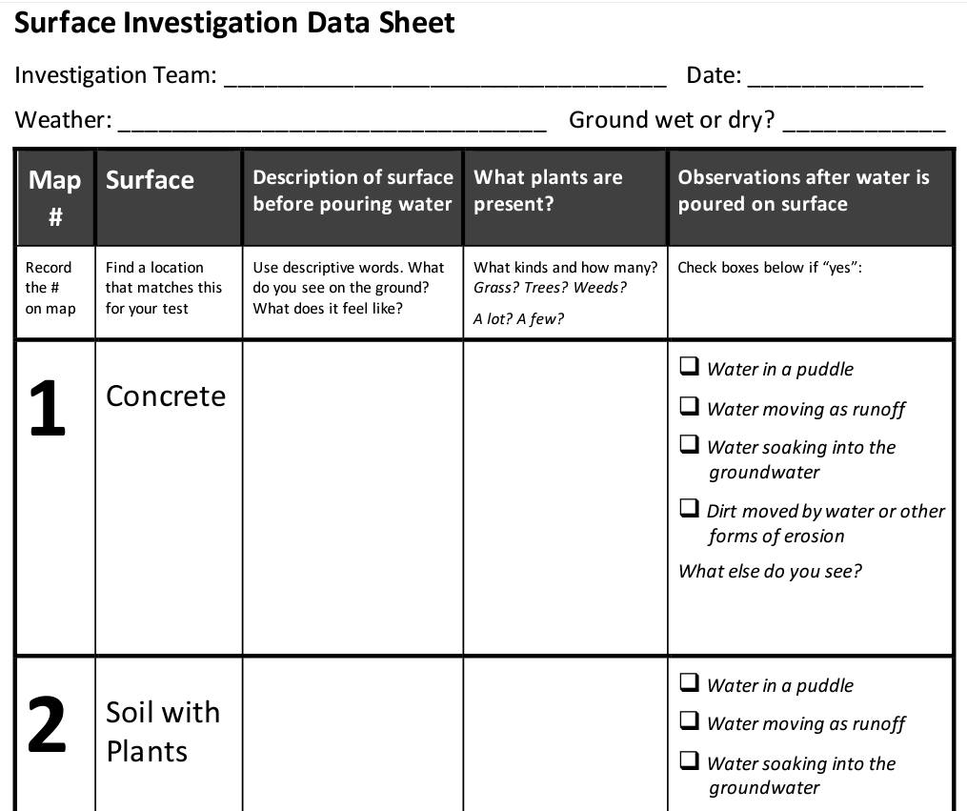
Fill out this top part first!
4. Describe the surface before pouring water, note what kinds of plants are present.
3. Find a surface that matches one of these rows with the amount of slope we have agreed on.
7. Repeat steps 2 – 6 with a different surface from a new row.
2. Record this number on your map.​
6. Check all boxes that you observed.
5. Shake a rainwater jar from waist height in the same location until 1000 mL has been released.

Slide 15
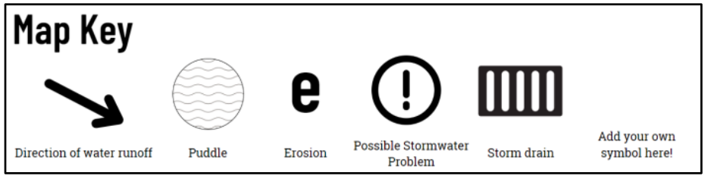
Additional map tasks
You will have a chance to mark locations on your map where you find drains that rain might go into and any locations where runoff, erosion, or puddles happen in the schoolyard during big storms.
Refer to this map key to mark your locations on your map.

Slide 16
Part 3 – Conduct the investigation!
Reminders:
Stay in your group
Listen for directions
Stay focused on our task

Slide 17
Back Pocket Questions
Observations
Which features at the school might slow down the water?
Which features might increase the speed of the water?
Which places at the school allow water to absorb into the ground?
Do you notice any pollution concerns?
Where are places that you have seen puddles form?
Inferences
Where would the water go from here?
Where did the water causing this problem (puddle or erosion) come from?
Where does all the water flowing off the surface end up?
Notes:
Your school’s Guide may have other location-specific questions.

Slide 18
Analyzing and interpreting our data
Lesson 2b
Learning Target: I can analyze data from an investigation and read texts to understand what happens when rain falls on various surfaces.
Notes:
https://communitywaters.org/teaching-community-waters/lesson-2-2/

Slide 19
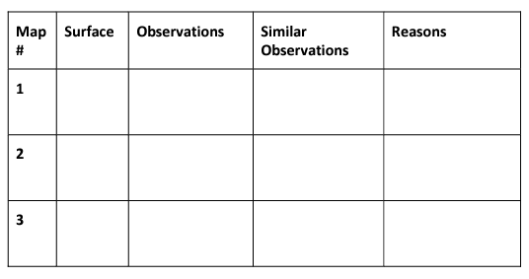
Class data table
Where did we see runoff? Did you see any erosion?

Slide 20
Decision Point
Are you going to introduce "pervious" and "impervious" terms now or later?
If later, skip to slide 22 (#6 in Teacher Manual)

Slide 21
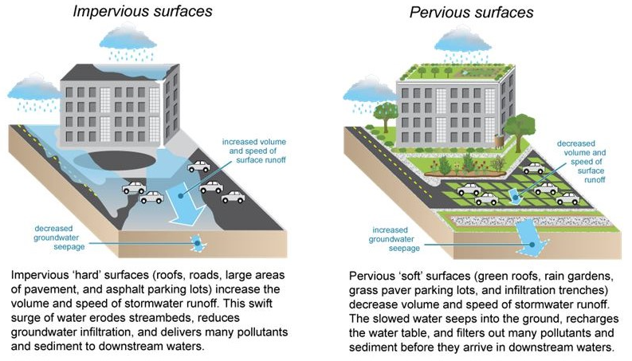
Surfaces

Slide 22
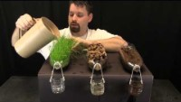
Erosion and soil Video: how do plants and soil filter water?
Which surfaces in the video had the most erosion? Which had the least?

Slide 23
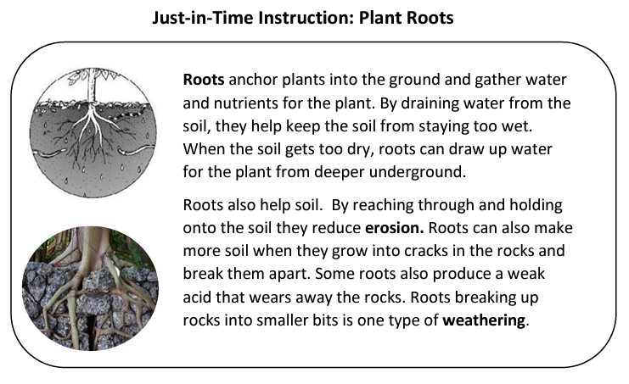
How does this help our understanding of what we discovered?

Slide 24

Referring back to the schoolyard map you made, choose a feature you added and discuss why it is found at that location.
What surfaces add to the stormwater runoff problems in our city?​
What surfaces reduce the amount of stormwater runoff?​
How can plants help with stormwater runoff?

Slide 25
Teacher next steps
Fill in the Teacher Reflection Worksheet to consider how well the tasks, talk, and tools worked for students.
If your students have more ideas to explore about how stormwater moves or what it does where it falls, return to this lesson first before moving on.
More information about frost wedging and potholes created when you add cars can be found in the teacher background section of the manual, as well as in the Appendix
Notes:
See page 46 in Teacher Manual

