Slide 1




Community waters Science unit
4th grade

Slide 2
Flooding in our Community
Community Waters Science Unit: Lesson 1
Notes:
https://communitywaters.org/teaching-community-waters/lesson-1-flooding-in-our-community/

Slide 3
Teacher prep
Test embedded video in PPT (slide 6) – prepare in separate tab if needed
Have explanatory models (1 per student) printed/ready
Prep drawing or coloring materials you want students to use
Prep chart paper and post its for public records
Decision points:
  Will you use a “wondering wall” or other public record of student questions?
  Will you use other public records for student understanding?
  Will you have students participate in a “gallery walk” during which they can view others’ explanatory models? (after slide 7)
  Are there students that have experienced trauma around flooding, and how will you be sensitive to stress around flooding? (this might have been surfaced in the Take-home Interview)

Slide 4
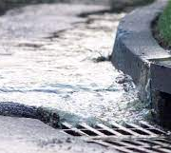
Flooding in our community
Focus Question: Why does flooding happen in our community?
Learning Target: I can draw on a model to share what I know about storm water.
In this lesson:
Students will make and share observations about the effects of stormwater in an urban setting.
Students will access prior knowledge to begin building an understanding of what is causing the stormwater runoff problem.

Slide 5


What have you noticed when it rains a lot around here?

Slide 6
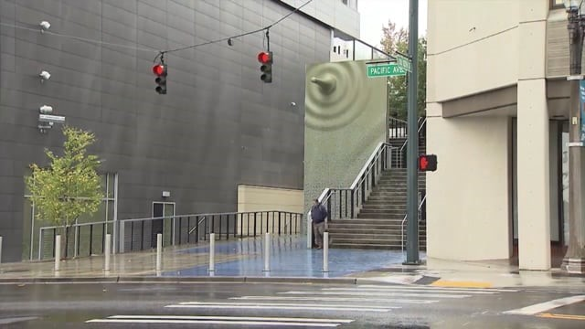
Phenomenon video
Instructions after video
Turn and Talk:
What are your observations?
Have you or your family experienced something like this?

Slide 7
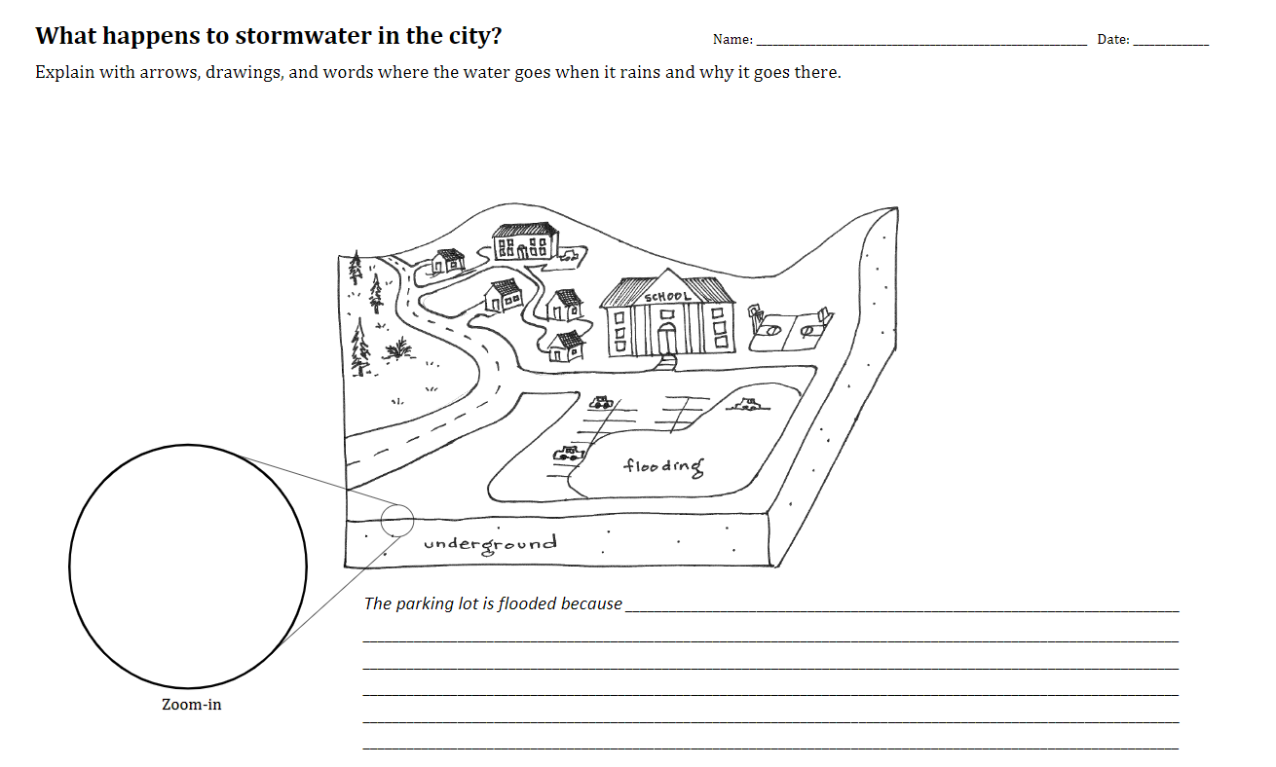
Explanatory model
Be sure to put your name and today’s date on the paper because we will be comparing this model to one you create later in the unit.
The “zoom in” can be used to show more detail.
Use pictures, arrows, labels, and words to show your understanding.
Write your explanation of why the parking lot is flooded here.
Notes:
Examples of past student work can be found here:
https://communitywaters.org/2018/11/14/lesson-1-flooding-in-seattle/
After students have a chance to work on their models, decide if they will do a gallery walk to see their classmate's work. Ask what hypotheses they have about what kinds of things happen to stormwater in the city and why flooding occurs. Add ideas to the List of Hypotheses.

Slide 8
Teacher back-pocket questions to ask students
What did you observe happening with the water in the video?
What have you observed water doing when it rains around our neighborhood?
You said you have seen water (insert student’s observation). Why do you think it did that?
Modeling Questions:
How can you show that on your model?
How could you describe it in words on your model?

Slide 9
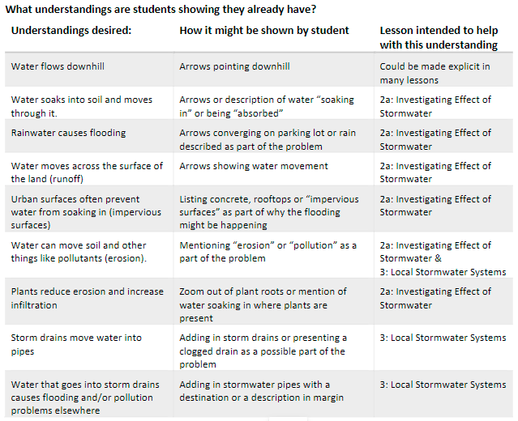
Teacher next steps
It is critical to examine your students’ explanatory models. You might use the WHAT – HOW – WHY CHART on CommunityWaters.org.
  What are the understandings and alternate conceptions your students show?
  How are they showing their thinking?
  Do they have personal/familial experiences that can be integrated into the unit?
Notes:
See page 46 in Teacher Manual

