Slide 1


Community Waters School Guide:
Whittier Elementary
How to Use This Guide
This School Guide supports the Community Waters Science Unit Teacher Manual with information, maps, and images specific to your school and neighborhood.
It is written for teachers - its goal is to provide a better understanding of what is happening with stormwater in and around your school.
All content within may change, and can be adapted as desired.
If you have any questions about these maps, accompanying lessons, or stormwater around your school, contact IslandWood staff at communitywaters@IslandWood.org.

Slide 2
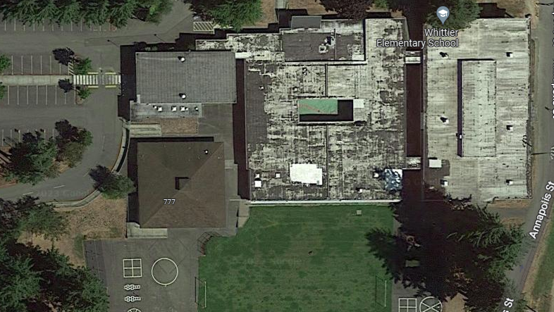
Stormwater in Our Schoolyard: lesson 2
You will find the student worksheet for this lesson following the teacher guide version.
Please use the extra space on the pages to add your own notes and questions!
Notes:
Whittier points of interest need to be inserted.

Slide 3
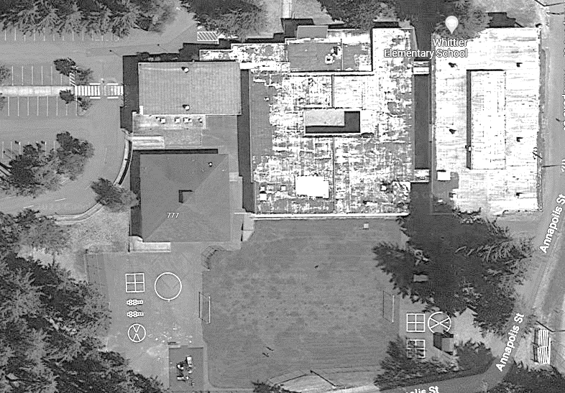


Mapping Your Schoolyard – Whittier Name: ____________ Date: _________
Include on your map:
Symbols from the Key including flow of water, erosion, and storm drains.
Show where you see any evidence of possible stormwater problems (this could be places where there's lots of erosion or big puddles, or oil from cars, etc).
Sketch larger plants and bushes if they are there.

Slide 4
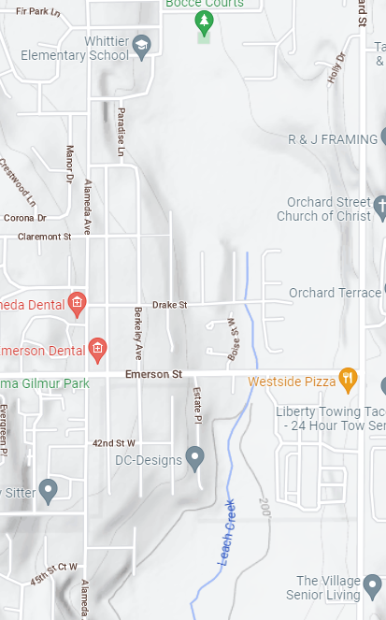
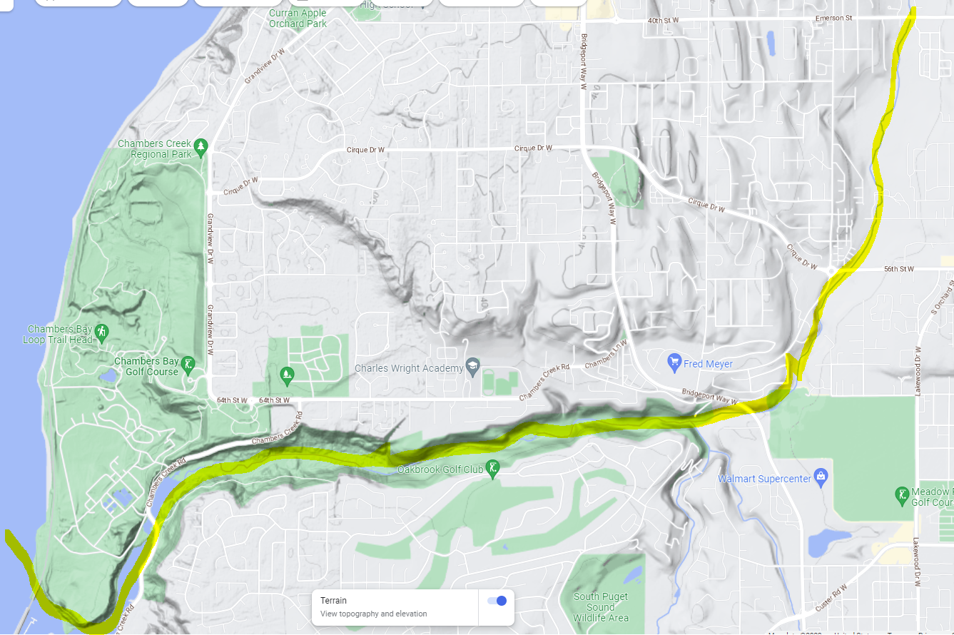
Local Stormwater Systems: lesson 3
We did not have access to GIS mapping tools* to identify the exact path of the stormwater from the school, but based on the topography of the land, it would seem that water from the school flows southeast in to Leach Holding Basin then into Leach Creek, which then flows into Chambers Creek and out to the Salish Sea/Puget Sound.
Whittier is in the Chambers-Clover watershed with a drainage area of 5,001 acres.
The Chambers-Clover watershed extends from the town of Ruston on Commencement Bay south to DuPont, and east to Frederickson, covering about 149 square miles. Major lakes include American, Spanaway, Steilacoom, Gravelly, and Tule. Major streams are Chambers, Clover, Spanaway, Morey, Murray, Flett, Leach, Puget and Peach.
Seven municipalities, three military installations, and one drainage district, as well as Pierce County, have jurisdiction concerning water quality. The cities are: Tacoma, Lakewood, Fircrest, University Place, Steilacoom, DuPont, and Ruston.
*Since Whittier is in the city of Fircrest, not Tacoma, the Tacoma GIS mapping website we’ve used for other Tacoma Public Schools doesn’t work.
Notes:
WRIA 12: Chambers-Clover watershed
The Chambers-Clover watershed is located in central Pierce County and is roughly triangular in shape, bounded by Puget Sound on the west, and extends east to near the community of Graham. Point Defiance and the southwest shore of Commencement Bay serve as the northern boundary. The City of DuPont near the Nisqually River Basin is located near the southern boundary. The Chambers-Clover watershed covers approximately 180 square miles (Clothier, et al 2003). This watershed comprises the Chambers-Clover Creek Basin and the neighboring small drainages of Sequalitchew (including American Lake and Murray Creek) and Puget Creeks in Pierce County, Washington. It also encompasses several independent stream drainages, including unnamed creeks draining from the North Tacoma area directly into Puget Sound, and Crystal Springs Creek. Important lakes within the Chambers-Clover watershed are Lake Louise, Owens Marsh, and Steilacoom, Gravelly, American, Spanaway, Waughop, Charlton, and Wapato Lakes (Clothier, et al 2003). The watershed includes approximately the western half of the City of Tacoma, all of the Cities of Lakewood and University Place, and the Towns of Steilacoom, Dupont, Fircrest, and Ruston. It also includes the unincorporated communities of Parkland, Spanaway, Elk Plain, Frederickson, and Midland. McChord Air Force Base and part of Fort Lewis occupy a large portion of the central and southern part of the basin (Clothier, et al 2003).
Please Note: The pipes information provided here is our best estimate of the stormwater flow in your community based on the information we have currently. If you encounter more information in the course of your investigation, please let us know so we can update future versions of this document.
*additional information about North Tacoma watershed: Historically, the area along the waterfront was inhabited by The Puyallup Tribe of Indians, used for hunting and fishing grounds, and travelled by many other tribes. Once non-natives arrived, they began establishing industrial businesses and trade along the waterfront including sawmills, grain terminals, loading docks and other water-related activities. Geologically, this area contains sandy soils on top of clay layers with
steep slopes located along the northern edge of the watershed.

Slide 5
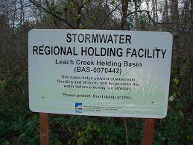






Whittier Elementary
Where does your school’s stormwater go?
Leach Creek Holding Basin

Slide 6
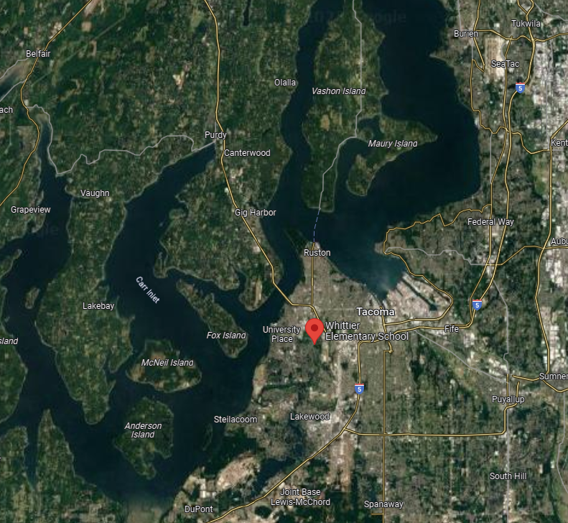

Now follow the orange line away from your school to see how it gets to the Salish Sea!

