Slide 1
Community Waters School Guide:
Fawcett Elementary School
@ McKinley
How to Use This Guide
This School Guide supports the Community Waters Science Unit Teacher Manual with information, maps, and images specific to your school and neighborhood.
It is written for teachers - its goal is to provide a better understanding of what is happening with stormwater in and around your school. The blue slides with maps are designed for students to use during Lesson 3.
All content within may change, and can be adapted as desired.
If you have any questions about these maps, accompanying lessons, or stormwater around your school, contact IslandWood staff at communitywaters@IslandWood.org.

Slide 2
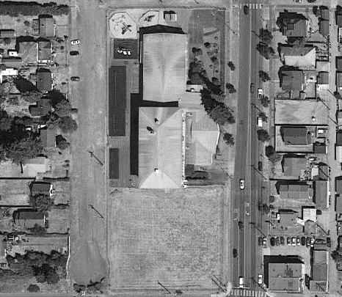

Mapping Your Schoolyard – Fawcett Elementary Name: ____________ Date: _________
Include on your map:
Symbols from the Key including flow of water, erosion, and storm drains.
Show where you see any evidence of possible stormwater problems (this could be places where there's lots of erosion or big puddles, or oil from cars, etc).
Add larger plants and bushes if they are there.
Notes:
PRINT THIS PAGE for the STUDENT WORKSHEET

Slide 3
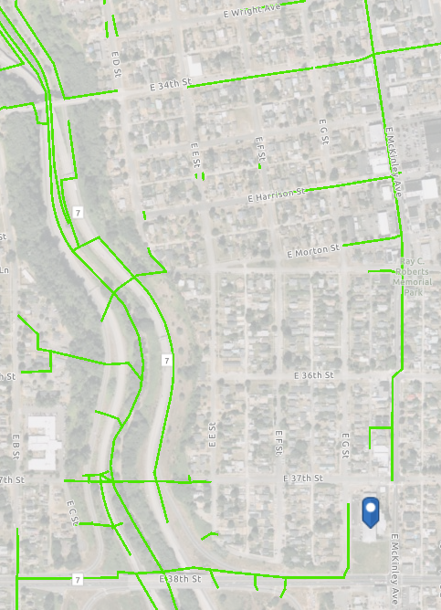
Fawcett Elementary @ McKinley
Where does your school’s stormwater go?
Follow the green lines and arrows!
What happens with the stormwater around your school?
Water in the storm drains at your school empty into stormwater pipes under the school and travel underground moving north on E McKinley Ave, and west on E 38th St. Where McKinley Ave meets McKinley Way, the water moves northwest, following McKinley Way towards Highway 705. The water that moves along 38th St. turns north and follows Highway 7, and both of these paths meet to flow north into Thea Foss waterway.
Notes:
STUDENT SLIDES ARE BLUE; Please Note: The pipes information provided here is our best estimate of the stormwater flow in your community based on the information we have currently. If you encounter more information in the course of your investigation, please let us know so we can update future versions of this document.

Slide 4
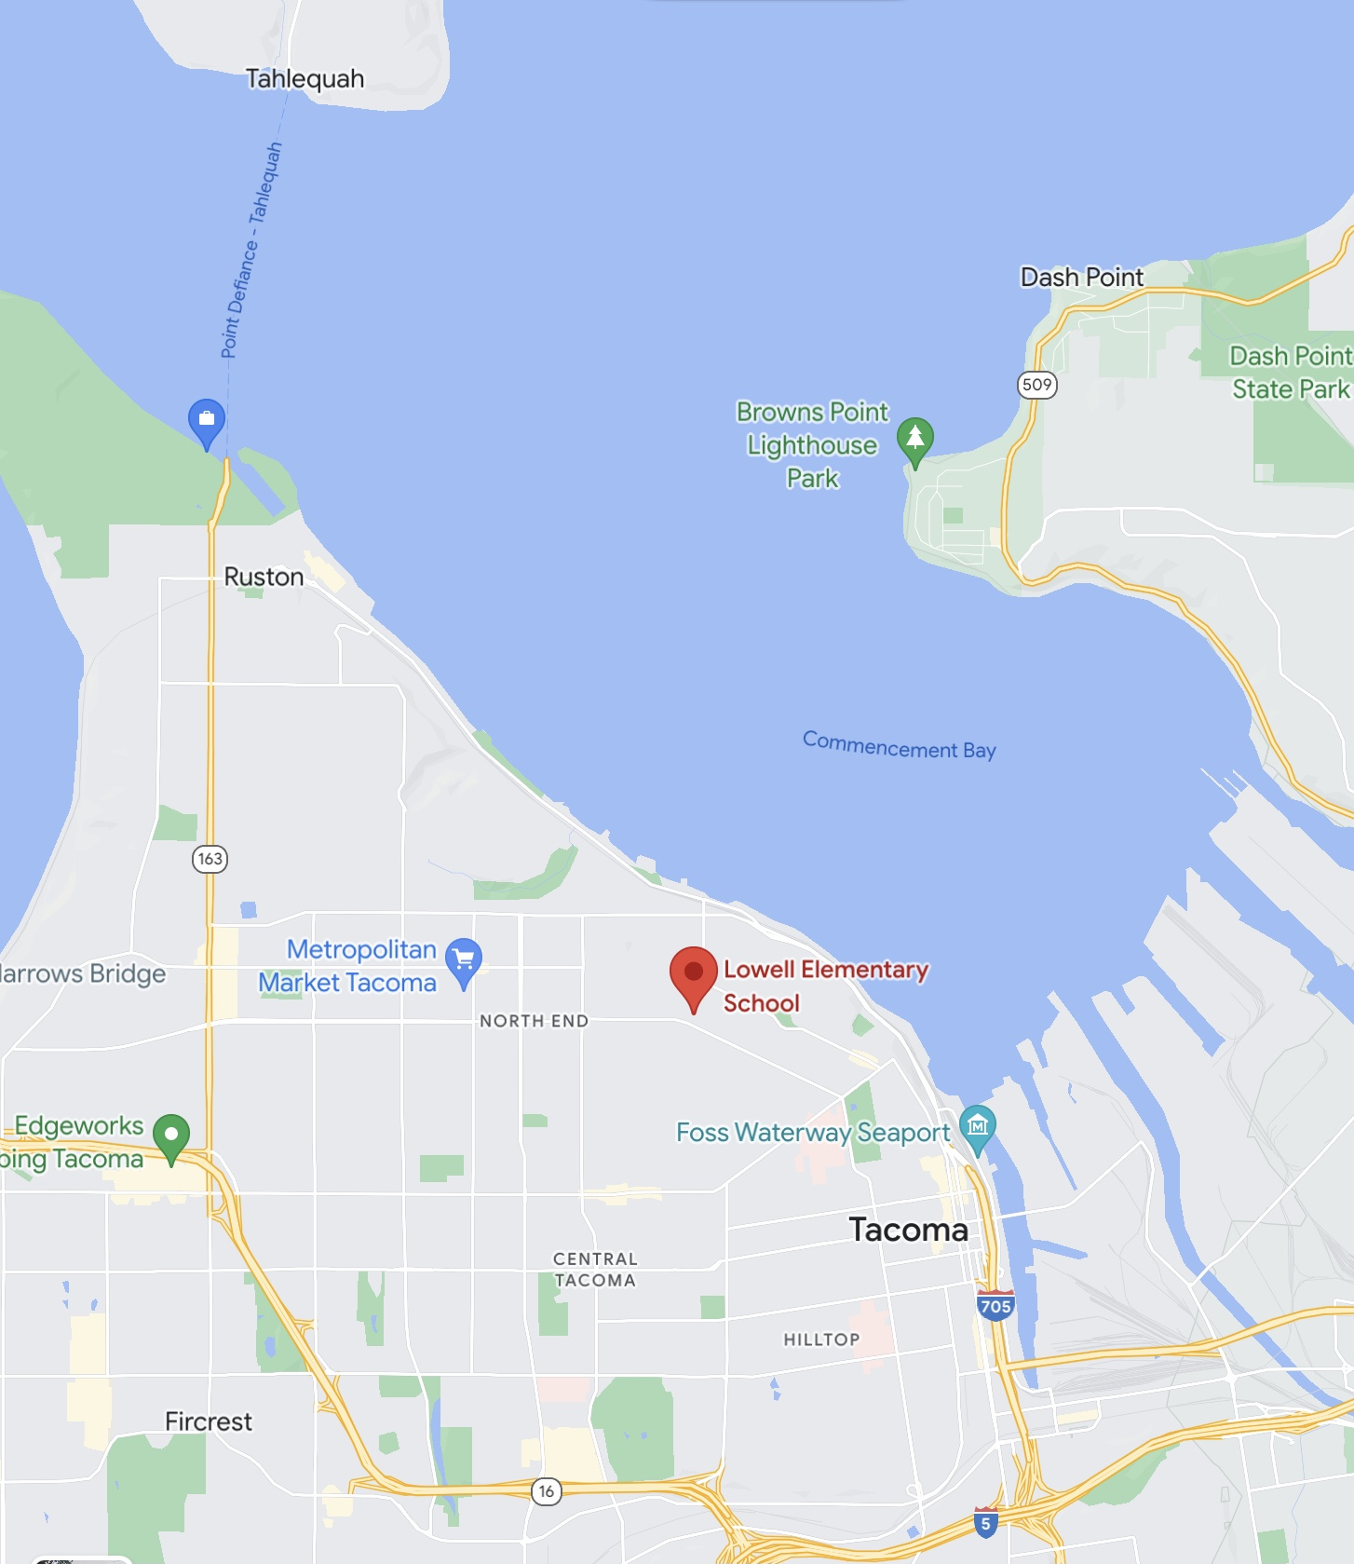
Where does your stormwater runoff end up?
Your school is in the Foss Waterway watershed:
Foss Waterway is a subwatershed of the Puyallup watershed. Covering 5,781 acres in south-central Tacoma this subwatershed is mostly residential but contains Tacoma’s industrial businesses located in the Tideflats and Nalley Valley.​
​
The Thea Foss and Wheeler-Osgood waterways became designated Superfund cleanup sites in 1983. Waterway cleanup and construction was finished in 2006. The City will monitor the waterway for the next 10 years. Learn more about the Thea Foss Waterway Cleanup.
Source: https://www.cityoftacoma.org/cms/One.aspx?portalId=169&pageId=2860#Foss%20Waterway ​
Notes:
STUDENT SLIDES ARE BLUE

Slide 5
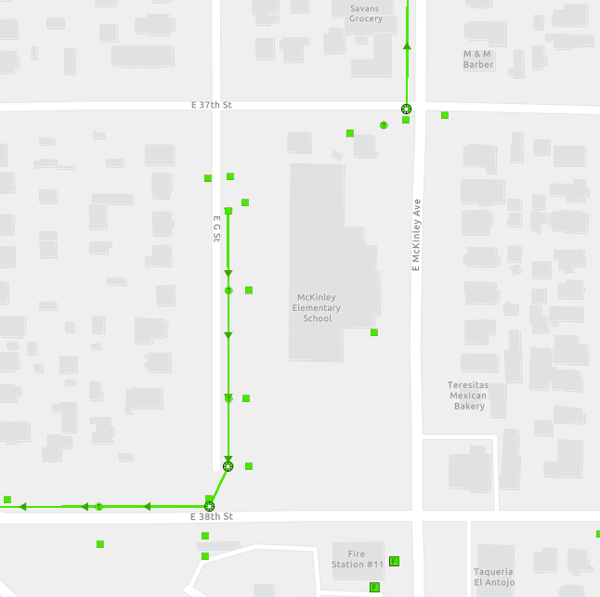
Fawcett Elementary
Where does your school’s stormwater go?
Start by following the green lines and arrows!
Go to the next slide to see where it goes from there.
Notes:
STUDENT SLIDES ARE BLUE

Slide 6
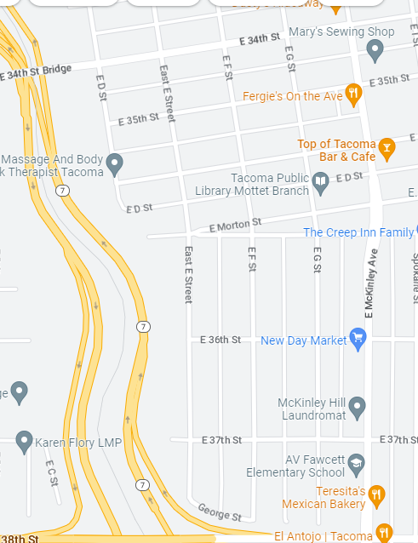
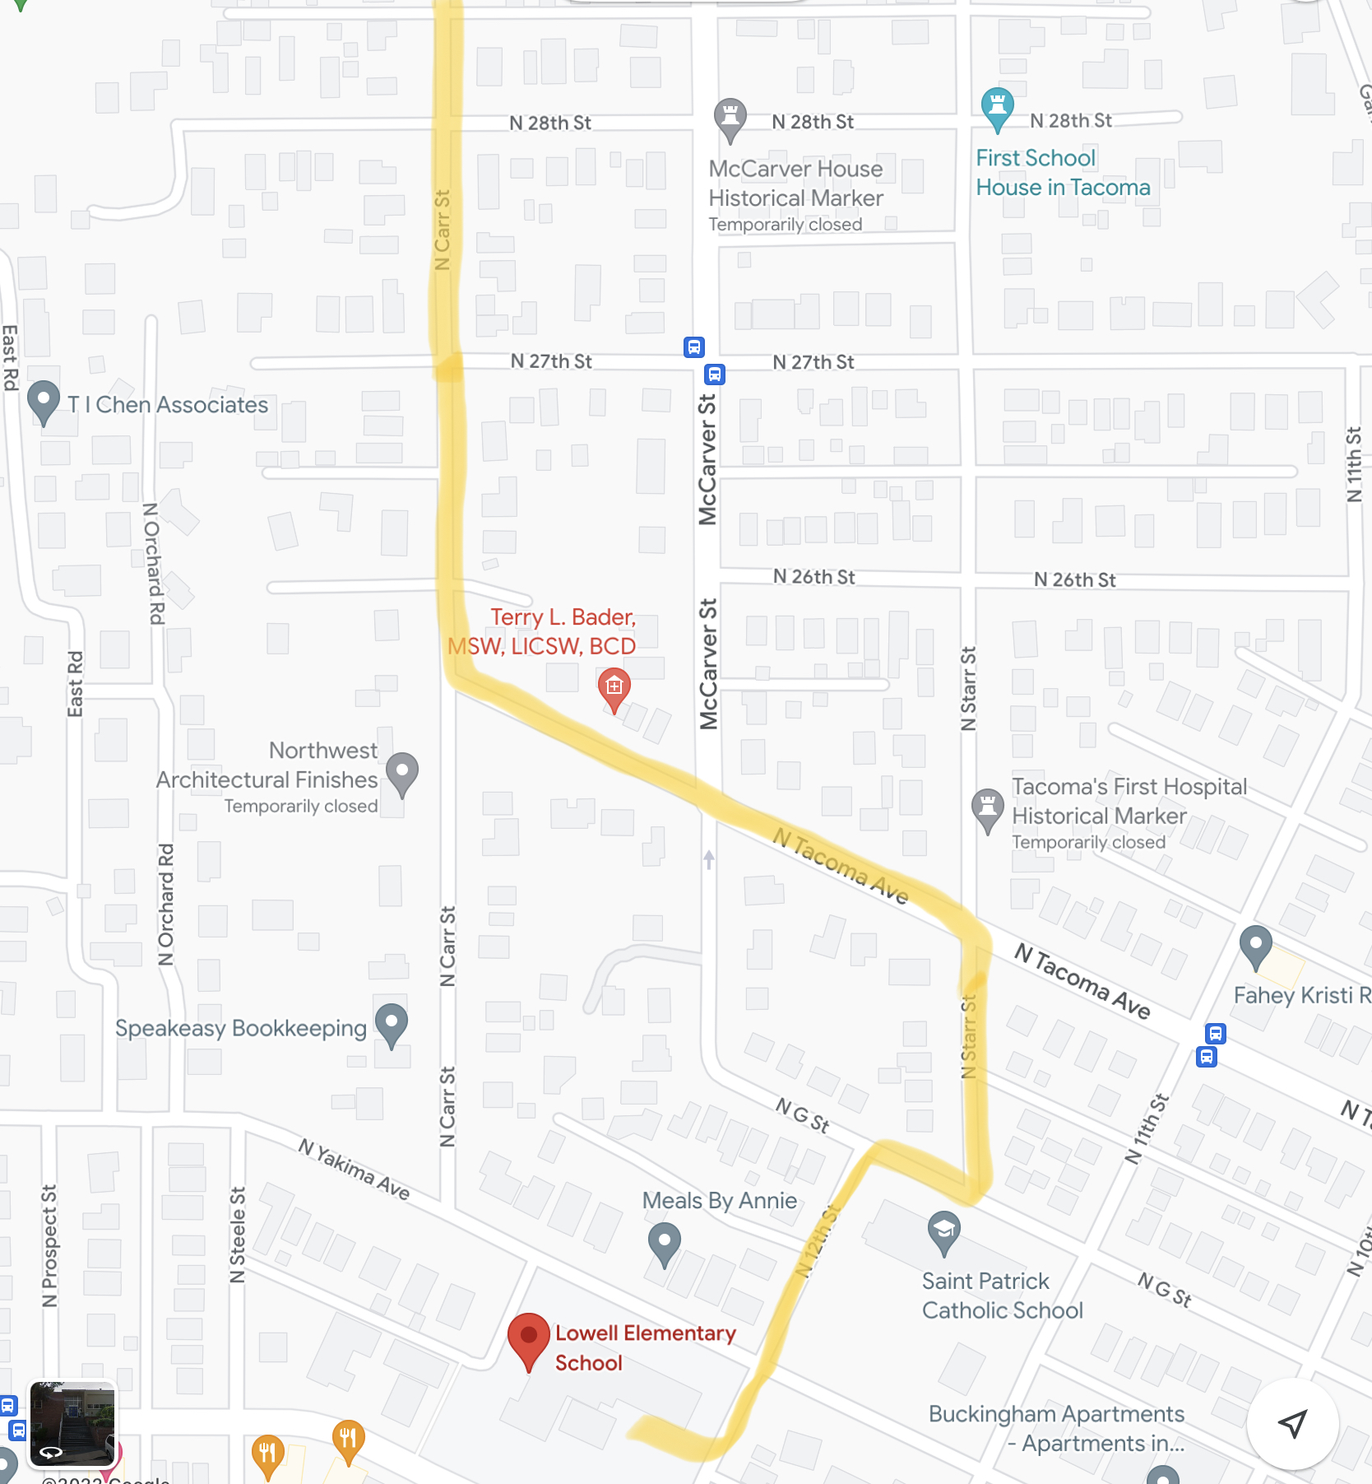
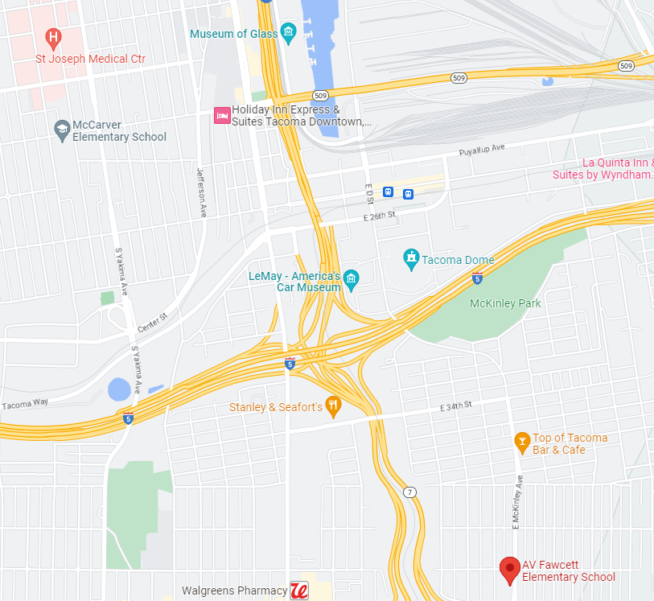







Follow the green line to see the whole path water in your schoolyard takes to reach Commencement Bay
Notes:
STUDENT SLIDES ARE BLUE

Slide 7
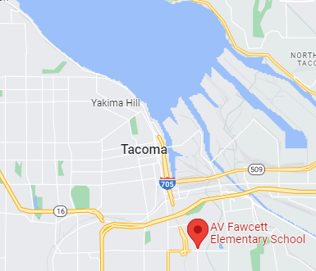




Now look to see how water in your school yard reaches the Bay and all the way out to the Puget Sound/Salish Sea!
Notes:
STUDENT SLIDES ARE BLUE

Slide 8


How did we figure this out?
To view this map on your own, go here:
https://tacoma.maps.arcgis.com/home/webmap/viewer.html?layers=23e9a402b47d46058193362cb6c27a9e
View in “Map Classic”
Check “Surfacewater Network” box
Put in the name of the school
Zoom IN to see the green lines

