Slide 1


Community Waters School Guide:
Whitman Elementary
How to Use This Guide
This School Guide supports the Community Waters Science Unit Teacher Manual with information, maps, and images specific to your school and neighborhood.
It is written for teachers - its goal is to provide a better understanding of what is happening with stormwater in and around your school.
All content within may change, and can be adapted as desired.
If you have any questions about these maps, accompanying lessons, or stormwater around your school, contact IslandWood staff at communitywaters@IslandWood.org.

Slide 2
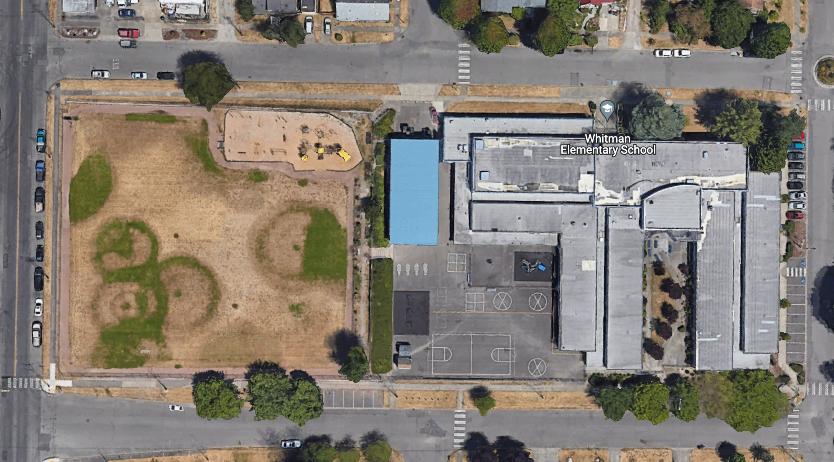
Stormwater in Our Schoolyard – Lesson 2
This map and points of interest (photos and info) can be used to guide your class’ exploration of the schoolyard. You will find the student worksheet for this lesson following the teacher guide version. Please use the extra space on the pages to add your on notes and questions!
A
C
D
B
E
A
G
E

Slide 3
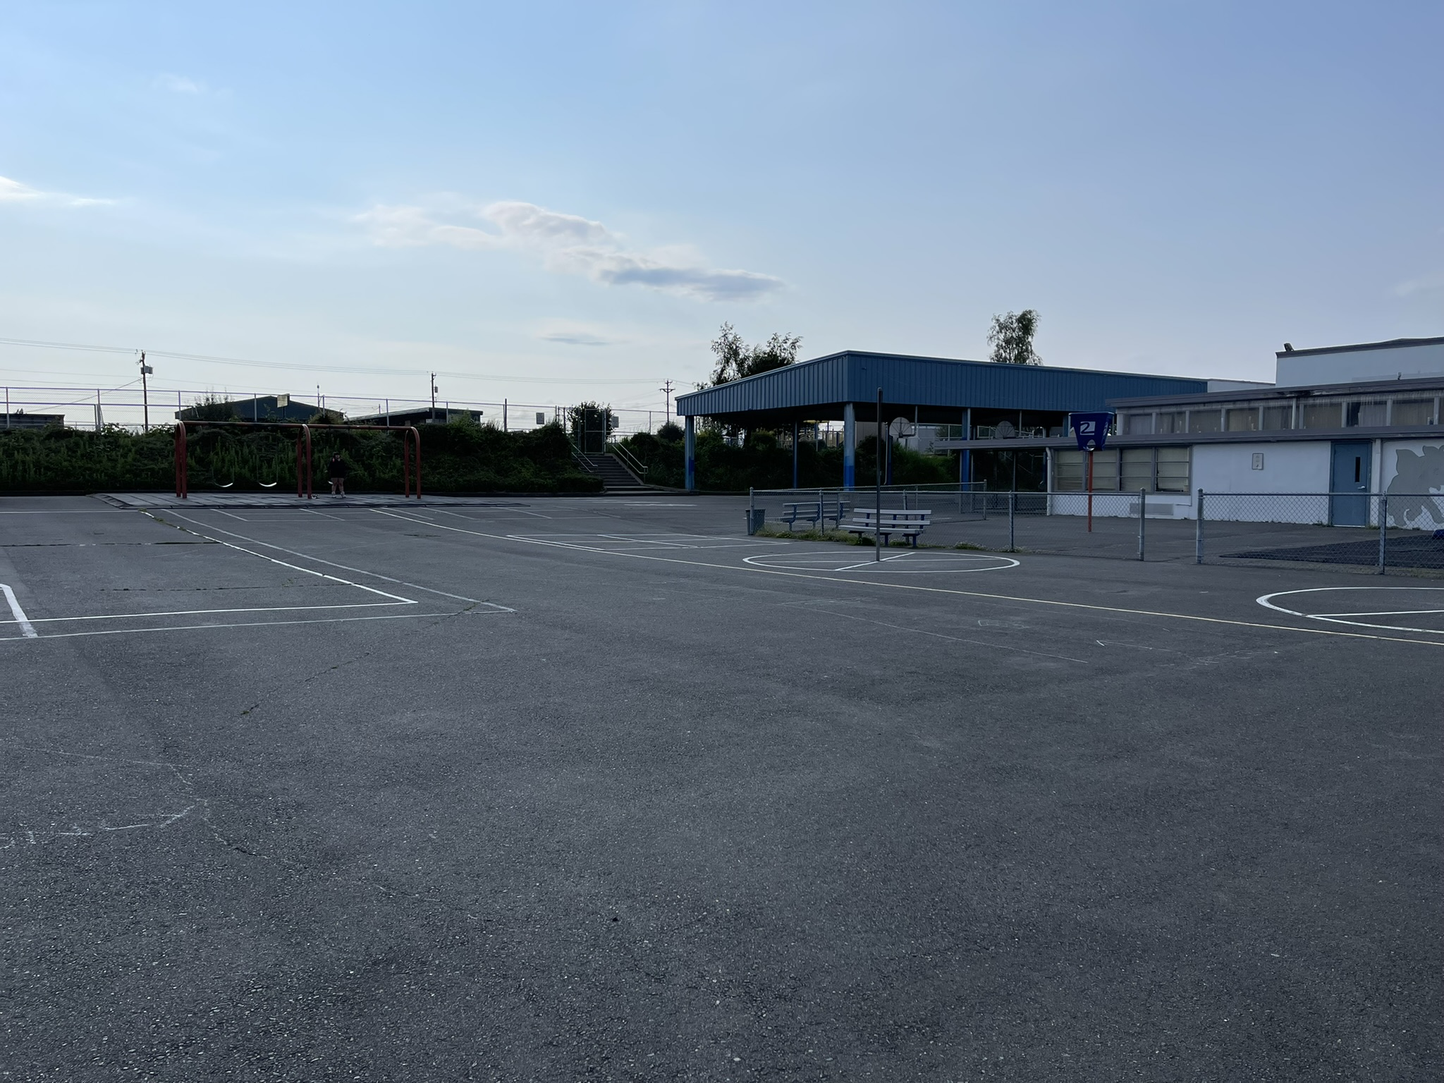
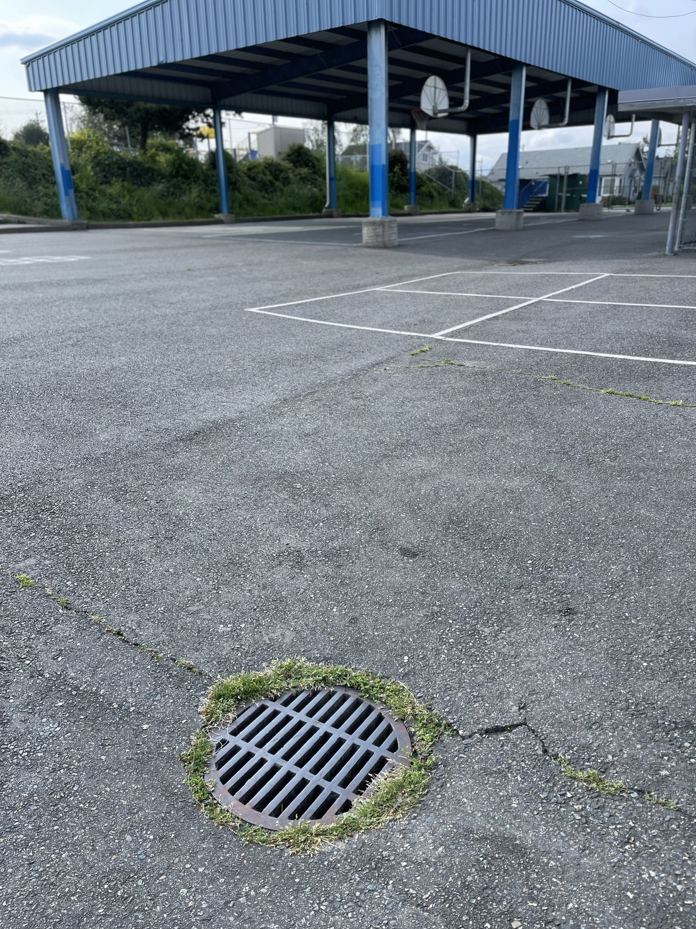
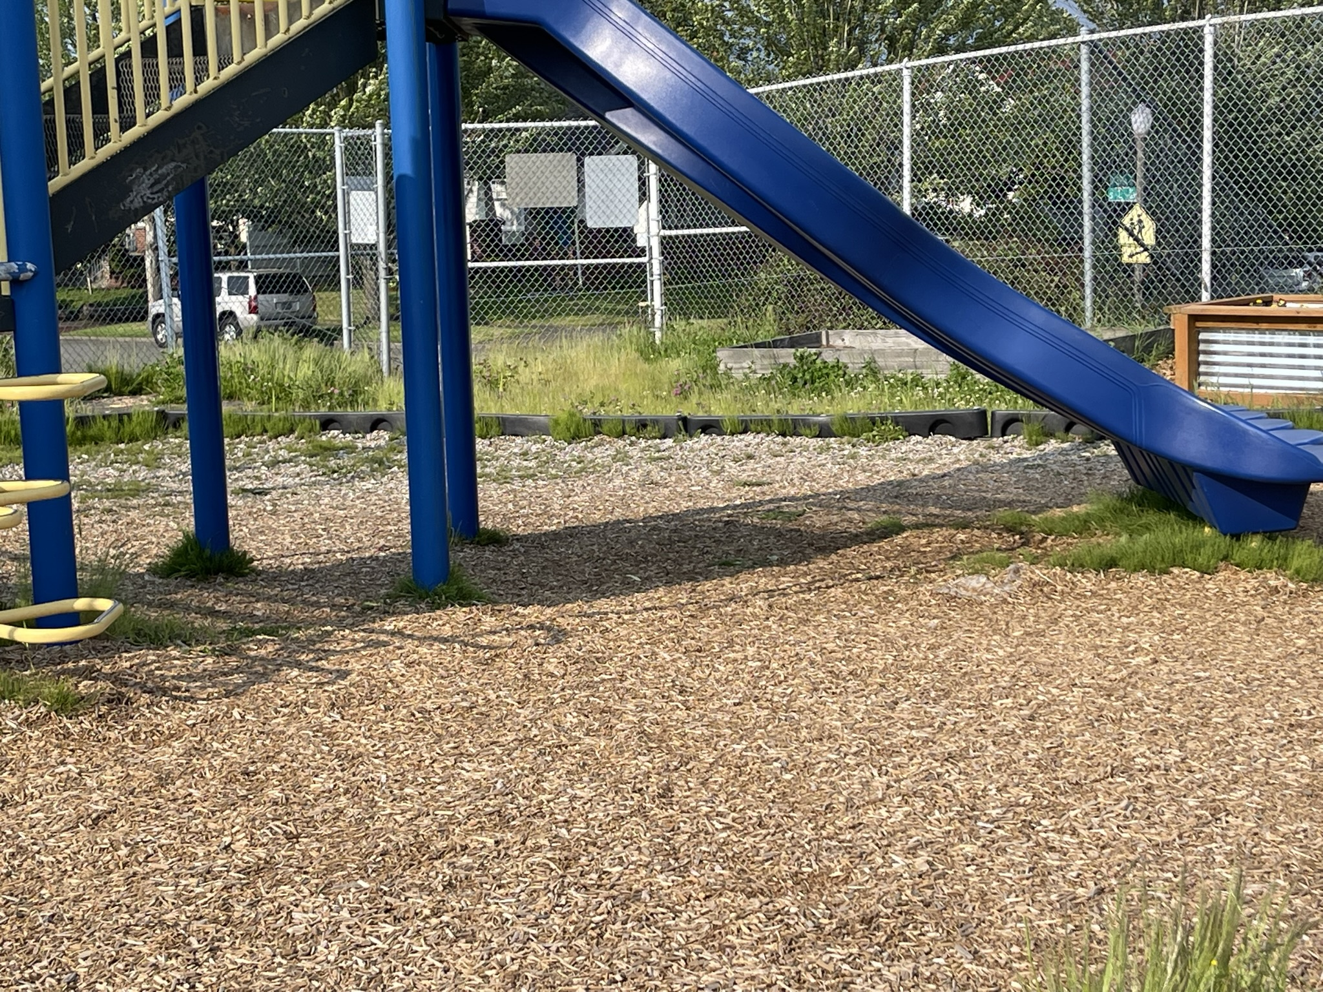
Schoolyard stormwater points of interest
A
B
A. Playground surfaces – Note what directions water flows off these different surfaces. Are they pervious or impervious?
Can you find where the water would collect or puddle or drain in a heavy rain?
A
B. Storm Drains – Note how this drain is surrounded by grass. Why might this drain have been put here? What might happen to stormwater here?
Where else can you find storm drains?

Slide 4
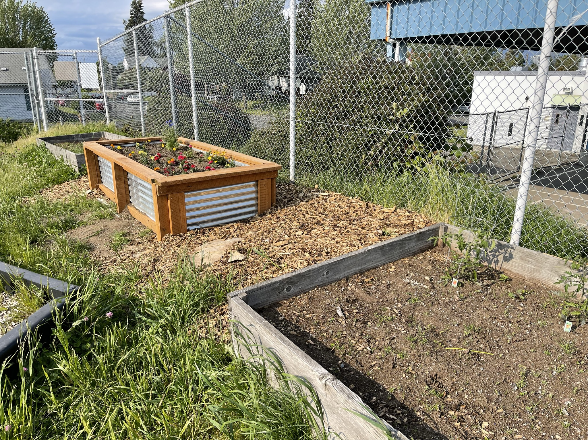
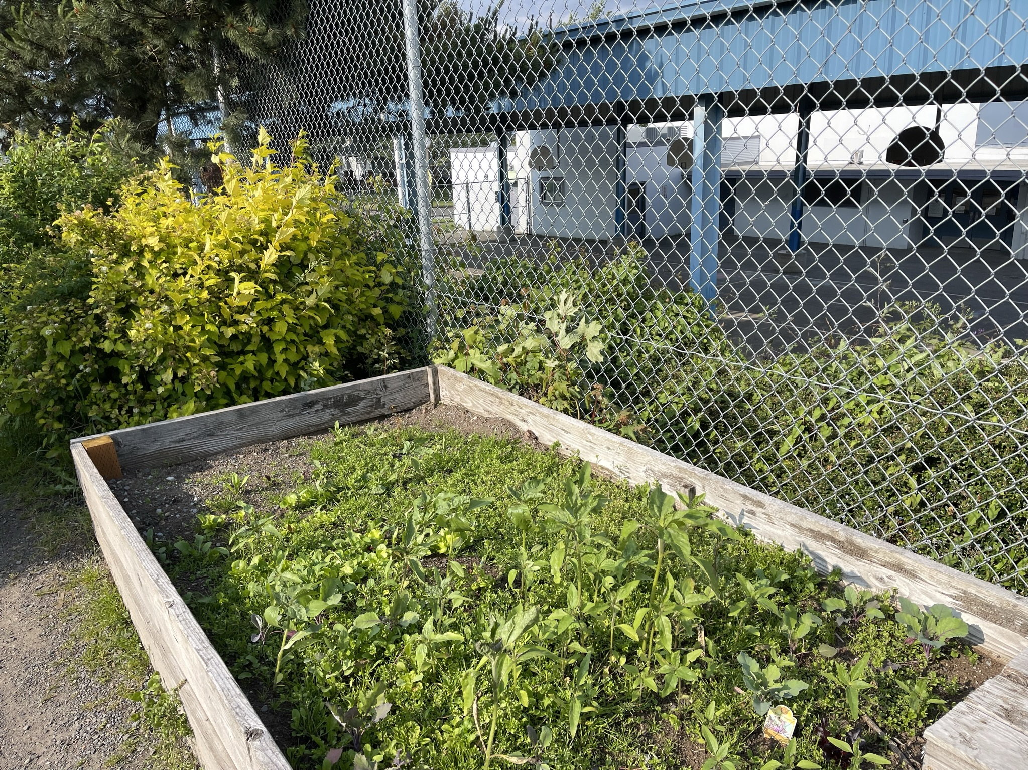
Schoolyard stormwater points of interest
C
C
C. Garden beds -
How does this area interact with heavy rain? Are there other areas that might help water soak into the ground instead of going into drains? How is this area used? What do students notice here?

Slide 5
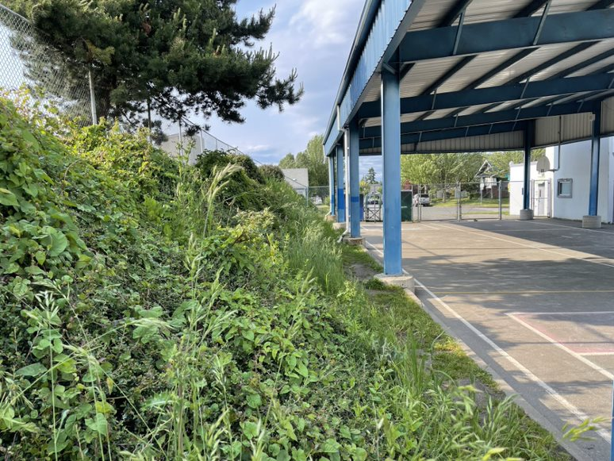
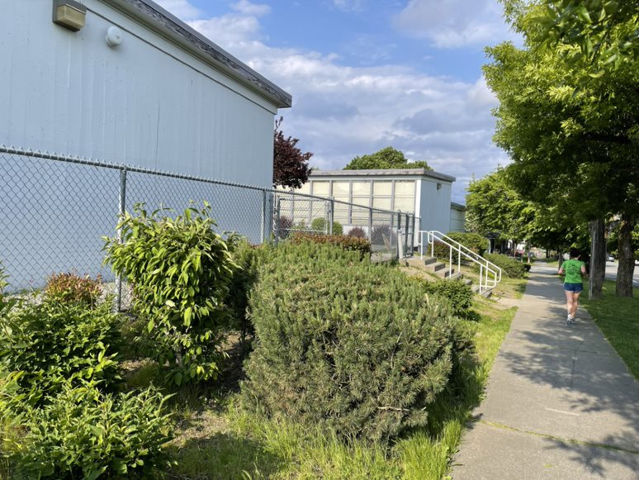
Schoolyard stormwater points of interest
Slopes
How do these area interact with heavy rain? Do the different plants here seem to make a difference when it comes to runoff?

Slide 6
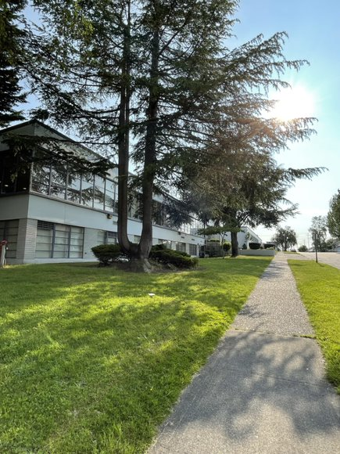
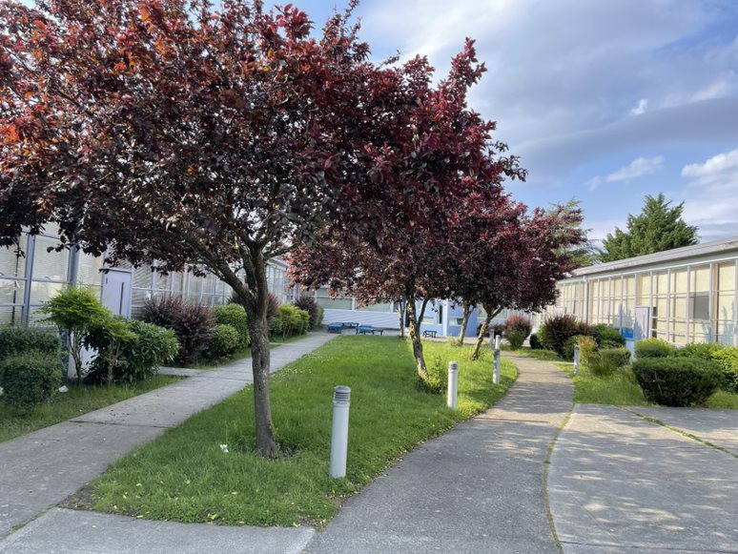
Schoolyard stormwater points of interest
Trees
Different sizes and types of trees might have different effects on stormwater. If it’s raining out, what do you notice while under these trees?

Slide 7
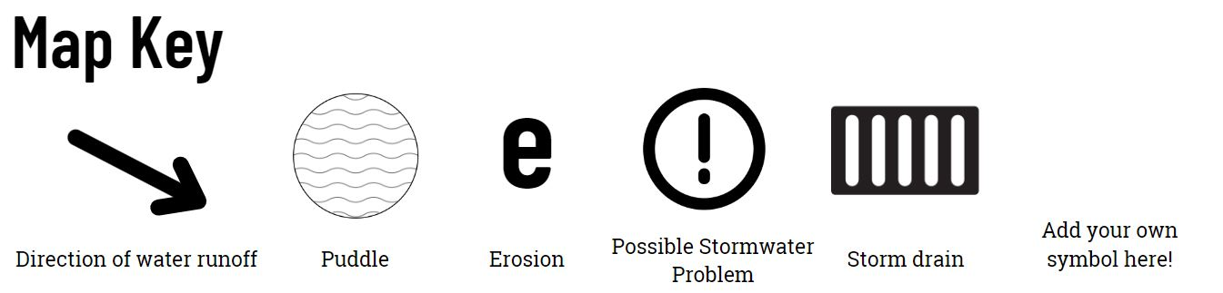
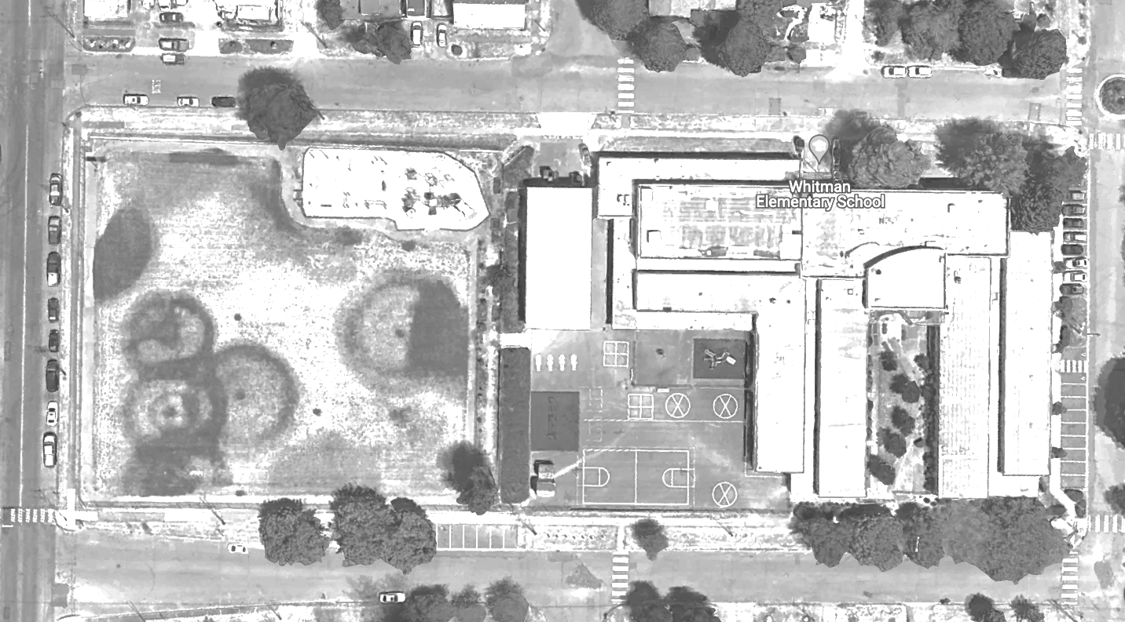
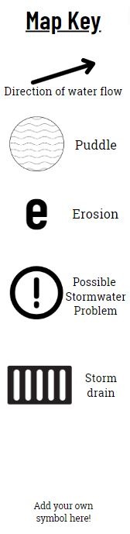

Mapping Your Schoolyard – Whitman Elementary Name: ____________ Date: _________
Include on your map:
Symbols from the Key including flow of water, erosion, and storm drains.
Show where you see any evidence of possible stormwater problems (this could be places where there's lots of erosion or big puddles, or oil from cars, etc).
Add larger plants and bushes if they are there.
Notes:
PRINT THIS PAGE for the STUDENT WORKSHEET

Slide 8
Local Stormwater Systems
What happens with the stormwater around your school?
Where does your stormwater runoff end up?
Your school is in the Foss Waterway Watershed.
Traveling underneath either South L Street or South K Street, down the hill toward Lincoln Park and under Highway 5, stormwater then heads east on South Tacoma Way, and finally exits by Waterway Park and into Commencement Bay/Puget Sound at Thea Foss Waterway.
Foss Waterway is a subwatershed of the Puyallup watershed. Covering 5,781 acres in south-central Tacoma this subwatershed is mostly residential but contains Tacoma’s industrial businesses located in the Tideflats and Nalley Valley.
The Thea Foss and Wheeler-Osgood waterways became designated Superfund cleanup sites in 1983. Waterway cleanup and construction was finished in 2006. The City will monitor the waterway for the next 10 years. Learn more about the Thea Foss Waterway Cleanup.
https://www.cityoftacoma.org/cms/One.aspx?portalId=169&pageId=2860#T-Street/Lower%20Puyallup
Notes:
Please Note: The pipes information provided here is our best estimate of the stormwater flow in your community based on the information we have currently. If you encounter more information in the course of your investigation, please let us know so we can update future versions of this document.

Slide 9
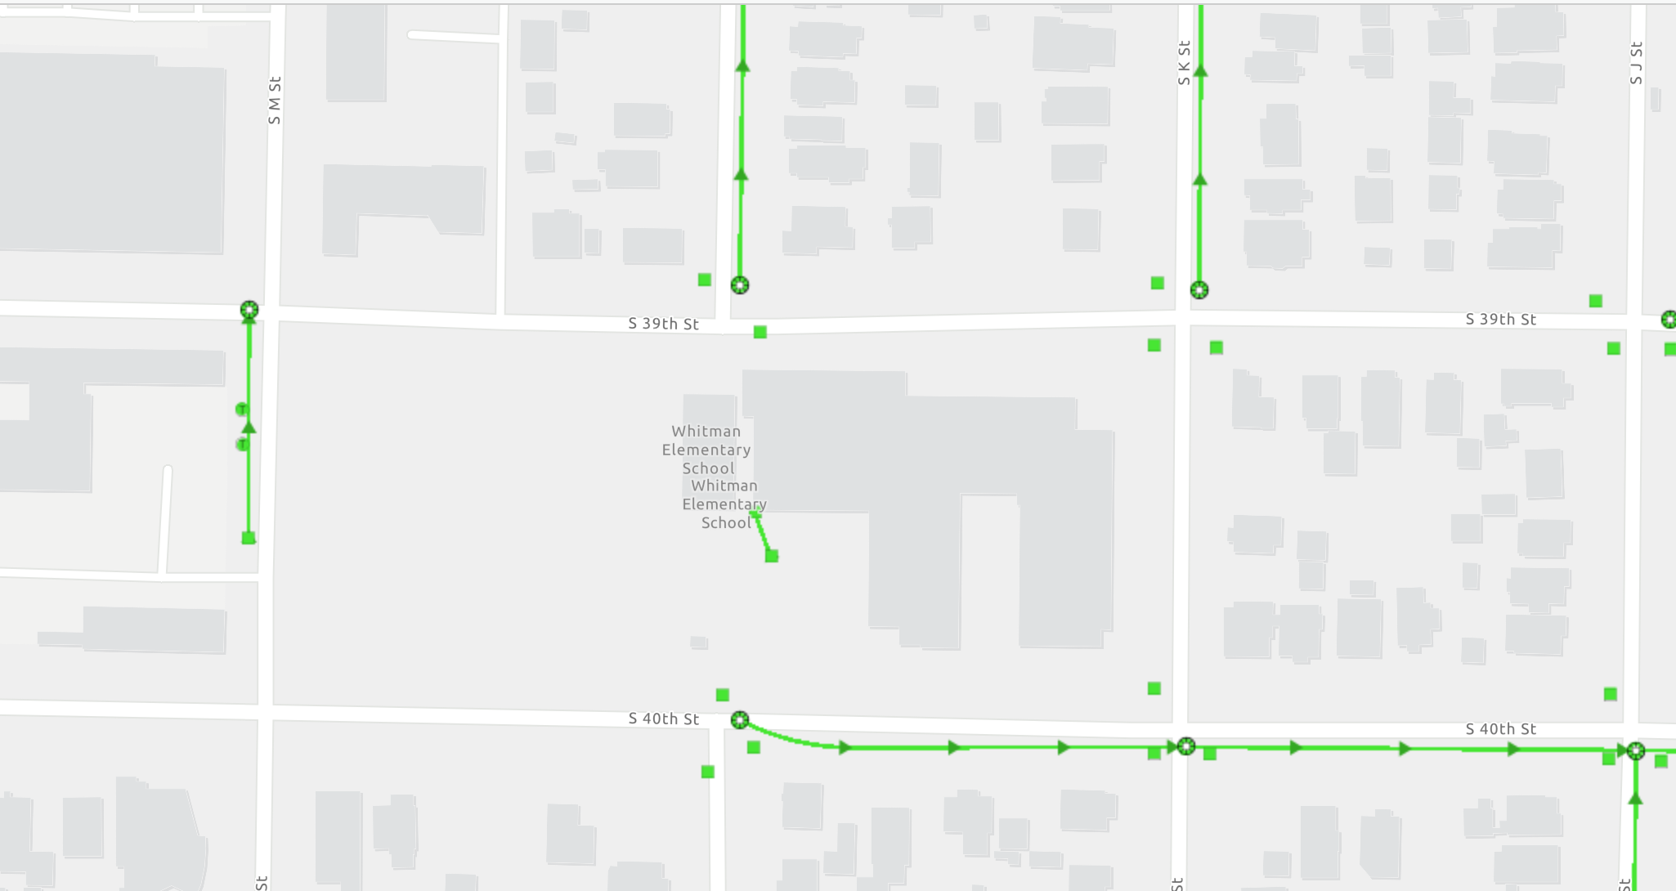
Whitman Elementary Where does your school’s stormwater go?
Follow the lines and arrows!

Slide 10
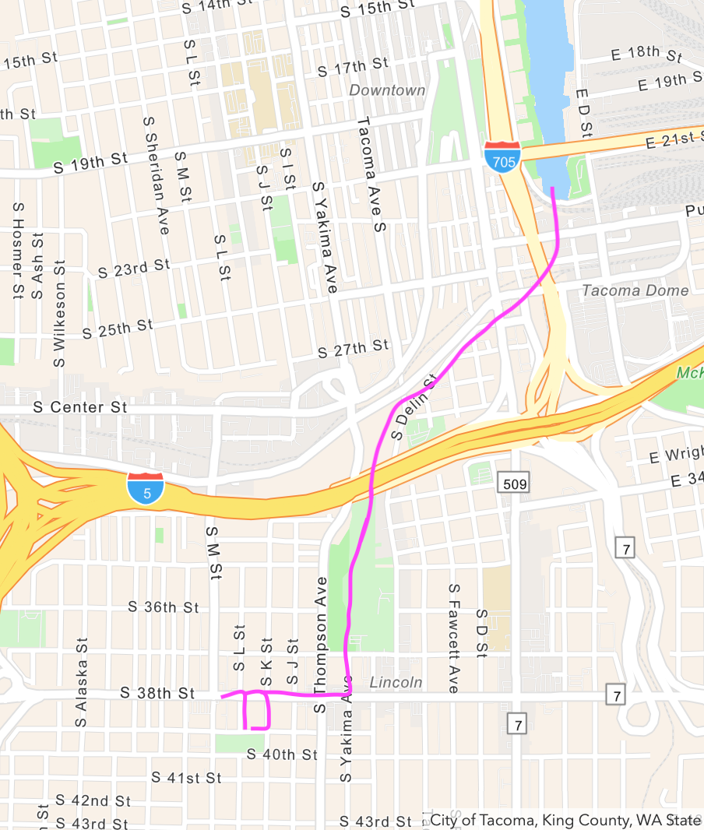
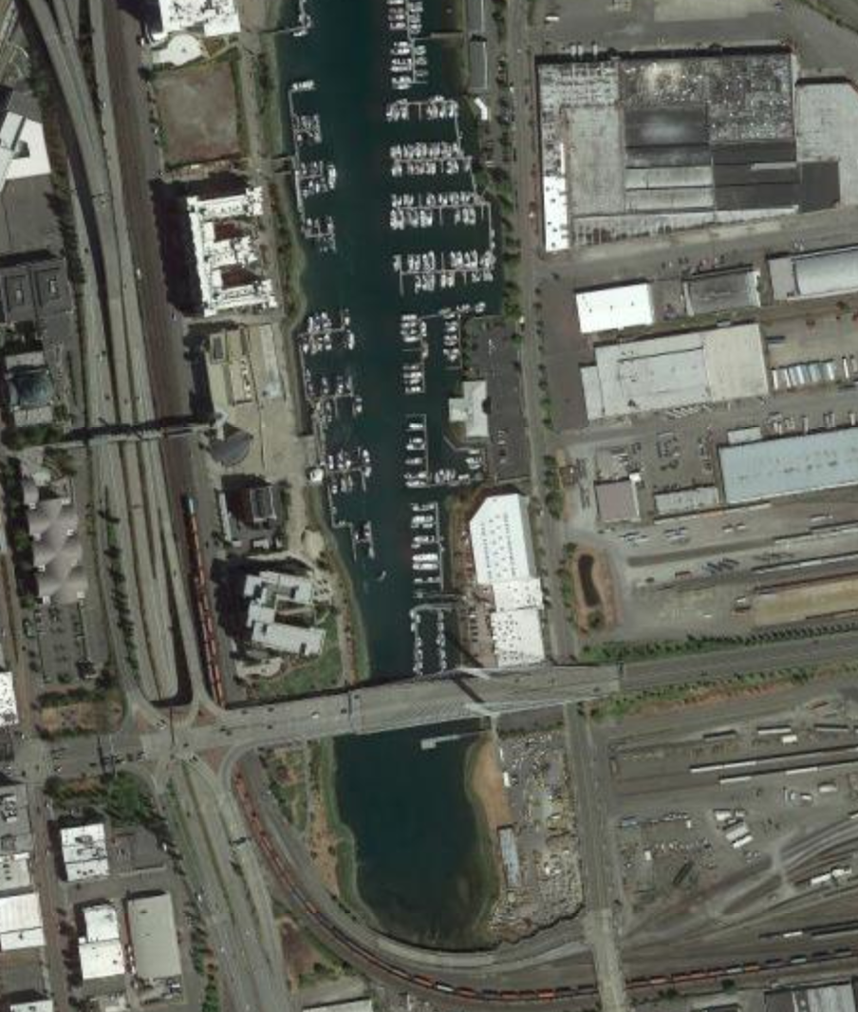
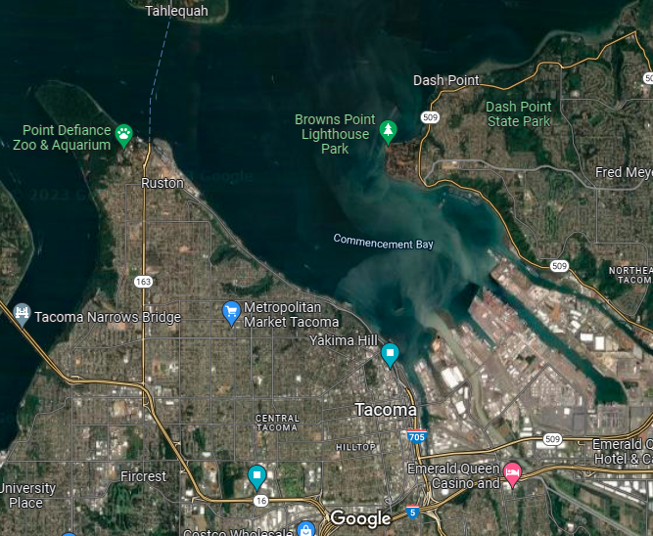


Now follow the pink line away from your school (find your school by looking for the star) to see how it gets to the Salish Sea!

Slide 11


How did we figure this out?
To view this map on your own, go here:
https://tacoma.maps.arcgis.com/home/webmap/viewer.html?layers=23e9a402b47d46058193362cb6c27a9e
View in “Map Classic”
Check “Surfacewater Network” box
Put in the name of the school
Zoom IN to see the green lines

Slide 12
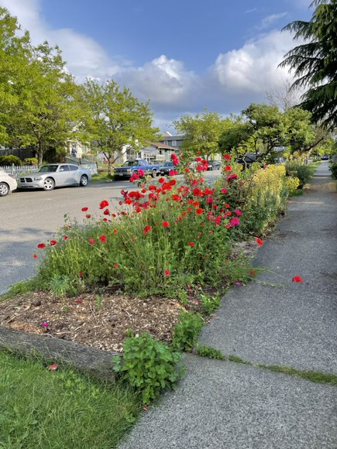
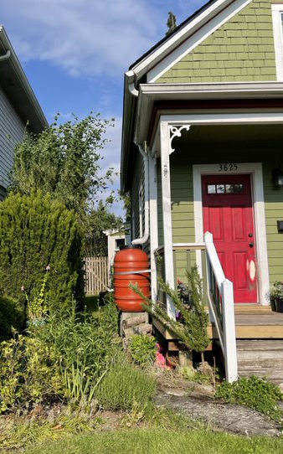
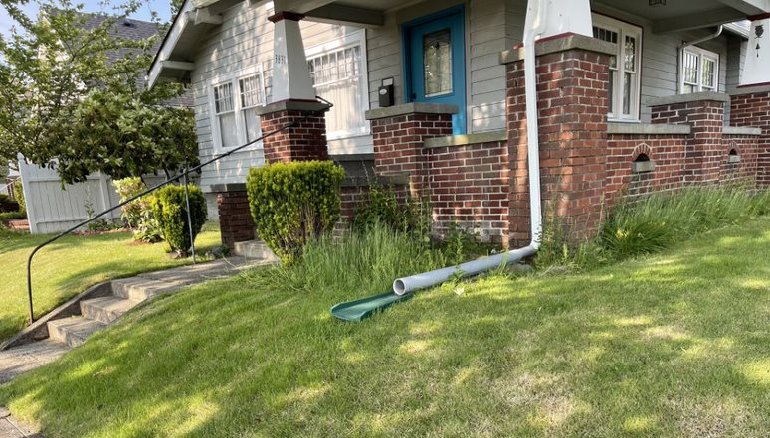
Optional: Stormwater in Our Community
Use these points of interest as suggestions for students exploring their neighborhoods or the area near the school, recognizing there may be other things of importance to note that aren’t shown here.
Suggested Points of Interest - Left to Right:
“Disconnected downspout” (water is allowed to soak into grass instead of entering pipes underground)
Rain barrel (water from roof goes into container to be used for gardening)
Garden in sidewalk planting strip (bushes, flowers, etc and mulch/woodchips tend to handle stormwater better than grass or gravel)

