Slide 1


Community Waters School Guide:
Manitou Park Elementary
How to Use This Guide
This School Guide supports the Community Waters Science Unit Teacher Manual with information, maps, and images specific to your school and neighborhood.
It is written for teachers - its goal is to provide a better understanding of what is happening with stormwater in and around your school.
All content within may change, and can be adapted as desired.
If you have any questions about these maps, accompanying lessons, or stormwater around your school, contact IslandWood staff at communitywaters@IslandWood.org.

Slide 2
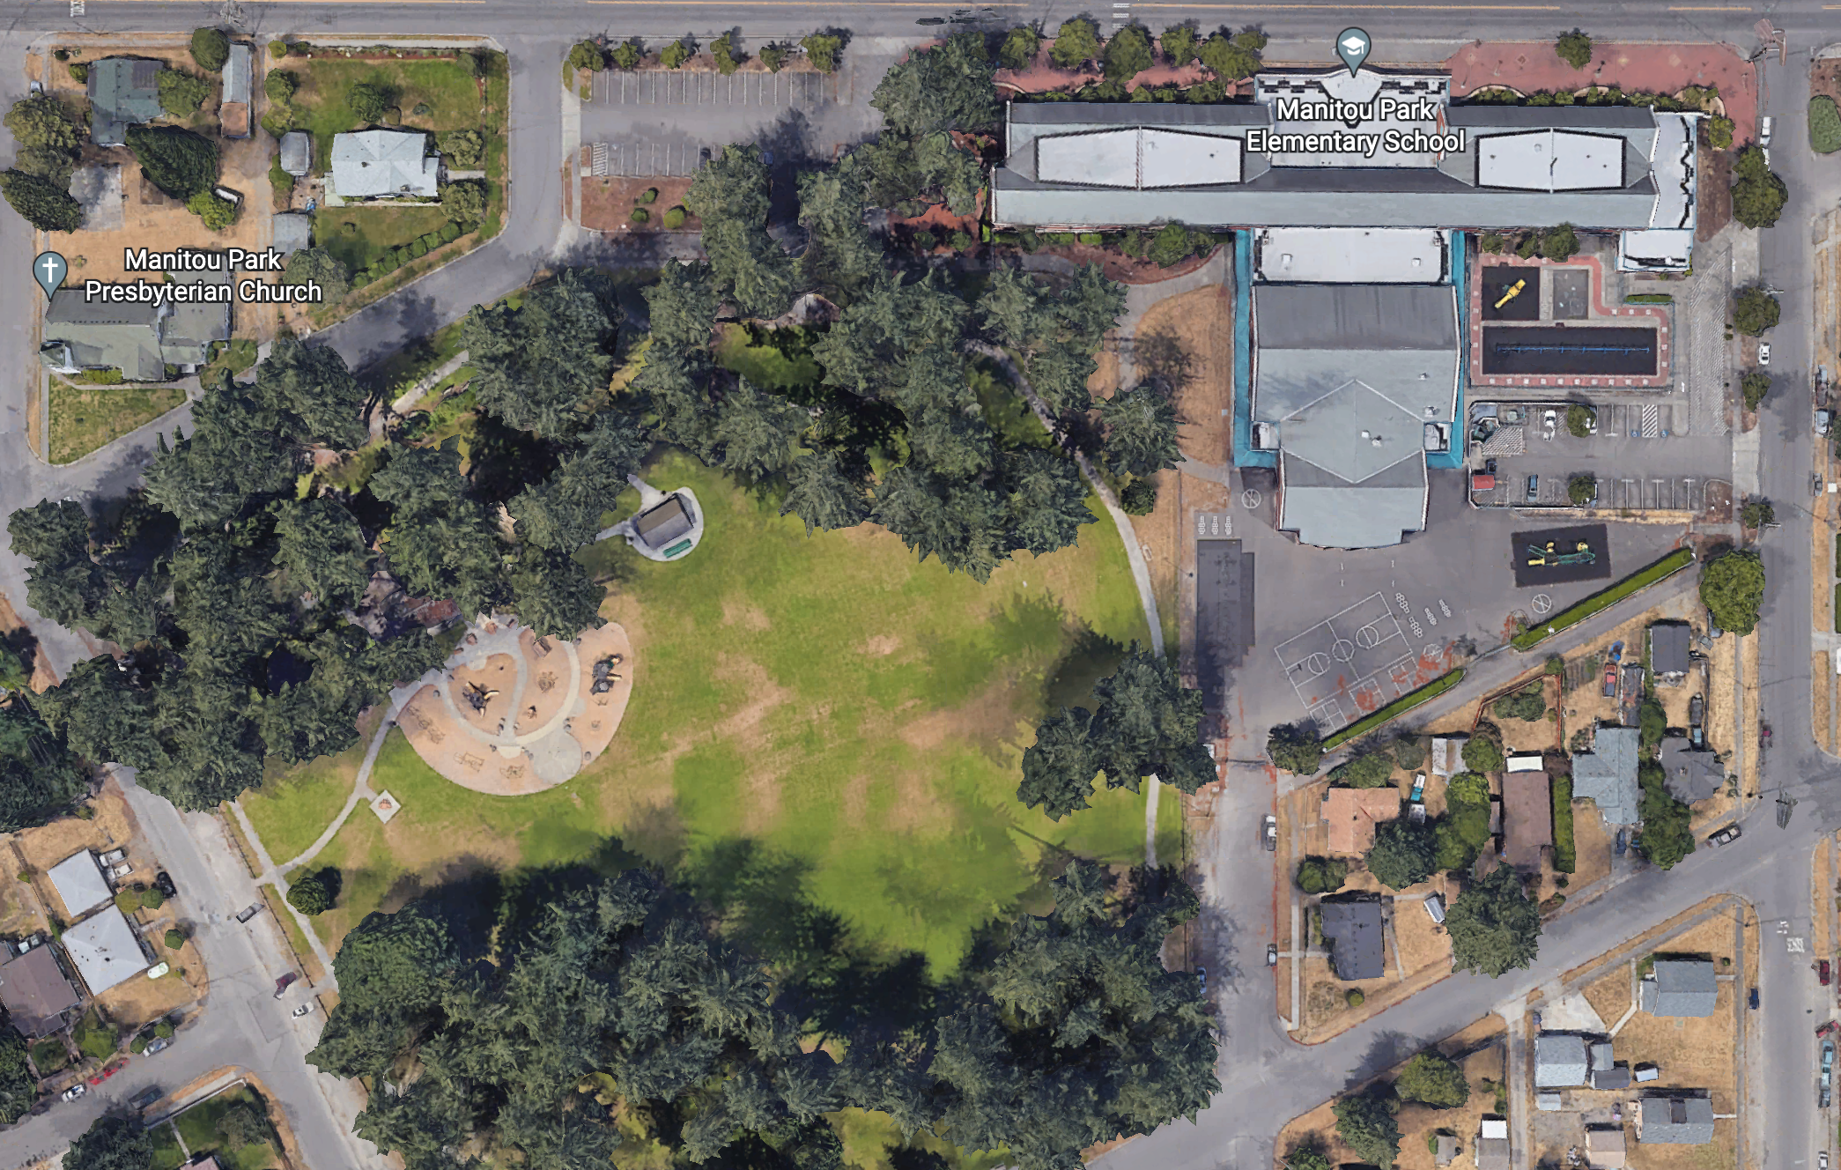
Stormwater in Our Schoolyard from Lesson 2
C
A
B

Slide 3
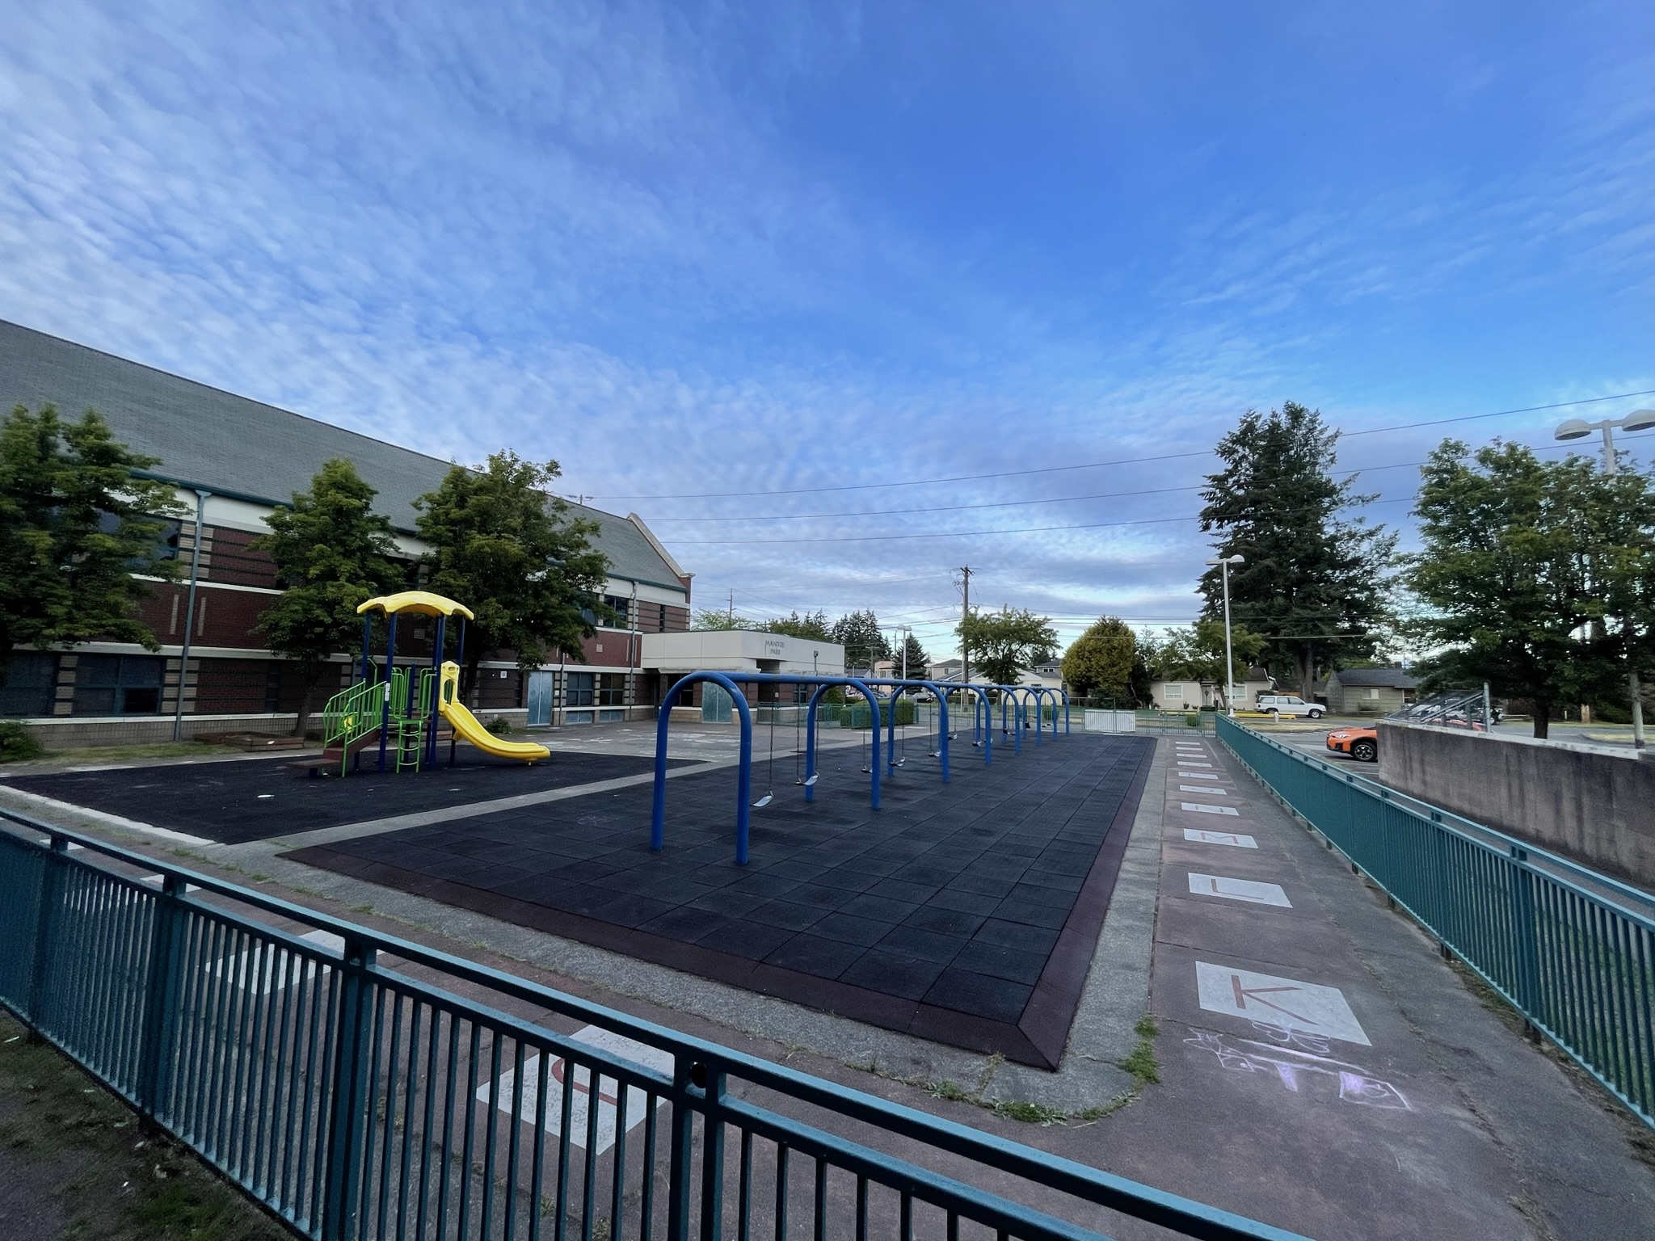
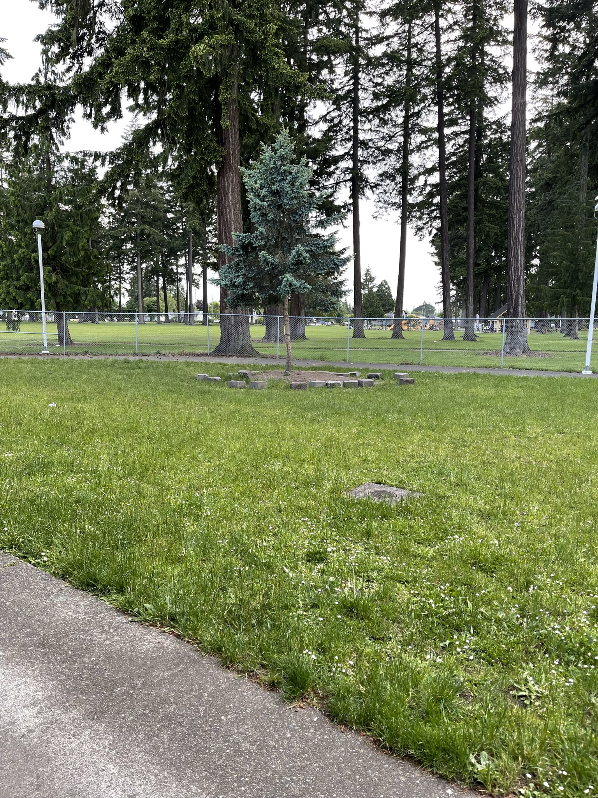
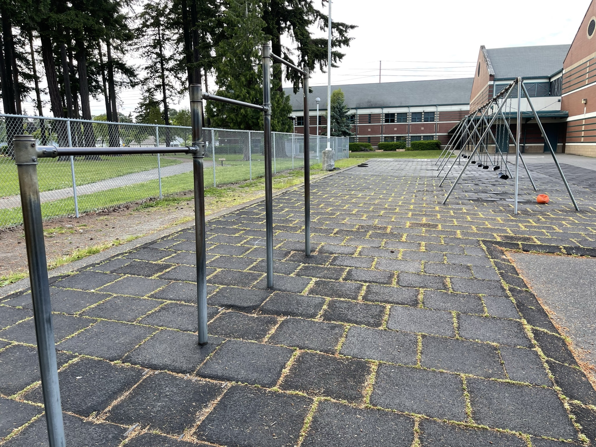
Schoolyard stormwater points of interest
A
B
B. Field surfaces - How pervious is this soil? Test it with some water – If it doesn’t soak in quickly, is it mostly impervious because of being compacted?
Do puddles often form here at the bottom of the hill or other low places?
A
A. Playground/recess surfaces – Note what directions water flows off these different surfaces. Are they pervious or impervious?
Can you find where the water would collect or puddle or drain in a heavy rain?

Slide 4
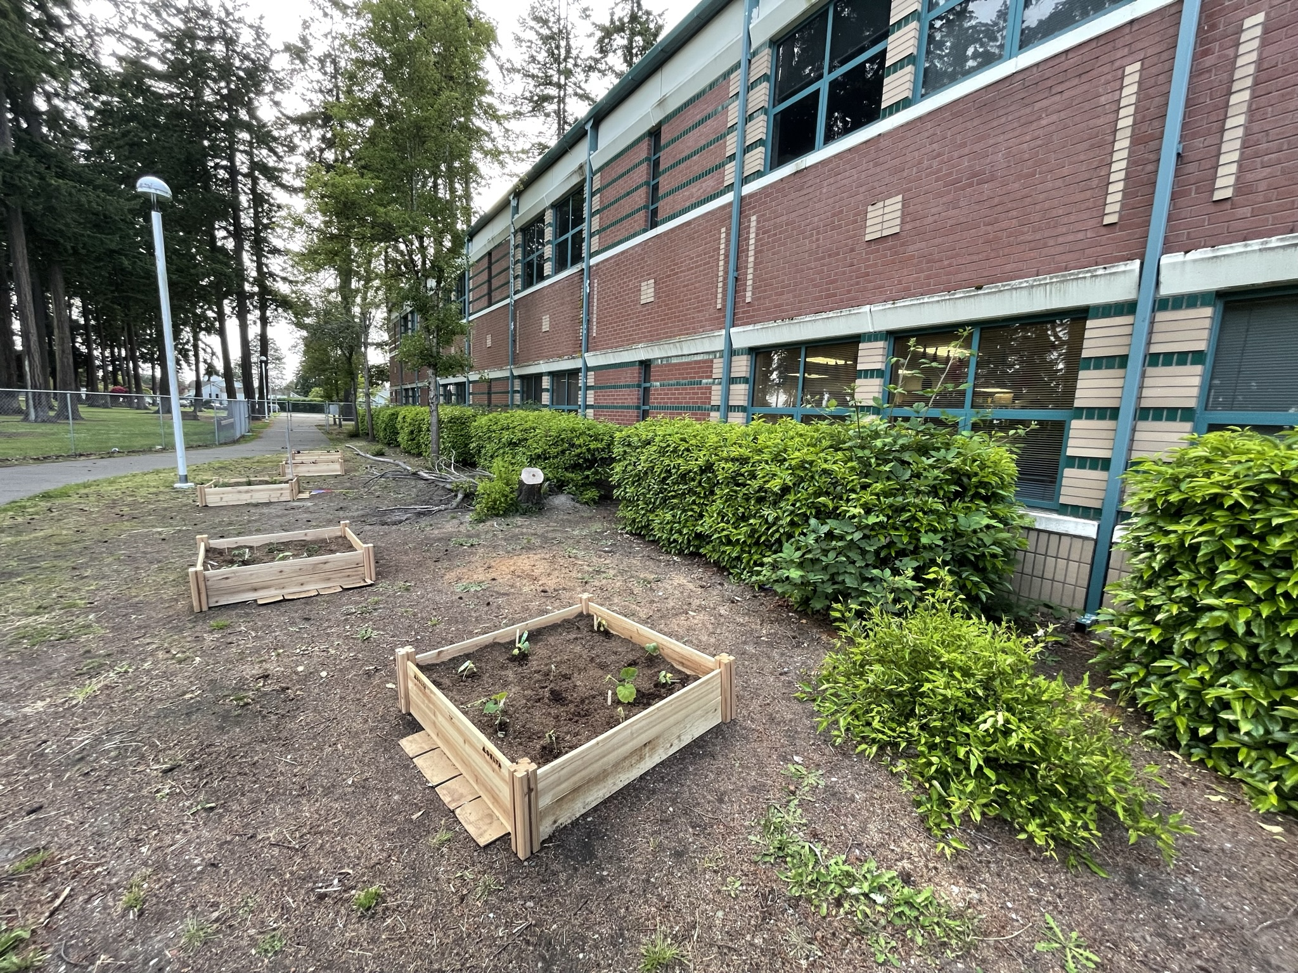
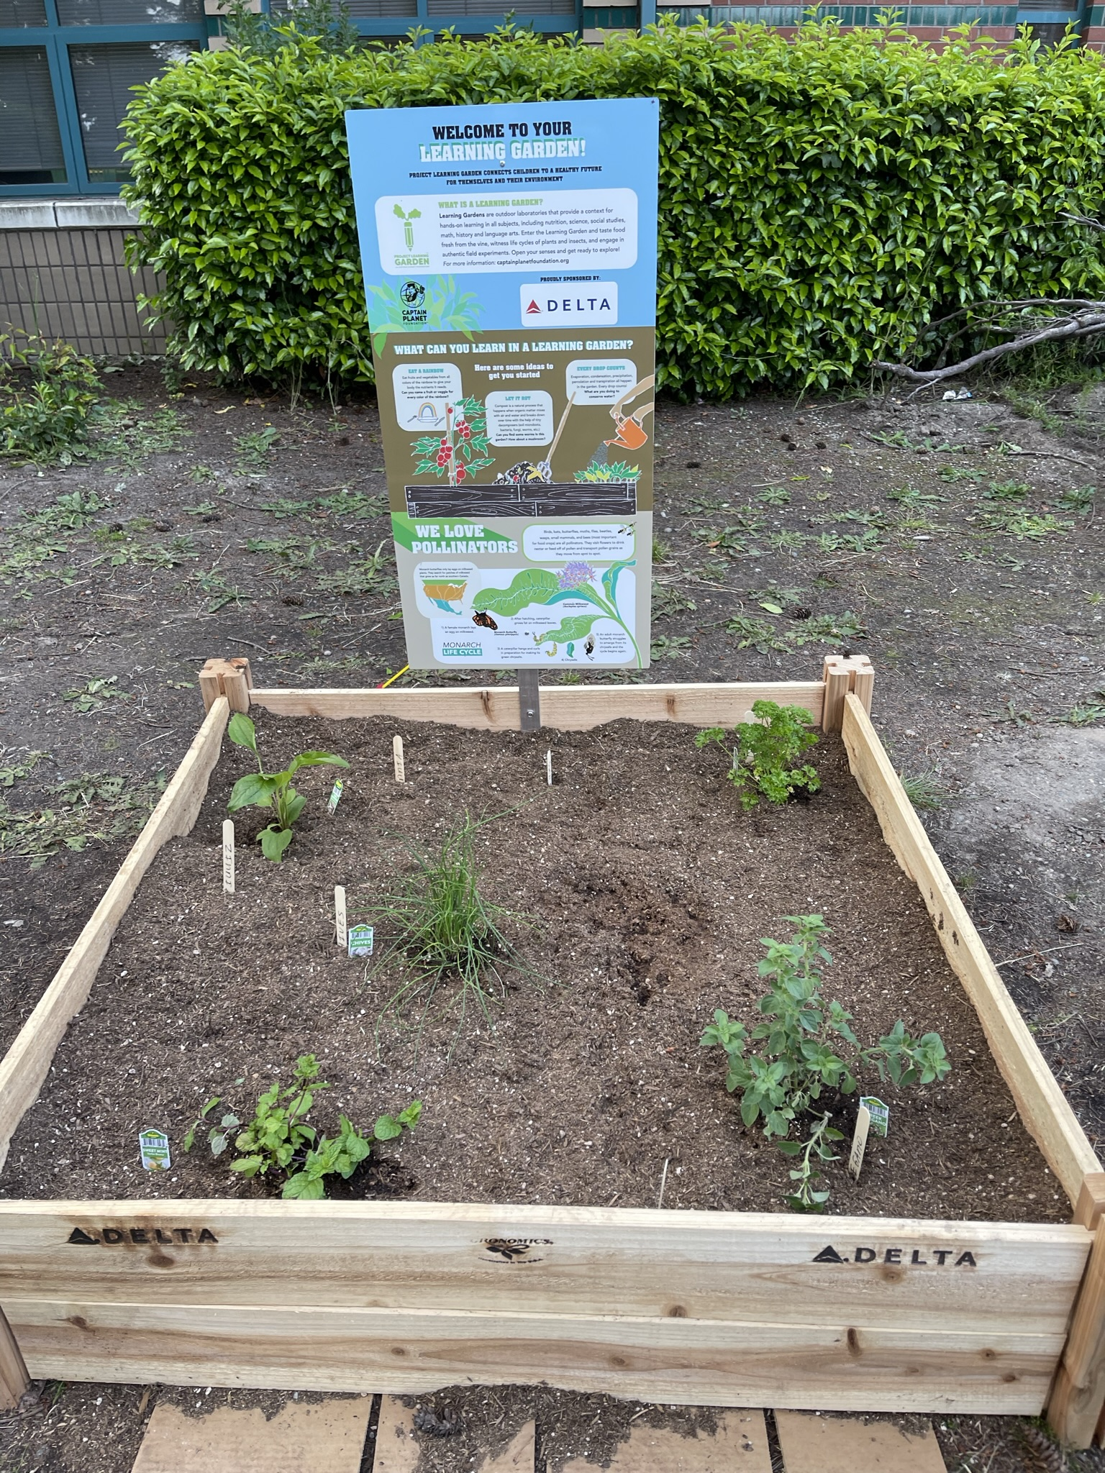
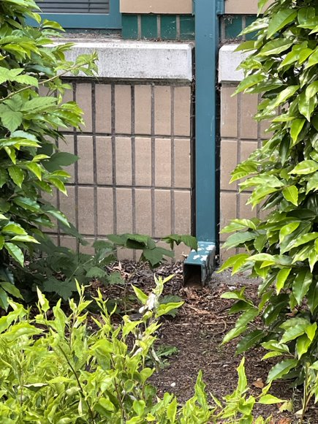
Schoolyard stormwater points of interest
C. Garden beds -
How does this area interact with heavy rain?
Are there other areas that might help water soak into the ground instead of going into drains? How is this area used? What do students notice here?
Can you find this “disconnected” downspout? It’s disconnected from the stormwater pipes underground and that allows water to soak naturally into the soil.

Slide 5
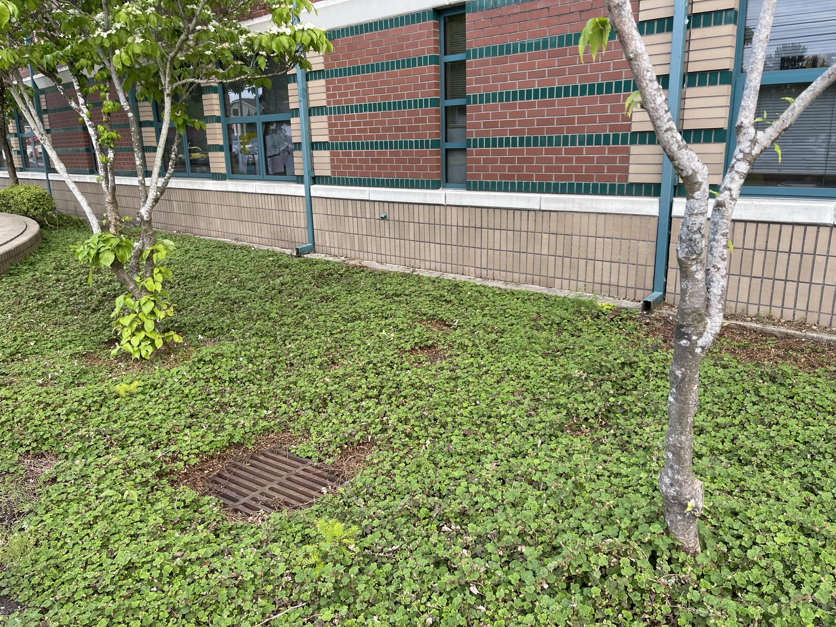
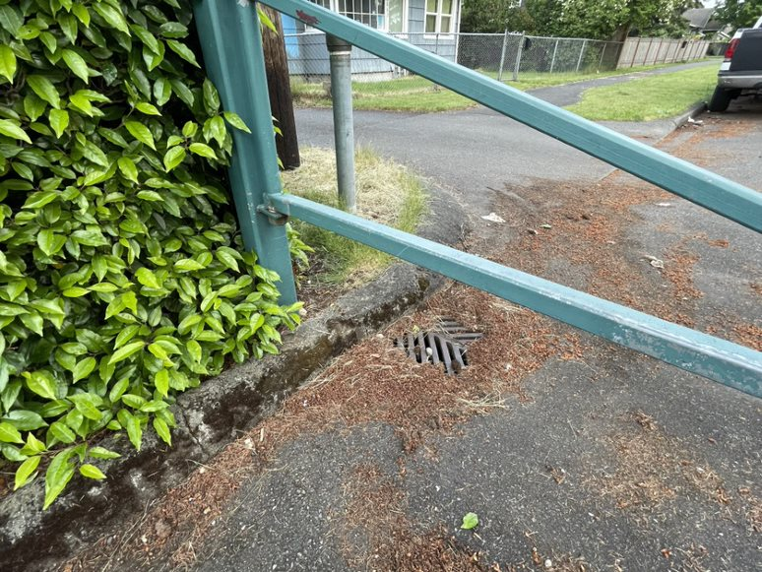
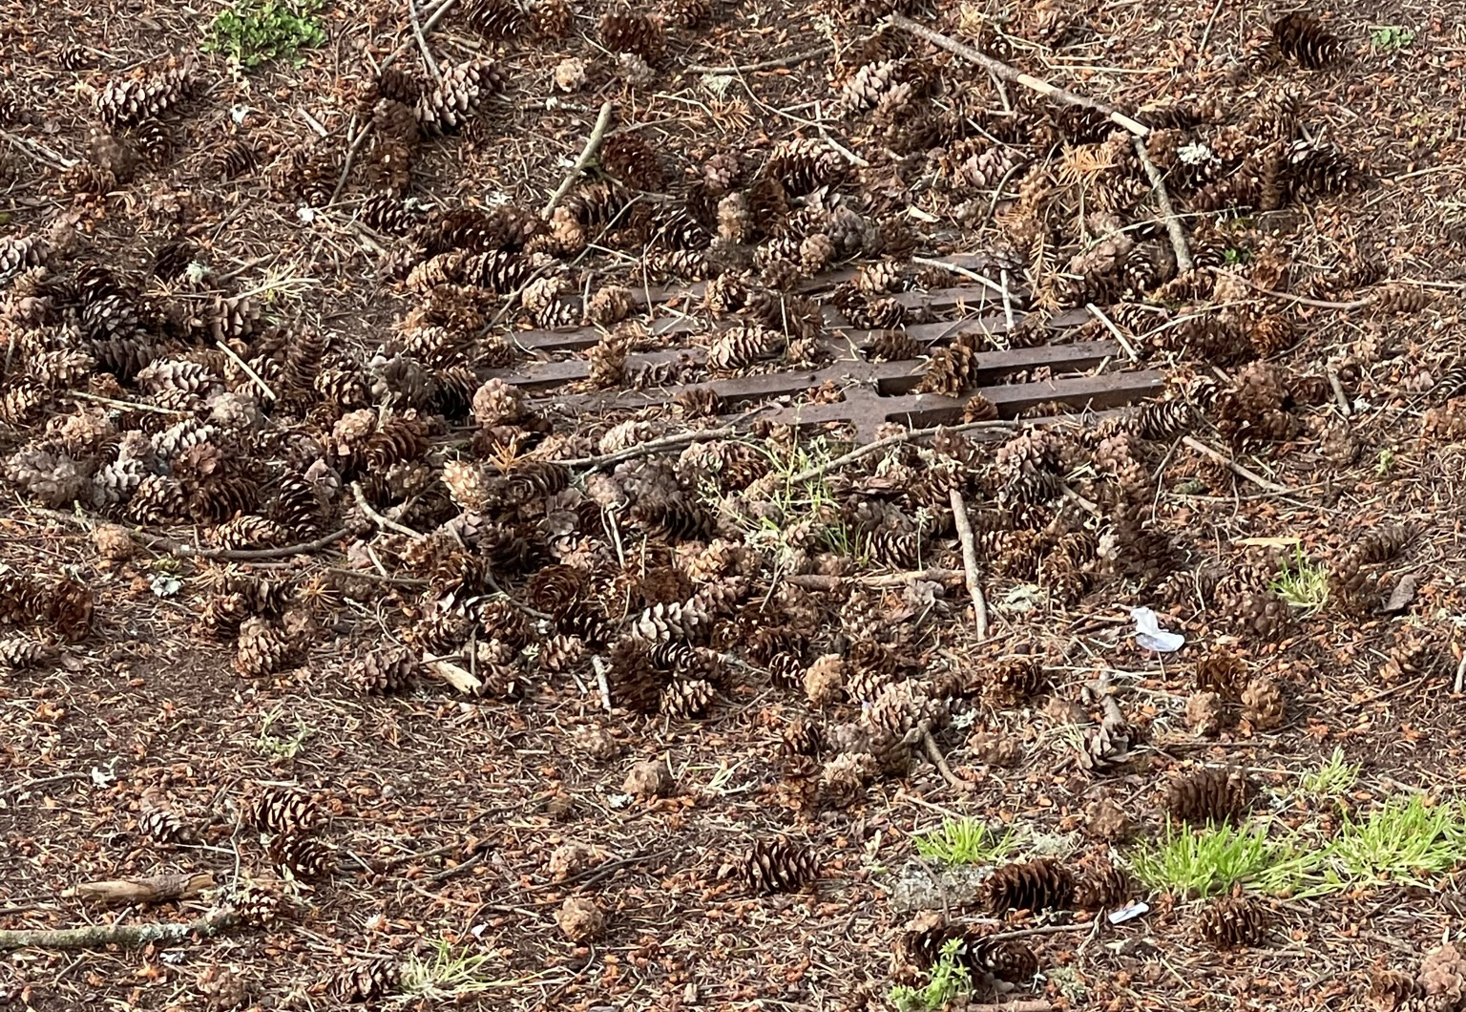
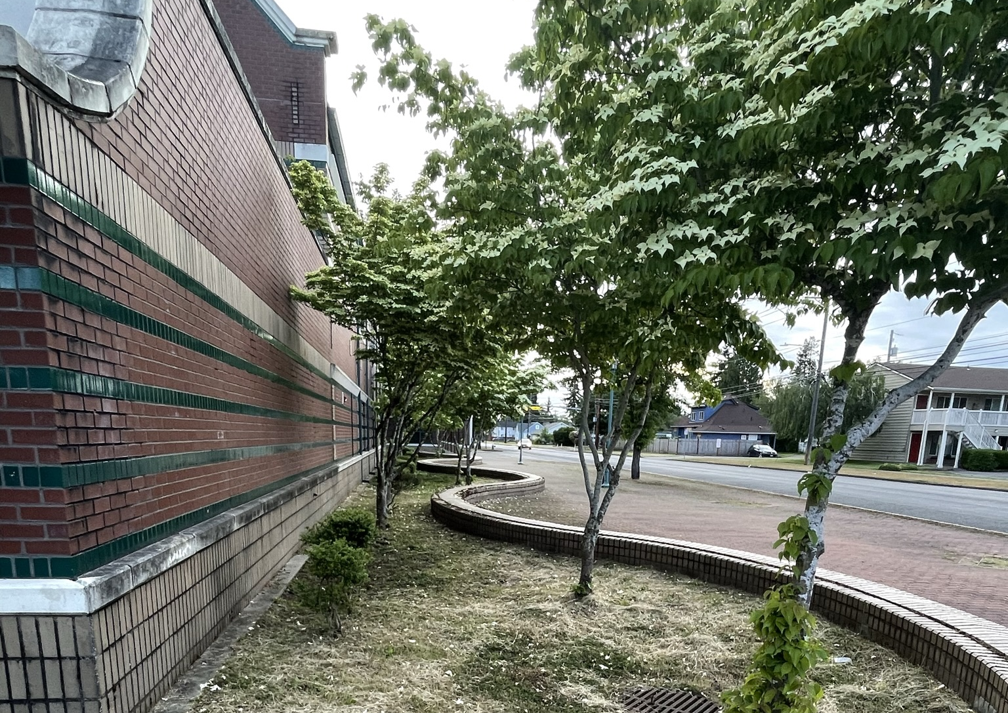
Schoolyard stormwater points of interest
Storm Drains – Note how some drains are surrounded by grass/plants. Why might this drain have been put here? What might happen to stormwater here?
Where else can you find storm drains, and what do you notice near, in or on top them?

Slide 6
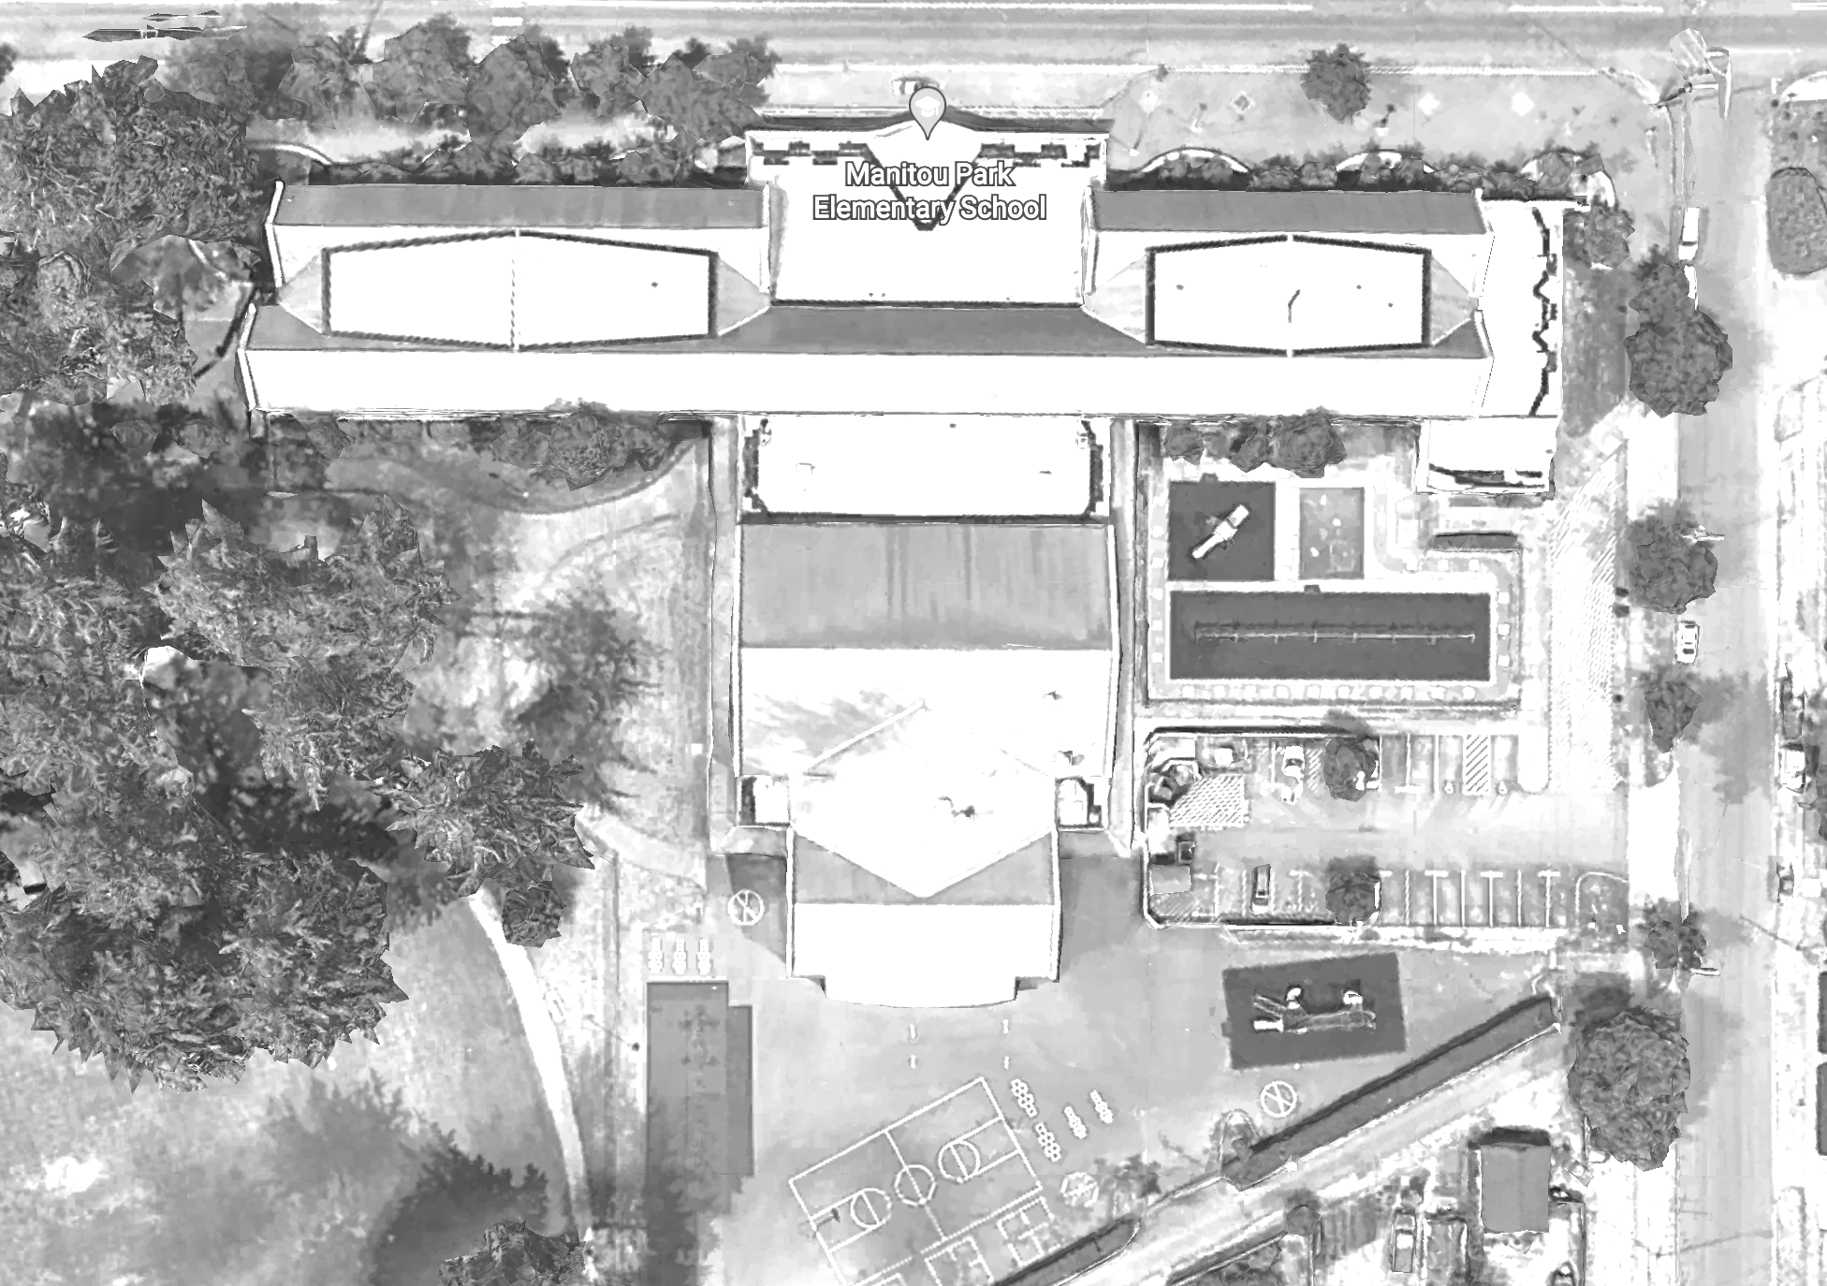


Mapping Your Schoolyard – Manitou Park Elementary Name: _________ Date: _________
Include on your map:
Symbols from the Key including flow of water, erosion, and storm drains.
Show where you see any evidence of possible stormwater problems (this could be places where there's lots of erosion or big puddles, or oil from cars, etc).
Add larger plants and bushes if they are there.
Notes:
PRINT THIS PAGE for the STUDENT WORKSHEET

Slide 7
Local Stormwater Systems
What happens with the stormwater around your school?
Where does your stormwater runoff end up?
The stormwater from your school ends up in Flett Creek and then Chambers Creek.
Your school is in the Flett Creek Watershed.
First, stormwater travels east on S 66th Street, then (appears to) discharge into a stormwater pond at STAR Center. Excess stormwater then likely travels south towards Flett Pond, then towards Flett Creek and Chambers Creek. Finally, it discharges into Chambers Bay and/or Puget Sound.
Flett Creek covers 7,153 acres and is the second largest subwatershed in Tacoma and is mostly residential with light commercial and industrial areas.
The Flett Creek surface water drains through a series of holding basins, including Hosmer, Ward’s Lake, a gravel holding basin just north of Ward’s Lake and the four Flett Creek holding basins in the west. At the last Flett Creek holding basin a pump station sends the water to the Flett Dairy wetlands, where it flows into Flett Creek. Downstream, Flett Creek flows into Chambers Creek, a salmonid-bearing stream, which discharges into Chambers Bay then to the Narrows.
https://www.cityoftacoma.org/cms/One.aspx?portalId=169&pageId=2860#Flett%20Creek
Notes:
Please Note: The pipes information provided here is our best estimate of the stormwater flow in your community based on the information we have currently. If you encounter more information in the course of your investigation, please let us know so we can update future versions of this document.

Slide 8
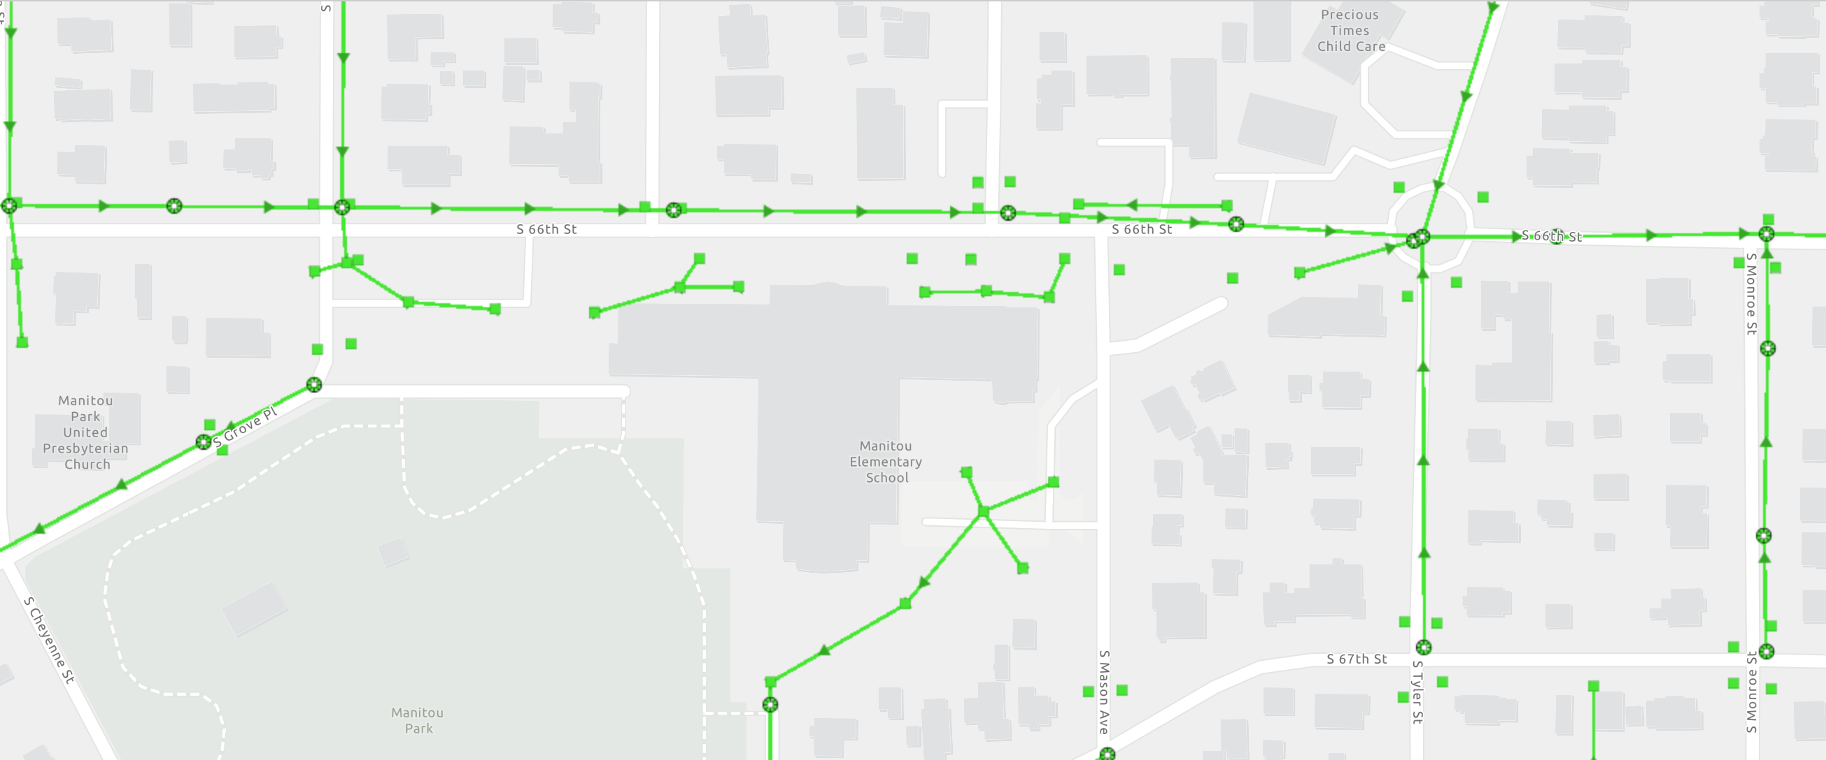
Manitou Park Elementary Where does your school’s stormwater go?
Follow the lines and arrows!

Slide 9
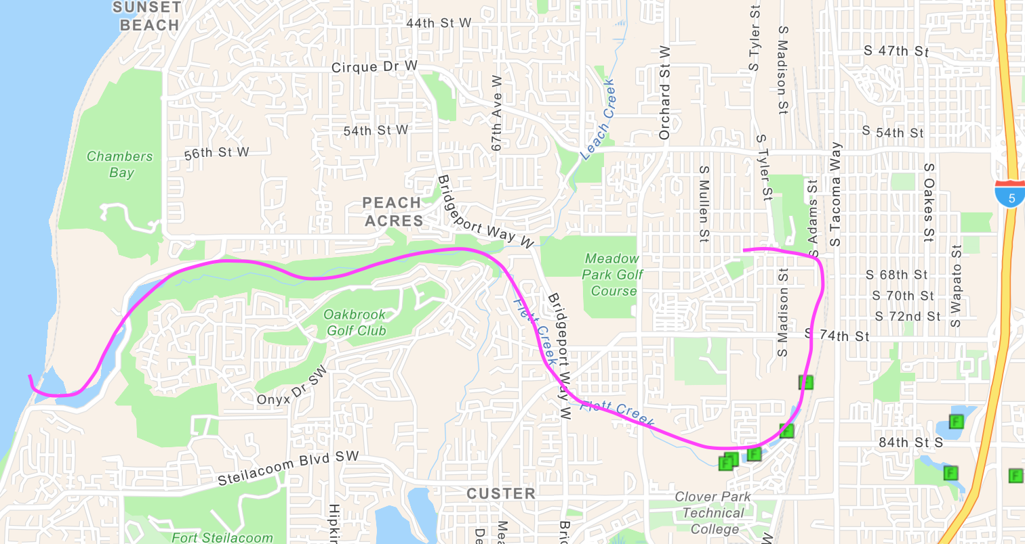
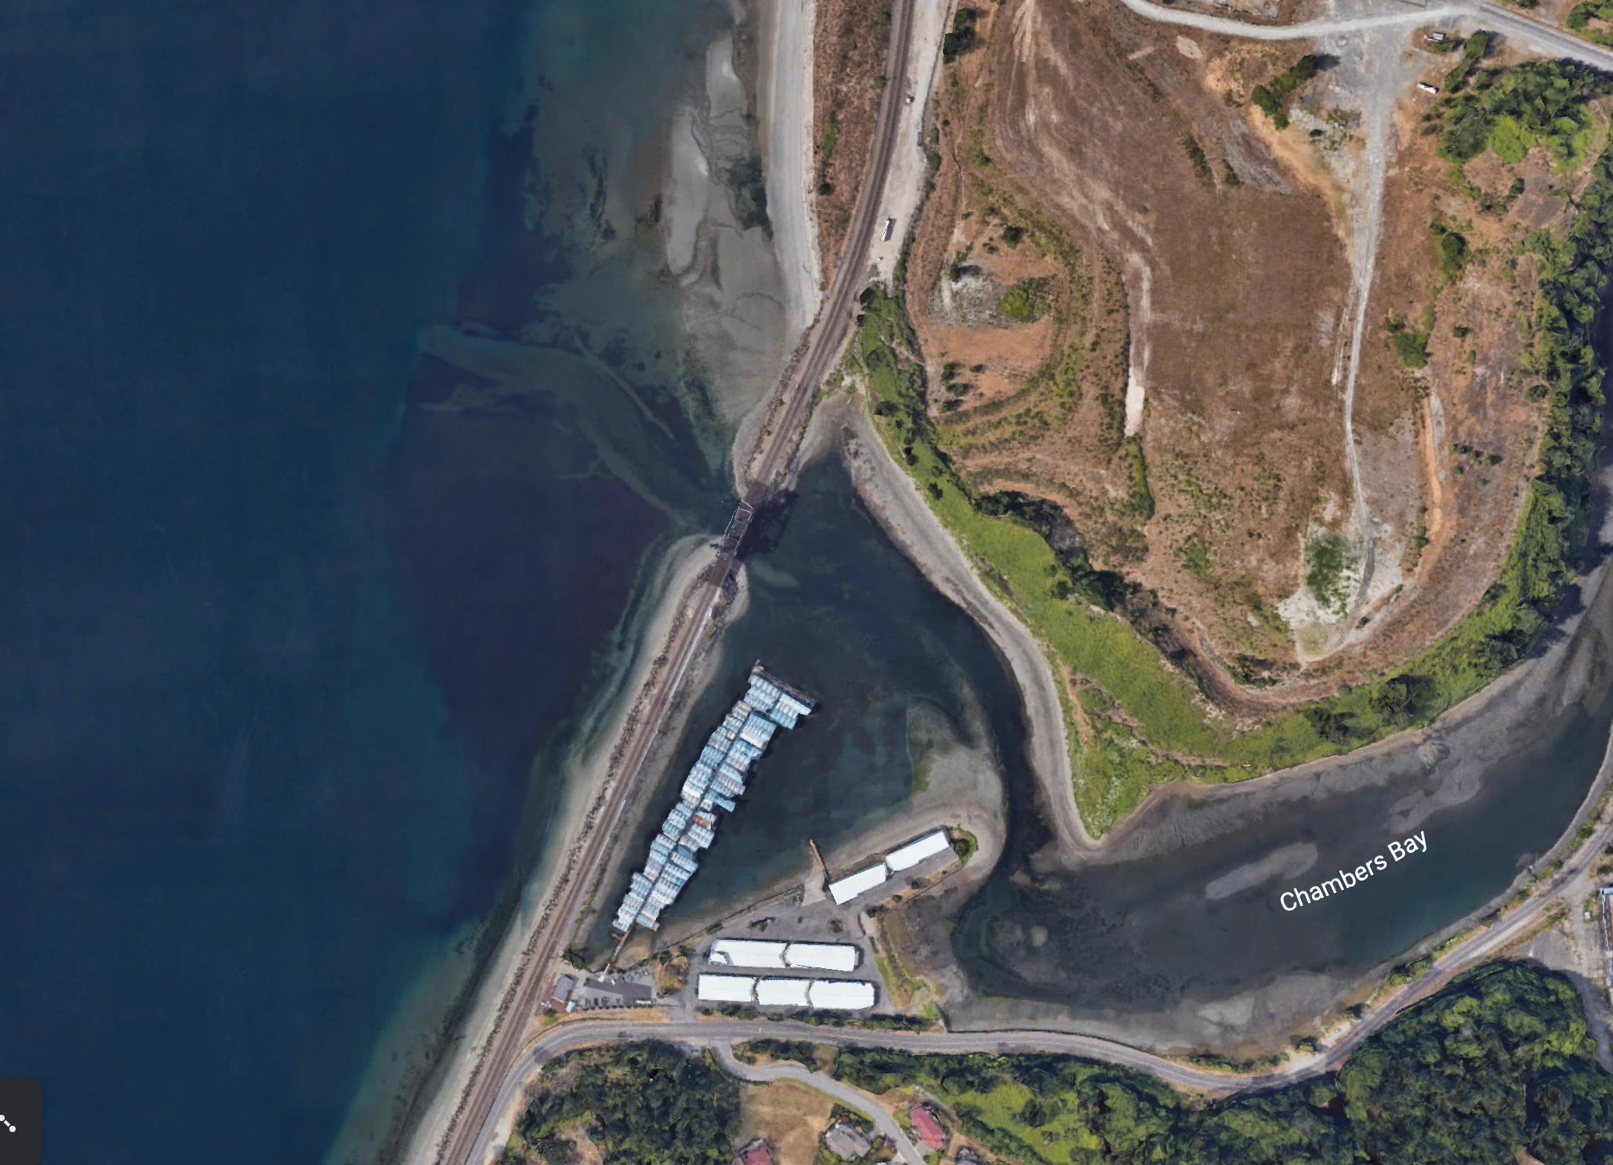
Now follow the pink line away from your school (find your school by looking for the star) to see how it gets to the Salish Sea!

Slide 10


How did we figure this out?
To view this map on your own, go here:
https://tacoma.maps.arcgis.com/home/webmap/viewer.html?layers=23e9a402b47d46058193362cb6c27a9e
View in “Map Classic”
Check “Surfacewater Network” box
Put in the name of the school
Zoom IN to see the green lines

Slide 11
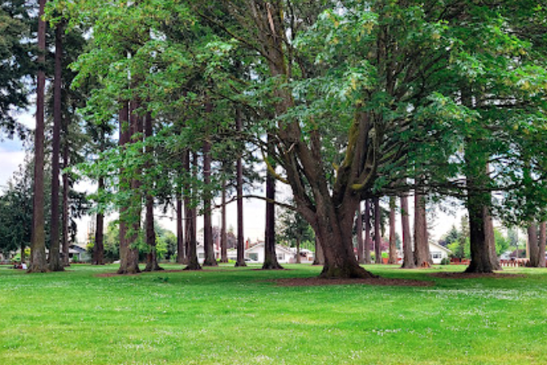
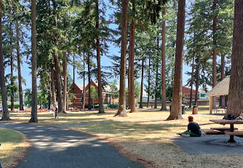
Optional: Stormwater in Our Community
Use this map and/or points of interest as suggestions for students exploring their neighborhoods or the area near the school, recognizing there may be other things of importance to note that aren’t shown here.
Suggested Points of Interest: Manitou Park! There are lots of older trees here! Take a walk through the park to see if you see signs of erosion, puddles, water interacting with plants and animals, etc.

