Slide 1


Community Waters School Guide:
Crescent Heights
How to Use This Guide
This School Guide supports the Community Waters Science Unit Teacher Manual with information, maps, and images specific to your school and neighborhood.
It is written for teachers - its goal is to provide a better understanding of what is happening with stormwater in and around your school.
All content within may change, and can be adapted as desired.
If you have any questions about these maps, accompanying lessons, or stormwater around your school, contact IslandWood staff at communitywaters@IslandWood.org.

Slide 2
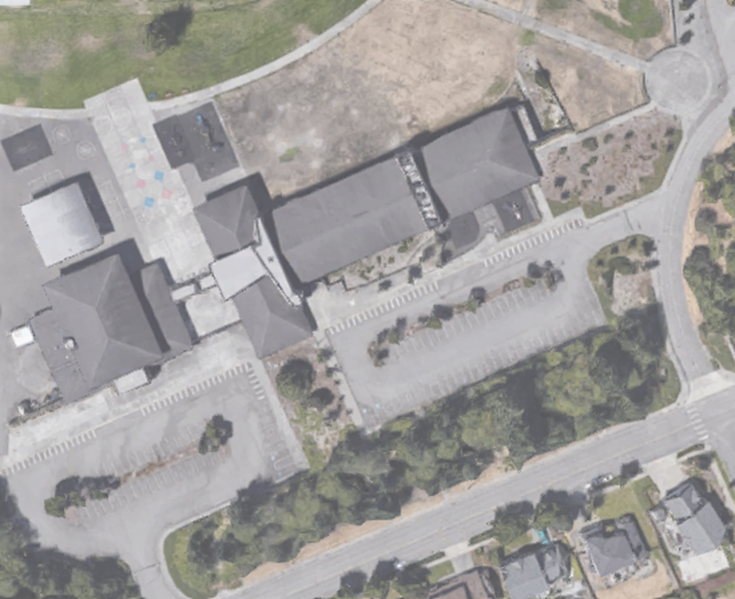
Stormwater in Our Schoolyard from Lesson 2
C
E
B
D
A

Slide 3
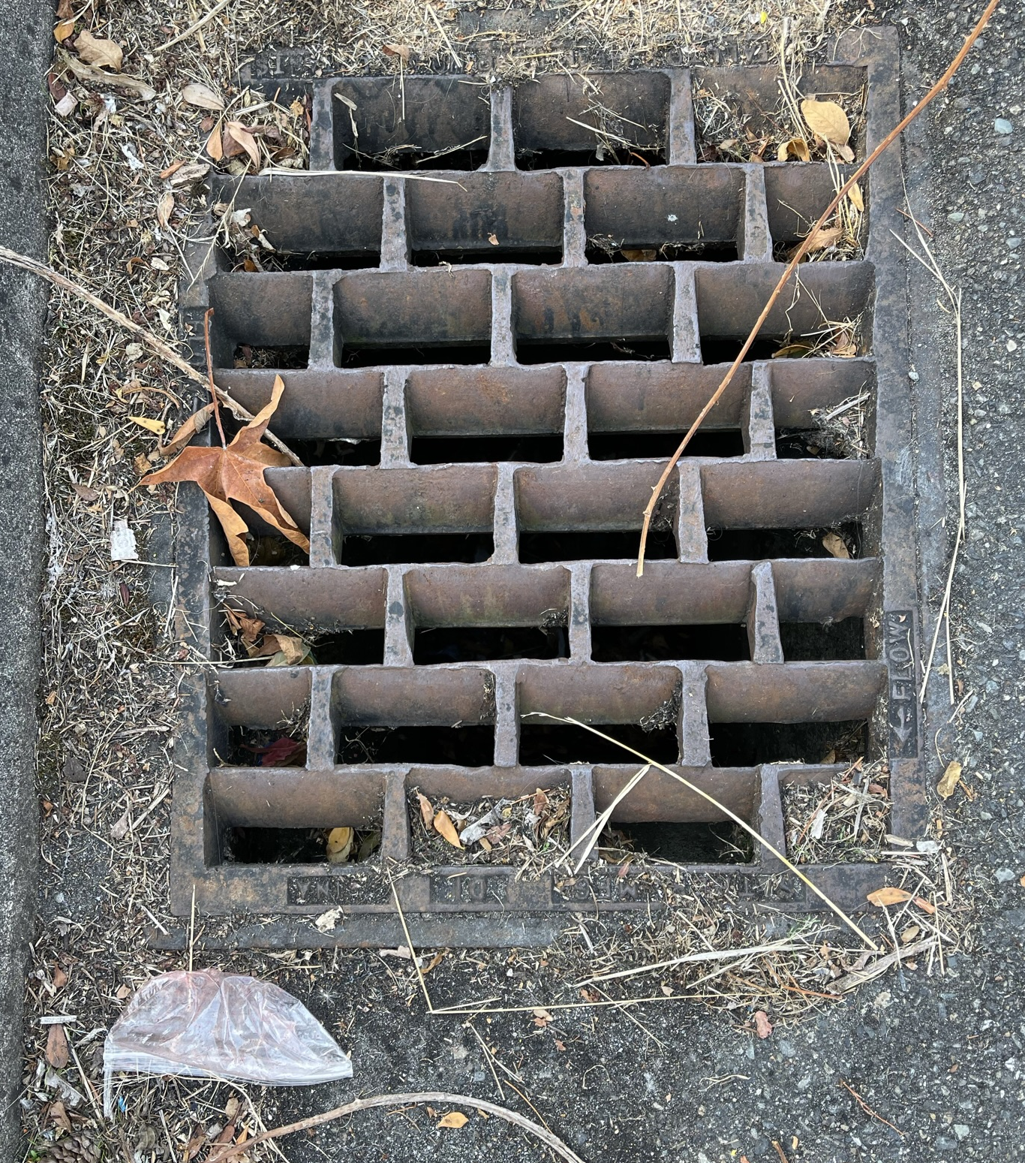
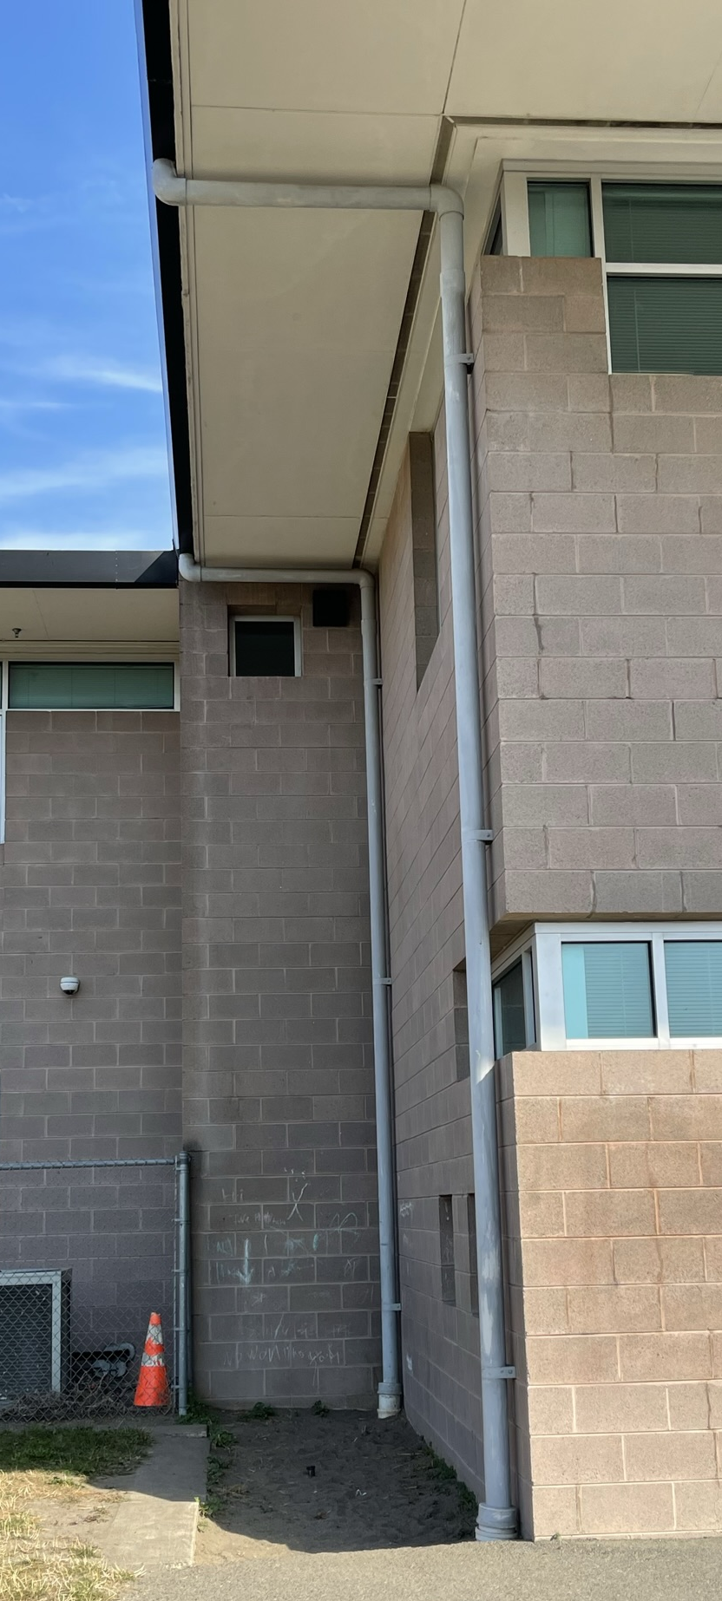
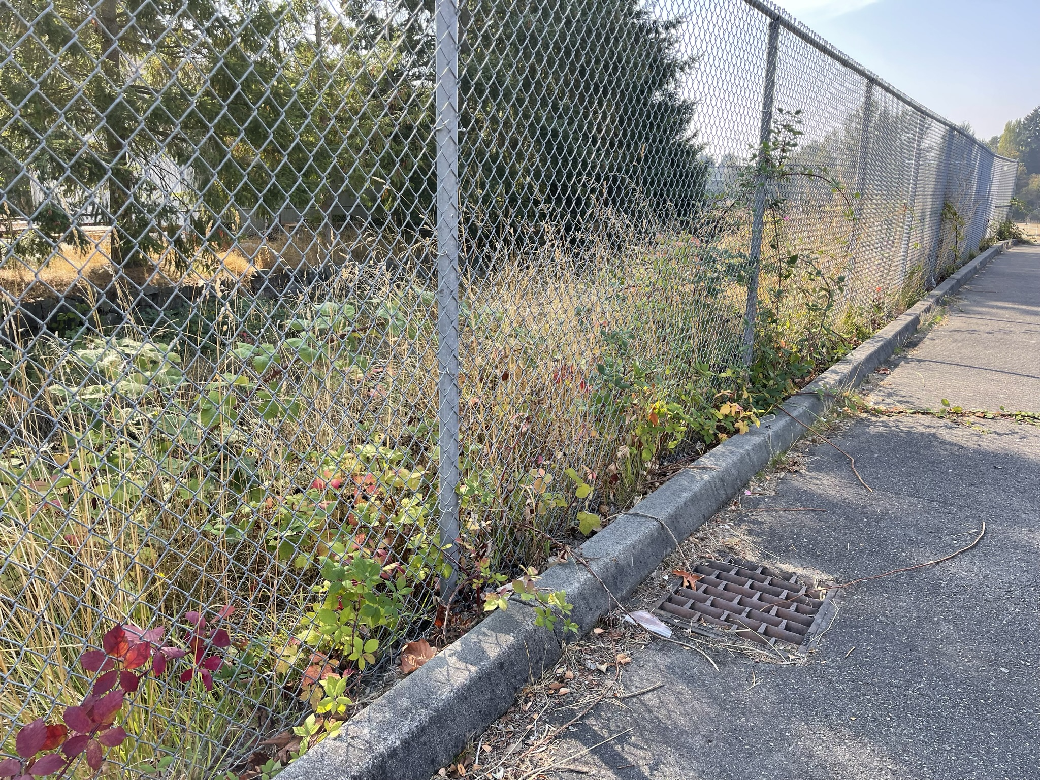
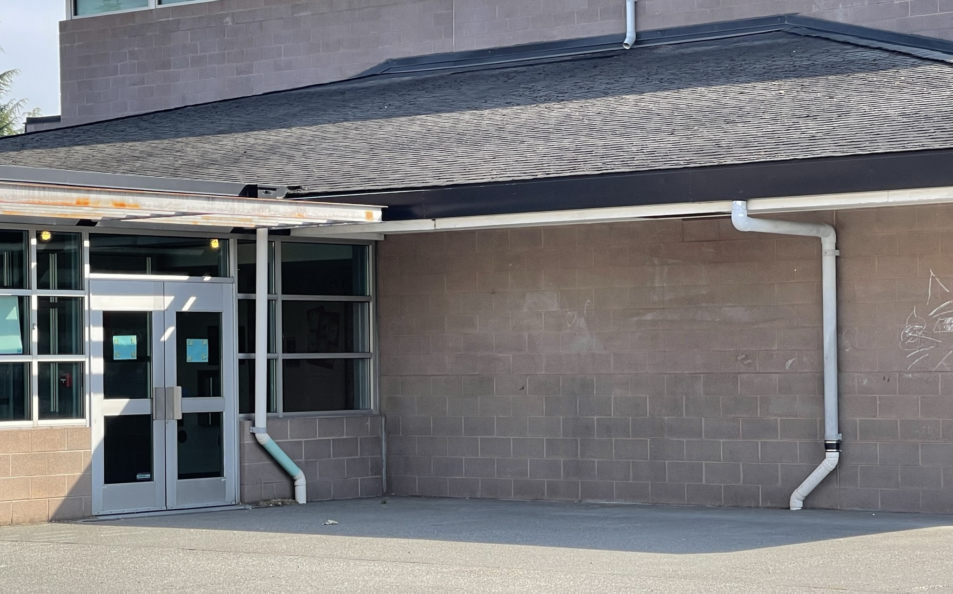
Schoolyard Stormwater Points of Interest
A. Storm Drain - notice the placement of this drain and the surfaces around it. Why might this drain have been put here? What might happen to stormwater here? Where else can you find storm drains?
B. Downspout - where does water flowing through this downspout go? Where does the water start?
A
B

Slide 4
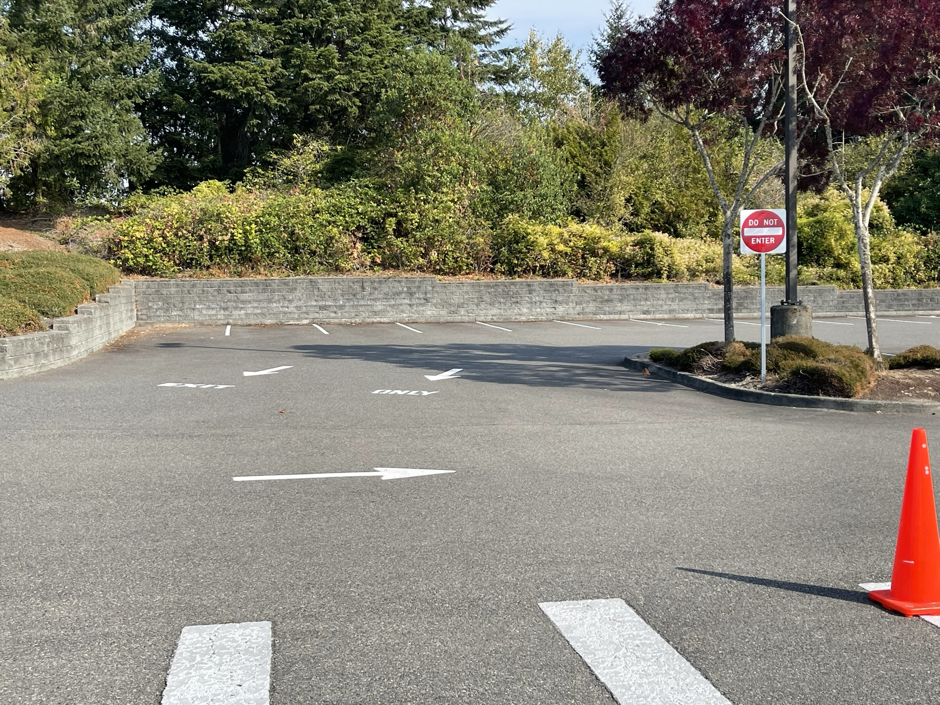
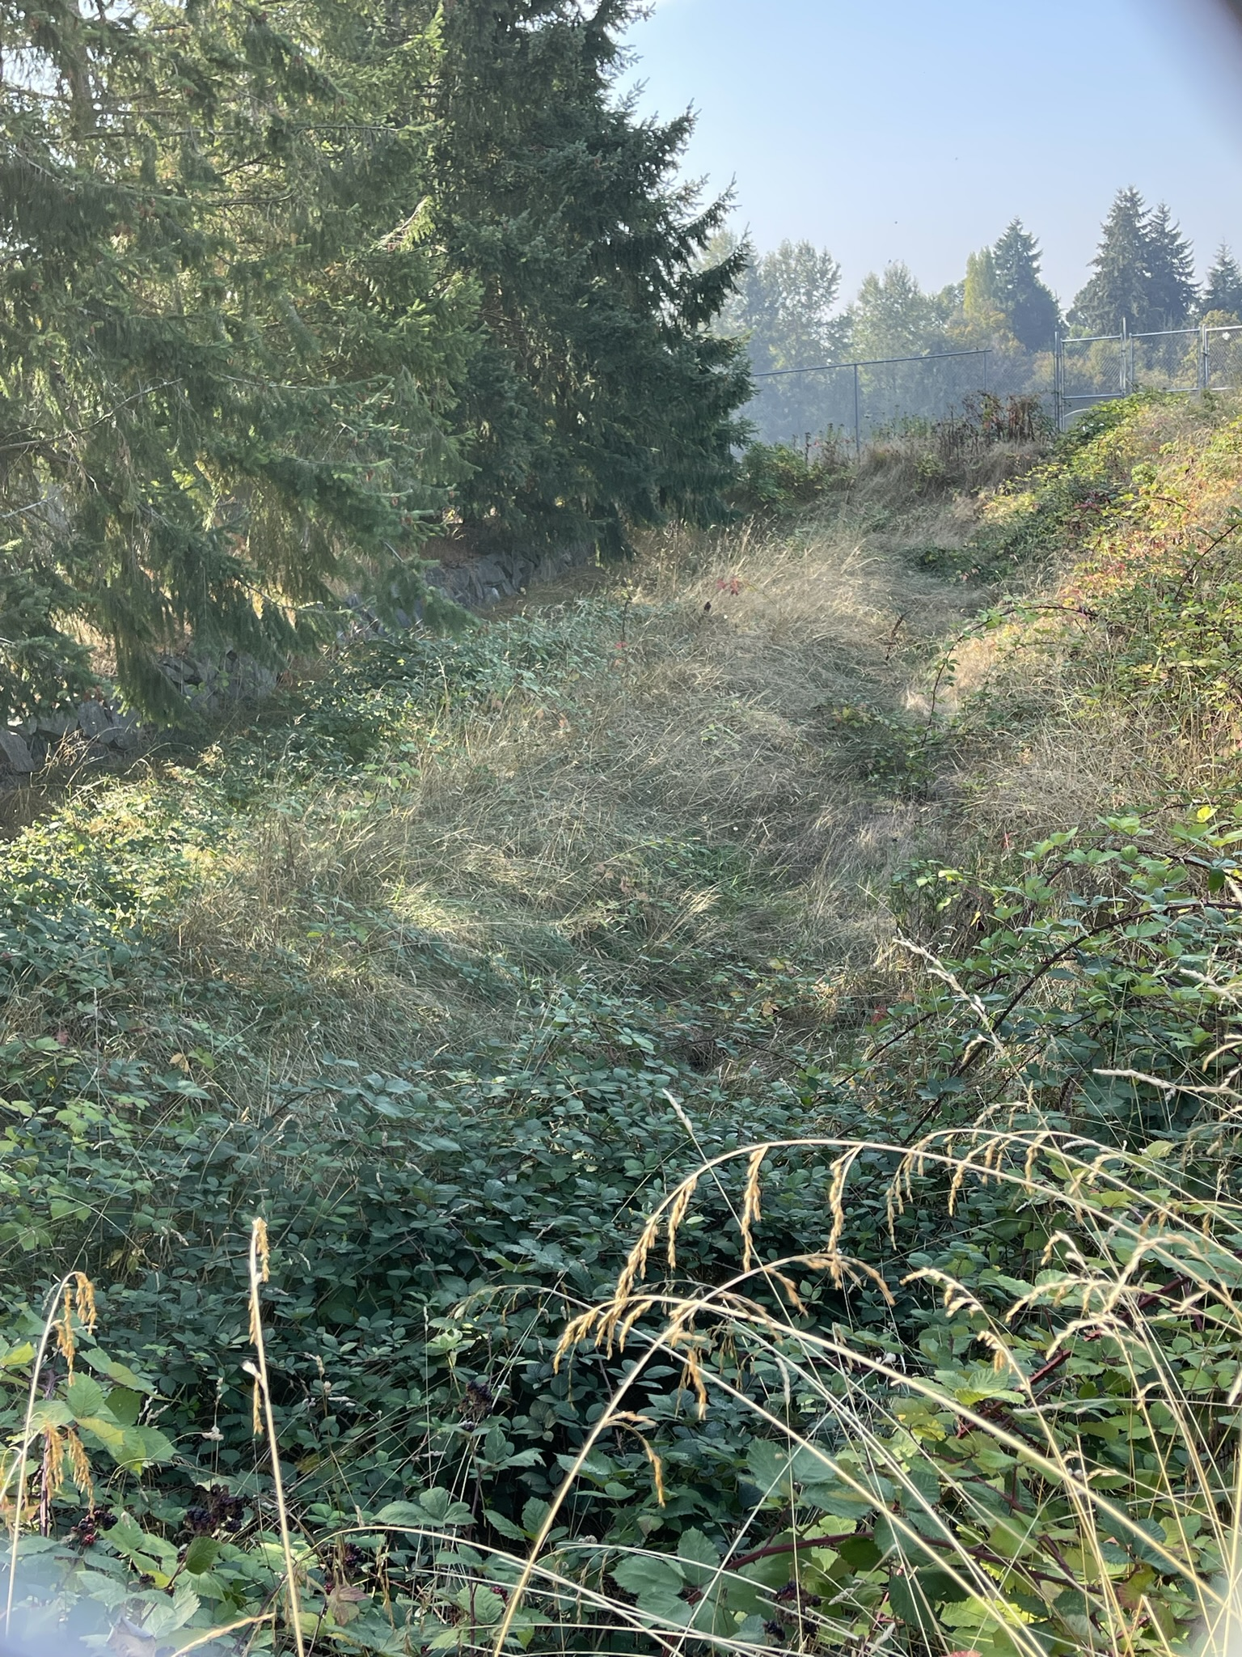
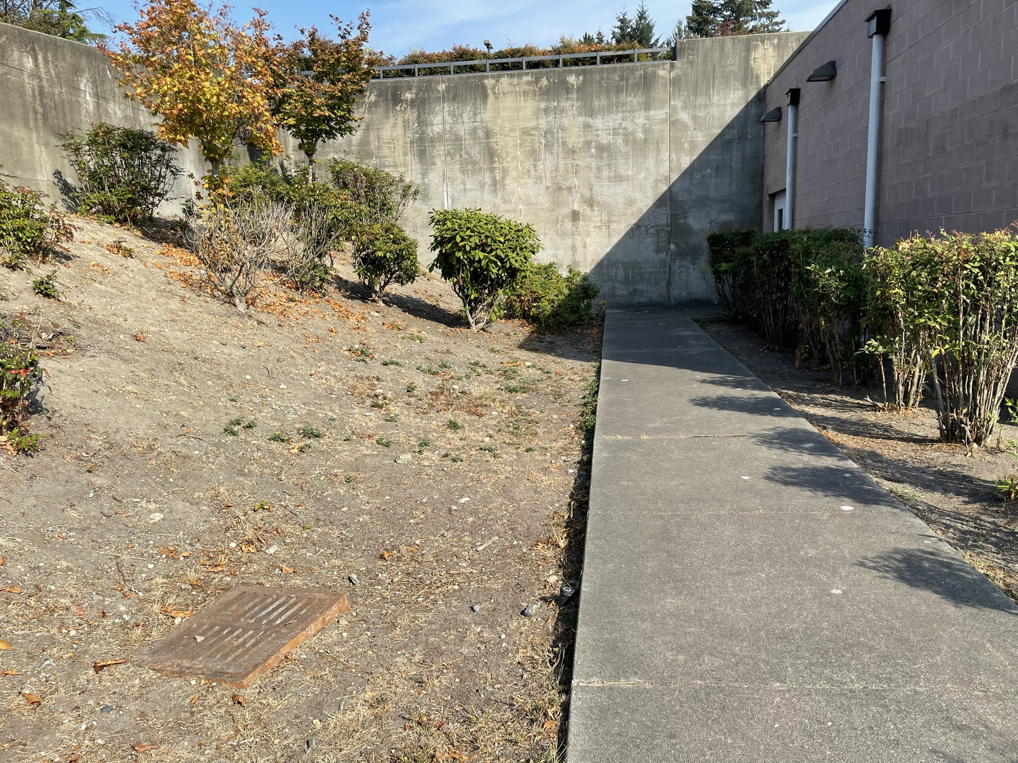
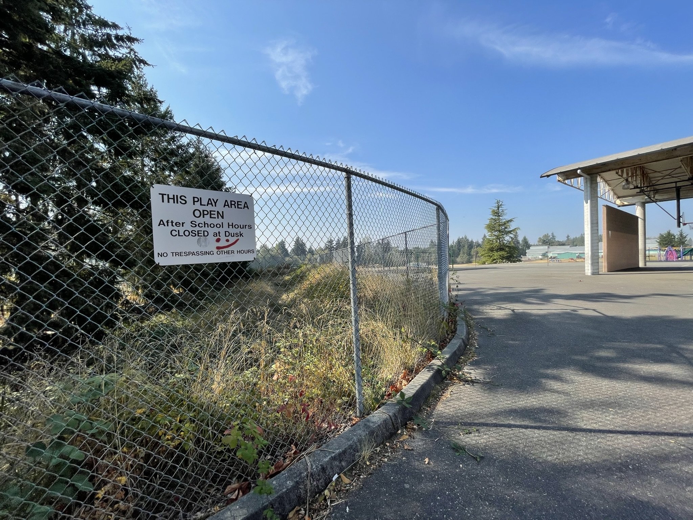
Schoolyard stormwater points of interest
C. Retaining walls and drain - are there pipes at the bases of the retaining walls?​ Such pipes let out water in heavy rains into lower areas (see the picture on the bottom left). There is a stormdrain pictured and there may be others.​
How do these areas interact with heavy rain?
D. Bioswale - notice what water flows into this area and where it is coming from. Where is it leading to? What do the plants and soil do for the flowing water?
C
D

Slide 5
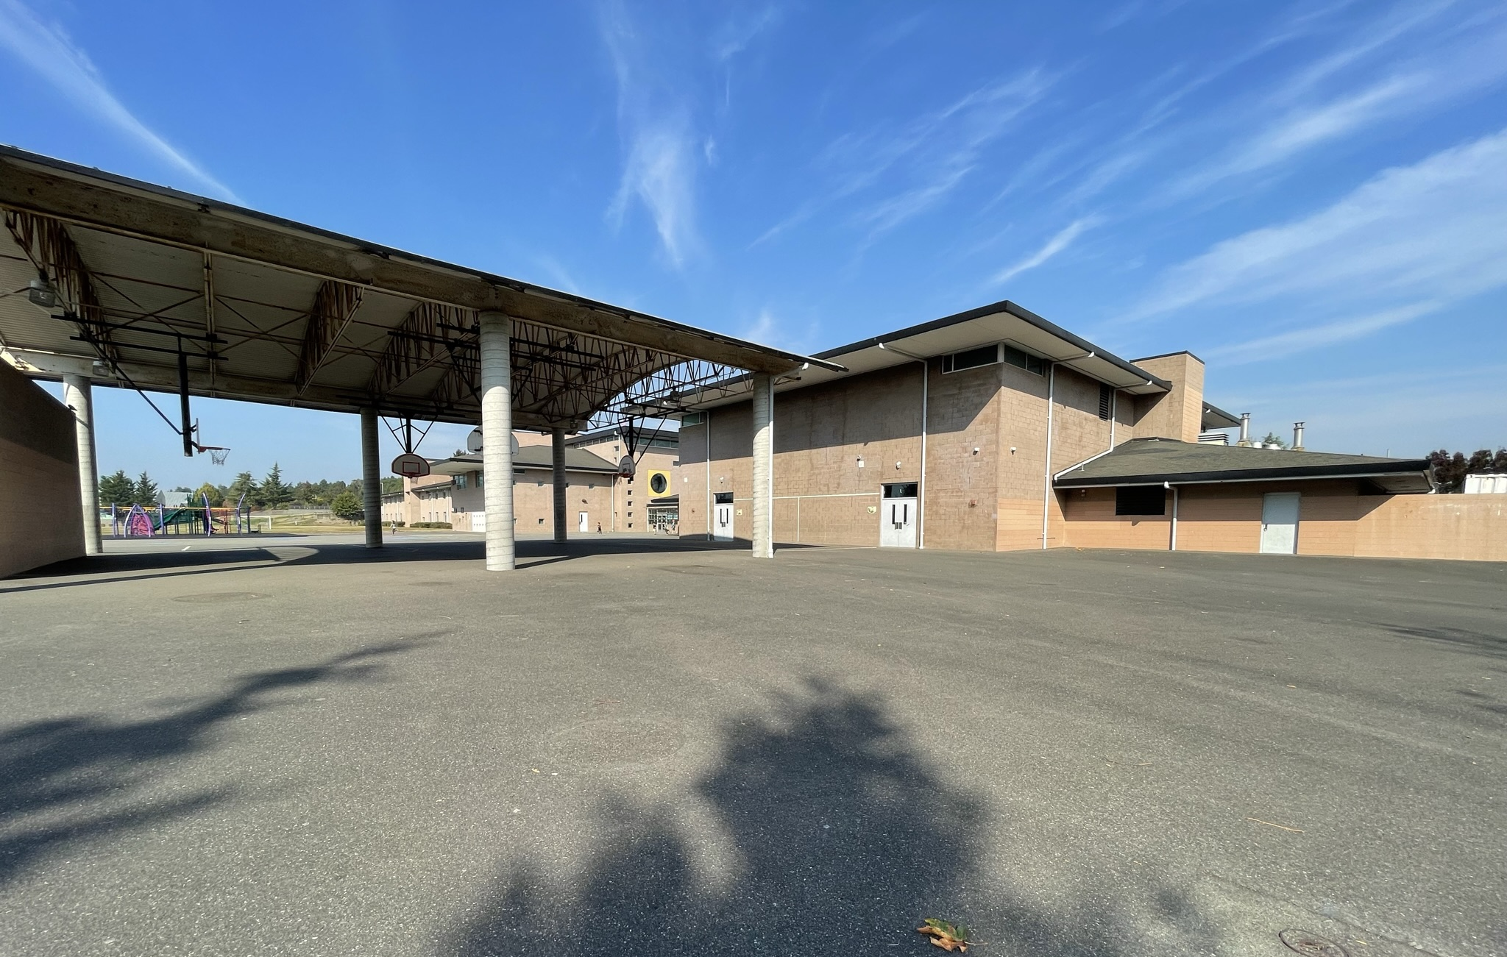
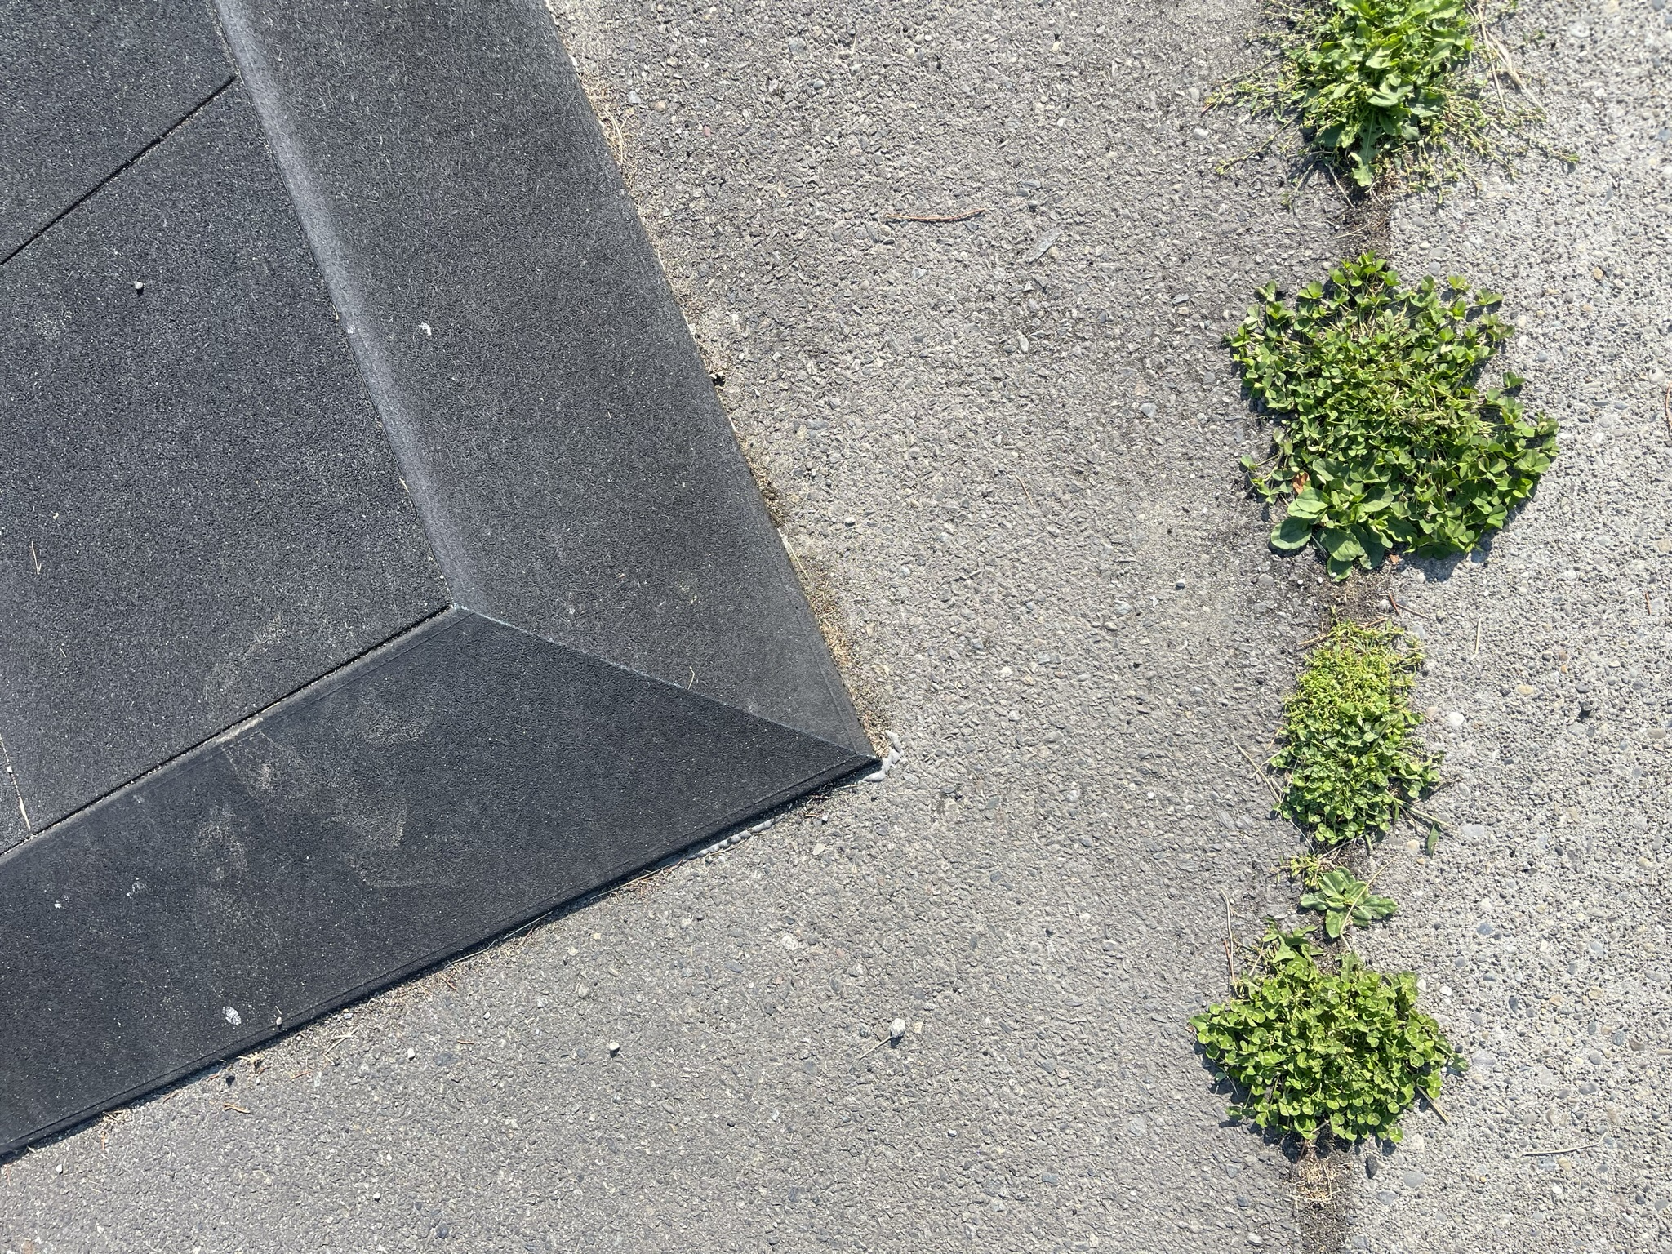
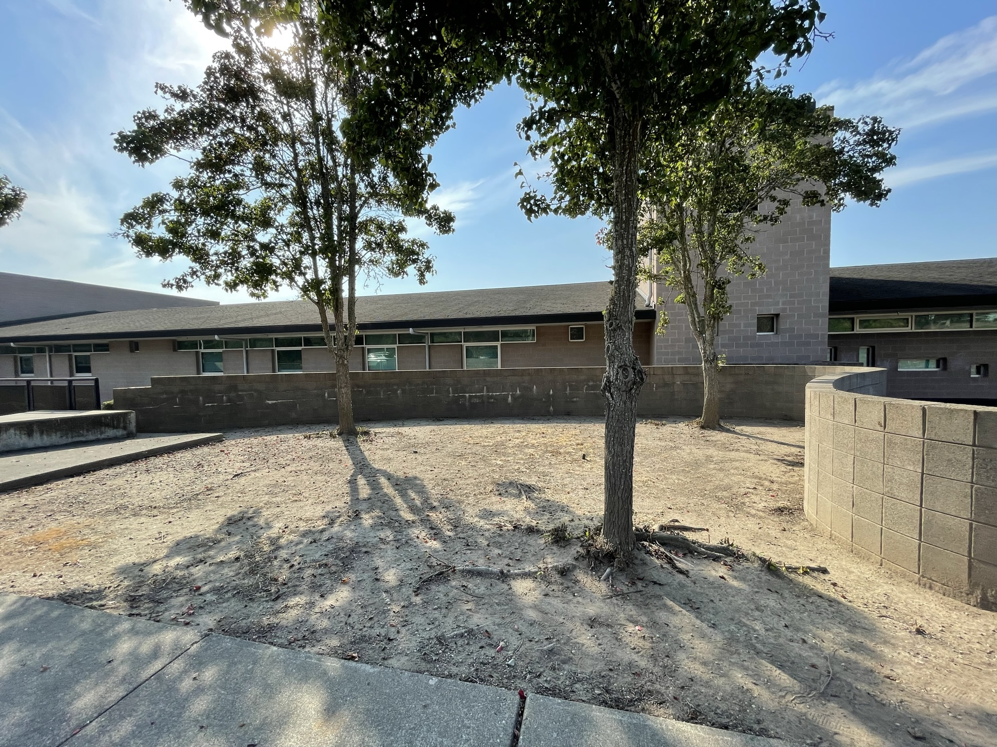
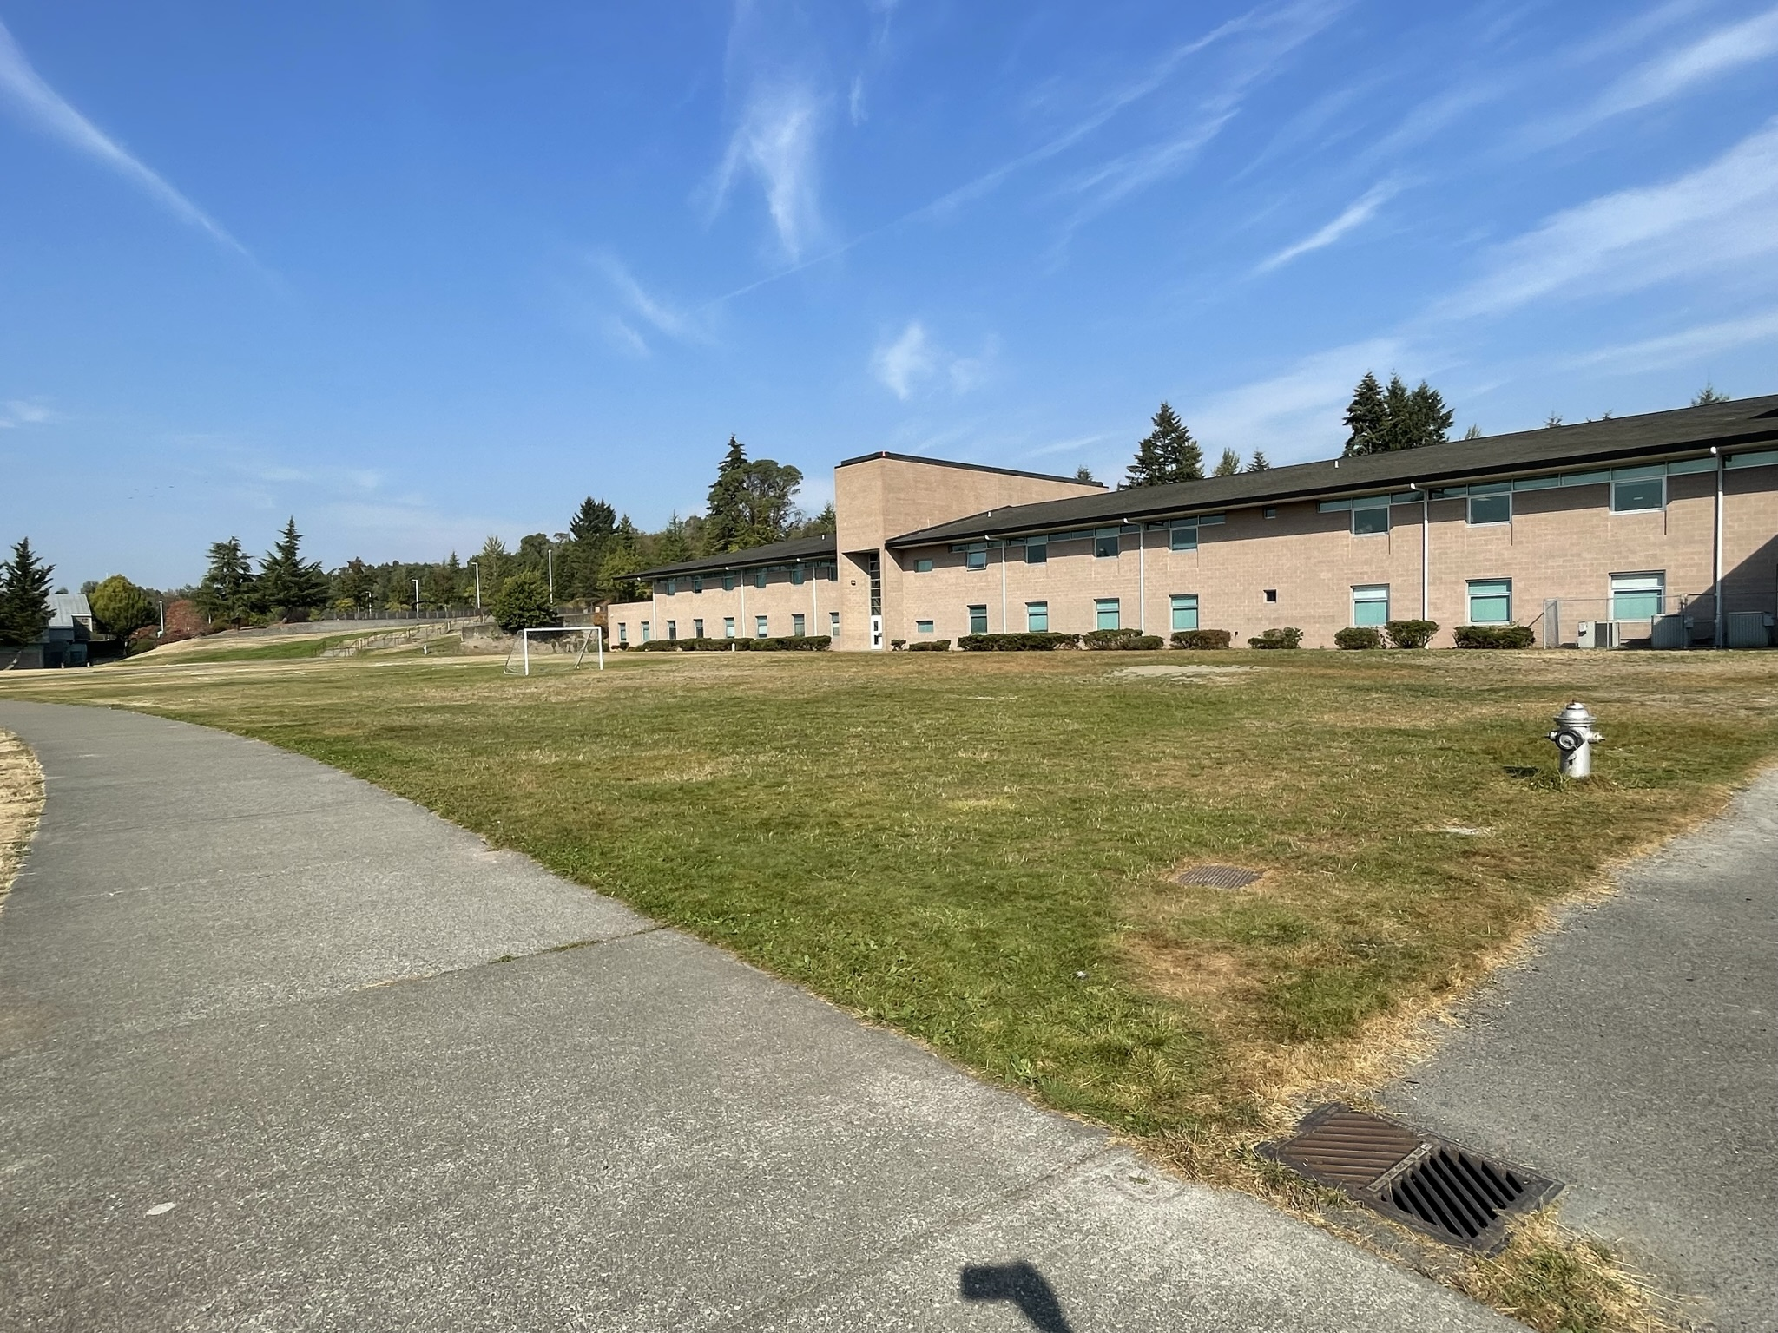
Schoolyard stormwater points of interest
E. Schoolyard surfaces – note what directions water flows from different surfaces. Are they pervious or impervious? Can you find where the water would collect or puddle or drain in a heavy rain?

Slide 6


Mapping Your Schoolyard – Crescent Heights Name: ____________ Date: _________
Include on your map:
Symbols from the Key including flow of water, erosion, and storm drains.
Show where you see any evidence of possible stormwater problems (this could be places where there's lots of erosion or big puddles, or oil from cars, etc).
Sketch larger plants and bushes if they are there.
Notes:
PRINT THIS PAGE for the STUDENT WORKSHEET

Slide 7
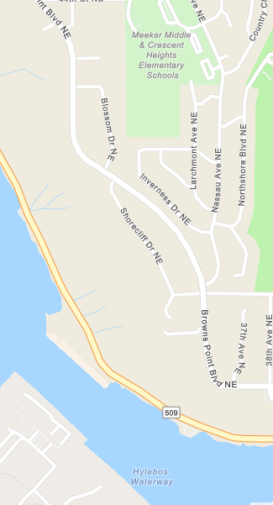


Local Stormwater Systems – teacher info
Crescent Heights Elementary is located in the Northeast Tacoma subwatershed within the Commencement Bay watershed. Covering 2,641 acres, this subwatershed is mostly residential that has recently become the fastest growing area in the city. Many large residential developments, as well as shopping areas, have been built or are currently under development.
The stormwater from your school will make its way to the Hylebos Waterway. During heavy rains, especially during the winter months, stormwater may be collected in the nearby holding ponds at the North Shore Golf Course. The holding ponds help to prevent neighborhood flooding.
The stormwater then travels south, downhill, and discharges into the Hylebos Waterway just southeast of Hylebos Marina, and into Commencement Bay and the Puget Sound/Salish Sea.
(City of Tacoma website: https://www.cityoftacoma.org/cms/One.aspx?portalId=169&pageId=2860#Northeast%20Tacoma )
Notes:
Please Note: The pipes information provided here is our best estimate of the stormwater flow in your community based on the information we have currently. If you encounter more information in the course of your investigation, please let us know so we can update future versions of this document.
Data gathered from
https://www.cityoftacoma.org/government/city_departments/environmentalservices/surface_water/surface_water_system (italicized type below)
https://tacoma.maps.arcgis.com/home/webmap/viewer.html?layers=23e9a402b47d46058193362cb6c27a9e (map screenshots)

Slide 8
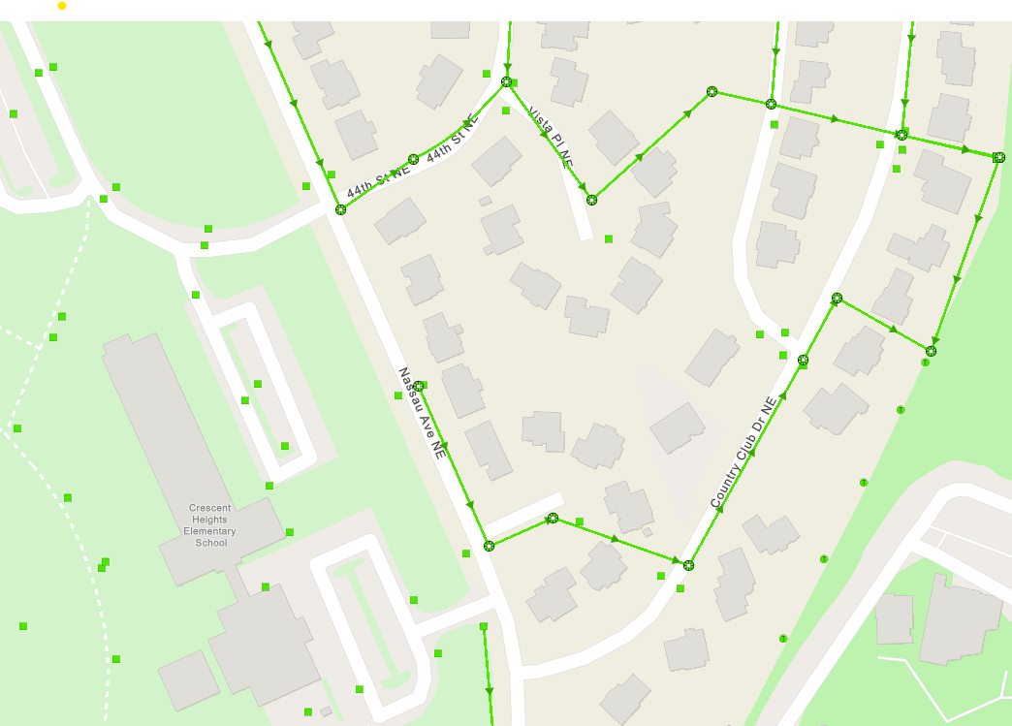
Crescent Heights Elementary Where does your school’s stormwater go?
Follow the lines and arrows!

Slide 9
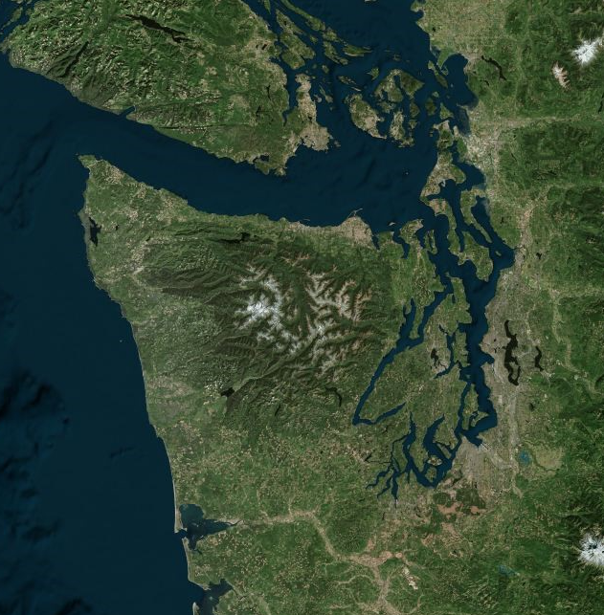
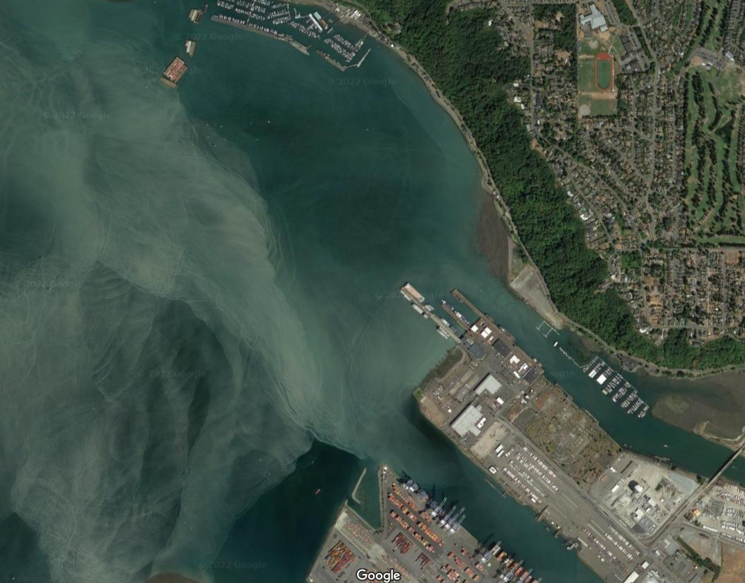
Now follow the yellow line away from your school (find your school by looking for the star) to see how it gets to the Salish Sea!
This image shows where the Hylebos Waterway meets Commencement Bay. Note the color difference in the water, likely from sediment and other pollutants flowing out into Commencement Bay.​
​
Past Commencement Bay is the larger Salish Sea.

Slide 10


How did we figure this out?
To view this map on your own, go here:
https://tacoma.maps.arcgis.com/home/webmap/viewer.html?layers=23e9a402b47d46058193362cb6c27a9e
View in “Map Classic”
Check “Surfacewater Network” box
Put in the name of the school
Zoom IN to see the green lines

