Slide 1


Community Waters School Guide:
Sheridan Elementary
How to Use This Guide
This School Guide supports the Community Waters Science Unit Teacher Manual with information, maps, and images specific to your school and neighborhood.
It is written for teachers - its goal is to provide a better understanding of what is happening with stormwater in and around your school.
All content within may change, and can be adapted as desired.
If you have any questions about these maps, accompanying lessons, or stormwater around your school, contact IslandWood staff at communitywaters@IslandWood.org.

Slide 2
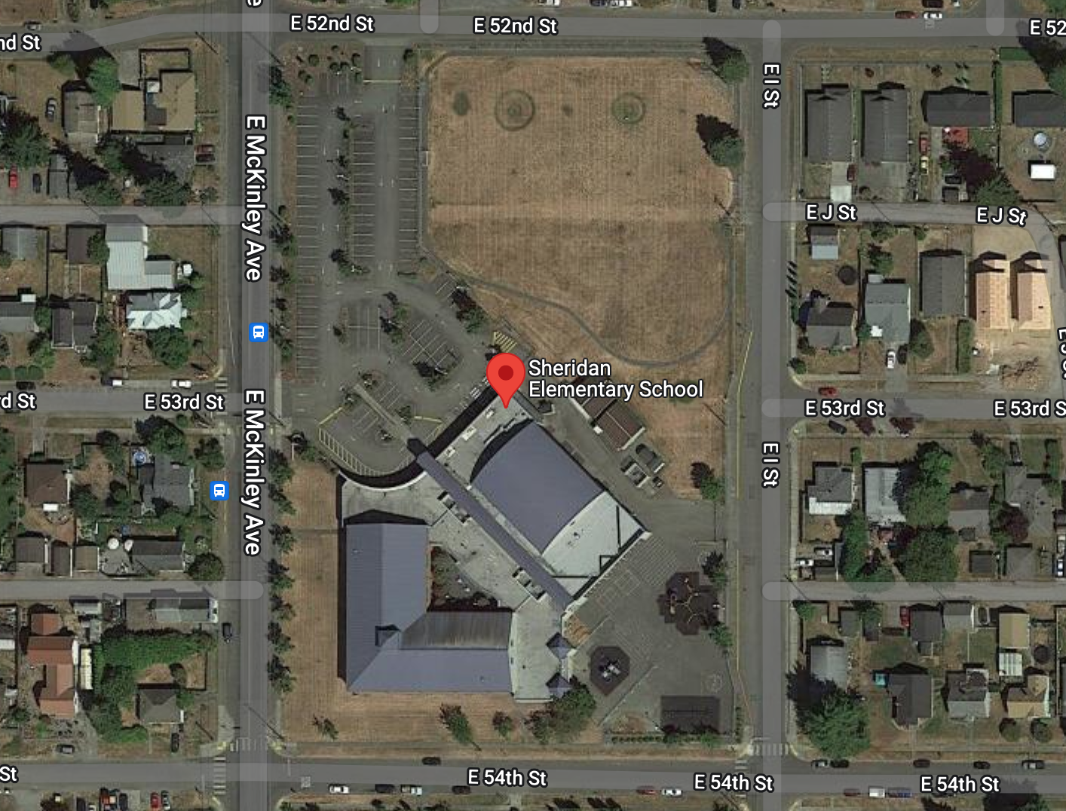
Stormwater in Our Schoolyard from Lesson 2
D
C
B
B
A
D

Slide 3
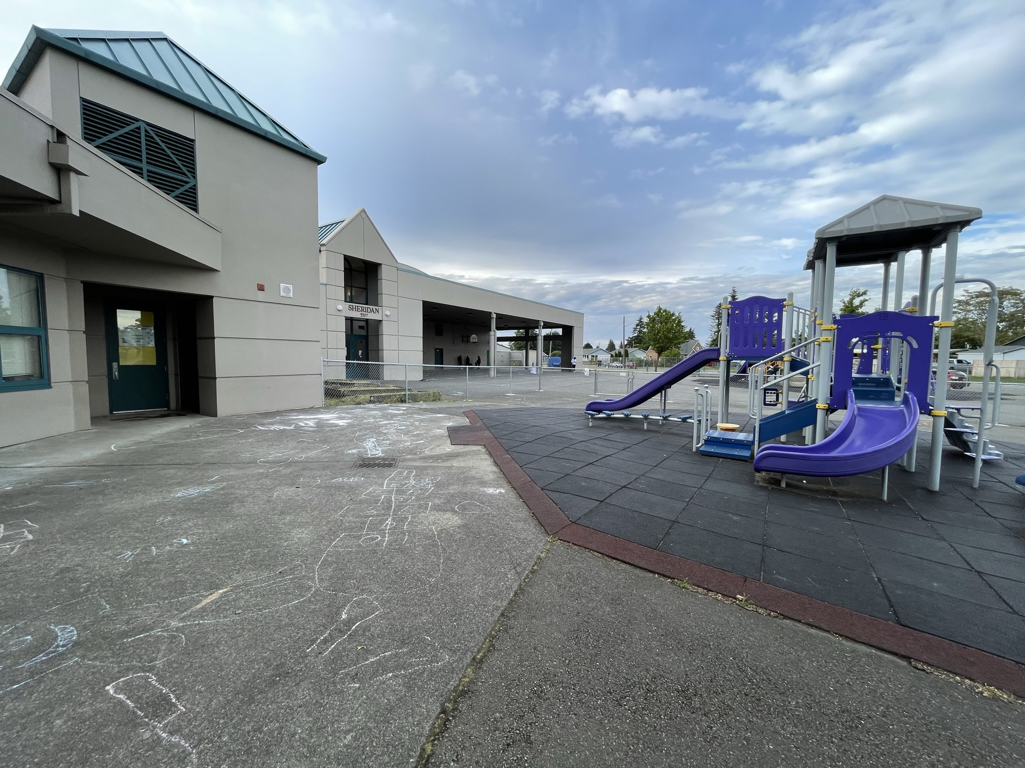
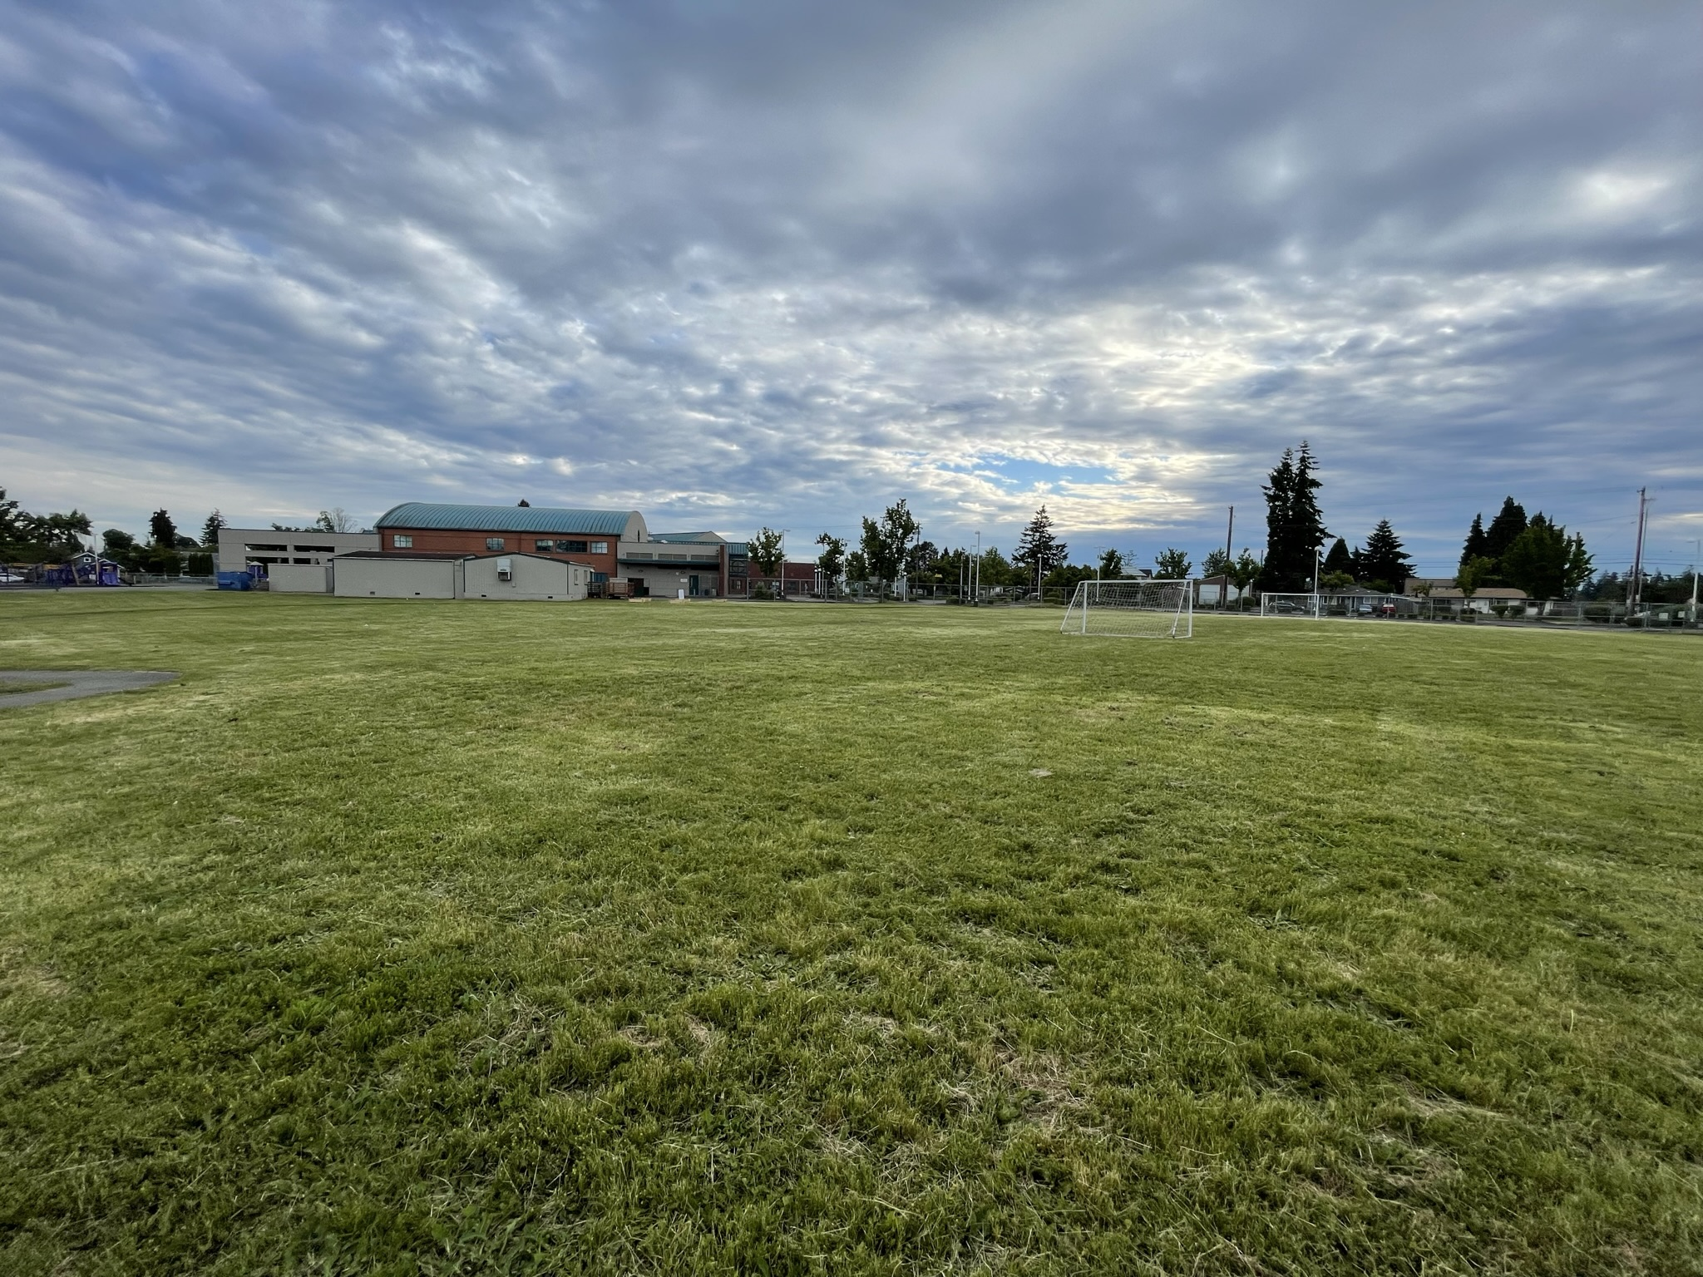
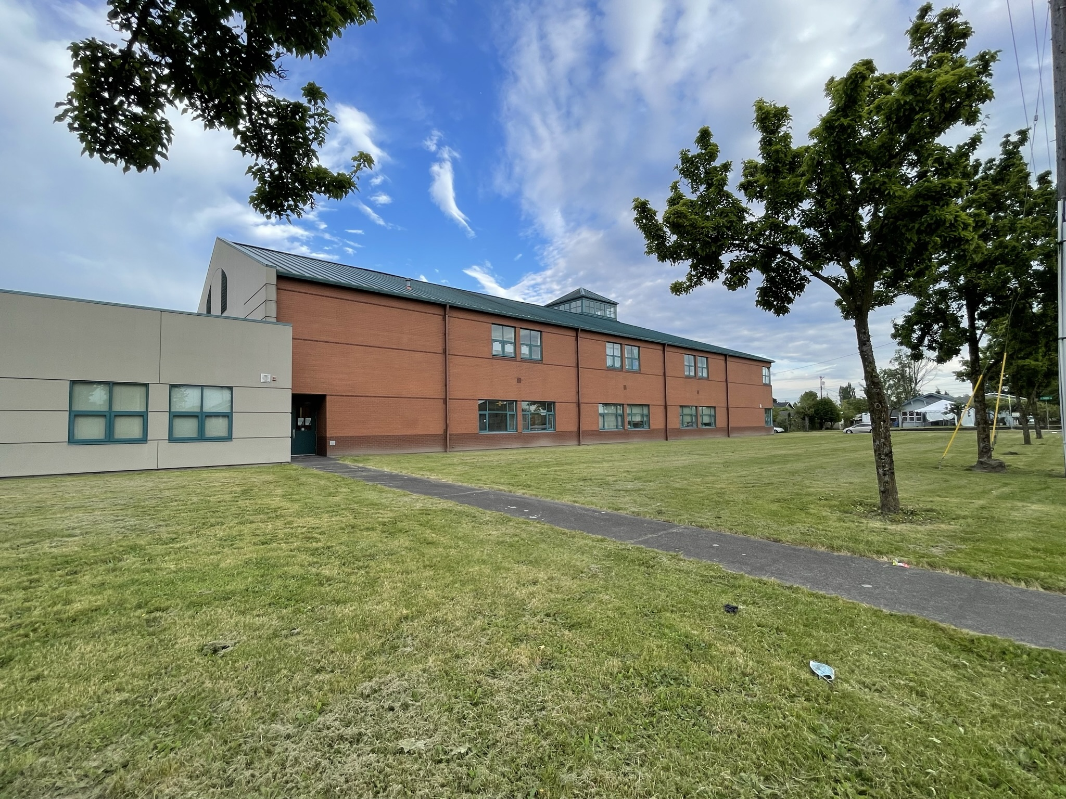
Schoolyard stormwater points of interest
B. Field surfaces - How pervious is this soil? Test it with some water – If it doesn’t soak in quickly, is it mostly impervious because of being compacted?
Do puddles often form here at the bottom of the hill or other low places?
B
A
B
A. Playground surfaces – Note what directions water flows off these different surfaces. Are they pervious or impervious?
Can you find where the water would collect or puddle or drain in a heavy rain?

Slide 4
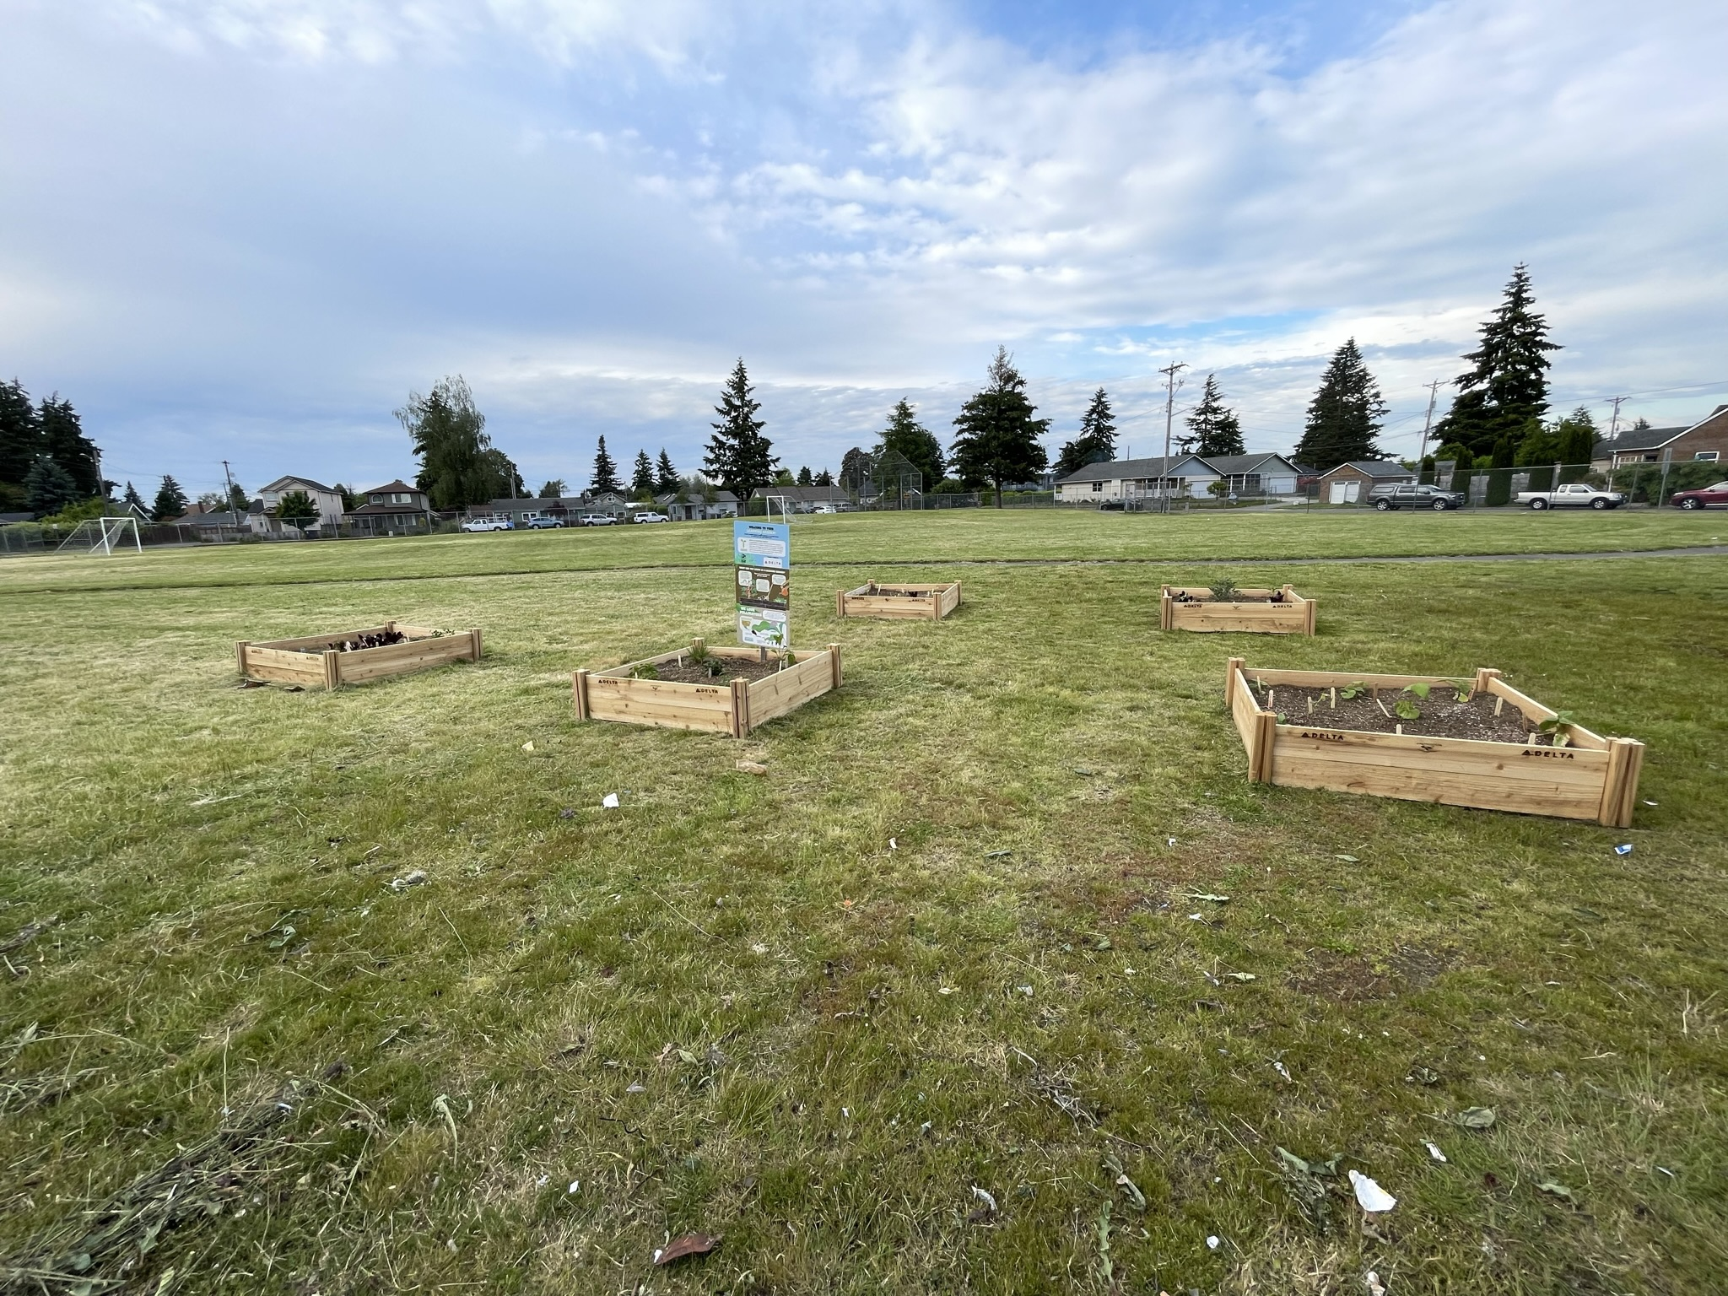
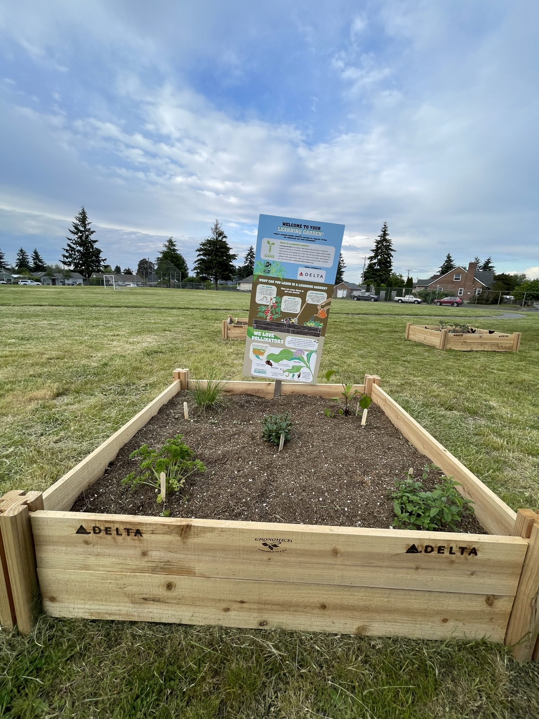
Schoolyard stormwater points of interest
C. Garden beds -
How does this area interact with heavy rain?
Are there other areas that might help water soak into the ground instead of going into drains? How is this area used? What do students notice here?
C

Slide 5
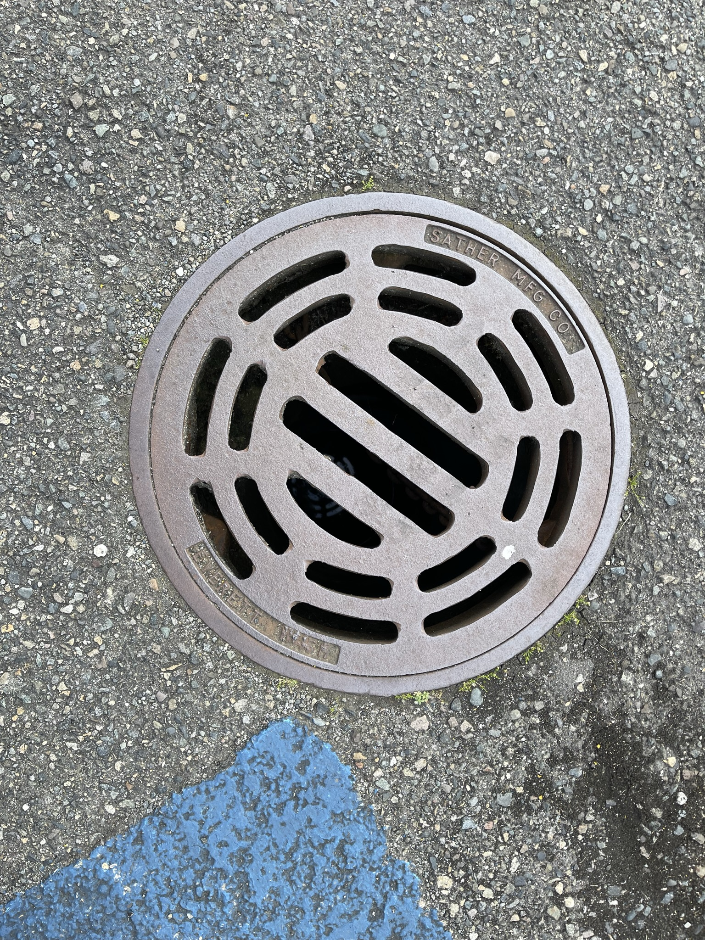
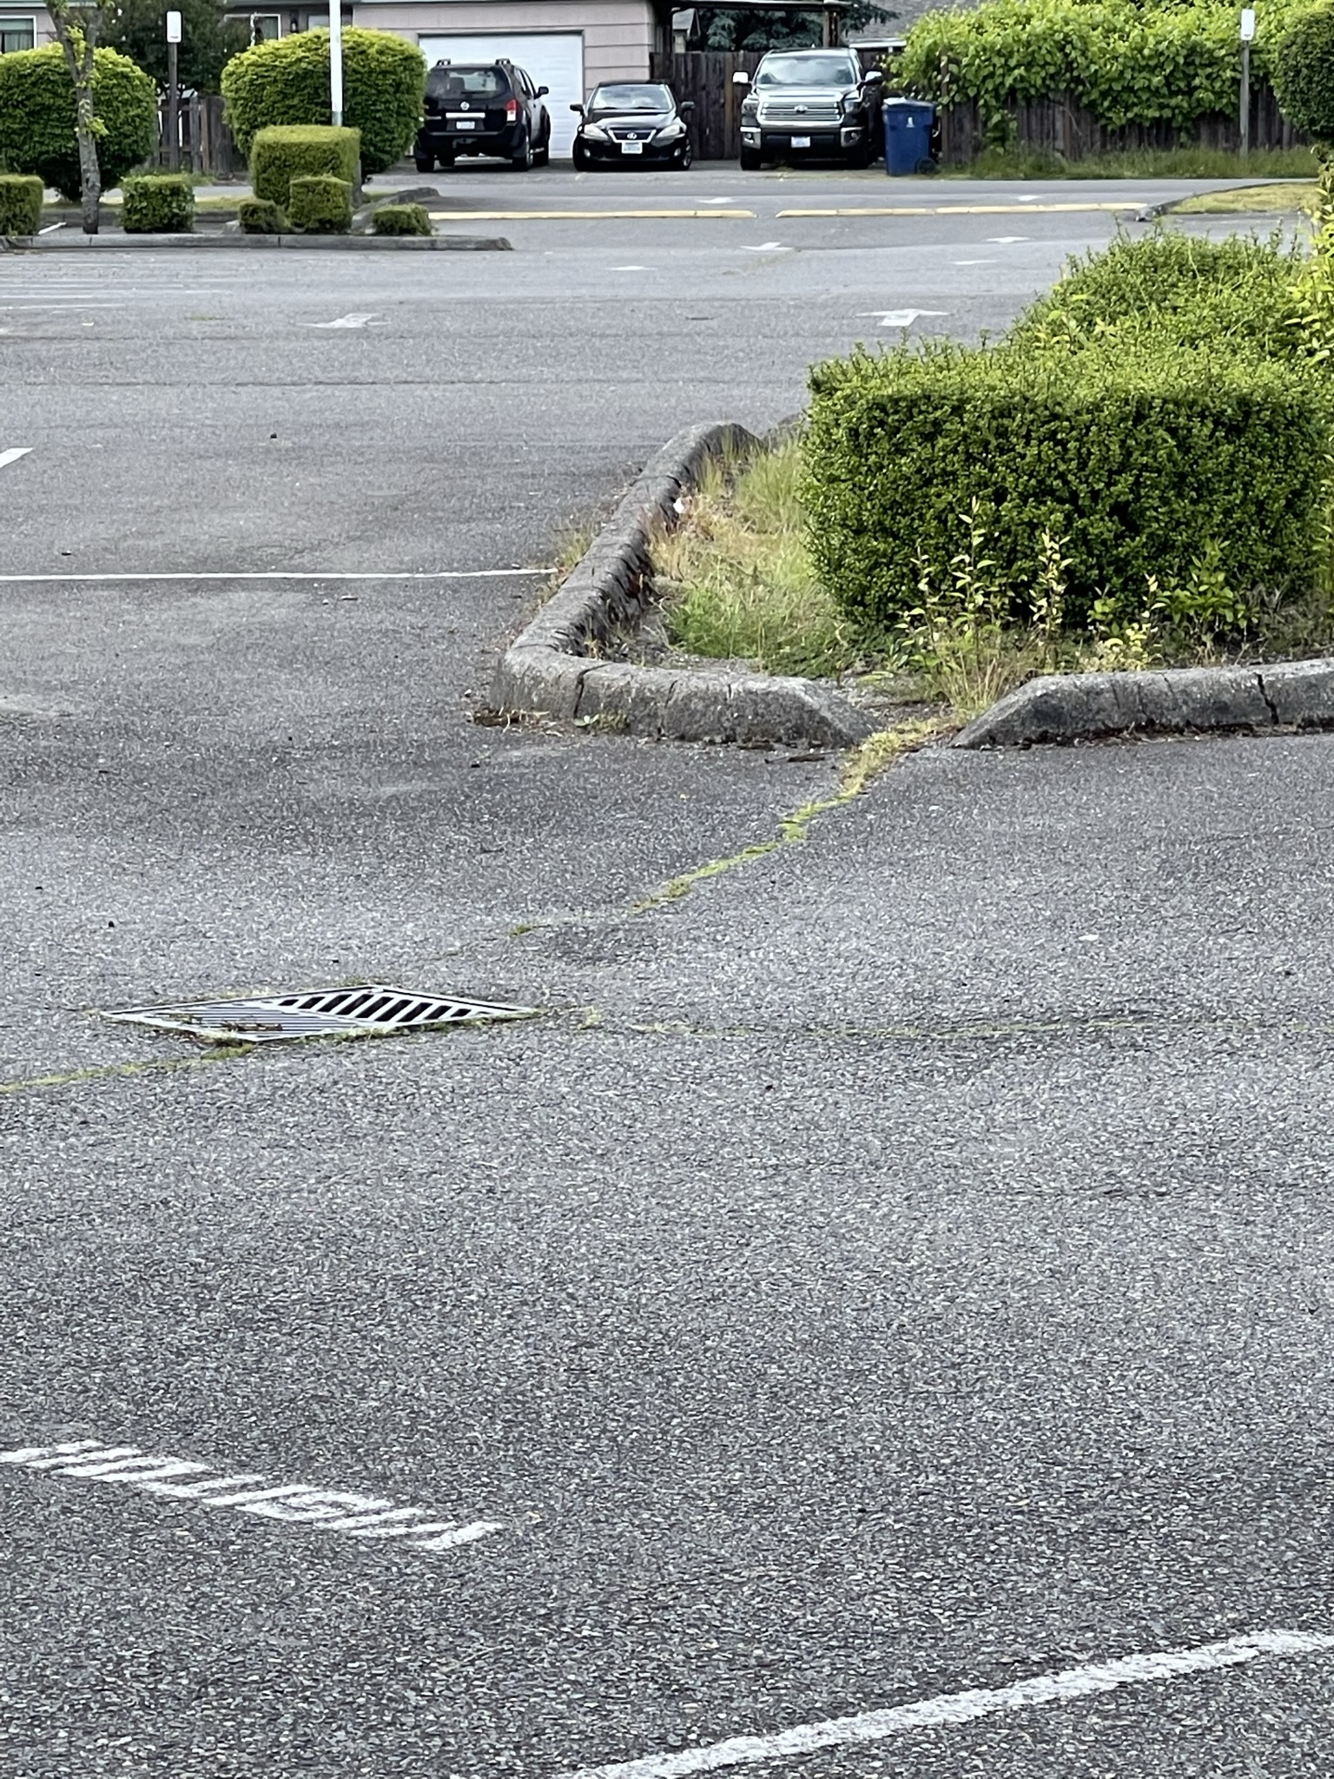
Schoolyard stormwater points of interest
D
D
B. Storm Drains – Note how this drain is surrounded by grass. Why might this drain have been put here? What might happen to stormwater here?
Where else can you find storm drains?

Slide 6
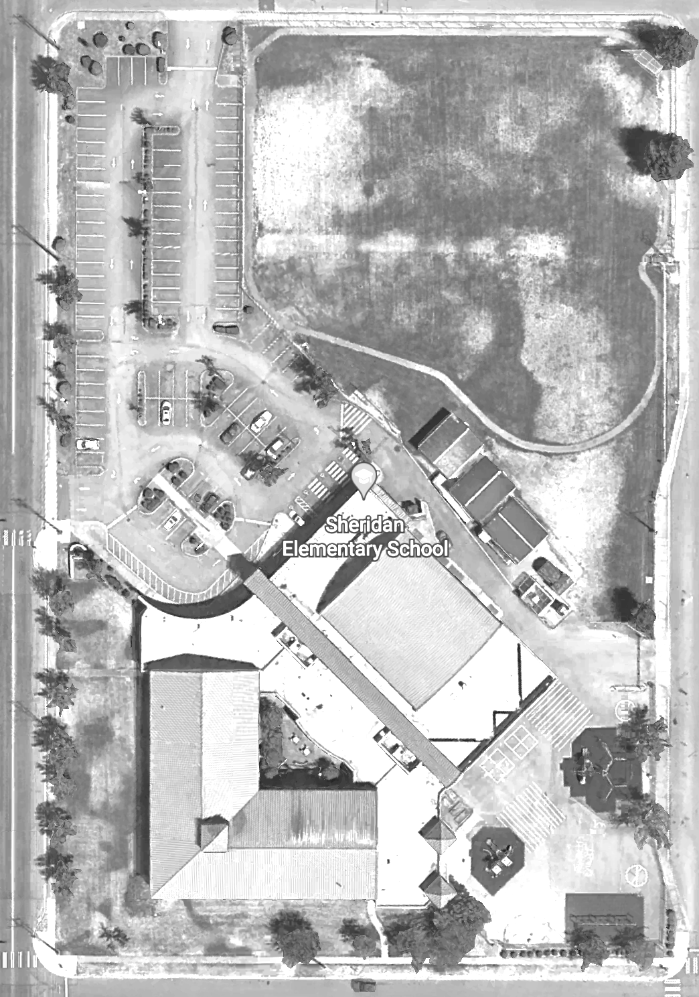


Mapping Your Schoolyard – Sheridan Elementary Name: ____________ Date: _________
Include on your map:
Symbols from the Key including flow of water, erosion, and storm drains.
Show where you see any evidence of possible stormwater problems (this could be places where there's lots of erosion or big puddles, or oil from cars, etc).
Add larger plants and bushes if they are there.
Notes:
PRINT THIS PAGE for the STUDENT WORKSHEET

Slide 7
Local Stormwater Systems
What happens with the stormwater around your school?
Where does your stormwater runoff end up?
The stormwater from your school ends up in Puyallup River.
Your school is located in the Lower Puyallup Watershed.
Water travels north on East McKinley Ave., then east on E 40th St, passes right by Blix Elementary (your stormwaters merge!. From there, stormwater discharges (flows) into First Creek, which flows north. Water reaches the Puyallup River and then Commencement Bay by going underground past the Emerald Queen Casino and under the freeway.
The T-Street/Lower Puyallup is a subwatershed of the Puyallup watershed. Located in southeast Tacoma this subwatershed covers 2,971 acres. The southern part of the subwatershed is mostly residential with some undeveloped open space and a few small commercial areas, while the northern part of the subwatershed contains industrial and commercial areas.
The Puyallup River, with its tributaries, serves as a major migration route for a variety of salmonid species. Four fish hatcheries are located in this system upstream from Tacoma. The lower Puyallup, where it meets Commencement Bay, is a salt-wedge estuary, with deeper marine water covered by a layer of fresh water. Learn more about Tacoma’s Salmon. https://www.cityoftacoma.org/cms/One.aspx?portalId=169&pageId=2860#T-Street/Lower%20Puyallup
Notes:
Please Note: The pipes information provided here is our best estimate of the stormwater flow in your community based on the information we have currently. If you encounter more information in the course of your investigation, please let us know so we can update future versions of this document.

Slide 8
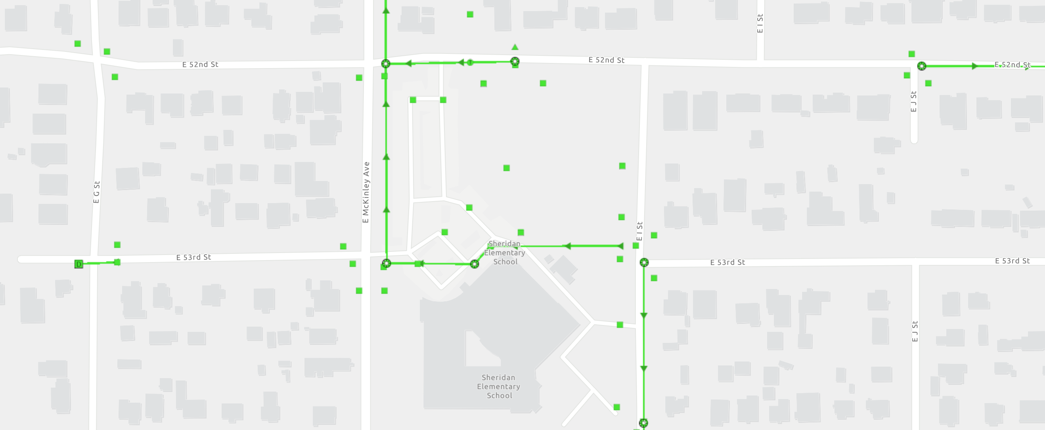
Sheridan Elementary Where does your school’s stormwater go?
Follow the lines and arrows!

Slide 9
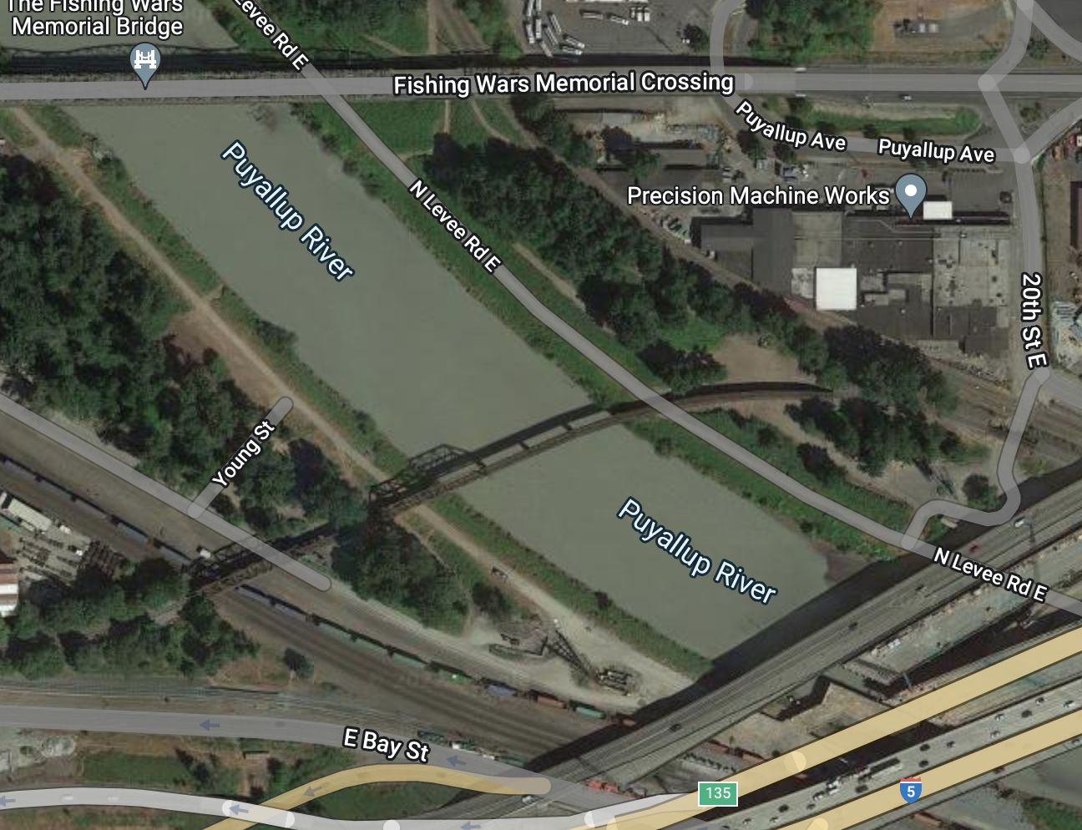
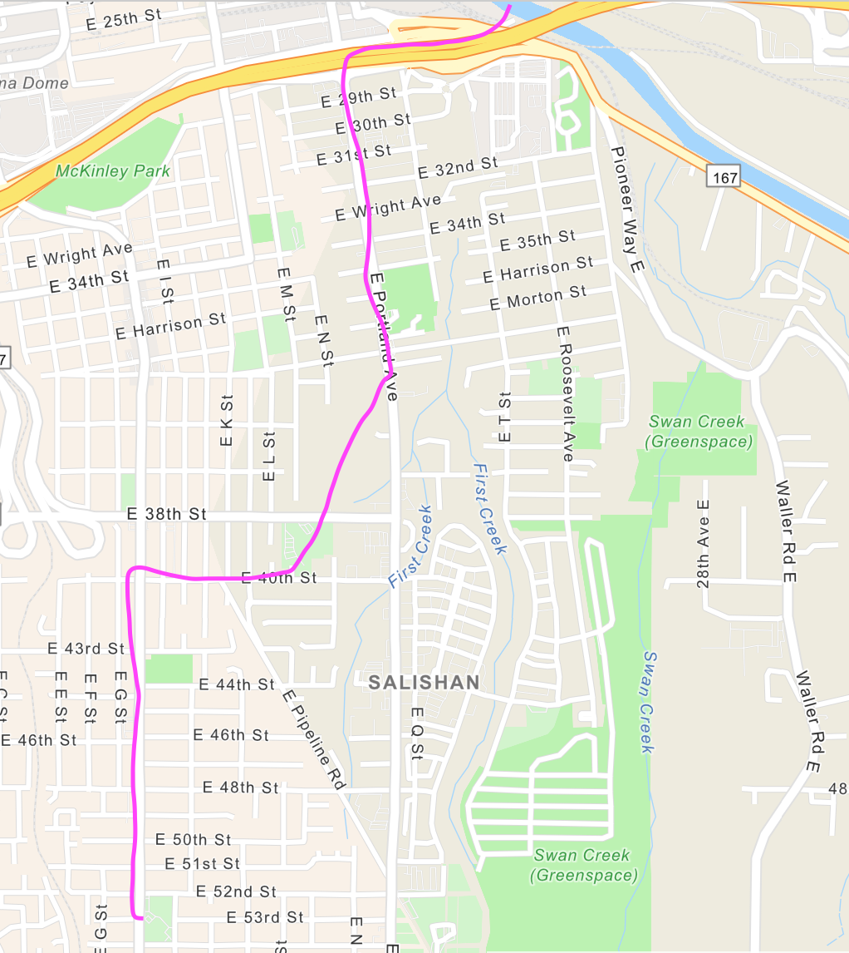
Now follow the pink line away from your school (find your school by looking for the star) to see how it gets to the Salish Sea!

Slide 10


How did we figure this out?
To view this map on your own, go here:
https://tacoma.maps.arcgis.com/home/webmap/viewer.html?layers=23e9a402b47d46058193362cb6c27a9e
View in “Map Classic”
Check “Surfacewater Network” box
Put in the name of the school
Zoom IN to see the green lines

