Slide 1

Community Waters School Guide:
Mann Elementary
How to Use This Guide
This School Guide supports the Community Waters Science Unit Teacher Manual with information, maps, and images specific to your school and neighborhood.
It is written for teachers - its goal is to provide a better understanding of what is happening with stormwater in and around your school.
All content within may change, and can be adapted as desired.
If you have any questions about these maps, accompanying lessons, or stormwater around your school, contact IslandWood staff at communitywaters@IslandWood.org.

Slide 2
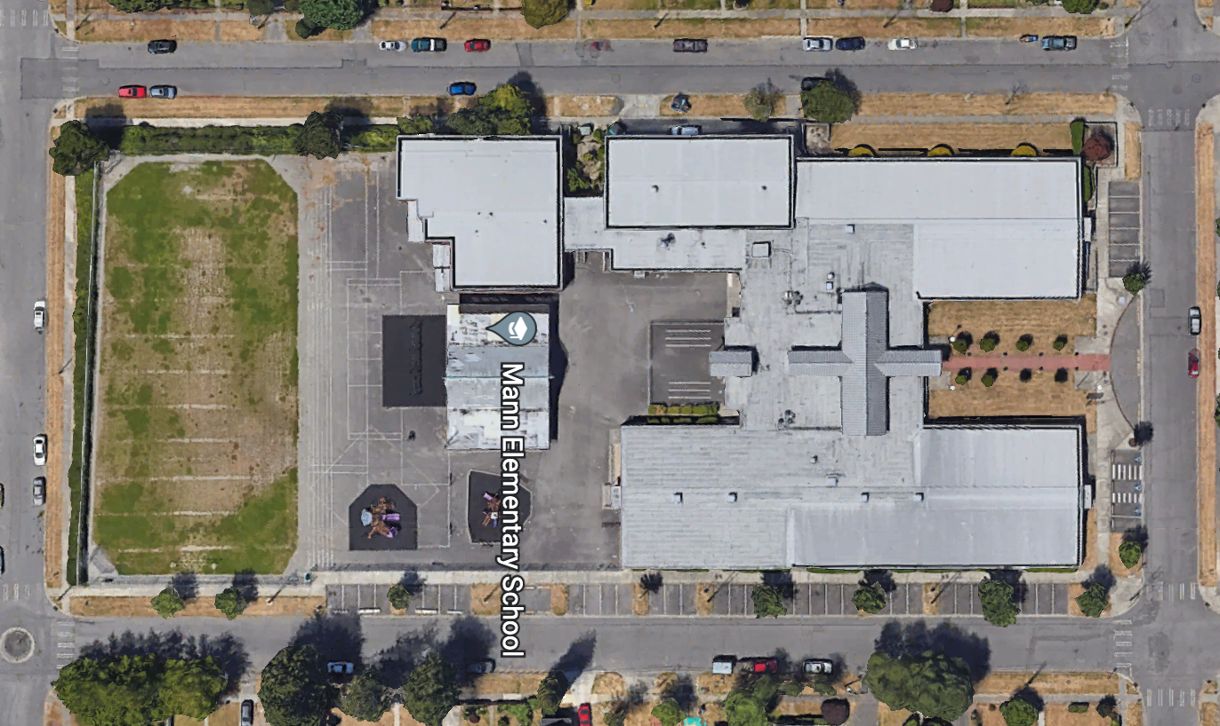
Stormwater in Our Schoolyard from Lesson 2
This map and points of interest (photos and info) can be used to guide your class’ exploration of the schoolyard. You will find the student worksheet for this lesson following the teacher guide version. Please use the extra space on the pages to add your own notes and questions!
C
B
A
D

Slide 3
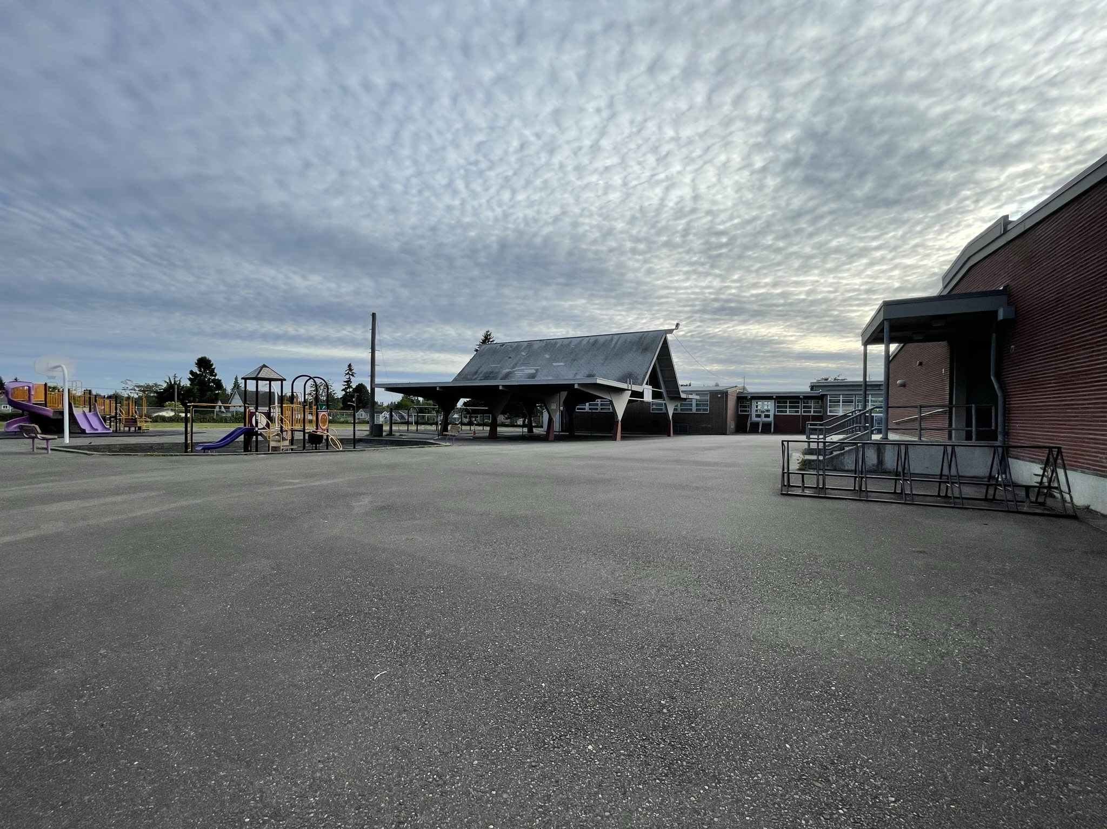
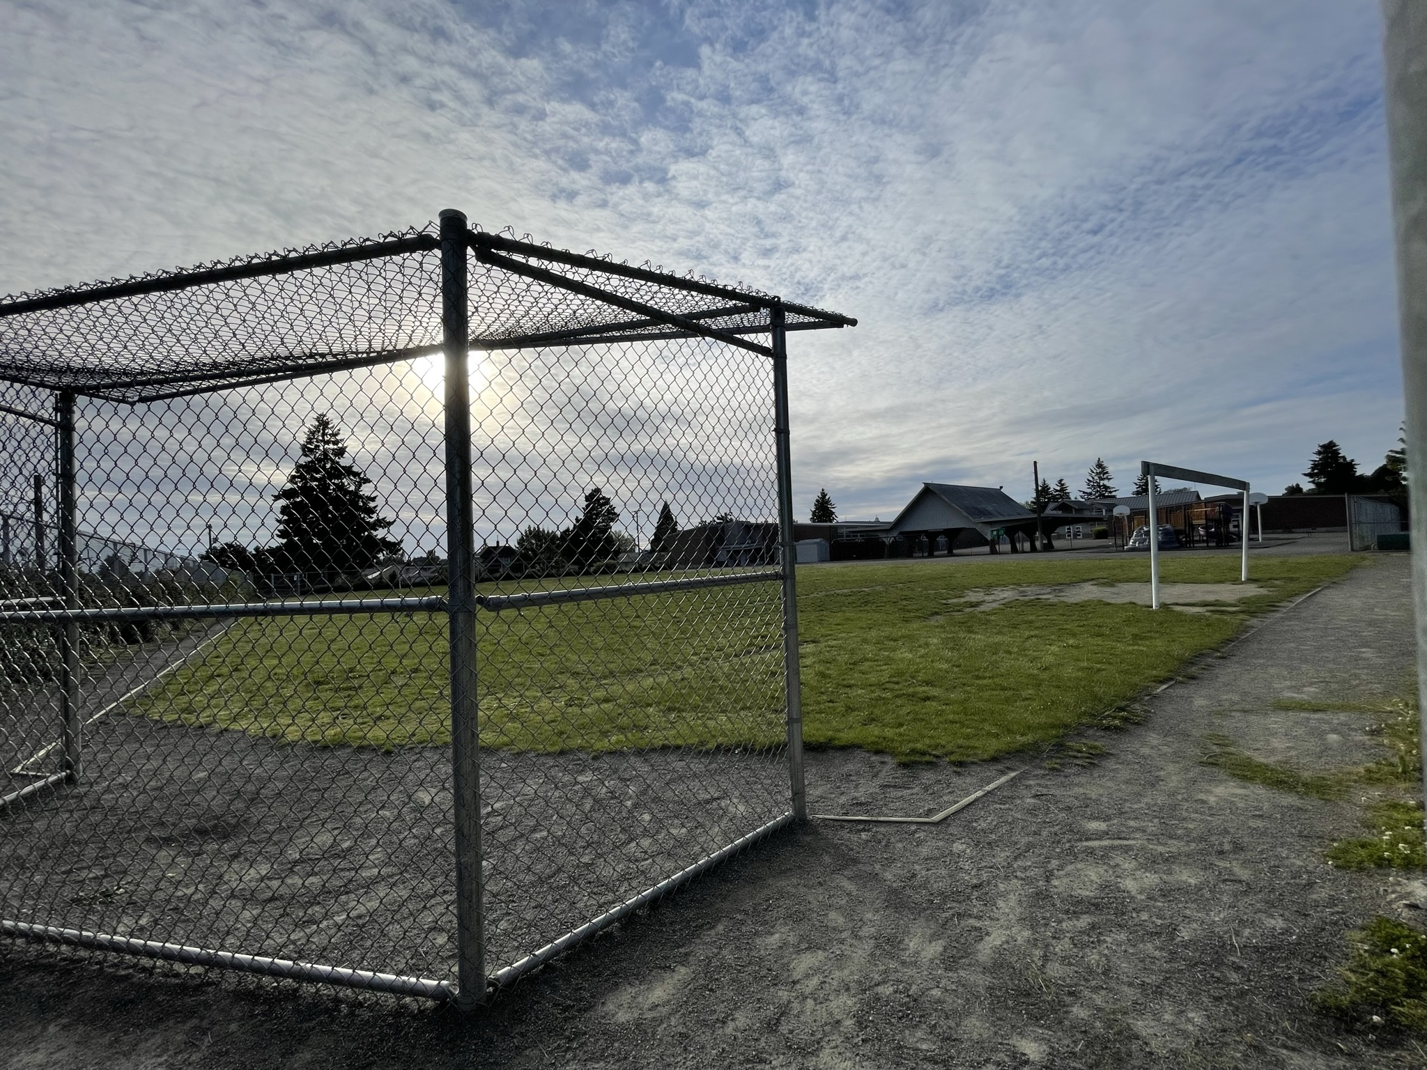
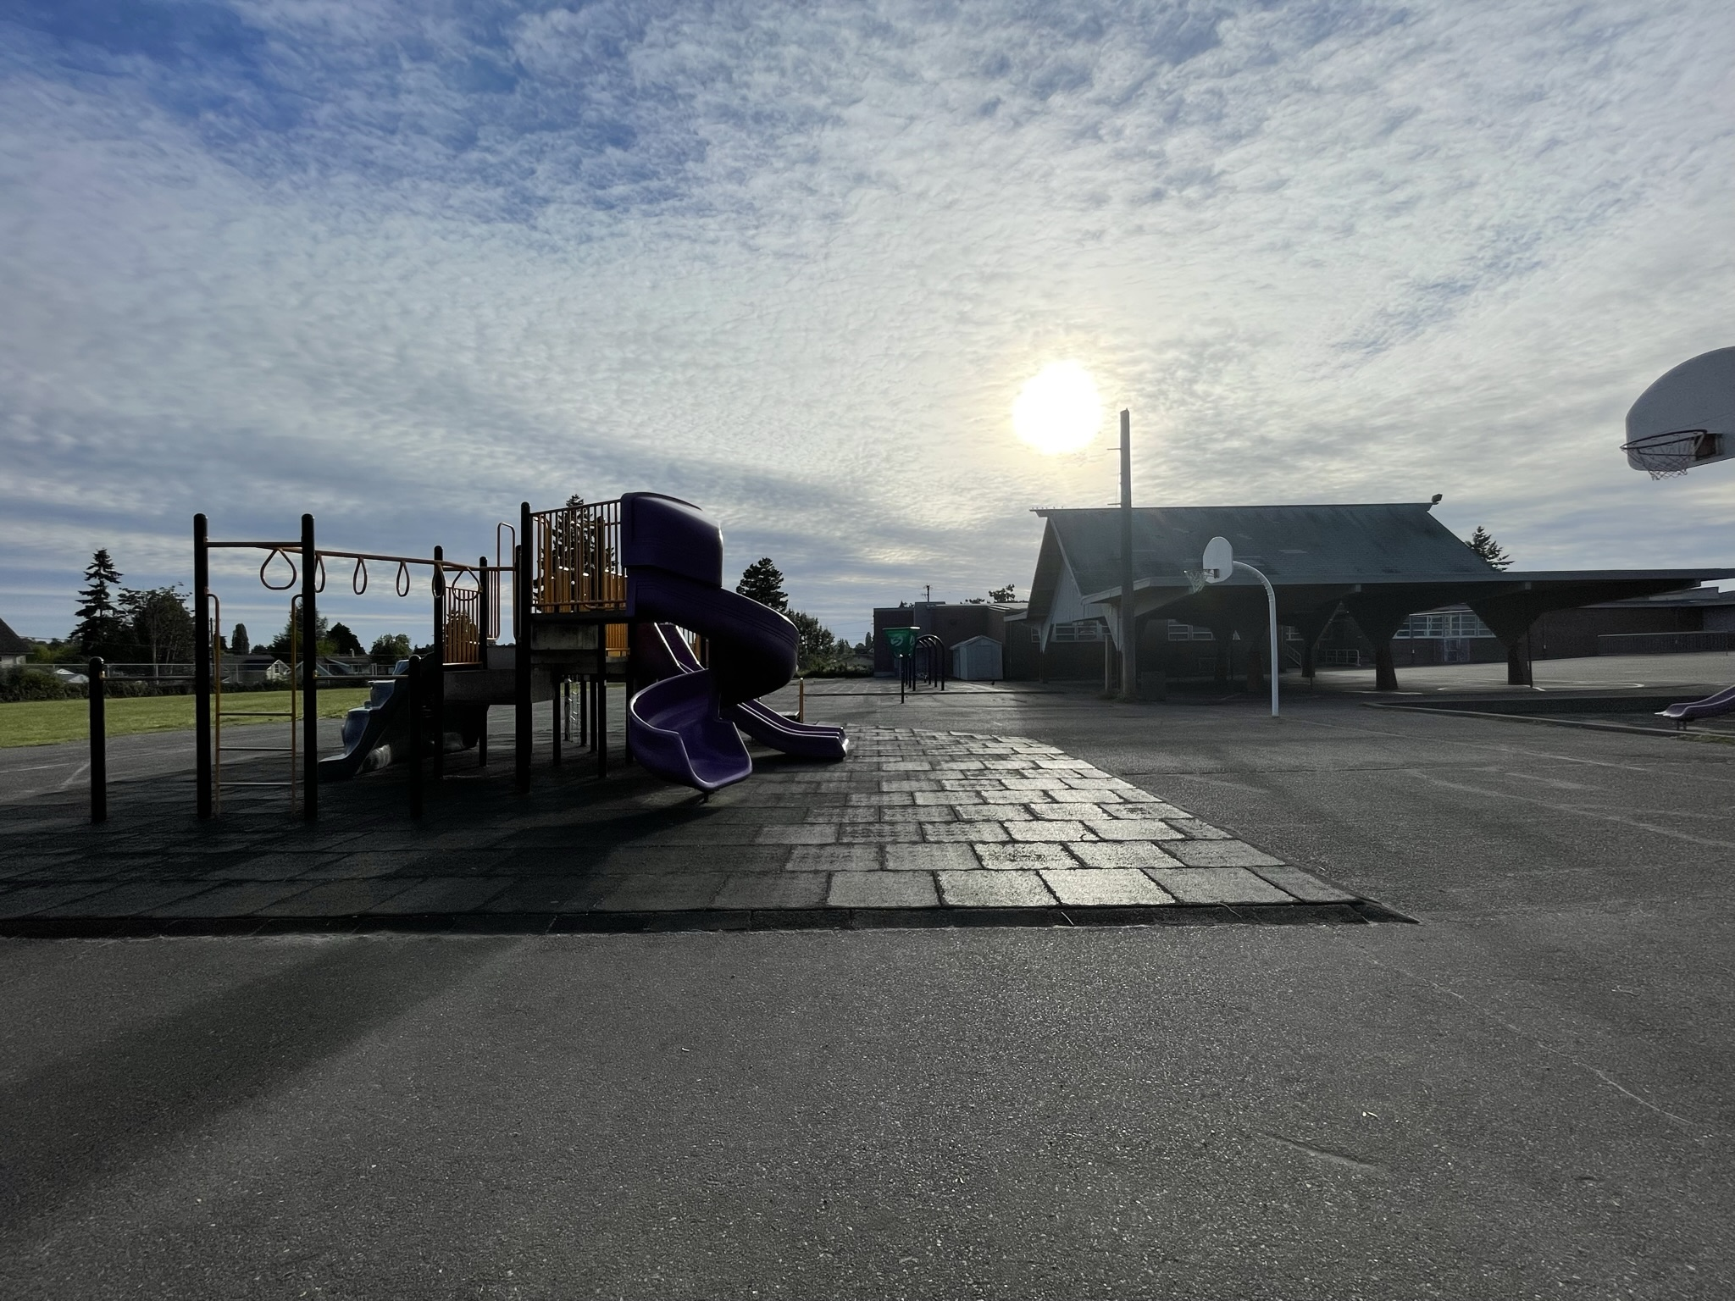
Schoolyard stormwater points of interest
A
B
A. Playground surfaces – Note what directions water flows off these different surfaces. Are they pervious or impervious?
Can you find where the water would collect or puddle or drain in a heavy rain?
A
B. Field surfaces - How pervious is this soil? Test it with some water – If it doesn’t soak in quickly, is it mostly impervious because of being compacted?
Do puddles often form here at the bottom of the hill or other low places?

Slide 4
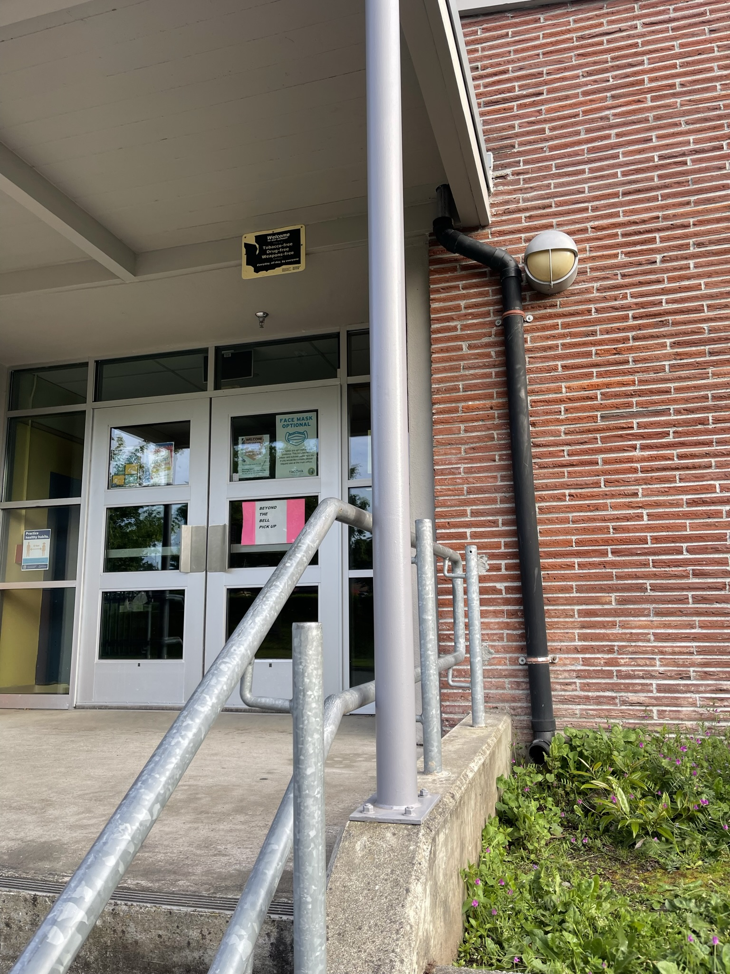
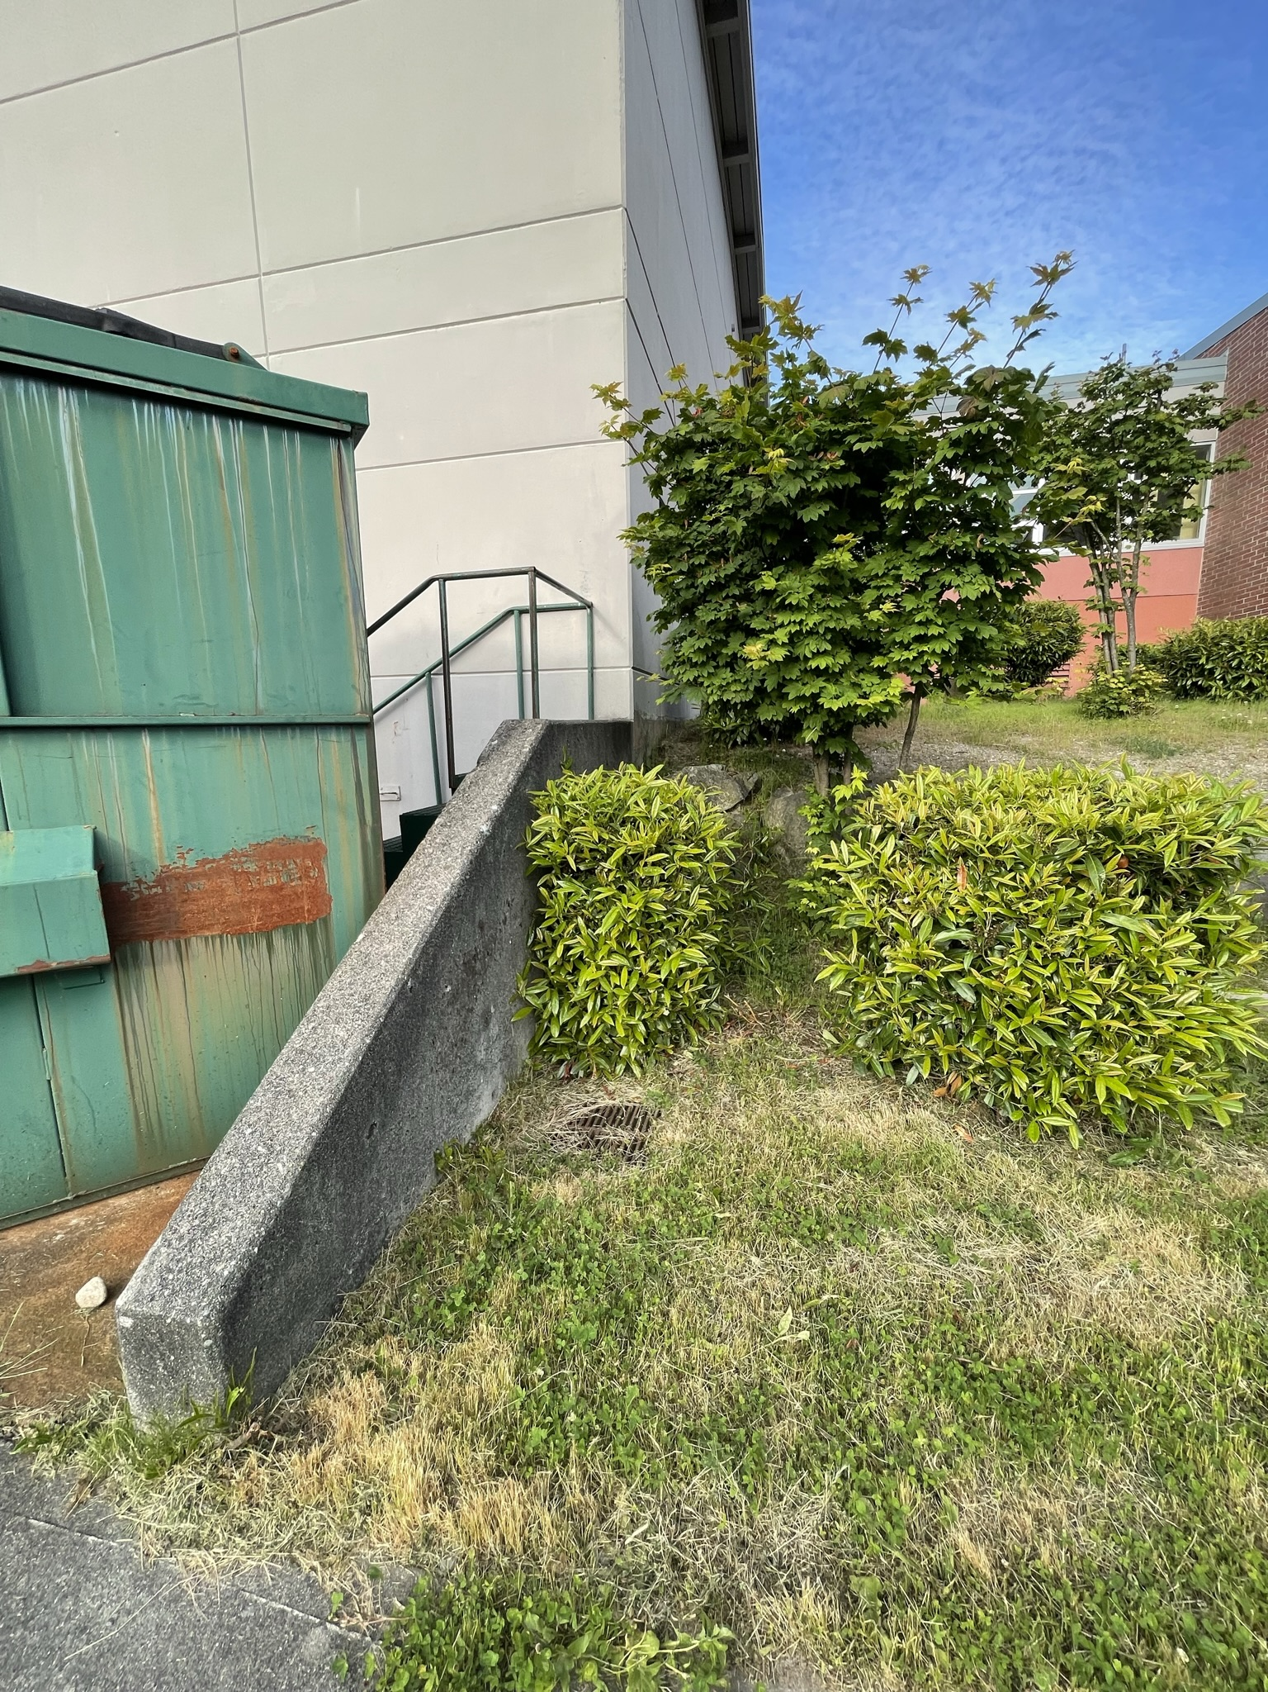
Schoolyard stormwater points of interest
C
D. Retaining wall, outflow, swale and drain – This area is a good example of engineering with water in mind! ​
There is a pipe at the base of the retaining wall that presumably lets out water in heavy rains, into this low area next to the building. This ditch or “swale” seems like it was designed for catching stormwater. There is a stormdrain at one end, but there may be others.​
How does this area interact with heavy rain? Are there other areas that might help water soak into the ground instead of going into drains? How is this area used? What do students notice here?

Slide 5
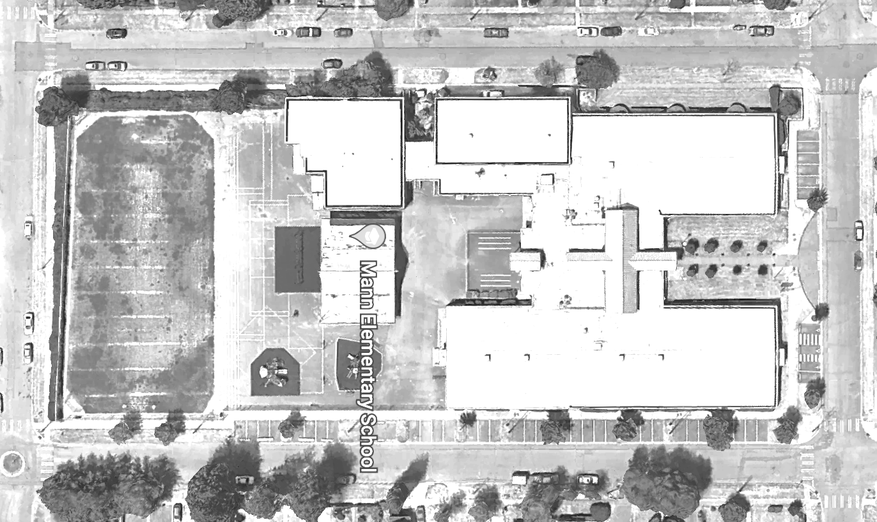


Mapping Your Schoolyard – Mann Elementary Name: ____________ Date: _________
Include on your map:
Symbols from the Key including flow of water, erosion, and storm drains.
Show where you see any evidence of possible stormwater problems (this could be places where there's lots of erosion or big puddles, or oil from cars, etc).
Add larger plants and bushes if they are there.
Notes:
PRINT THIS PAGE for the STUDENT WORKSHEET

Slide 6
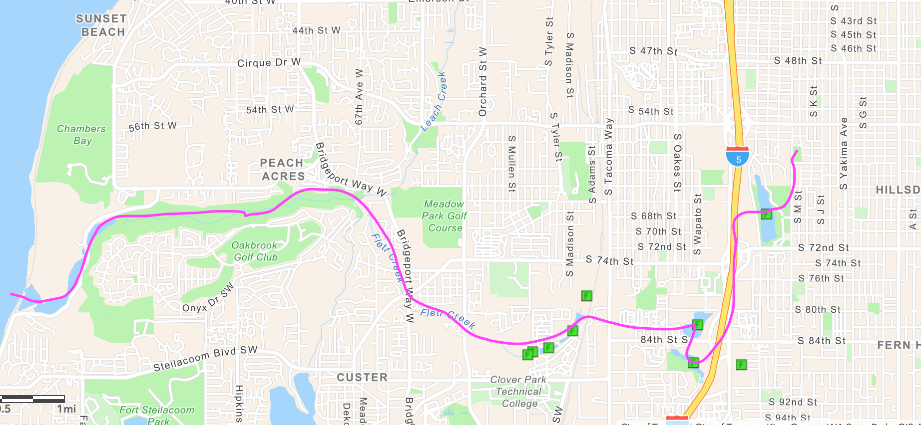

Local Stormwater Systems
What happens with the stormwater around your school?
Where does your stormwater runoff end up?
The stormwater from your school ends up in Flett Creek and Chambers Creek. Your school is in the Flett Creek Watershed.
Stormwater begins flowing south on S M St. and then flows south and discharges at Wapato Lake. It then travels west under I-5 and discharges into Wards Lake and then again at Gravel Pit. Stormwater then travels west, discharges into Flett Pond and continues into Flett Creek and Chambers Creek. Finally, the stormwater exits into Chambers Bay and Puget Sound.
Flett Creek covers 7,153 acres and is the second largest subwatershed in Tacoma and is mostly residential with light commercial and industrial areas.
Flett Creek subwatershed flows into Snake Lake and Wapato Lake. The Flett Creek surface water drains through a series of holding basins, including Hosmer, Ward’s Lake, a gravel holding basin just north of Ward’s Lake and the four Flett Creek holding basins in the west. At the last Flett Creek holding basin a pump station sends the water to the Flett Dairy wetlands, where it flows into Flett Creek. Downstream, Flett Creek flows into Chambers Creek, a salmonid-bearing stream, which discharges into Chambers Bay then to the Narrows.
Notes:
Source: https://www.cityoftacoma.org/cms/One.aspx?portalId=169&pageId=2860#Flett%20Creek
Please Note: The pipes information provided here is our best estimate of the stormwater flow in your community based on the information we have currently. If you encounter more information in the course of your investigation, please let us know so we can update future versions of this document.

Slide 7
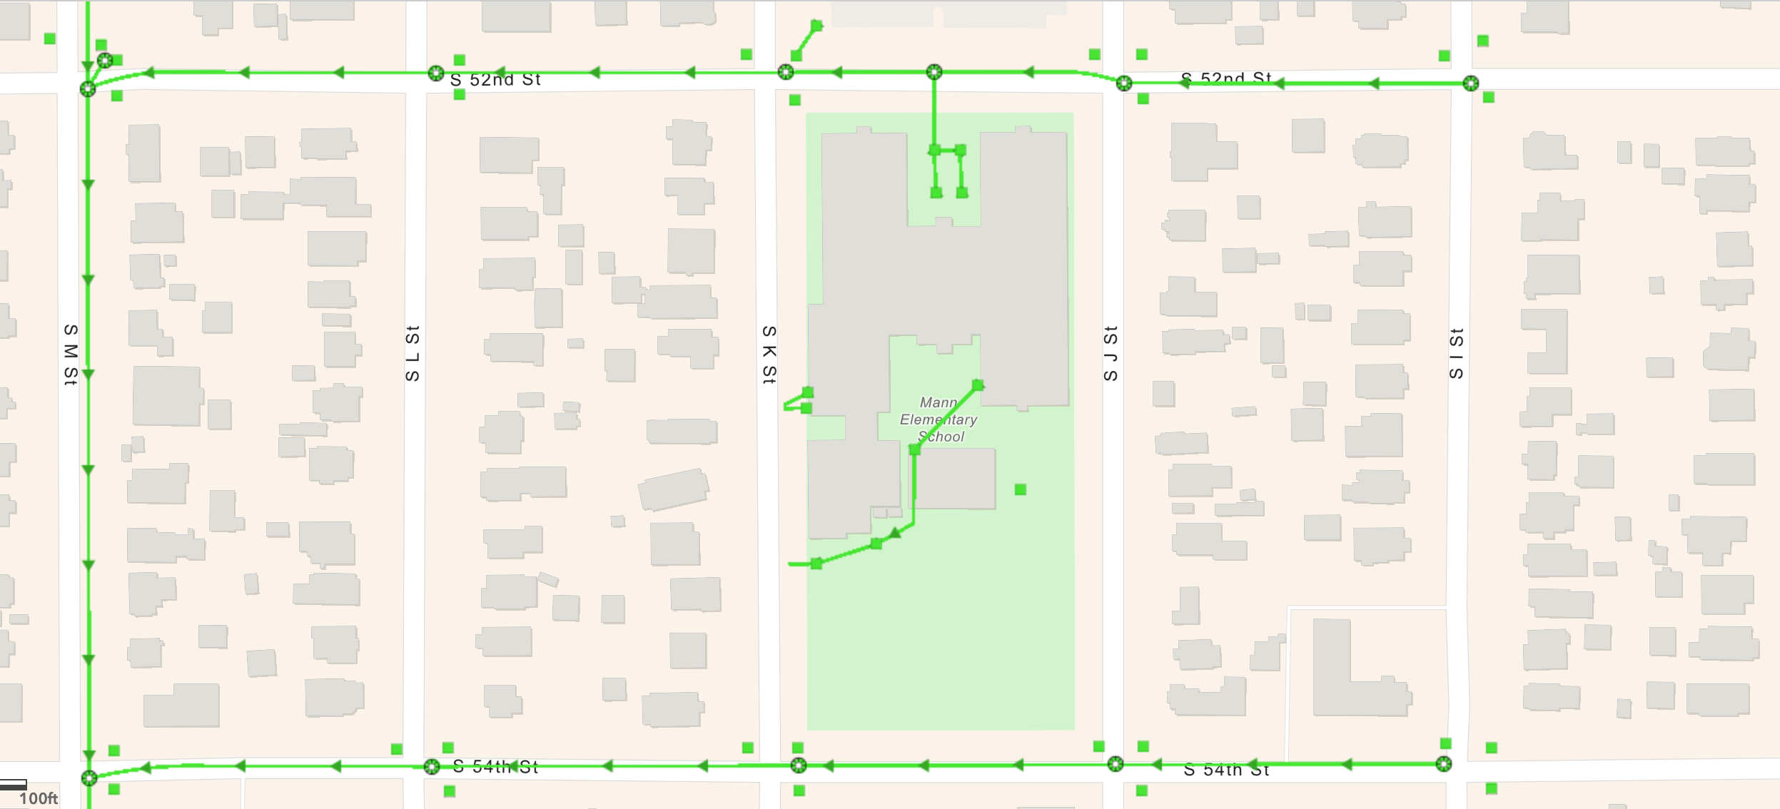
Mann Elementary Where does your school’s stormwater go?
Follow the lines and arrows!

Slide 8
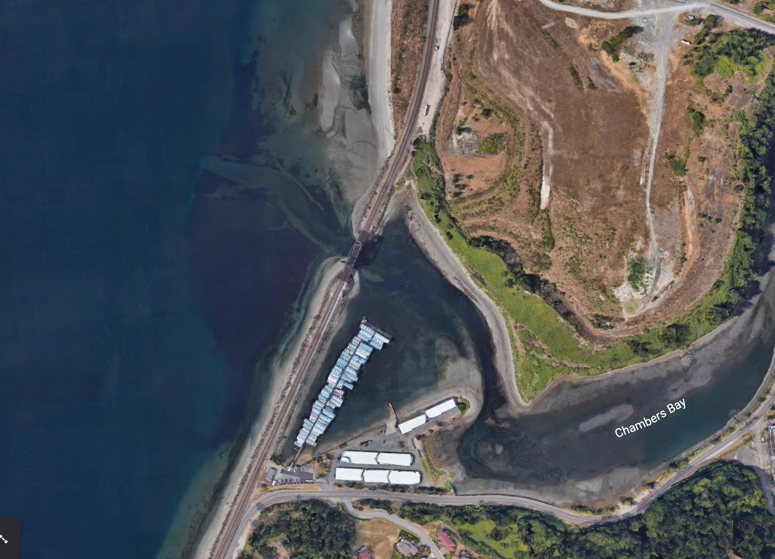
Now follow the pink line away from your school (find your school by looking for the star) to see how it gets to the Salish Sea!

Slide 9


How did we figure this out?
To view this map on your own, go here:
https://tacoma.maps.arcgis.com/home/webmap/viewer.html?layers=23e9a402b47d46058193362cb6c27a9e
View in “Map Classic”
Check “Surfacewater Network” box
Put in the name of the school
Zoom IN to see the green lines

