Slide 1


Community Waters School Guide:
Fern Hill Elementary
How to Use This Guide
This School Guide supports the Community Waters Science Unit Teacher Manual with information, maps, and images specific to your school and neighborhood.
It is written for teachers - its goal is to provide a better understanding of what is happening with stormwater in and around your school.
All content within may change, and can be adapted as desired.
If you have any questions about these maps, accompanying lessons, or stormwater around your school, contact IslandWood staff at communitywaters@IslandWood.org.

Slide 2
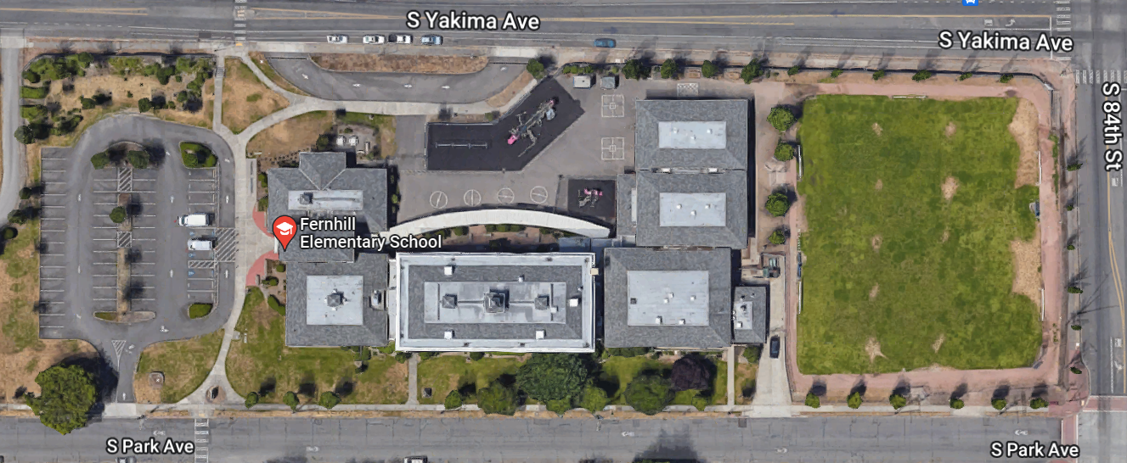
Stormwater in Our Schoolyard – Lesson 2
This map and points of interest (photos and info) can be used to guide your class’ exploration of the schoolyard. You will find the student worksheet for this lesson following the teacher guide version. Please use the extra space on the pages to add your own notes and questions!
D
A
F
E
C
C
D
C
B
E
A
C
A
G
E

Slide 3
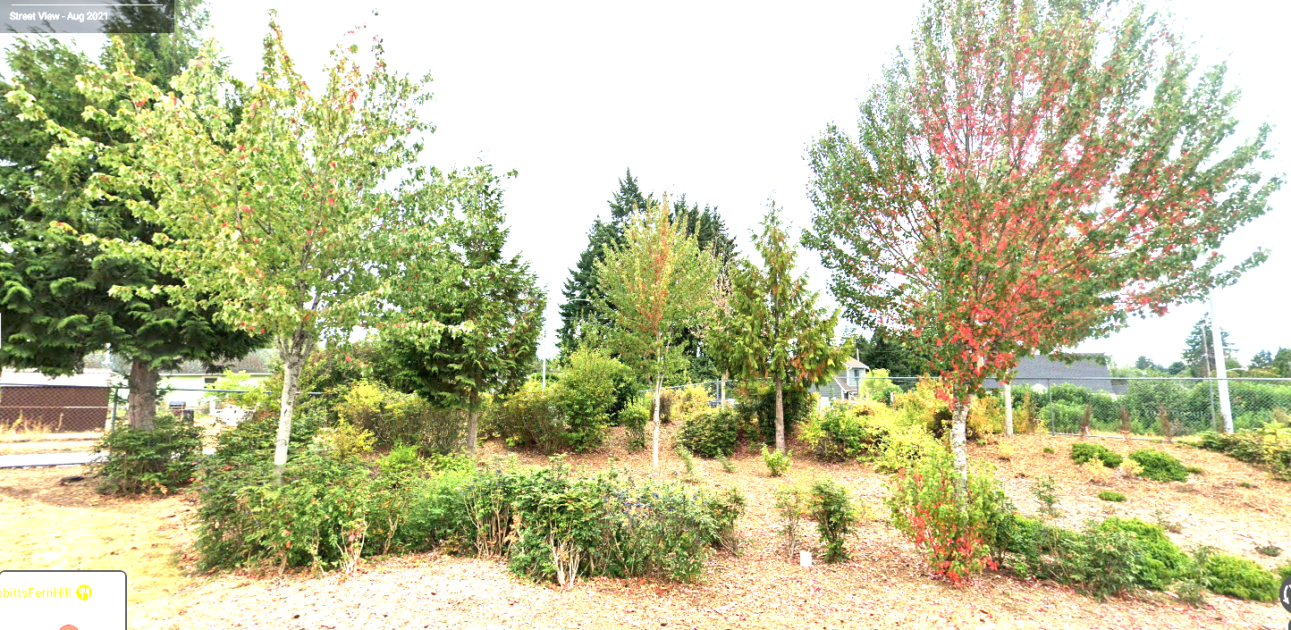
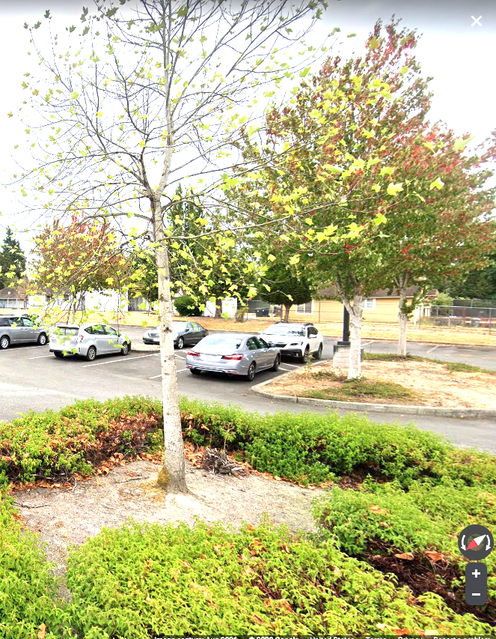
Schoolyard stormwater points of interest
A. Trees
Trees catch some rainwater in their leaves, releasing it more slowly to the ground. Tree roots hold soil in place so that it doesn't get washed away by runoff. Ask the students what they think trees do for stormwater. What would be different in this spot if these trees weren’t there? What is around the tree(s)? What kind of ground are they growing in? Do you like having trees in your schoolyard? Why or why not?

Slide 4
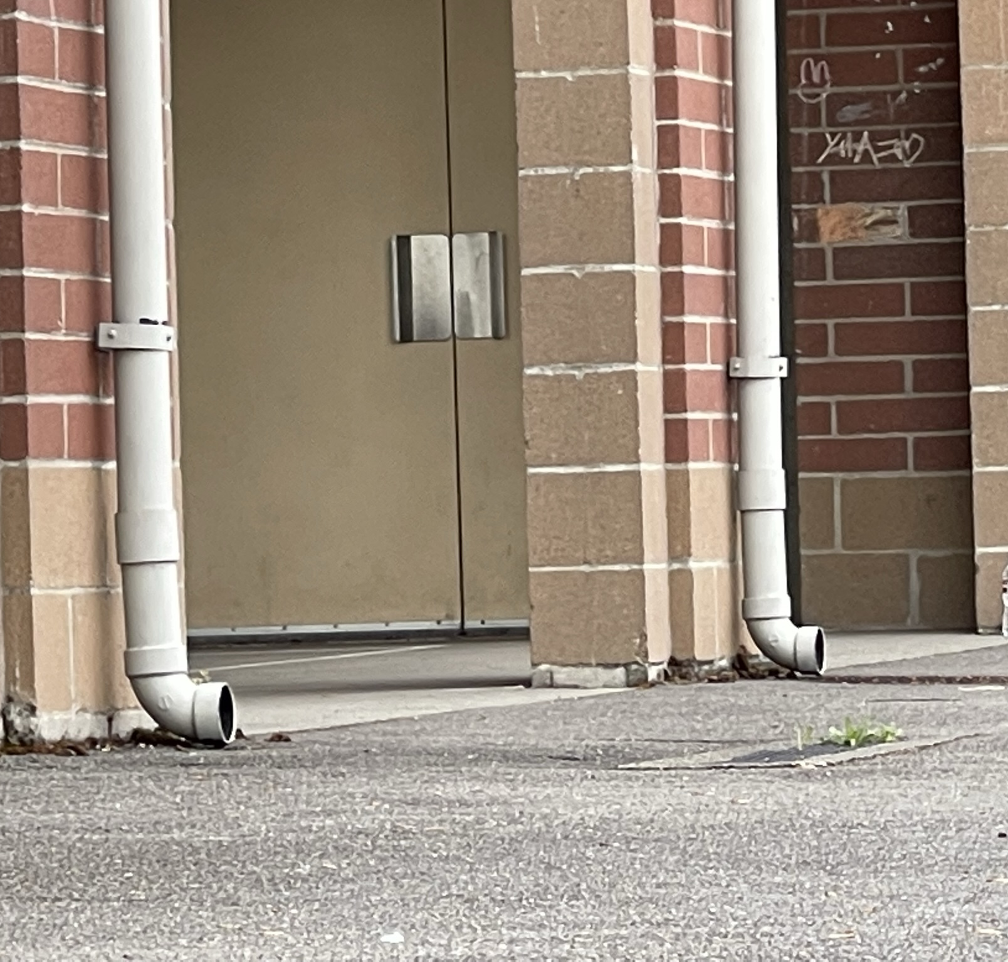
Schoolyard stormwater points of interest
B. Downspouts
Some downspouts drain into the ground near houses, while others are attached directly to the buildings sewer or stormwater pipes. Some go to locations where the water can soak in while others drain to the street or sewer systems. These downspouts collect water from this roof and send the stormwater into the ground. Can students find them? Where do you think the water might go? Where else can you find downspouts? Where does the water come from and where do you think it might go?

Slide 5
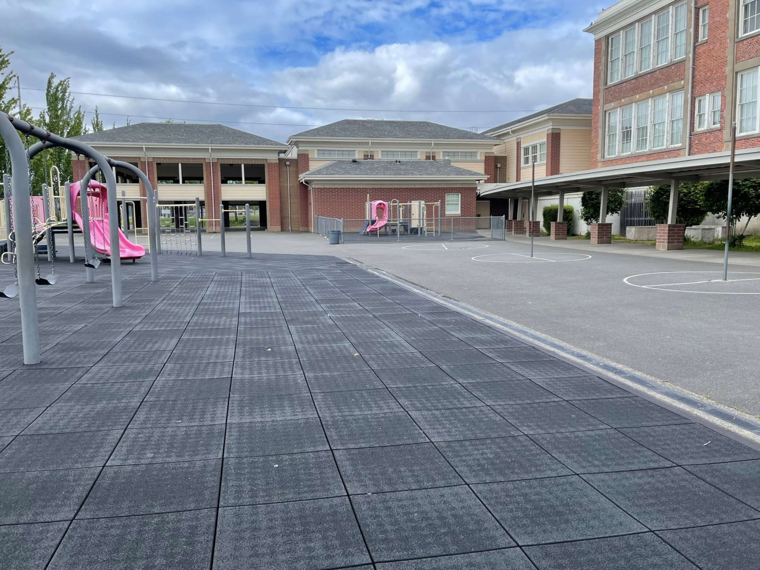
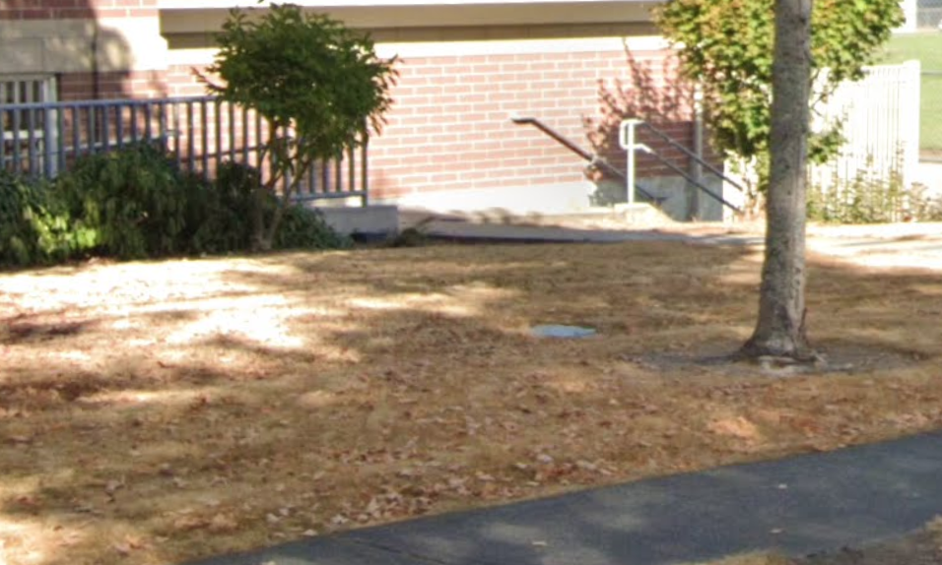
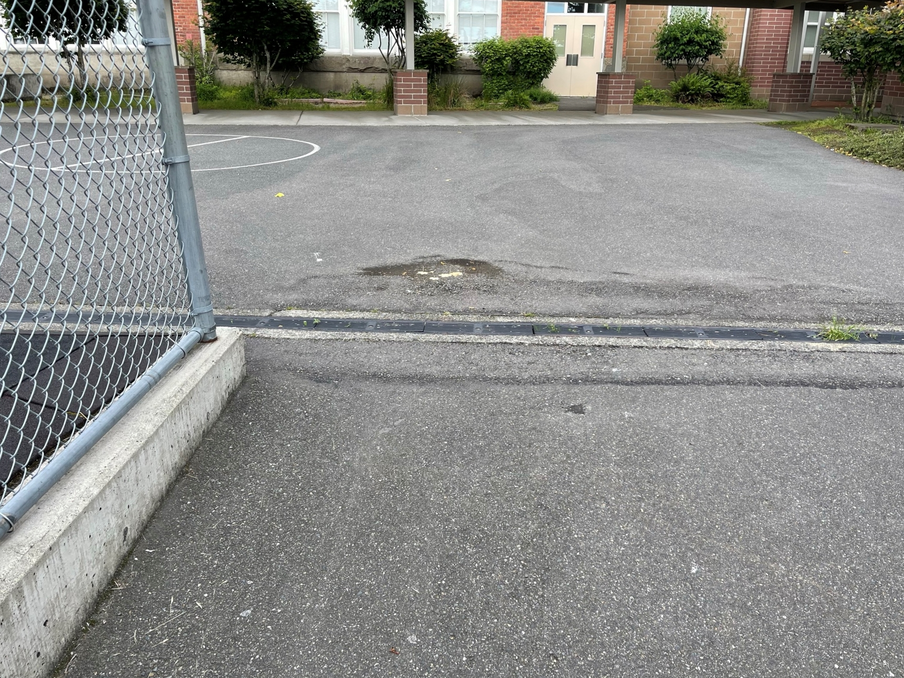
Schoolyard stormwater points of interest
C. Different surfaces
Observe all the surfaces in this area. Asphalt and most other paved surfaces are impervious. This means that no water soaks into them. Instead, it flows off the pavement into drains and onto soil, carrying whatever substances are on the pavement. Some newer surfaces are designed to pervious (let the water in) - what happens when water hits this surface? Where does the water go? What do you see that slows down stormwater? What speeds it up?
Grass = Pervious, unless it’s too compacted!
Recycled Rubber Squares = Semi-permvious (but what’s underneath?)
Black Top = Impervious

Slide 6
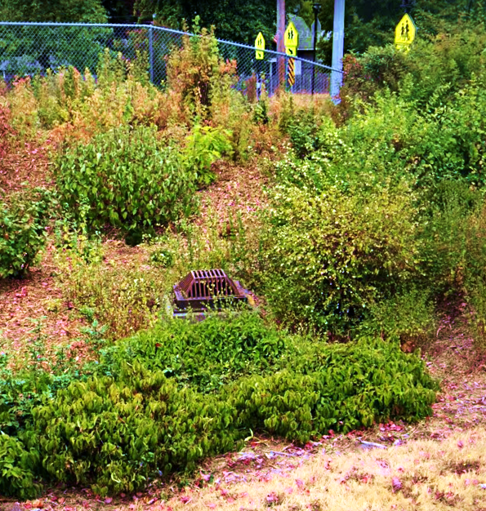
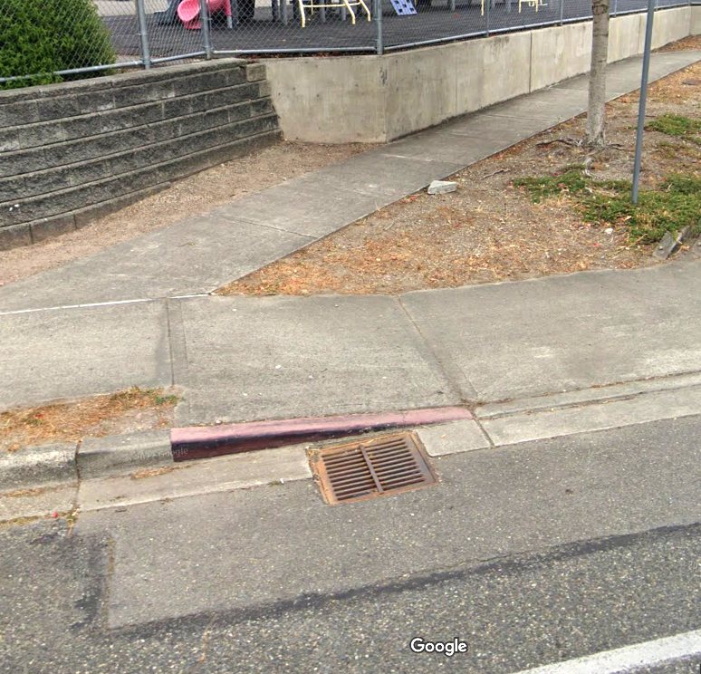
Schoolyard stormwater points of interest
D. Drain
Drains move water into underground pipes to take it somewhere else. Anything that gets carried into the drain could end up in the Puget Sound. Why do you think the drain was built in this location? Where does water come from that goes into this drain? Why might it have been placed in this place? Is the drain working properly? What is in the drain?
E. Storm Drain in Grass - Why would they build a storm drain in the plants? Is this area pervious or impervious – what happens to water here? Try pouring water on the grass: does the water soak in quickly or go into the drain?

Slide 7
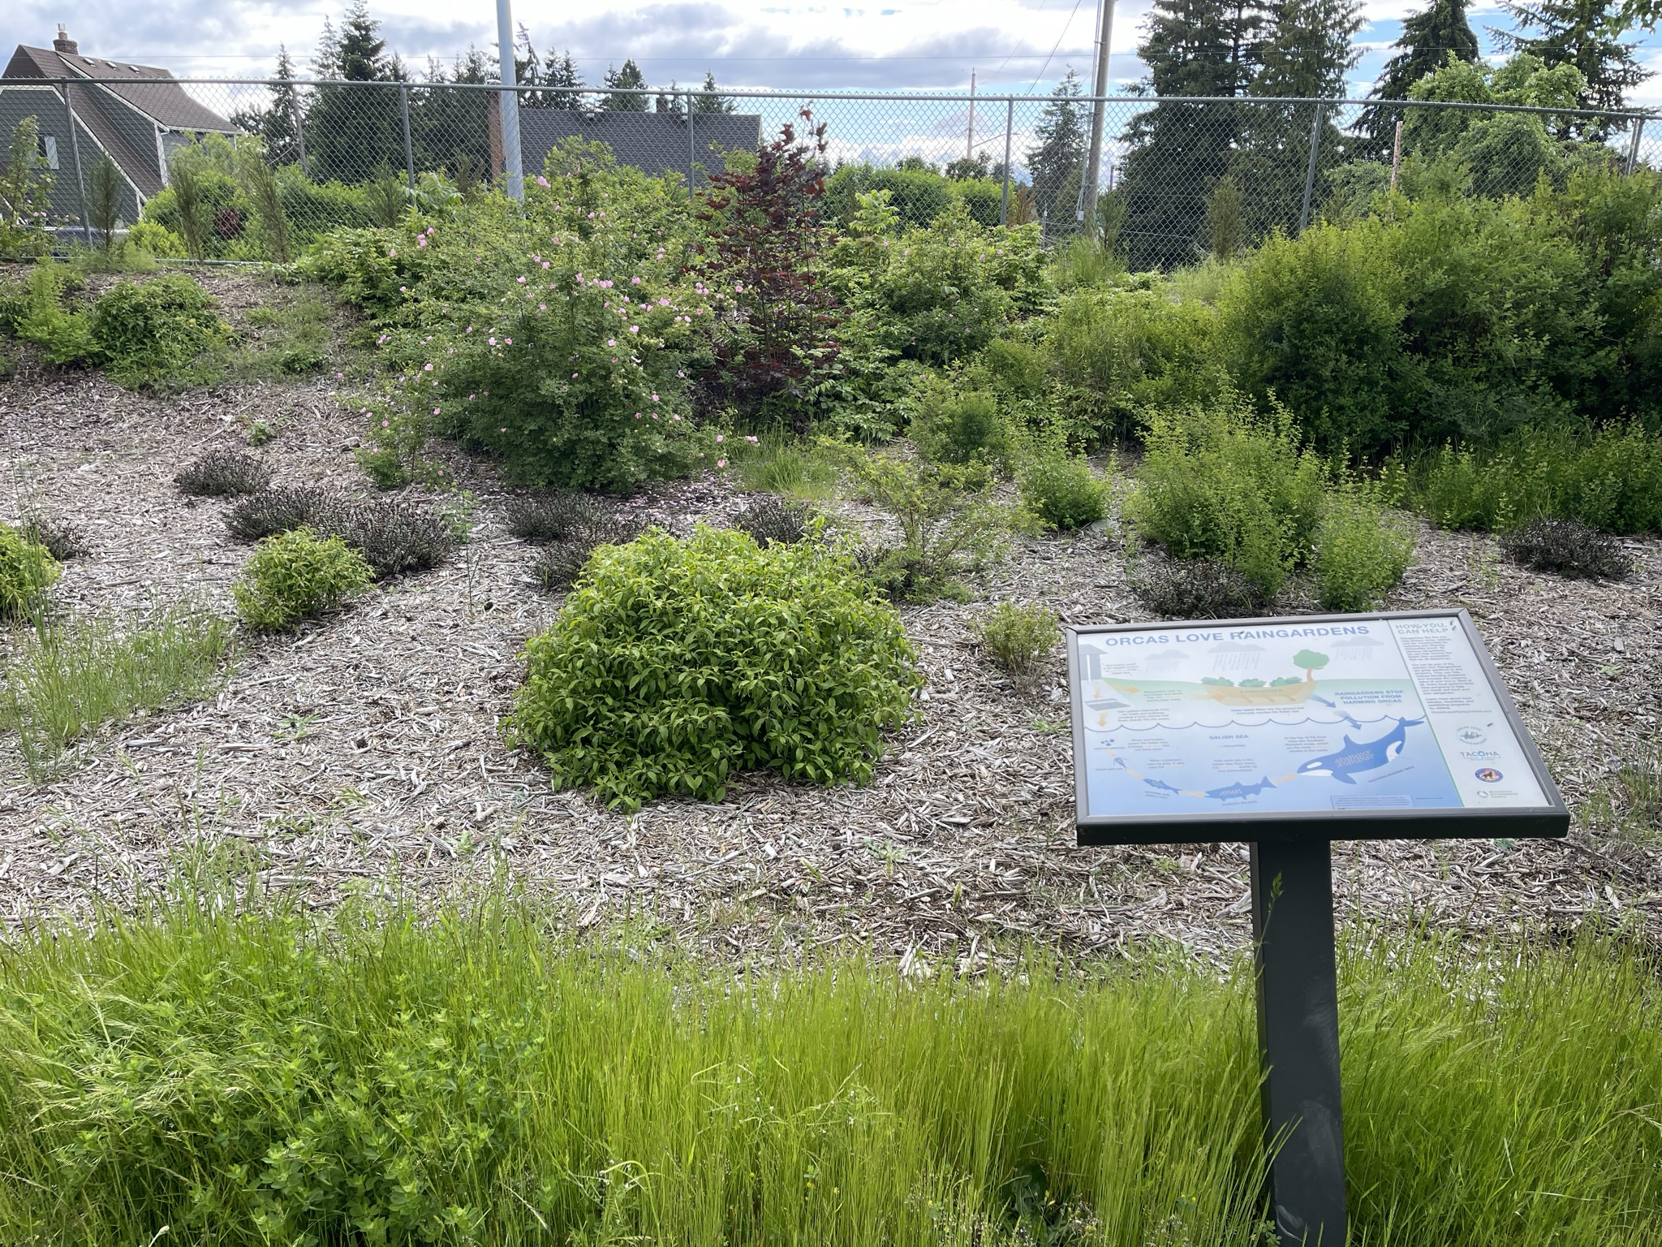
Schoolyard stormwater points of interest
F. Rain Garden - Rain gardens have a shallow depression to hold water while it soaks in and provides water to the plants in the garden. Rain gardens can slow, filter and absorb runoff. What do you notice about the garden? What happens to water when it goes into the garden? Have students notice where water can enter the rain garden and what happens if it fills up. What types of plants are living here, and how do they compare to the kinds of plants other places at school? Why would they be different?

Slide 8
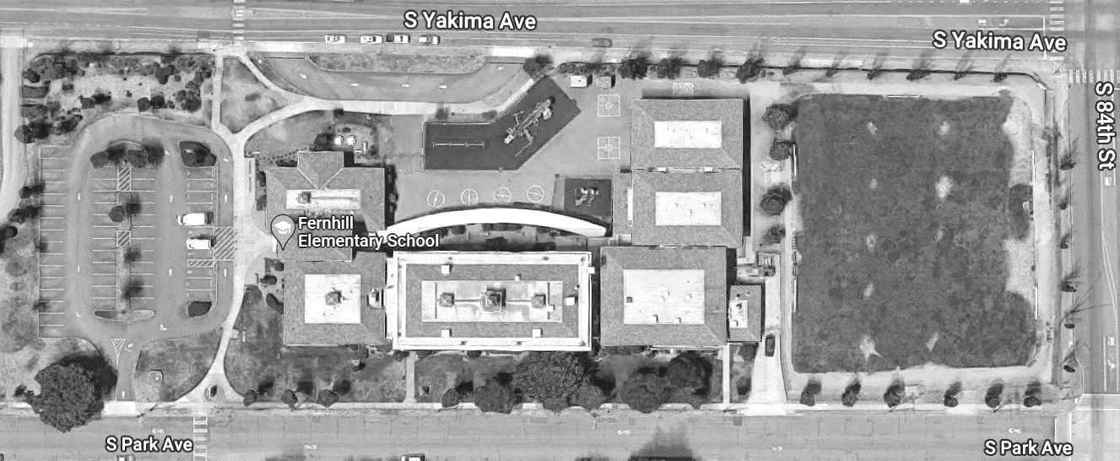
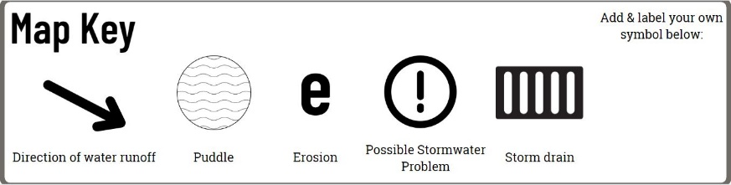
Mapping Your Schoolyard – Fern Hill Elementary
Include on your map:
Symbols from the Key including flow of water, surfaces, and storm drains.
Label locations of litter, pollution and places where puddles form.
Sketch any stormwater problems you see or are aware of.
Sketch larger plants and bushes.
Notes:
PRINT THIS PAGE for the STUDENT WORKSHEET

Slide 9
Local Stormwater Systems
What happens with the stormwater around your school?​
Some of it gets absorbed slowly by pervious ground like grass and gardens. Some of it travels quickly along the impervious surfaces of the ground until it finds a stormwater drain. ​
Where does your stormwater runoff end up?
The stormwater from your school is in the Flett Creek Watershed. At first it travels to the South and West through underground pipes and over surfaces like roads, sidewalks. Then it goes North towards Owens Marsh and Wards Lake. Then West again until it meets up with Flett Creek. Flett Creek then meets up with Chambers Creek to Chamber’s Bay where it meets the Narrows and to Puget Sound.
Notes:
Please Note: The pipes information provided here is our best estimate of the stormwater flow in your community based on the information we have currently. If you encounter more information in the course of your investigation, please let us know so we can update future versions of this document.

Slide 10
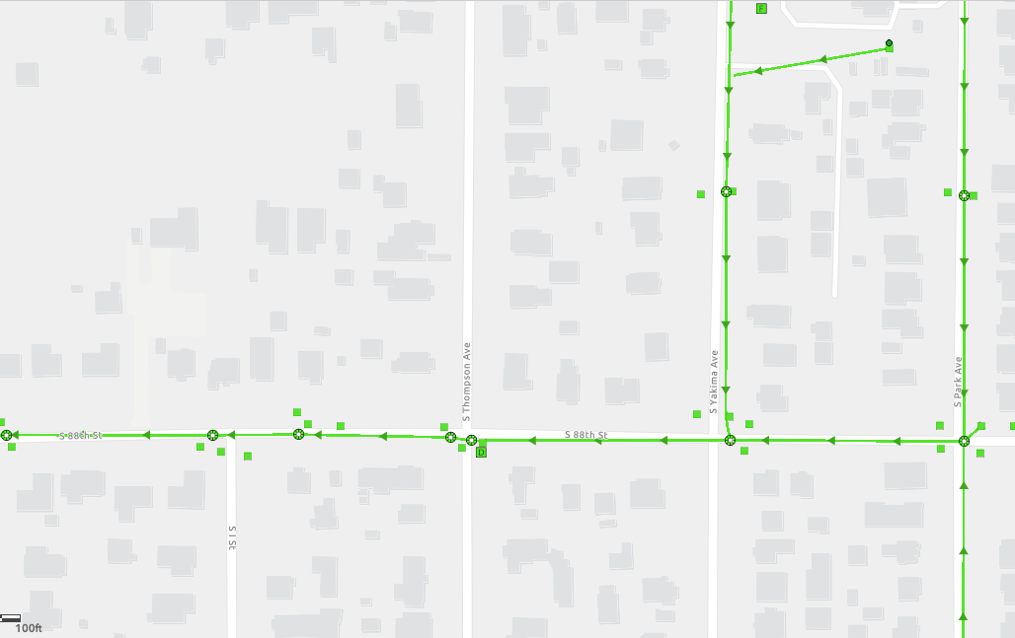
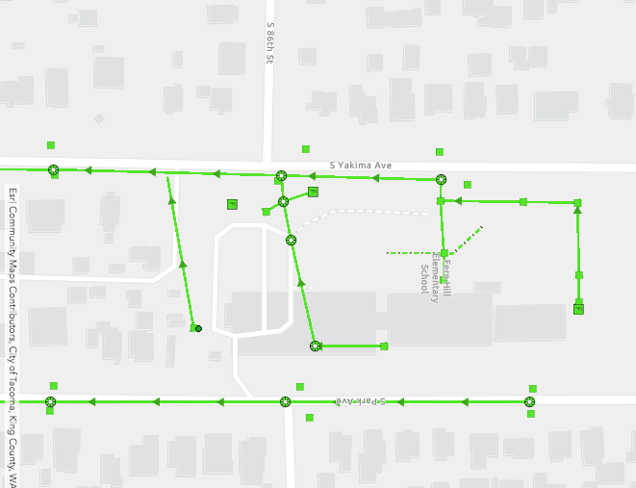
Fern Hill Elementary Where does your school’s stormwater go?
Follow the lines and arrows!

Slide 11
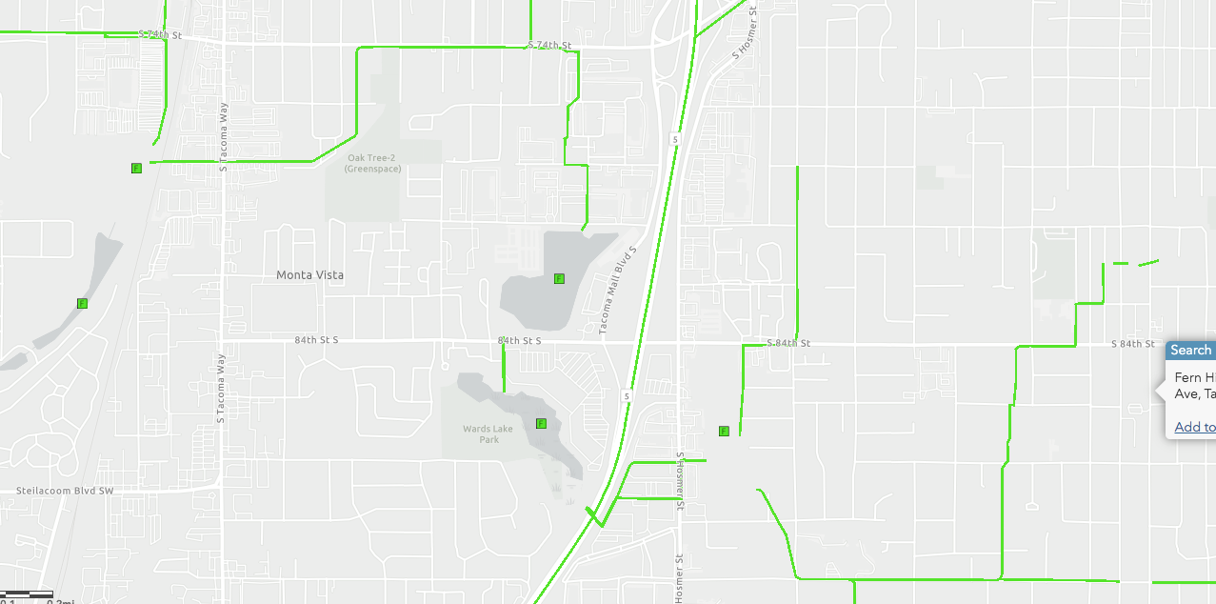
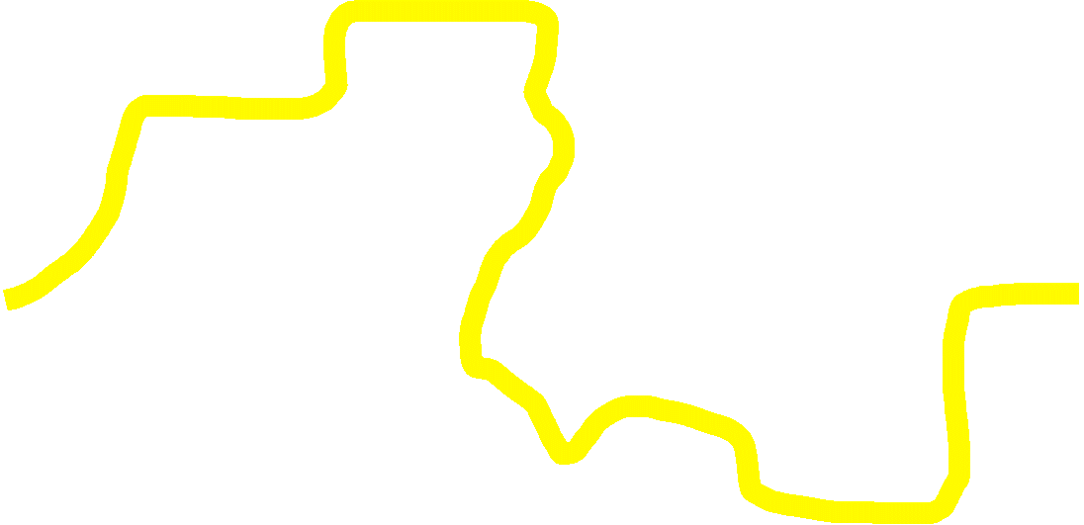
This map is zoomed out. Follow the yellow line to see how the stormwater gets from your school to Flett Creek.

Slide 12
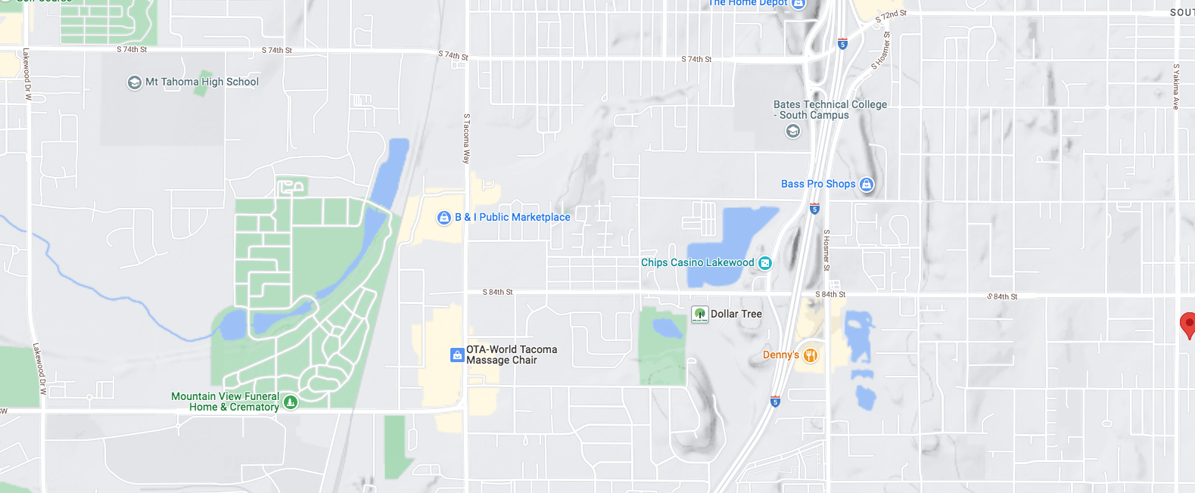
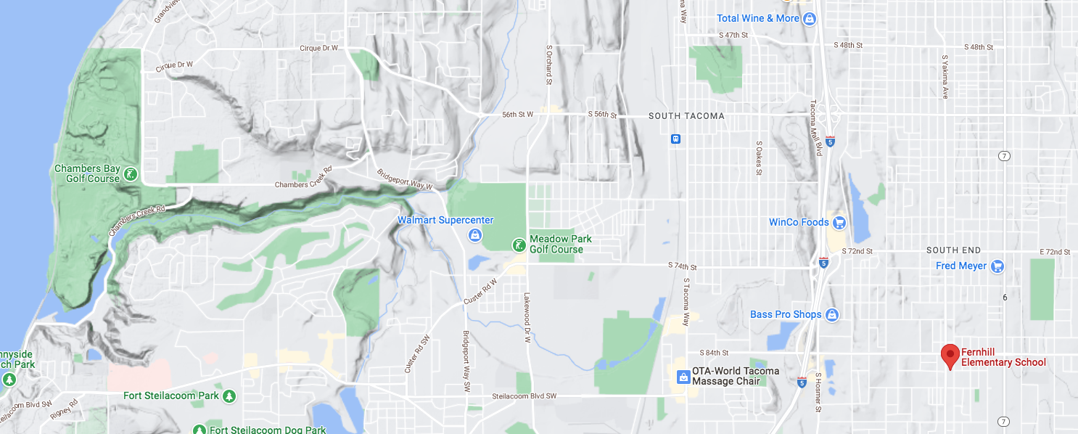


The stormwater around your school goes through greenspaces like a marsh as well as underground pipes, and then comes to the surface before it reaches Flett Creek that takes it to Chambers Bay.
Now follow the yellow line away from your school (find your school by looking for the star) to see how it gets to the Chambers Bay/Puget Sound!

Slide 13


How did we figure this out?
To view this map on your own, go here:
https://tacoma.maps.arcgis.com/home/webmap/viewer.html?layers=23e9a402b47d46058193362cb6c27a9e
View in “Map Classic”
Check “Surfacewater Network” box
Put in the name of the school
Zoom IN to see the green lines

Slide 14
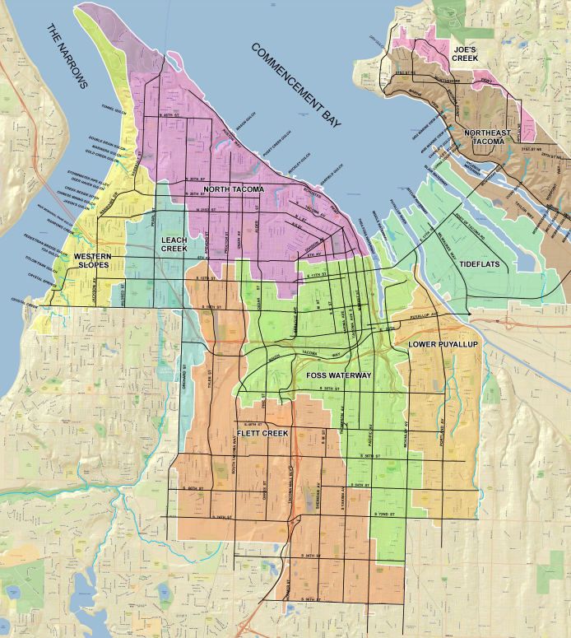
Optional: Stormwater in Our Community
Additional points of interest as suggestions for students exploring their neighborhoods or the area near the school, recognizing there may be other things of importance to note that are in the area or region surrounding your school but not on your school grounds.
Find your school on this map by locating the red FH for Fern Hill. Recognize the rivers that are near by that connect to the Puget Sound. Find the red CB for Chambers Bay. See the rivers in between. What sort of wildlife, animals, fish and plants live in the area in between these two places? What could humans do to make sure the area in between these two places is a clean as possible so that stormwater doesn’t bring pollution with it to these habitats?
CB
FH

