Slide 1


Community Waters School Guide:
Mary Lyon Elementary School
How to Use This Guide
This School Guide supports the Community Waters Science Unit Teacher Manual with information, maps, and images specific to your school and neighborhood.
It is written for teachers - its goal is to provide a better understanding of what is happening with stormwater in and around your school.
All content within may change, and can be adapted as desired.
If you have any questions about these maps, accompanying lessons, or stormwater around your school, contact IslandWood staff at communitywaters@IslandWood.org.

Slide 2
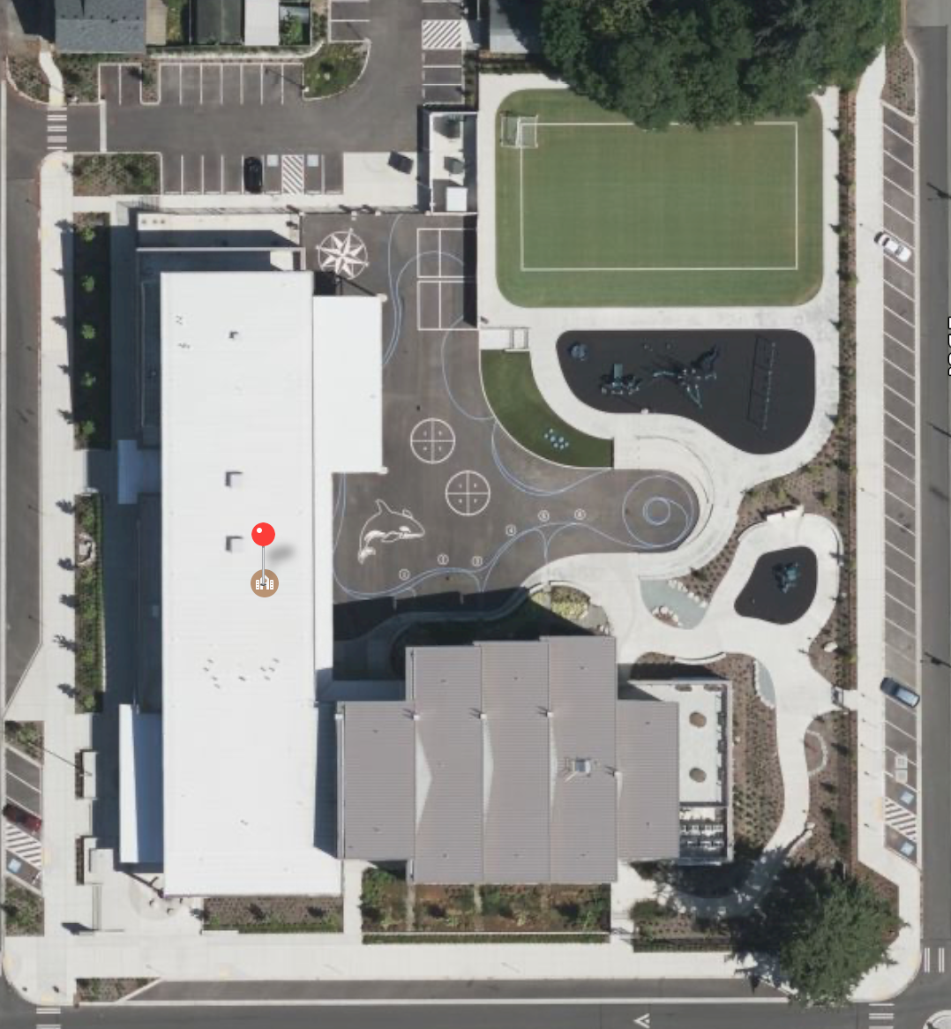
Stormwater in Our Schoolyard – Lesson 2
A
This map and points of interest (photos and info) can be used to guide your class’ exploration of the schoolyard. You will find the student worksheet for this lesson following the teacher guide version. Please use the extra space on the pages to add your own notes and questions!
Mary Lyon has wonderful stormwater features!
Because so many things were built here to help with stormwater, it may be challenging to find “problems” with stormwater at your school.
B
C
D
E
G
E

Slide 3
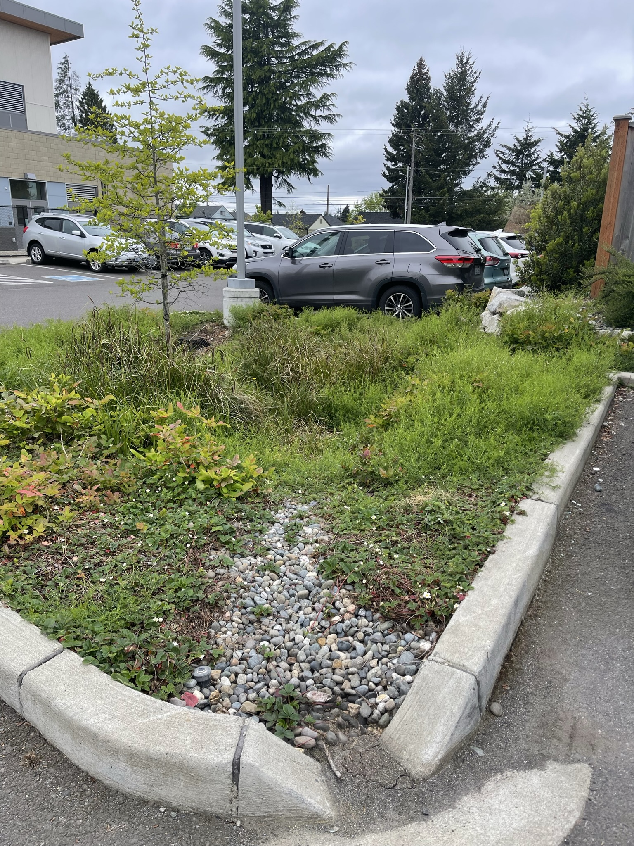
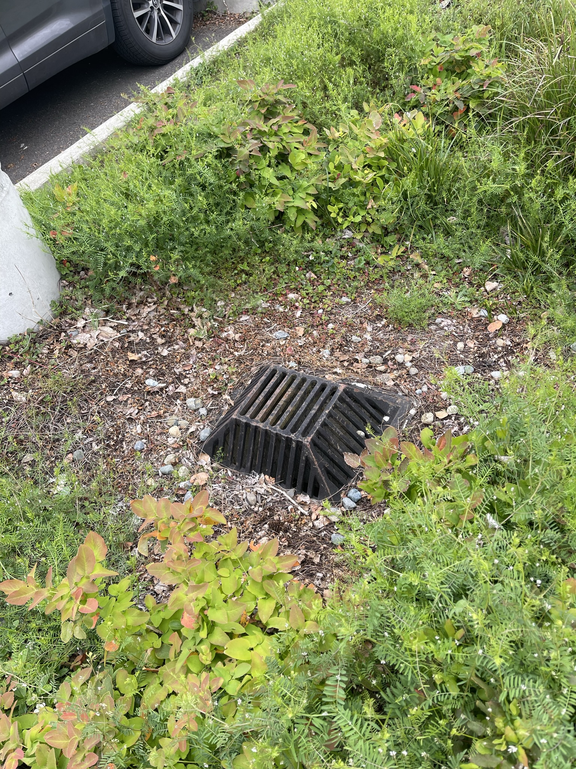
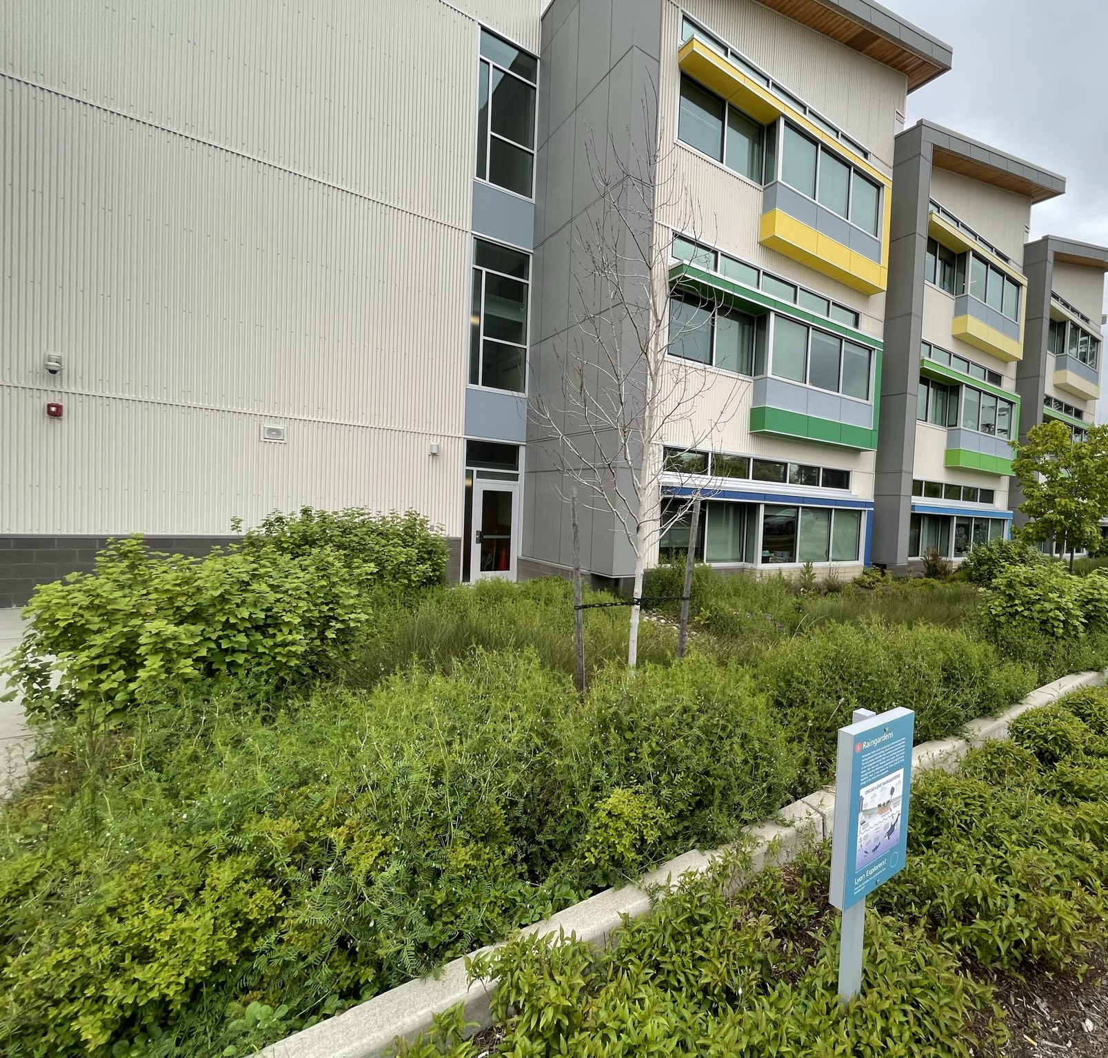
Schoolyard stormwater points of interest
A. Rain Gardens/Swales. Notice what water flows into this area and where it is coming from. Where is it leading to? What do the plants and soil do for the flowing water?
C. Parking lot surfaces – Notice the way this area is engineered.
Why are the rocks and plants there? What happens to water as it flows over these surfaces? Where does it go next?
B. Storm Drain – Notice the placement of this drain and the surfaces around it. Why might this drain have been put here? What might happen to stormwater here?

Slide 4
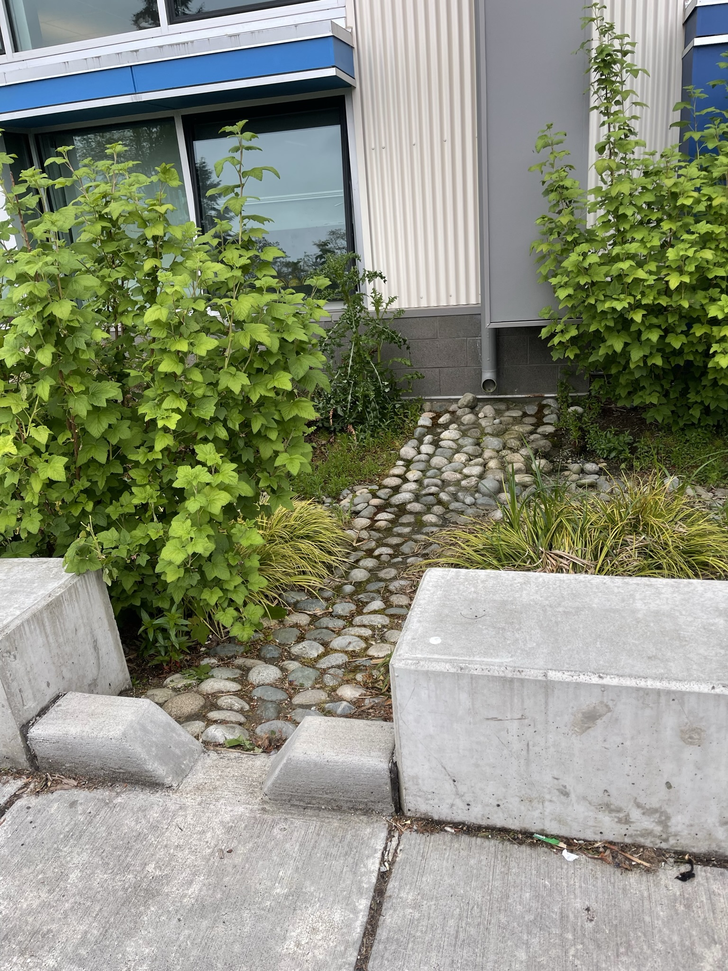
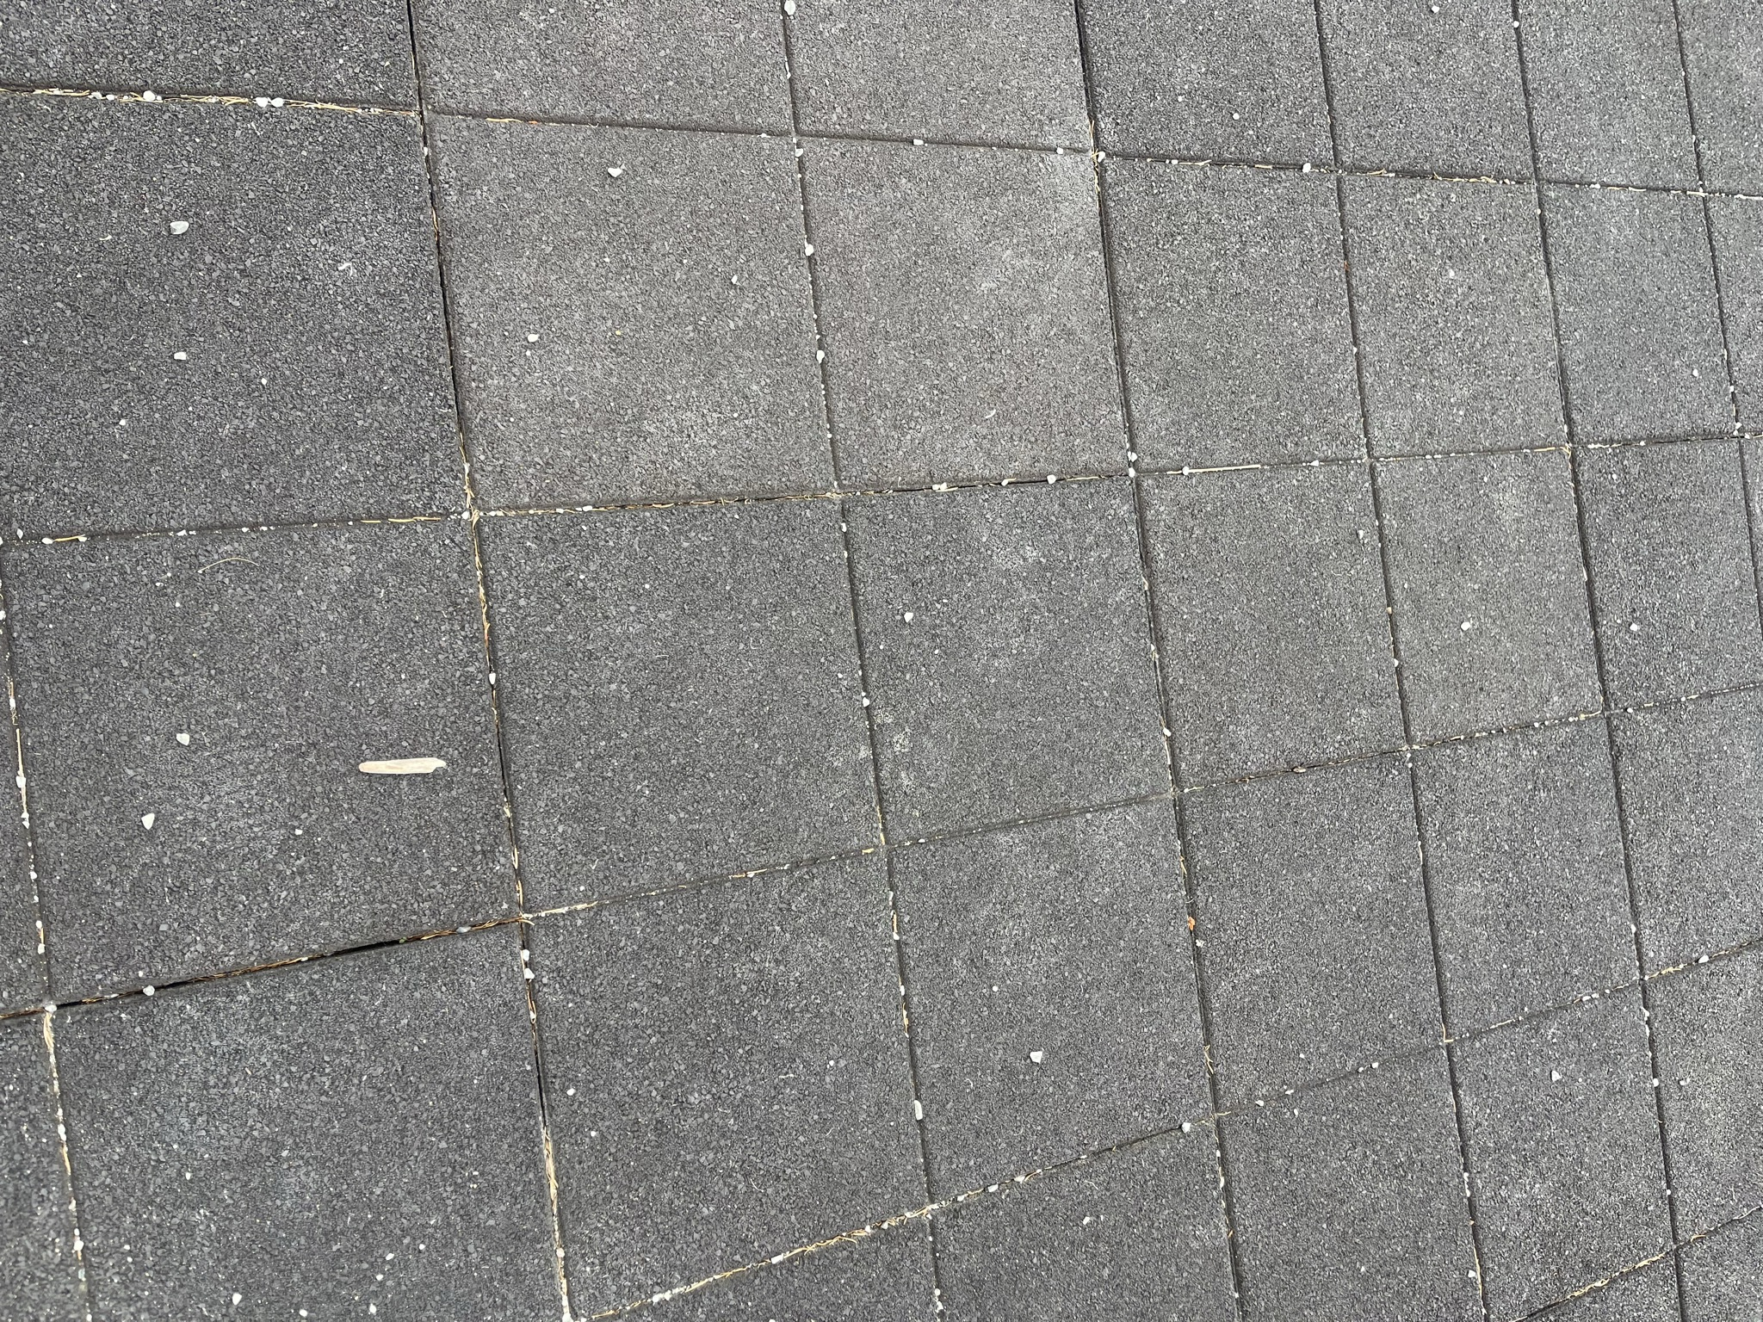
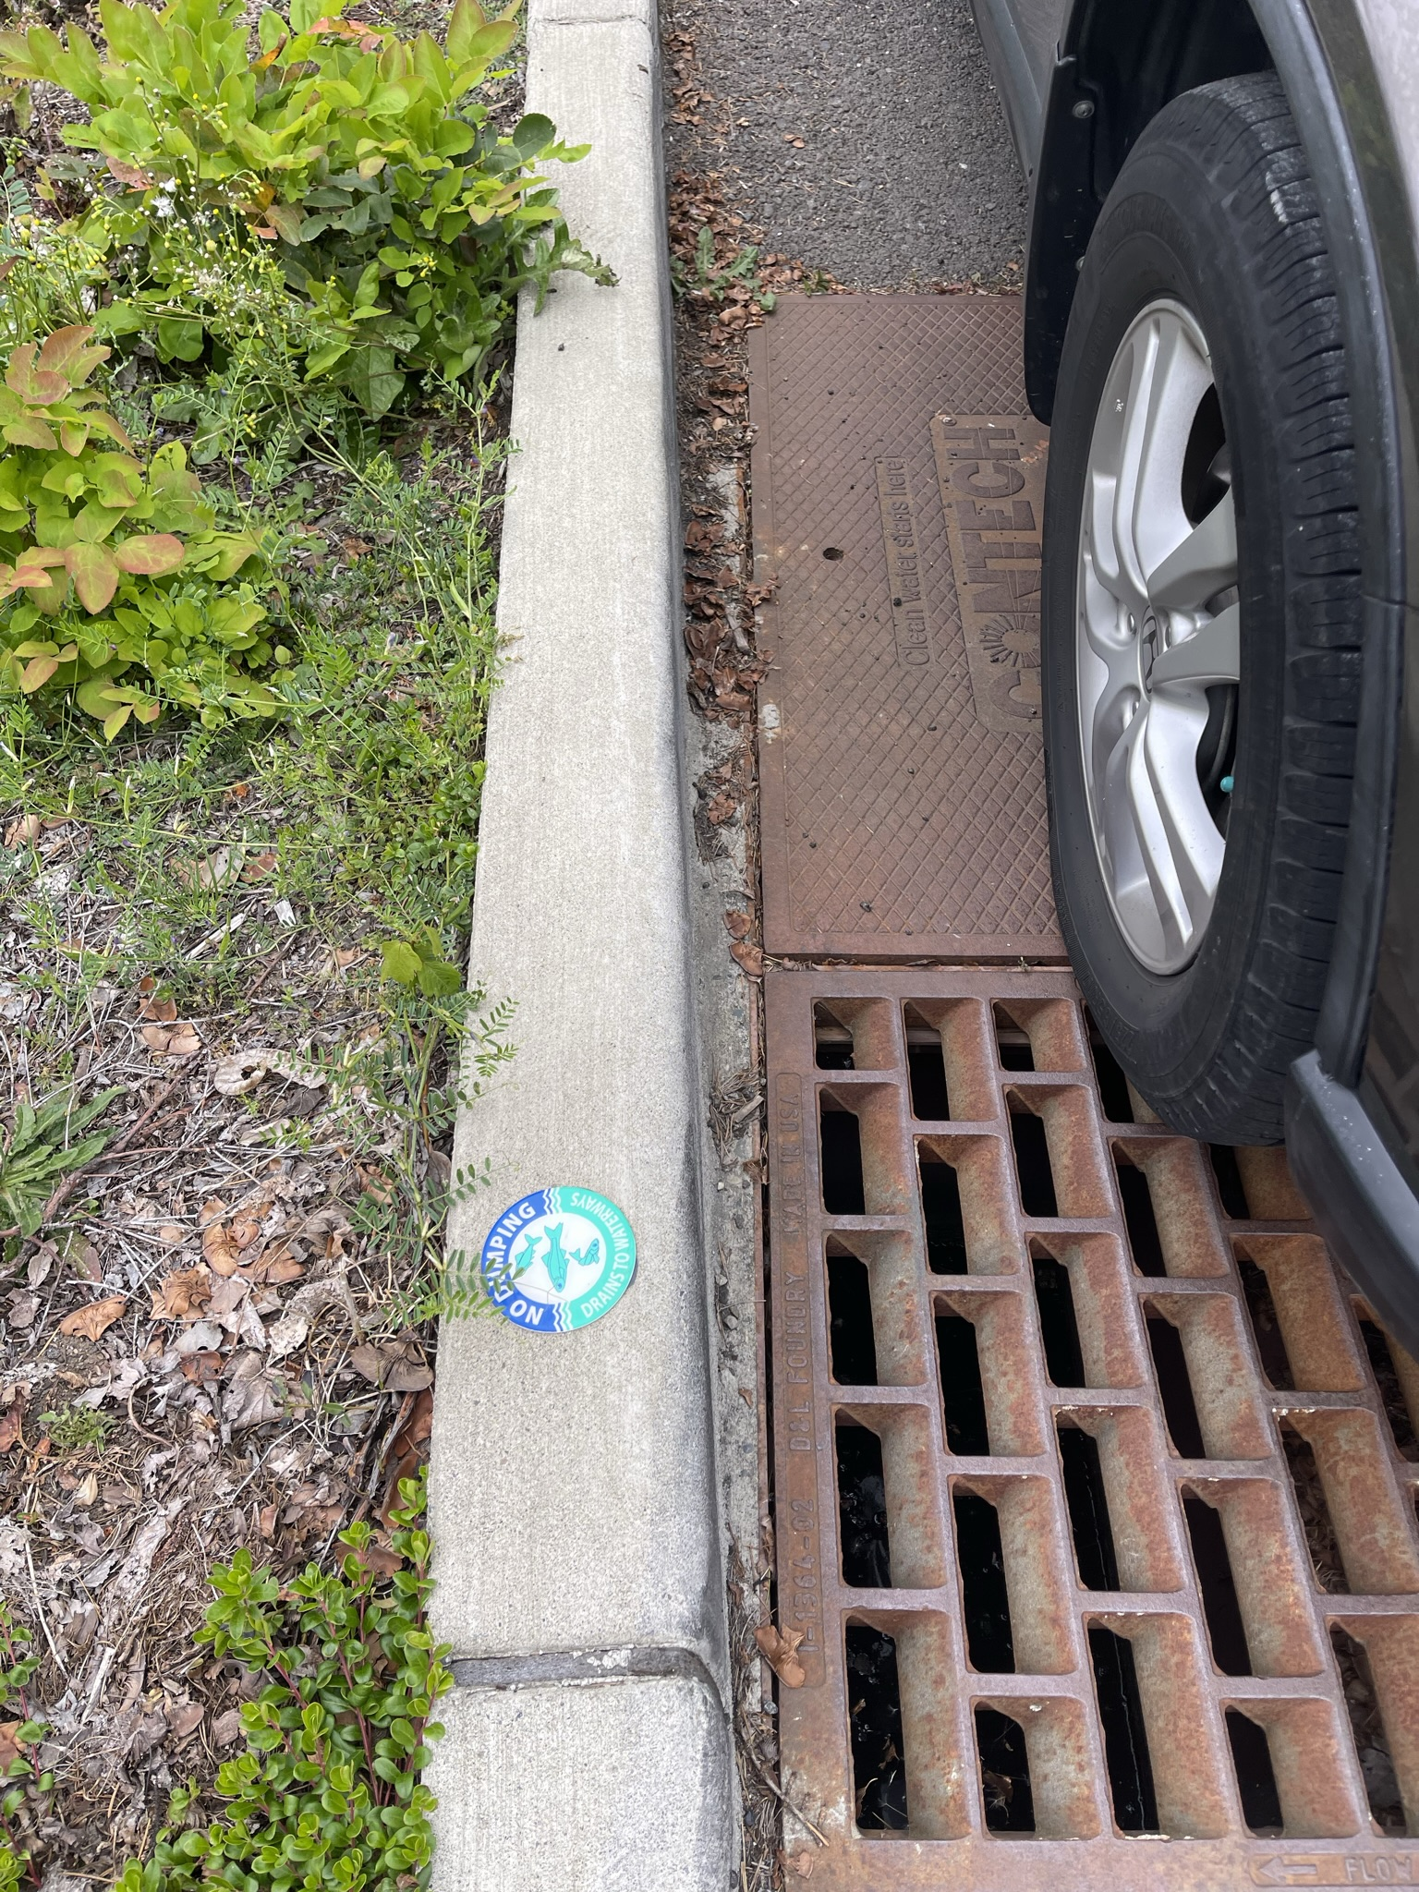
F. Drain. Notice where this drain is located and the surrounding surfaces that direct water towards it. Why is it located in this spot? What is water that falls as rain going to pick up as it flows into this storm drain?
E. Playground surfaces. Notice the direction that water flows on the surface and where it ends up.
What happens to rain as it falls here? Is this surface pervious or impervious? Test it out with some water!
D. Downspouts and surfaces. Notice the surface underneath where water exits the downspout. Why are the rocks placed there? What happens to water as it flows across these surfaces?

Slide 5
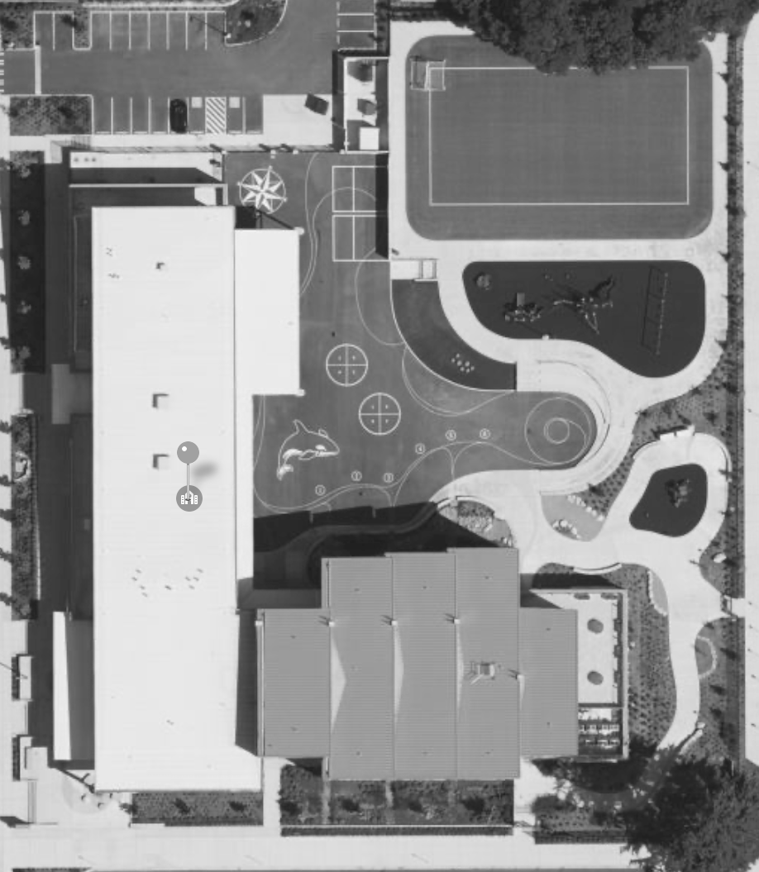
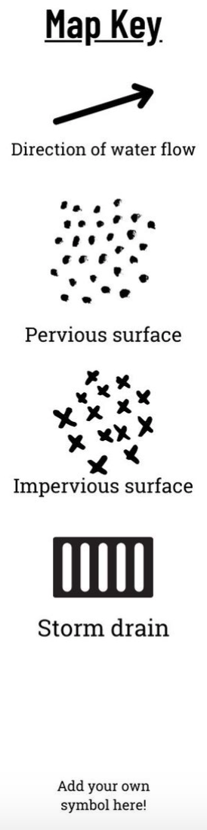
Mapping Your Schoolyard – Mary Lyon Elementary School Name: ____________ Date: _________
Include on your map:
Symbols from the Key including flow of water, surfaces, and storm drains.
Label locations of litter, pollution and places where puddles form.
Sketch any stormwater problems you see or are aware of.
Sketch larger plants and bushes.
Notes:
PRINT THIS PAGE for the STUDENT WORKSHEET

Slide 6
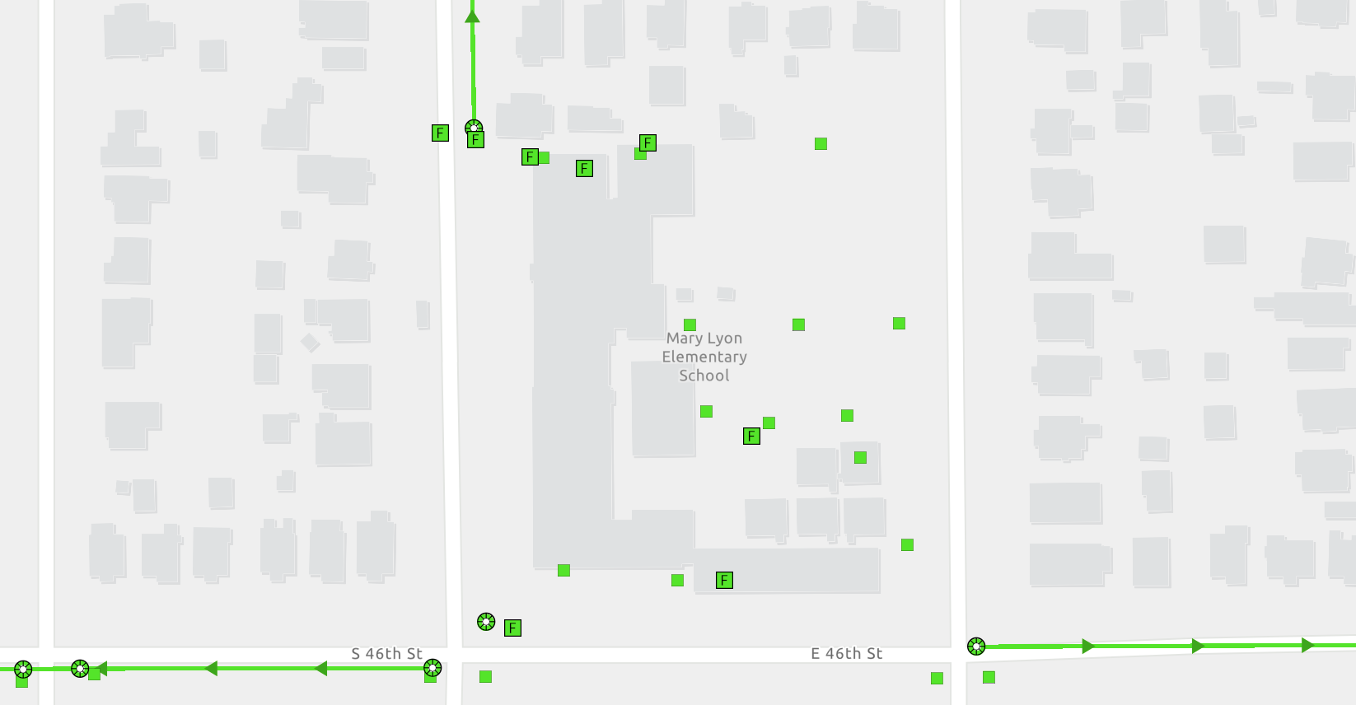
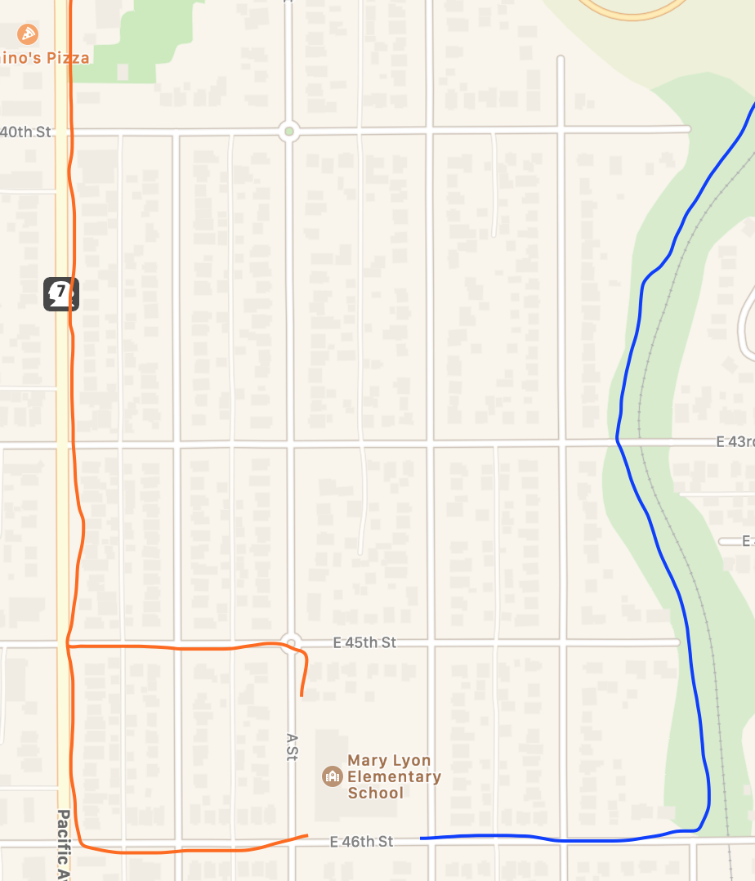
Local Stormwater Systems
What happens with the stormwater around your school?
Water that flows into the storm drains and catch basins near your school empty into stormwater pipes underground. The water travels along 46th St, depending on which side of your school, either travelling West until it reaches Pacific Ave (see orange line) OR travelling East and stays in pipes that parallel the nearby railroad (see blue line).
Notes:
Please Note: The pipes information provided here is our best estimate of the stormwater flow in your community based on the information we have currently. If you encounter more information in the course of your investigation, please let us know so we can update future versions of this document.

Slide 7
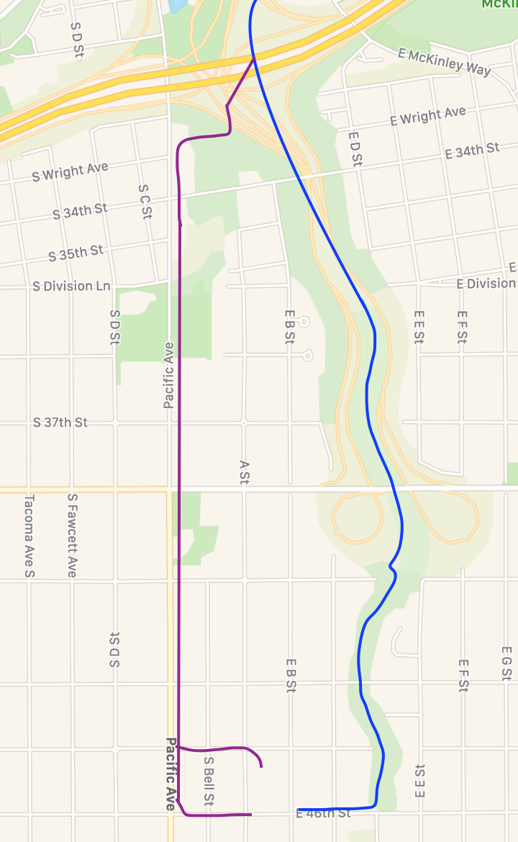
Where does your stormwater runoff end up?
The water in these stormwater pipes then begins travelling North, either along Pacific Ave or continuing to follow the stream (becoming a pipe). The pipes on Pacific Ave turn East near S Wright Ave and join the other pipe under WA-7. It continues to travel North, until it crosses under Dock St and finally reaches Thea Foss Waterway. Here the water travels out into Commencement Bay and into the Puget Sound!
See the next slides for a complete zoom out!

Slide 8
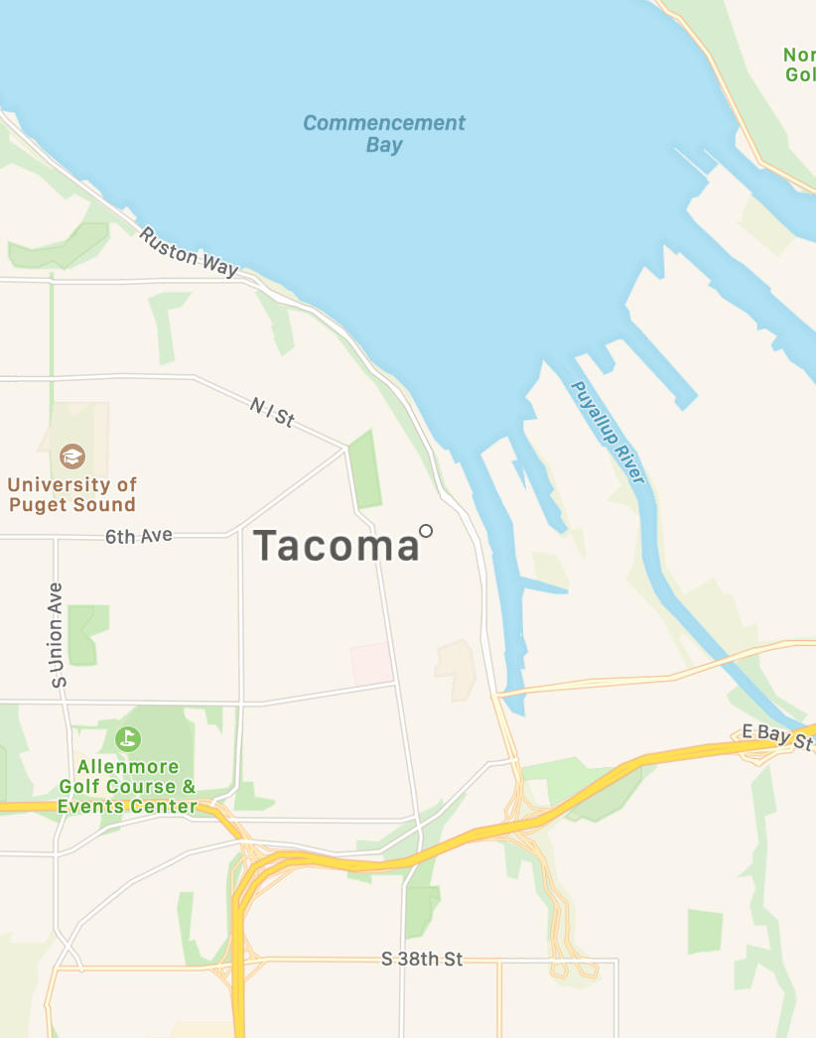
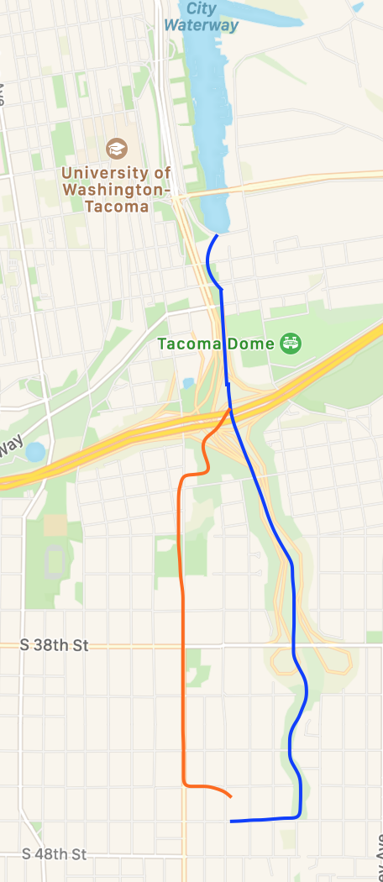
And here is how it reaches all the way out to Commencement Bay…
Mary Lyon Elementary School is a part of the Foss Waterway Watershed.
Foss Waterway is a subwatershed of the Puyallup watershed. Covering 5,781 acres in south-central Tacoma this subwatershed is mostly residential but contains Tacoma’s industrial businesses located in the Tideflats and Nalley Valley.
The Thea Foss and Wheeler-Osgood waterways became designated Superfund cleanup sites in 1983. Waterway cleanup and construction was finished in 2006. The City will monitor the waterway for the next 10 years.

Slide 9
Mary Lyon Elementary School Where does your school’s stormwater go?
Follow the lines and arrows!

Slide 10
Local Stormwater Systems
Where does the stormwater from your school go?
Notes:
Please Note: The pipes information provided here is our best estimate of the stormwater flow in your community based on the information we have currently. If you encounter more information in the course of your investigation, please let us know so we can update future versions of this document.

Slide 11
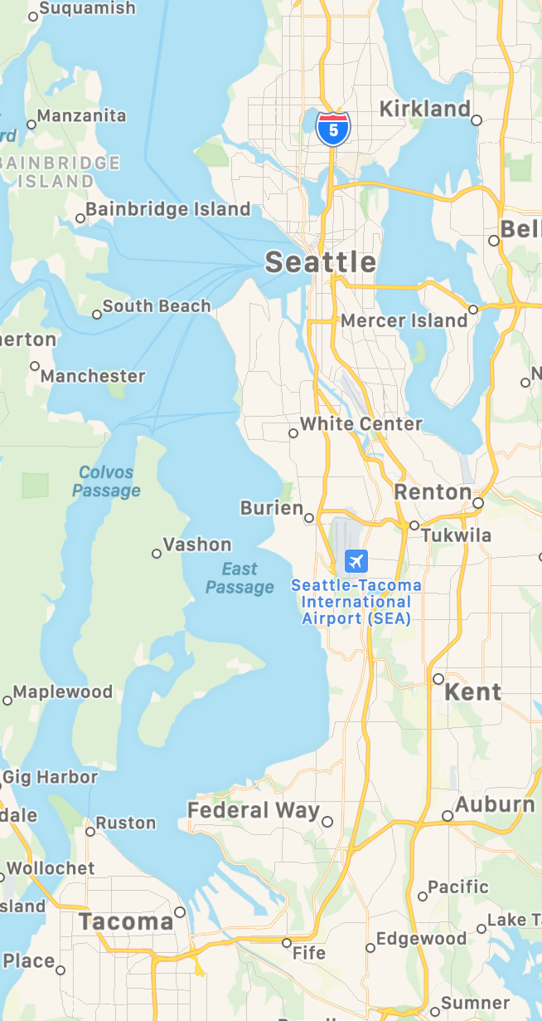
And here is how it reaches all the way out to Commencement Bay…
…and then flows into the Puget Sound/Salish Sea!
Notes:
The pictures zoom out from left to right.

Slide 12


How did we figure this out?
To view this map on your own, go here:
https://tacoma.maps.arcgis.com/home/webmap/viewer.html?layers=23e9a402b47d46058193362cb6c27a9e
View in “Map Classic”
Check “Surfacewater Network” box
Put in the name of the school
Zoom IN to see the green lines

