Slide 1

Community Waters Science Unit
Local Stormwater Systems:
Tacoma

Slide 2
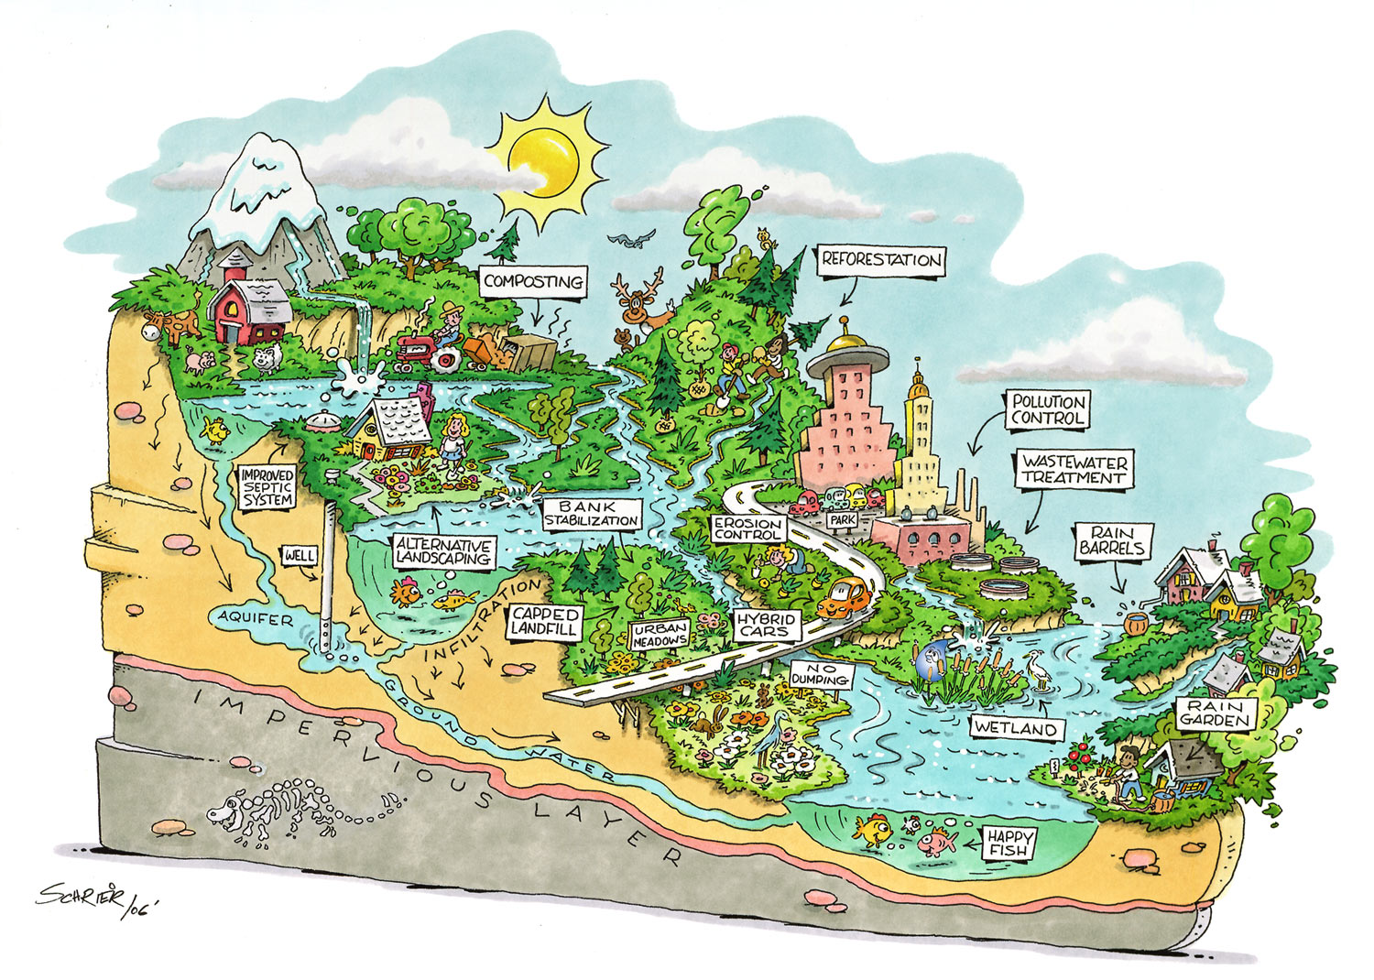
Notes:
Watershed Diagram. Source unknown

Slide 3
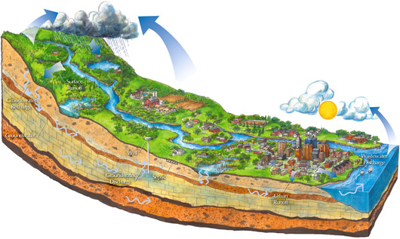
Notes:
Watershed Diagram. Source: http://www.zumbrowatershed.org/ourwatershed

Slide 4
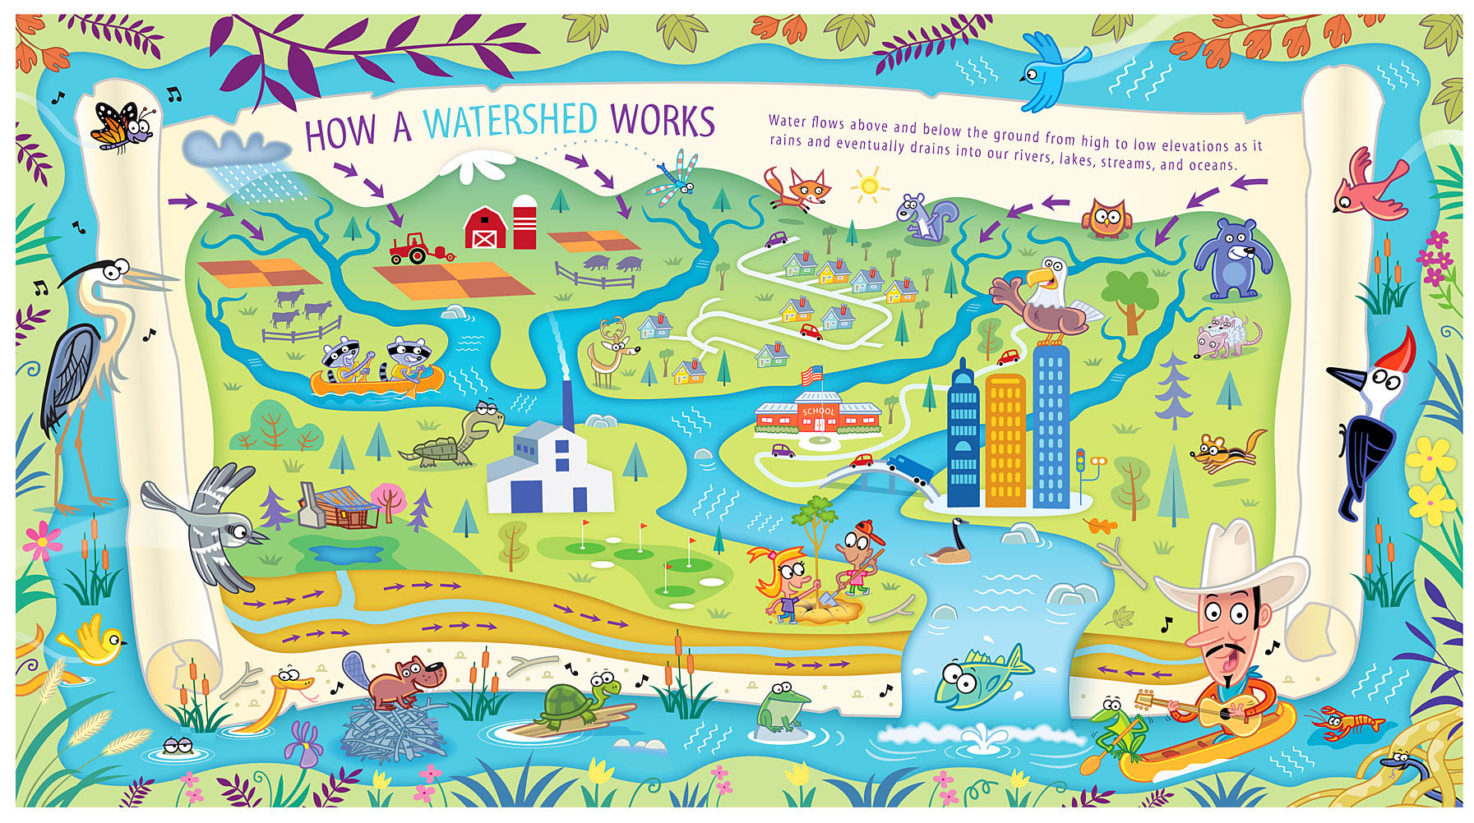
Notes:
Watershed Diagram. Source: http://www.jackdesrocher.com

Slide 5
Viewing Our Region
A. Western Washington - Olympic Peninsula, Cascade Mountains and Mt. Rainier, Seattle/Tacoma/Everett, all of Puget Sound
B. Puget Sound metropolitan region
C. City of Tacoma
What do you notice about the surfaces of the ground as you “zoom in”?
Hint: what surfaces might the different colors you see represent?

Slide 6
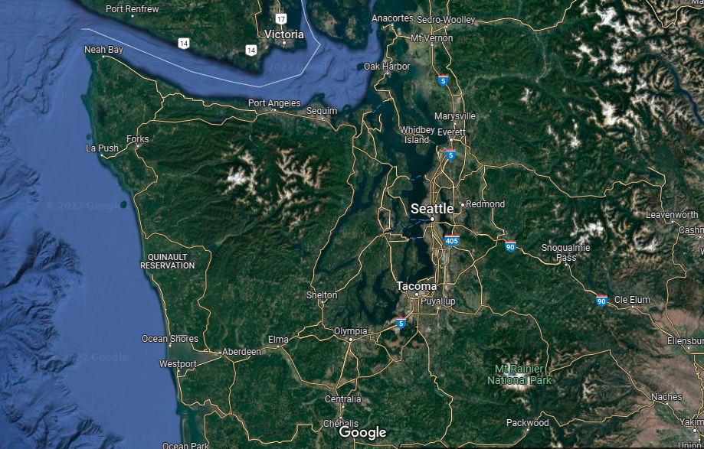
A

Slide 7
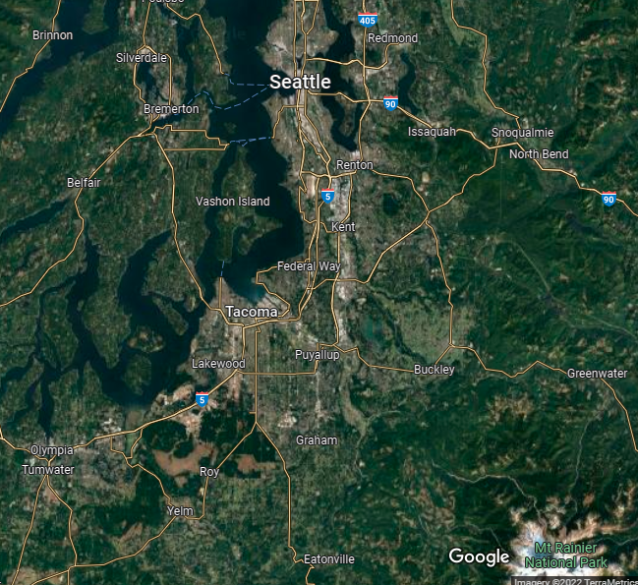
B

Slide 8
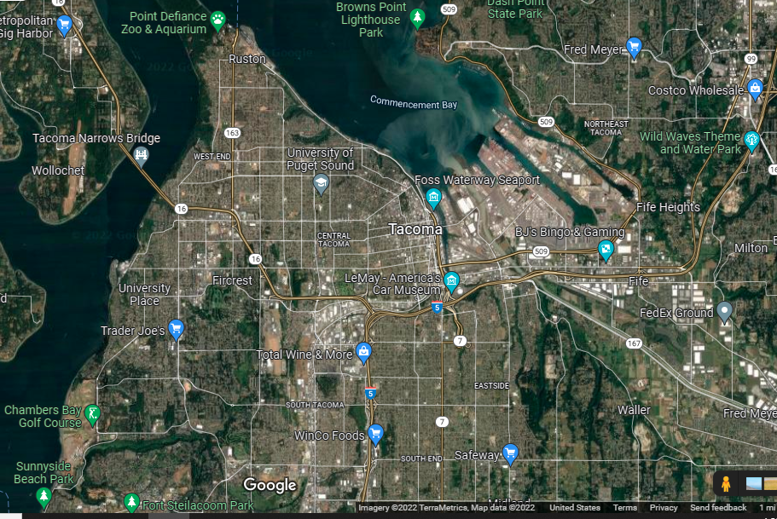
C

Slide 9
What did you notice about the surfaces of the ground as you “zoom in”?
Do you know where your school is located?

Slide 10
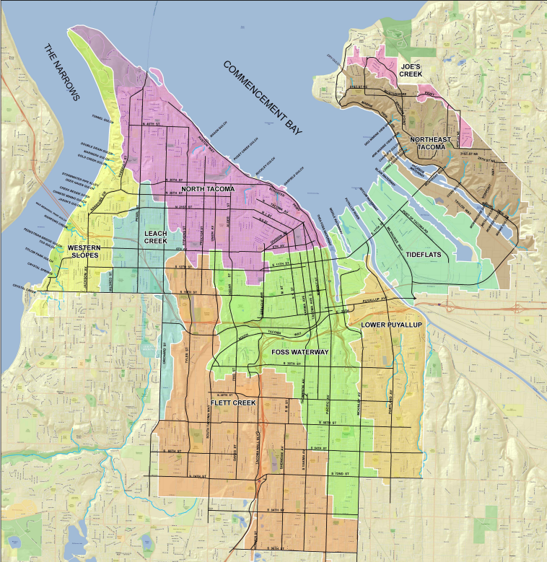
Tacoma Watersheds
Can you find which watershed your school is in?
Notes:
Source: https://cms.cityoftacoma.org/surfacewater/WATERSHED-08-2011.pdf

Slide 11
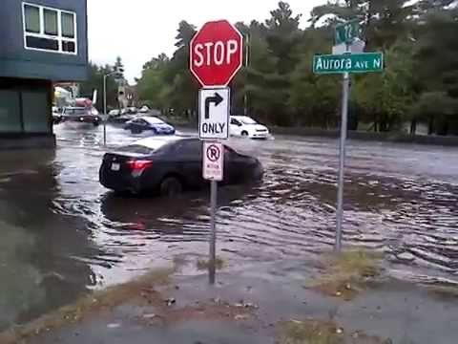
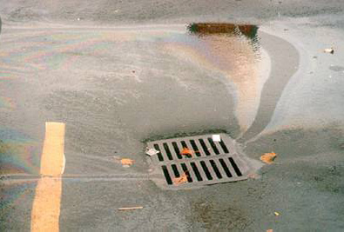
Our cities have a lot of hard, impervious surfaces that do not let water soak into the ground – Impervious surfaces include rooftops, roads, parking lots, concrete and blacktop (like playgrounds). Often, lawn and grass does a poor job of letting water drain into the ground, making those surfaces basically impervious also.
Pollution into a stormdrain!
1
2
As water runs off these impervious surfaces (instead of soaking into the ground), two main problems are created:
TOO MUCH water: When there is a big storm in the forest the trees and unpaved ground hold onto and soak up most of the stormwater. The remaining stormwater runoff in a forest flows into a stream that doesn’t have houses or roads along its banks to be flooded. In a city, all the impervious surfaces create a lot more stormwater runoff. The stormwater runoff flows down roads and picks up speed. The large amounts of water increase the risk of erosion and flooding. The increased speed of the water in city streams also washes away salmon eggs and other wildlife habitat.
POLLUTED water: Runoff flowing across roads and parking lots picks up pollutants that are on the ground and takes them into streams, lakes and Puget Sound. This polluted runoff, kills and confuses salmon, and harms other wildlife, people and ecosystems.
Notes:
Source: IslandWood.

Slide 12
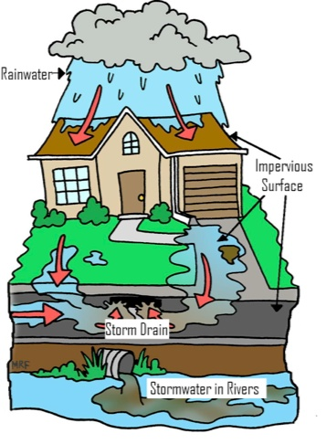
Notes:
Diagram of Storm Drain System. Source: http://cityofbarberton.com/oc/stormwater_old.shtml

Slide 13
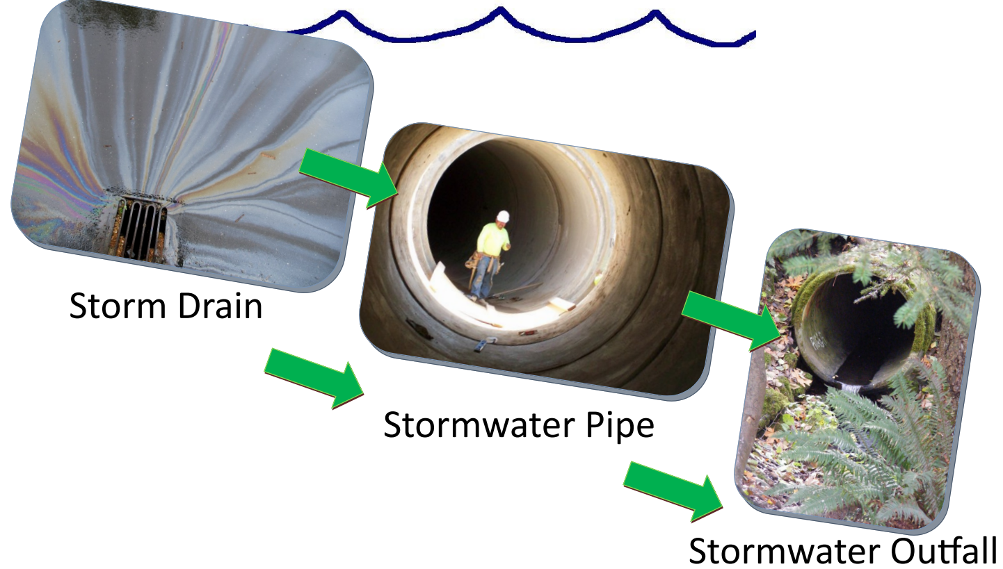
Notes:
Path of stormwater. Source: Seattle Public Utilities

Slide 14
Video: “Effects of Urbanization on Stream Ecosystems” video during this lesson. Watch from 0:00 to 2:57. You can find this video linked on communitywaters.org or at https://www.youtube.com/watch?v=BYwZiiORYG8
Video: Since the stormwater from your community enters Puget Sound, we suggest watching the “Drained: Urban Stormwater Pollution” video from 0:00 to 2:11. You can find this video linked on communitywaters.org or at https://vimeo.com/51603152.

Slide 15
Other map resources
River Runner – click on place on map to see where water goes - https://river-runner.samlearner.com/

Slide 16
