Slide 1


Community Waters School Guide: Larchmont Elementary
How to Use This Guide
This School Guide supports the Community Waters Science Unit Teacher Manual with information, maps, and images specific to your school and neighborhood.
It is written for teachers - its goal is to provide a better understanding of what is happening with stormwater in and around your school.
All content within may change, and can be adapted as desired.
If you have any questions about these maps, accompanying lessons, or stormwater around your school, contact IslandWood staff at communitywaters@IslandWood.org.

Slide 2
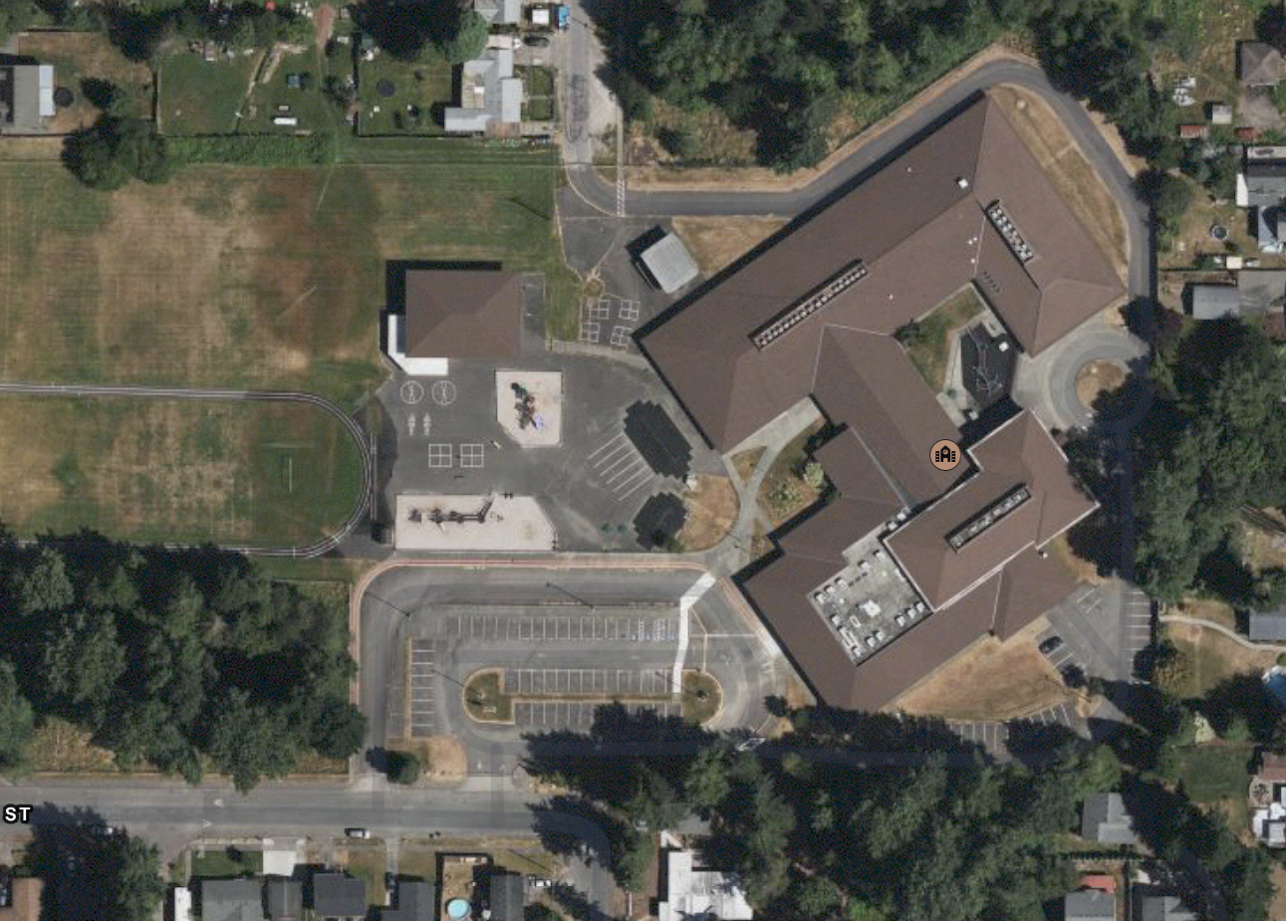
Stormwater in Our Schoolyard – Lesson 2
This map and points of interest (photos and info) can be used to guide your class’ exploration of the schoolyard. You will find the student worksheet for this lesson following the teacher guide version. Please use the extra space on the pages to add your own notes and questions!
A
B
C
D
E
G
E

Slide 3
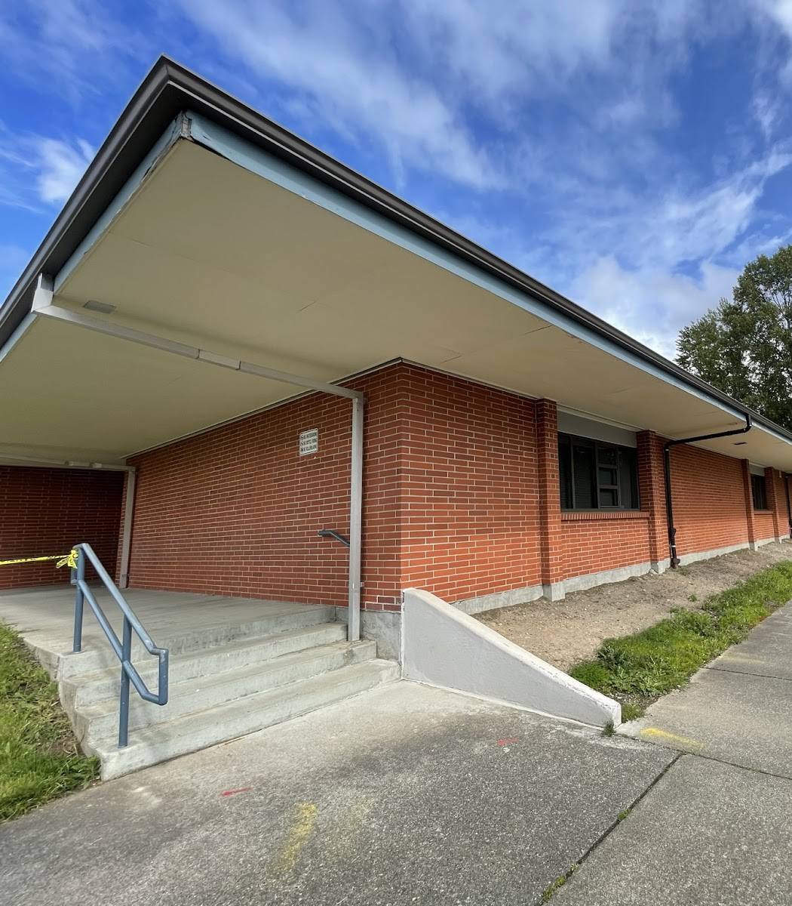
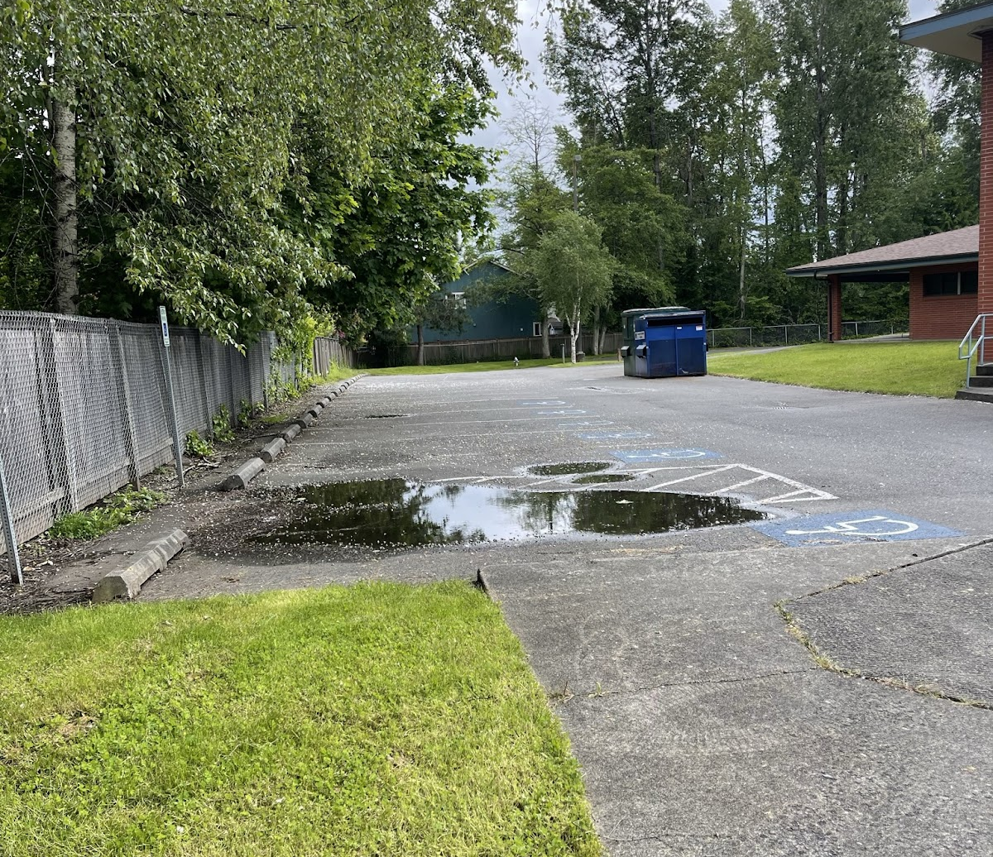
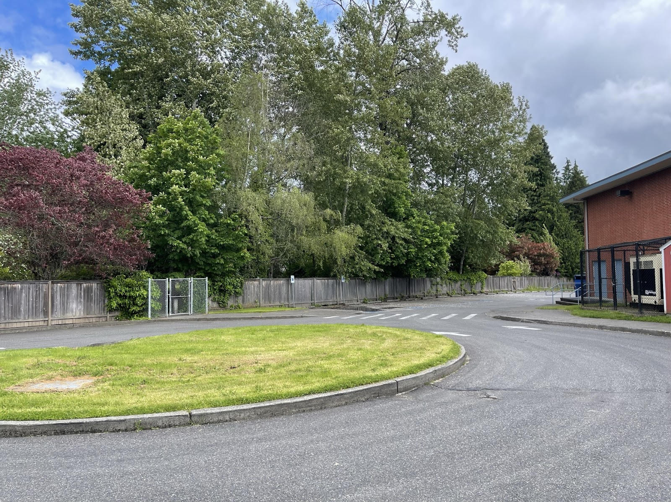
Schoolyard stormwater points of interest
A. Surfaces – Why is water pooling here? Investigate the area to see if there are any storm drain problems nearby. What collects in this stormwater?
C. Surfaces– Notice the directions that water flows on these surfaces and where it ends up.
What happens to rain as it falls here? Which surfaces are pervious or impervious?
Test it out by pouring water on the surface!
B. Downspouts - Where does water flowing through this downspout lead? Where does the water start?

Slide 4
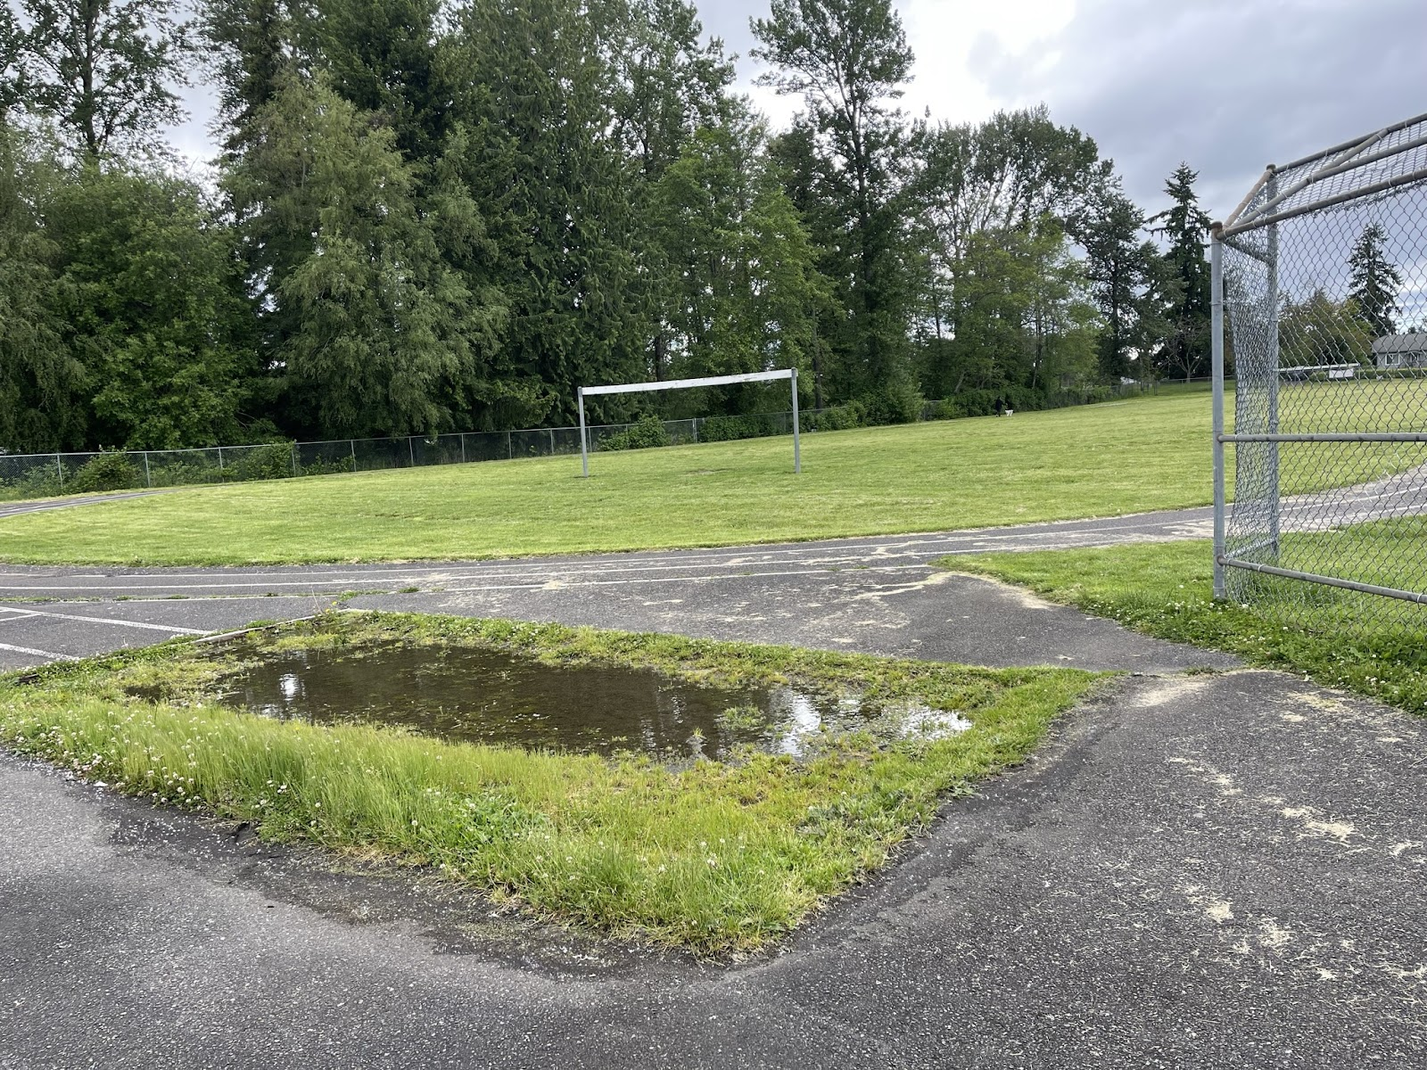
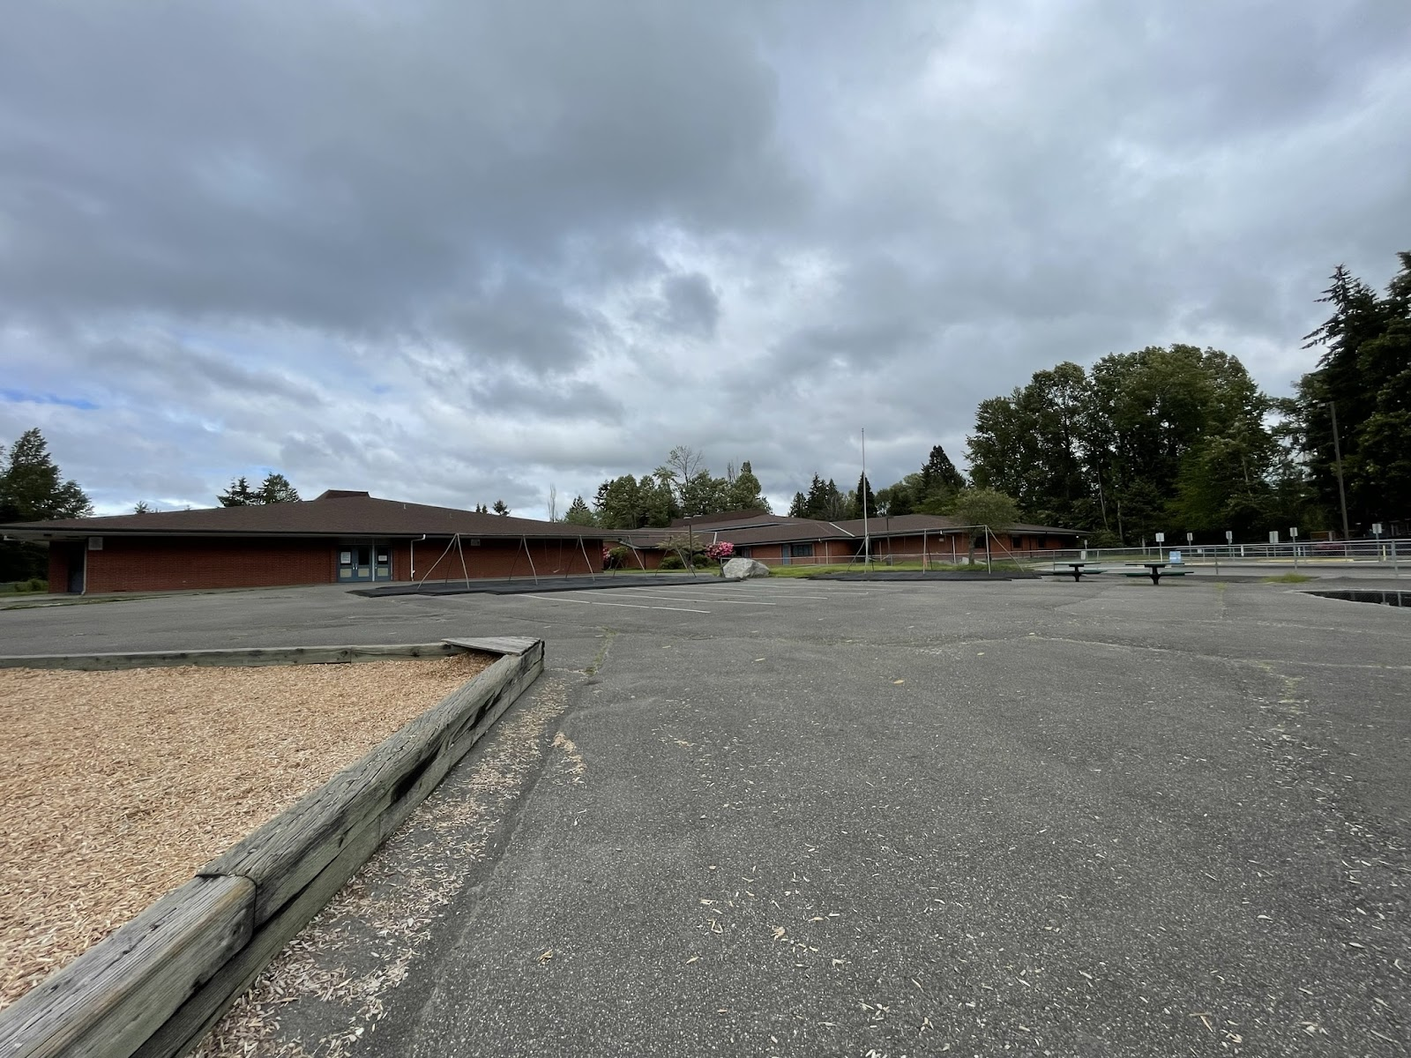
D & E. Playground surfaces – Notice the directions that water flows on these surfaces and where it puddles like in the picture on the left. Why does the water pool like this? Which surfaces are pervious or impervious across your schoolyard? Test them out with water!

Slide 5
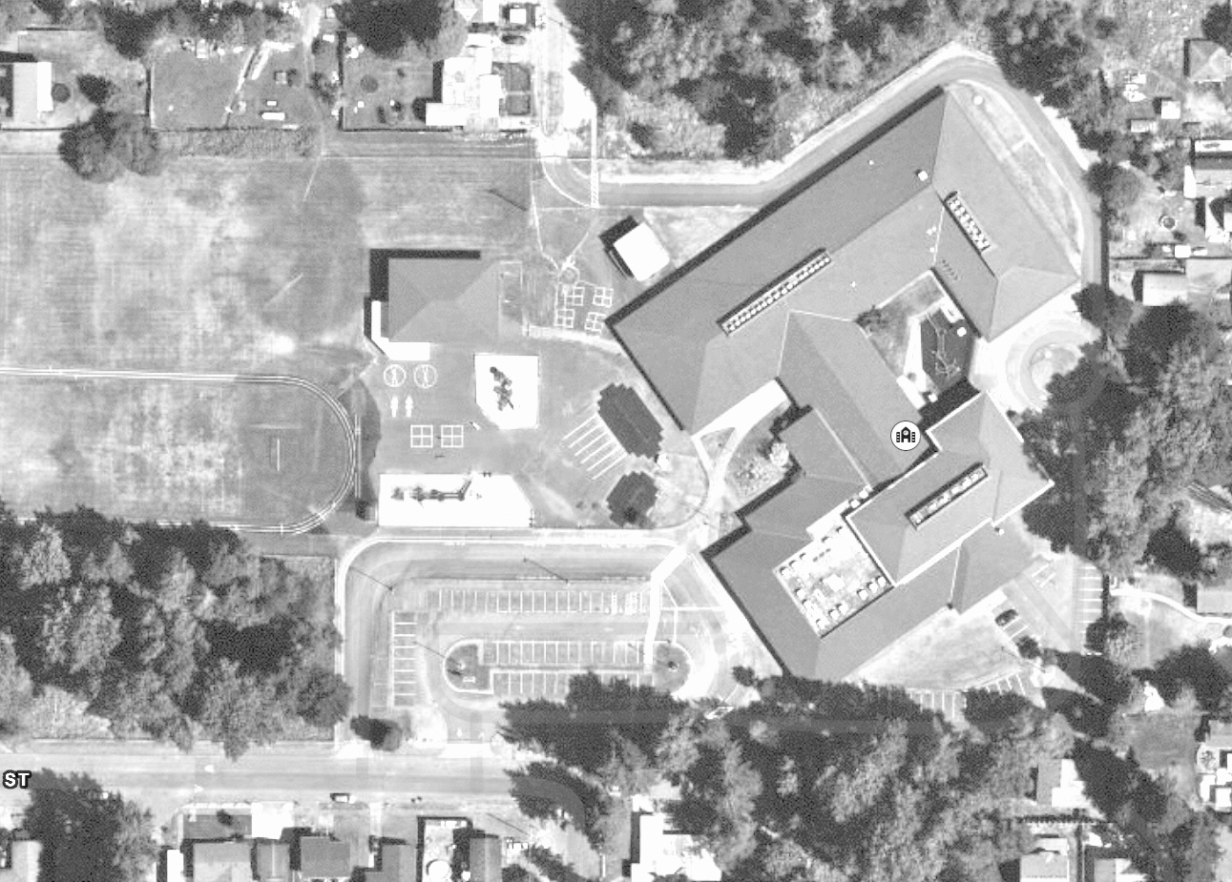
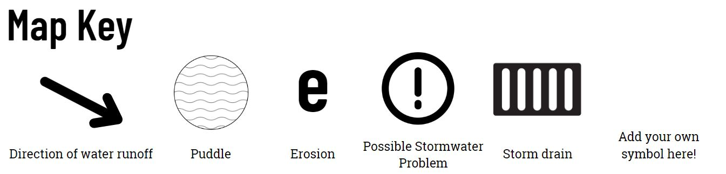

Mapping Your Schoolyard – Larchmont Elementary Name: ____________ Date: _________
Include on your map:
Symbols from the Key including flow of water, surfaces, and storm drains.
Label locations of litter, pollution and places where puddles form.
Sketch any stormwater problems you see or are aware of.
Sketch larger plants and bushes.
Notes:
PRINT THIS PAGE for the STUDENT WORKSHEET

Slide 6
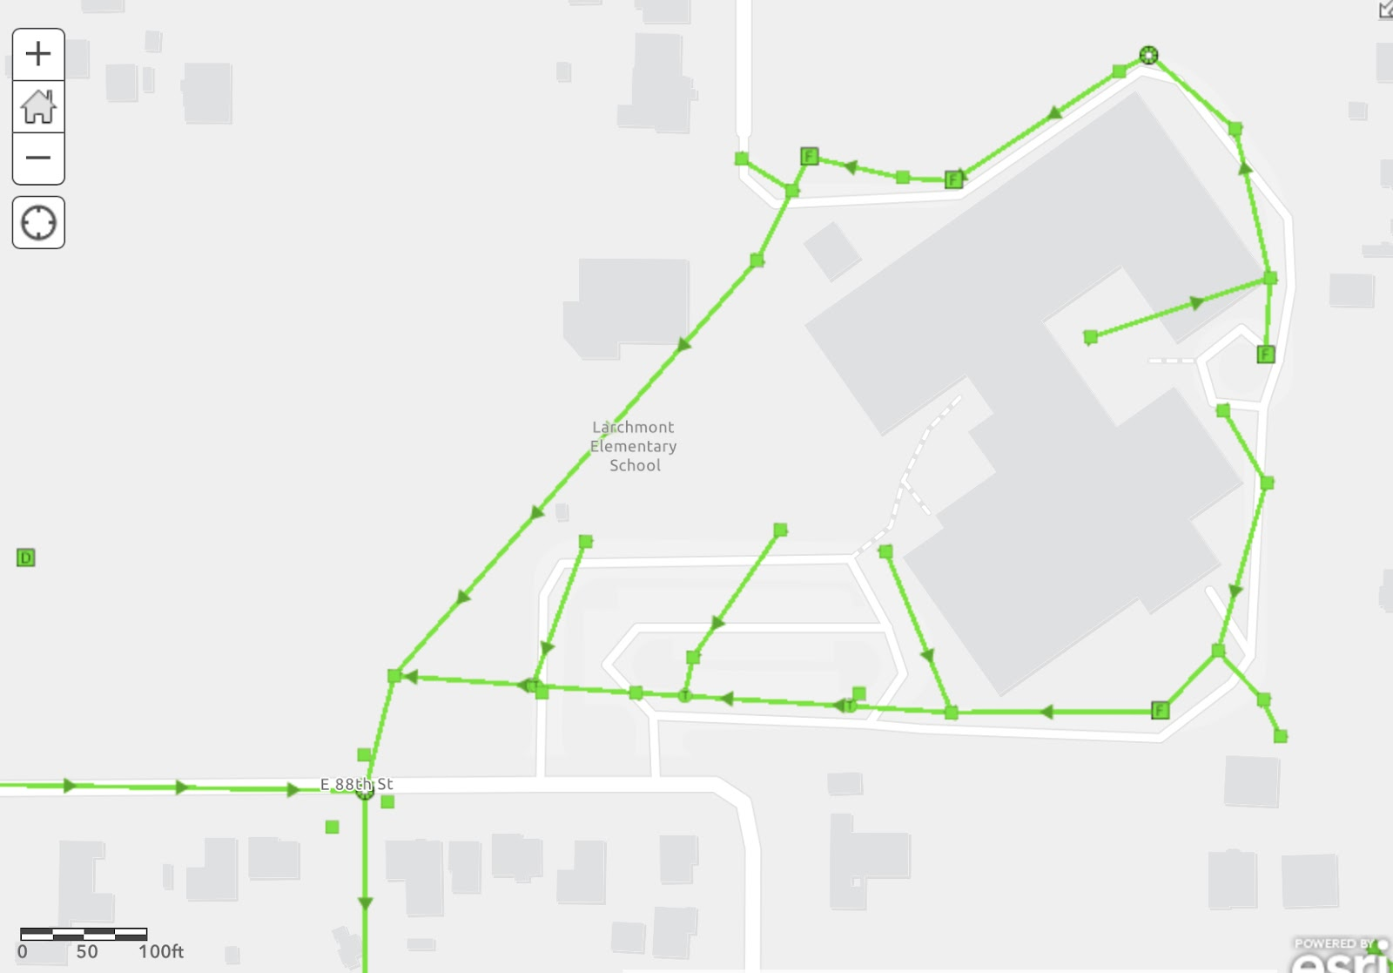
Larchmont Elementary Where does your school’s stormwater go?
Follow the lines and arrows!
What happens with the stormwater around your school?
Water in the storm drains at your school empty into stormwater pipes under the school and travel underground moving toward E 88th St where it begins to move south until E 92nd St.

Slide 7
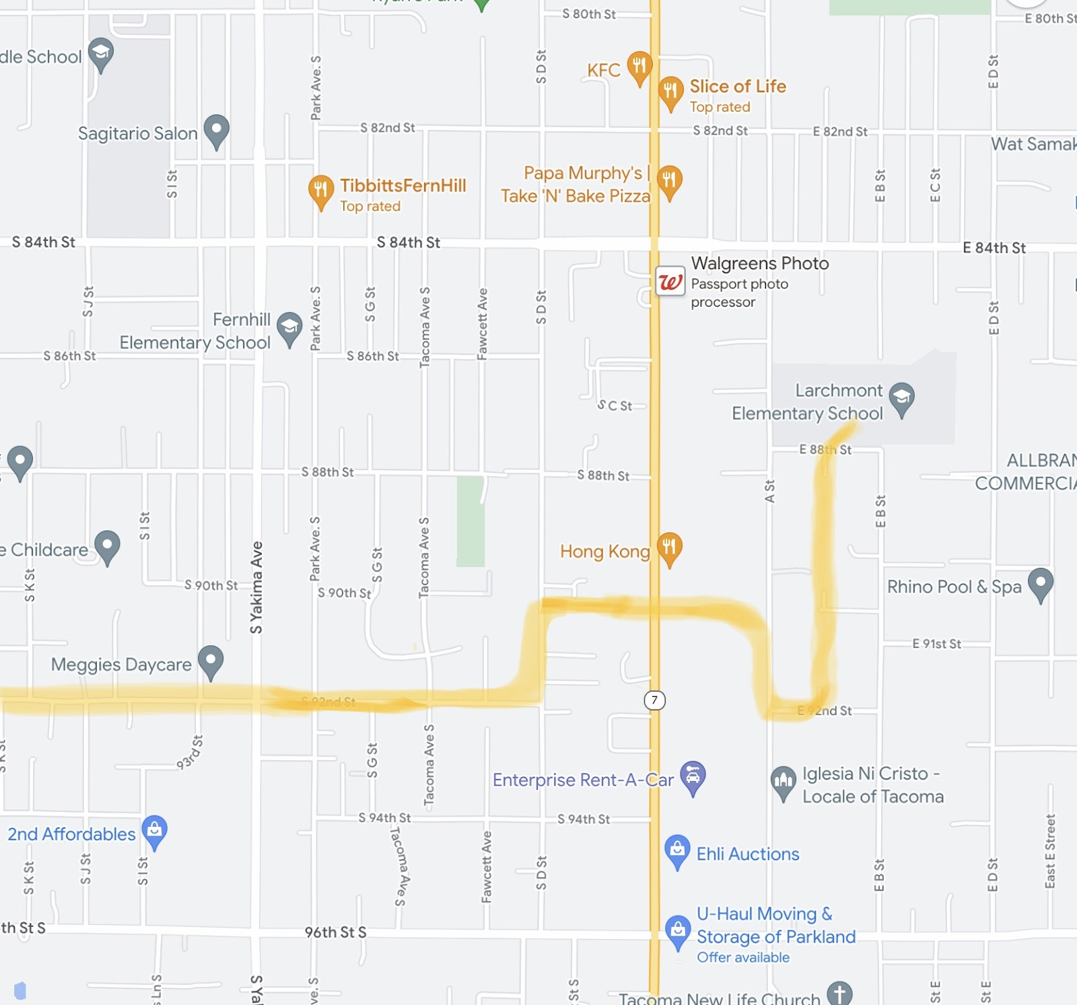
Local Stormwater Systems
What happens next?
The water from your school yard then takes a few turns as it moves west, crossing below SR 7. As it moves west, it then moves northwest and settles in Hosmer Holding Basin. From there, it travels under I5 in storm water pipes before settling in another holding basin called Ward’s Lake. Water in this lake then moves north until it reaches Gravel Pit Holding Basin.
This journey is mapped out on the following slide
Notes:
Please Note: The pipes information provided here is our best estimate of the stormwater flow in your community based on the information we have currently. If you encounter more information in the course of your investigation, please let us know so we can update future versions of this document.

Slide 8
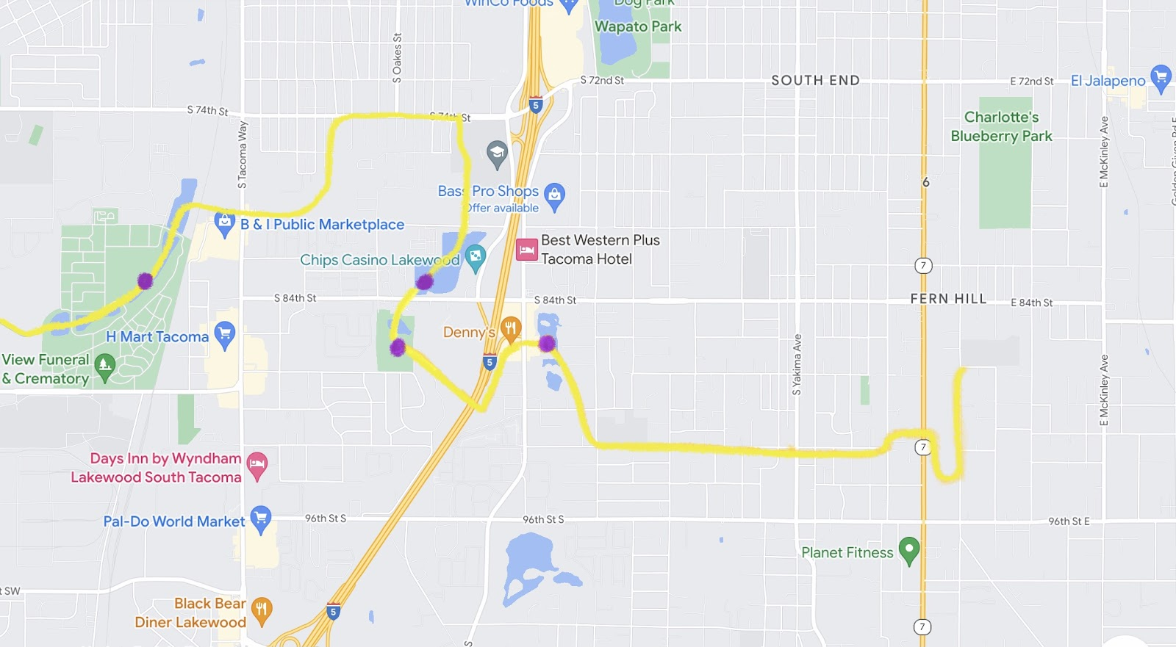
From the Gravel Pit Holding Basin, the stormwater then travels north to 74th St before it turns and moves southeast. This water then settles into a series of four Flett Creek Ponds before it goes through Flett Creek Pump Station.
This area consists of lakes, ponds and basins to hold surface water. Wapato Lake is fed by stormwater runoff from city streets and Interstate 5. It flows into Wards Lake in the City of Lakewood.
The discharge from the Flett Creek holding basins is pumped to the headwater of Flett Creek or flows south into Wards Lake in the City of Lakewood.
The purple dots on this map represent different holding basins that the stormwater settles in

Slide 9
Larchmont Elementary Where does your school’s stormwater go?
Follow the lines and arrows!

Slide 10
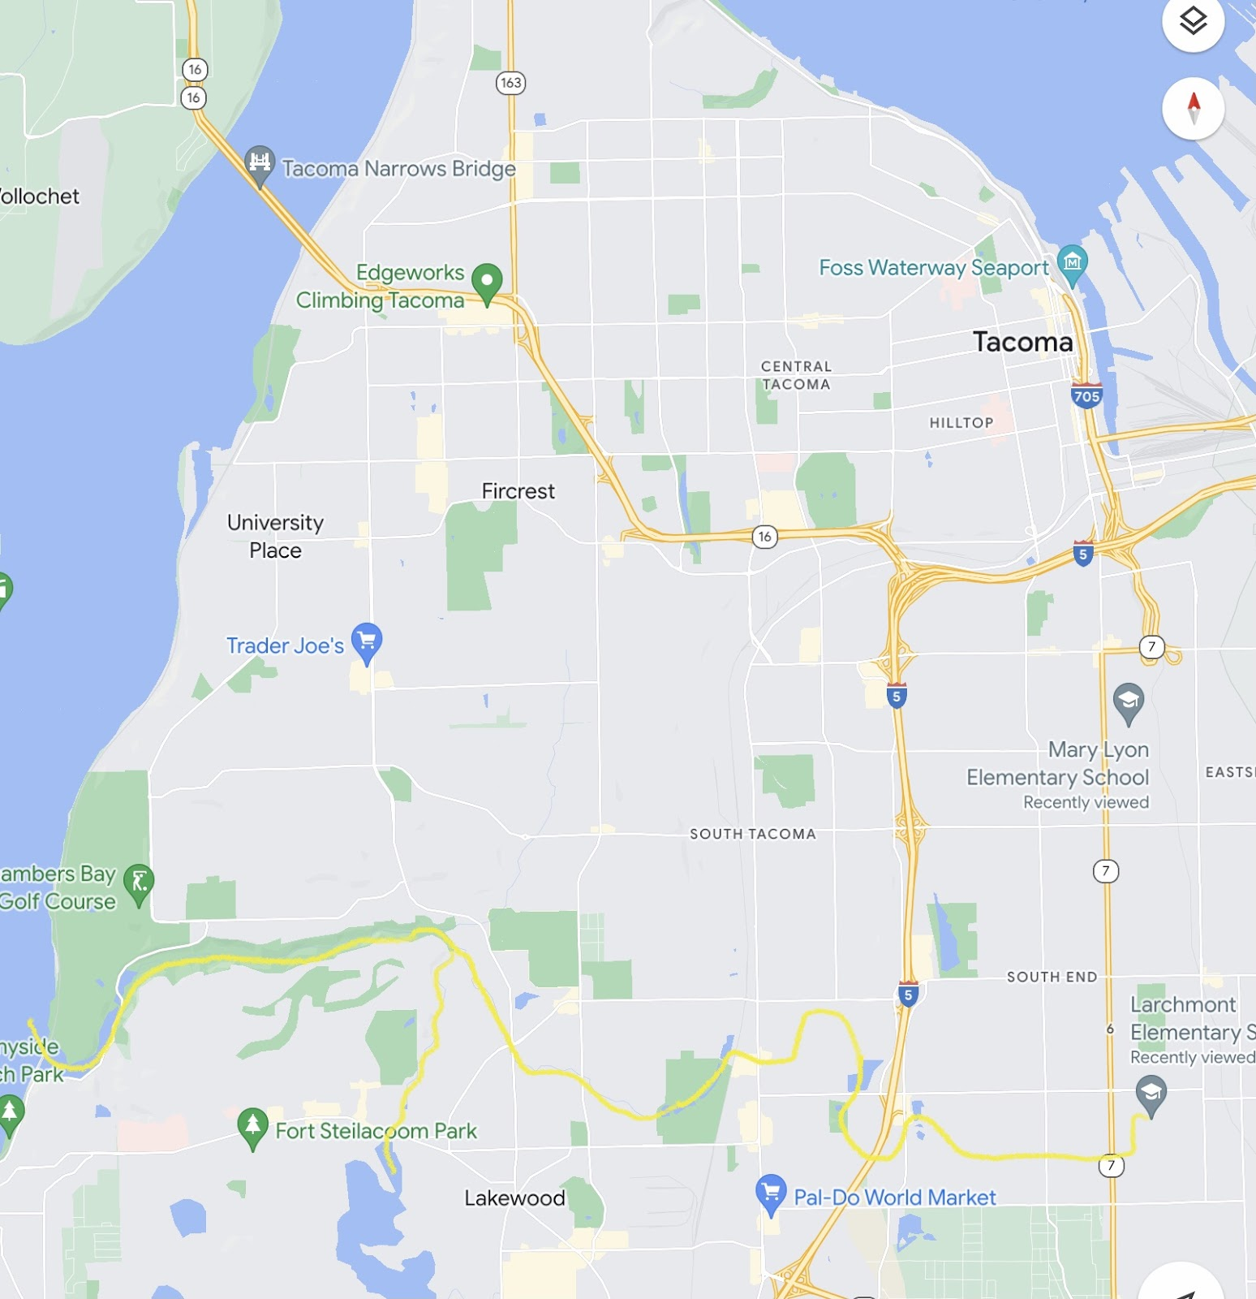
See the path of the stormwater from your school yard as it flows through Flett Creek and empties into Chambers Creek (outlined in a yellow line)…

Slide 11
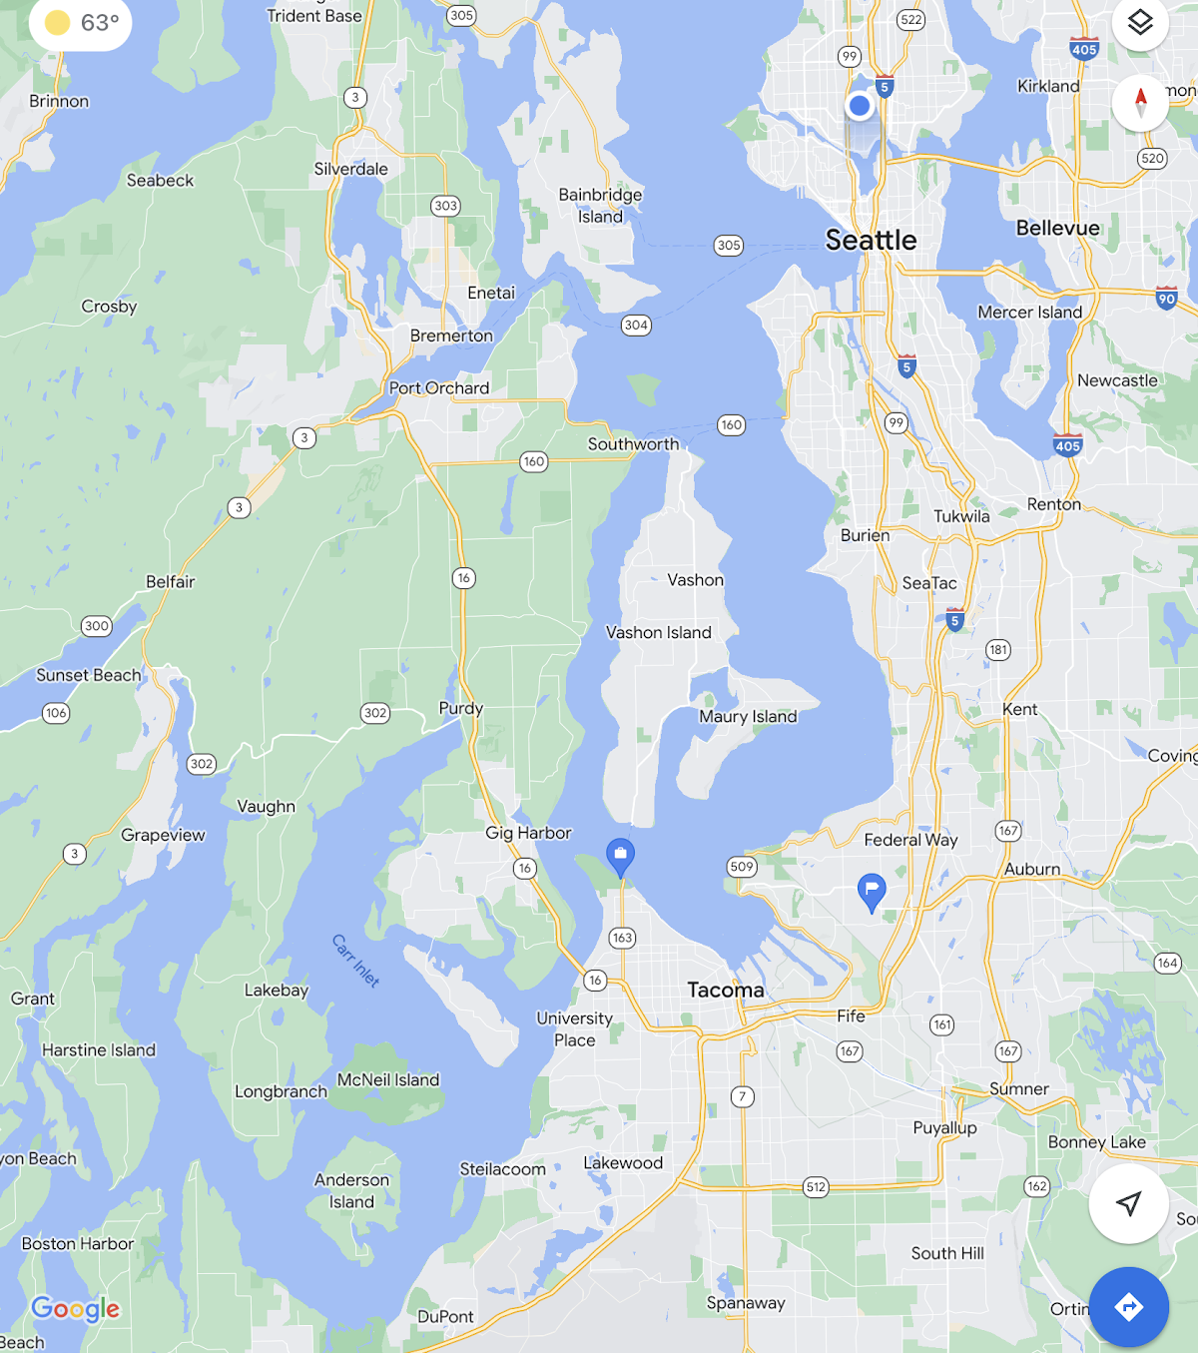
…where it finally reaches the Puget Sound/Salish Sea!

Slide 12
More information about your watershed:
Larchmont Elementary is a part of Flett Creek Watershed.
Flett Creek covers 7,153 acres and is the second largest subwatershed in Tacoma and is mostly residential with light commercial and industrial areas.
Flett Creek subwatershed flows into Snake Lake and Wapato Lake. The Flett Creek surface water drains through a series of holding basins, including Hosmer, Ward’s Lake, a gravel holding basin just north of Ward’s Lake and the four Flett Creek holding basins in the west. At the last Flett Creek holding basin a pump station sends the water to the Flett Dairy wetlands, where it flows into Fleet Creek. Downstream, Flett Creek flows into Chambers Creek, a salmonid-bearing stream, which discharges into Chambers Bay then to the Narrows.
Clover Park Technical College set aside a large amount of the Flett Dairy wetland to be preserved as open space and to provide for student training in water quality and environmental investigations and sampling.

Slide 13


How did we figure this out?
To view this map on your own, go here:
https://tacoma.maps.arcgis.com/home/webmap/viewer.html?layers=23e9a402b47d46058193362cb6c27a9e
View in “Map Classic”
Check “Surfacewater Network” box
Put in the name of the school
Zoom IN to see the green lines

