Slide 1


Community Waters School Guide:
Brown's Point Elementary
How to Use This Guide
This School Guide supports the Community Waters Science Unit Teacher Manual with information, maps, and images specific to your school and neighborhood.
It is written for teachers - its goal is to provide a better understanding of what is happening with stormwater in and around your school.
All content within may change, and can be adapted as desired.
If you have any questions about these maps, accompanying lessons, or stormwater around your school, contact IslandWood staff at communitywaters@IslandWood.org.

Slide 2
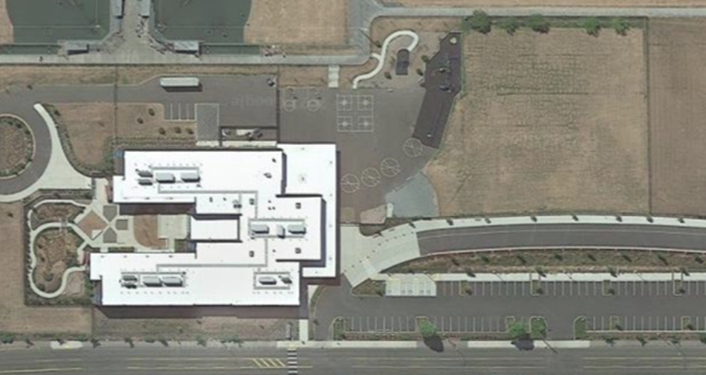
Stormwater in Our Schoolyard from Lesson 2
A
A
This map and points of interest (photos and info) can be used to guide your class' exploration of the schoolyard; questions included are intended for students as desired. The student worksheet for this lesson is separate.
B
E
F
G
D
C
C
E
D
G
E

Slide 3
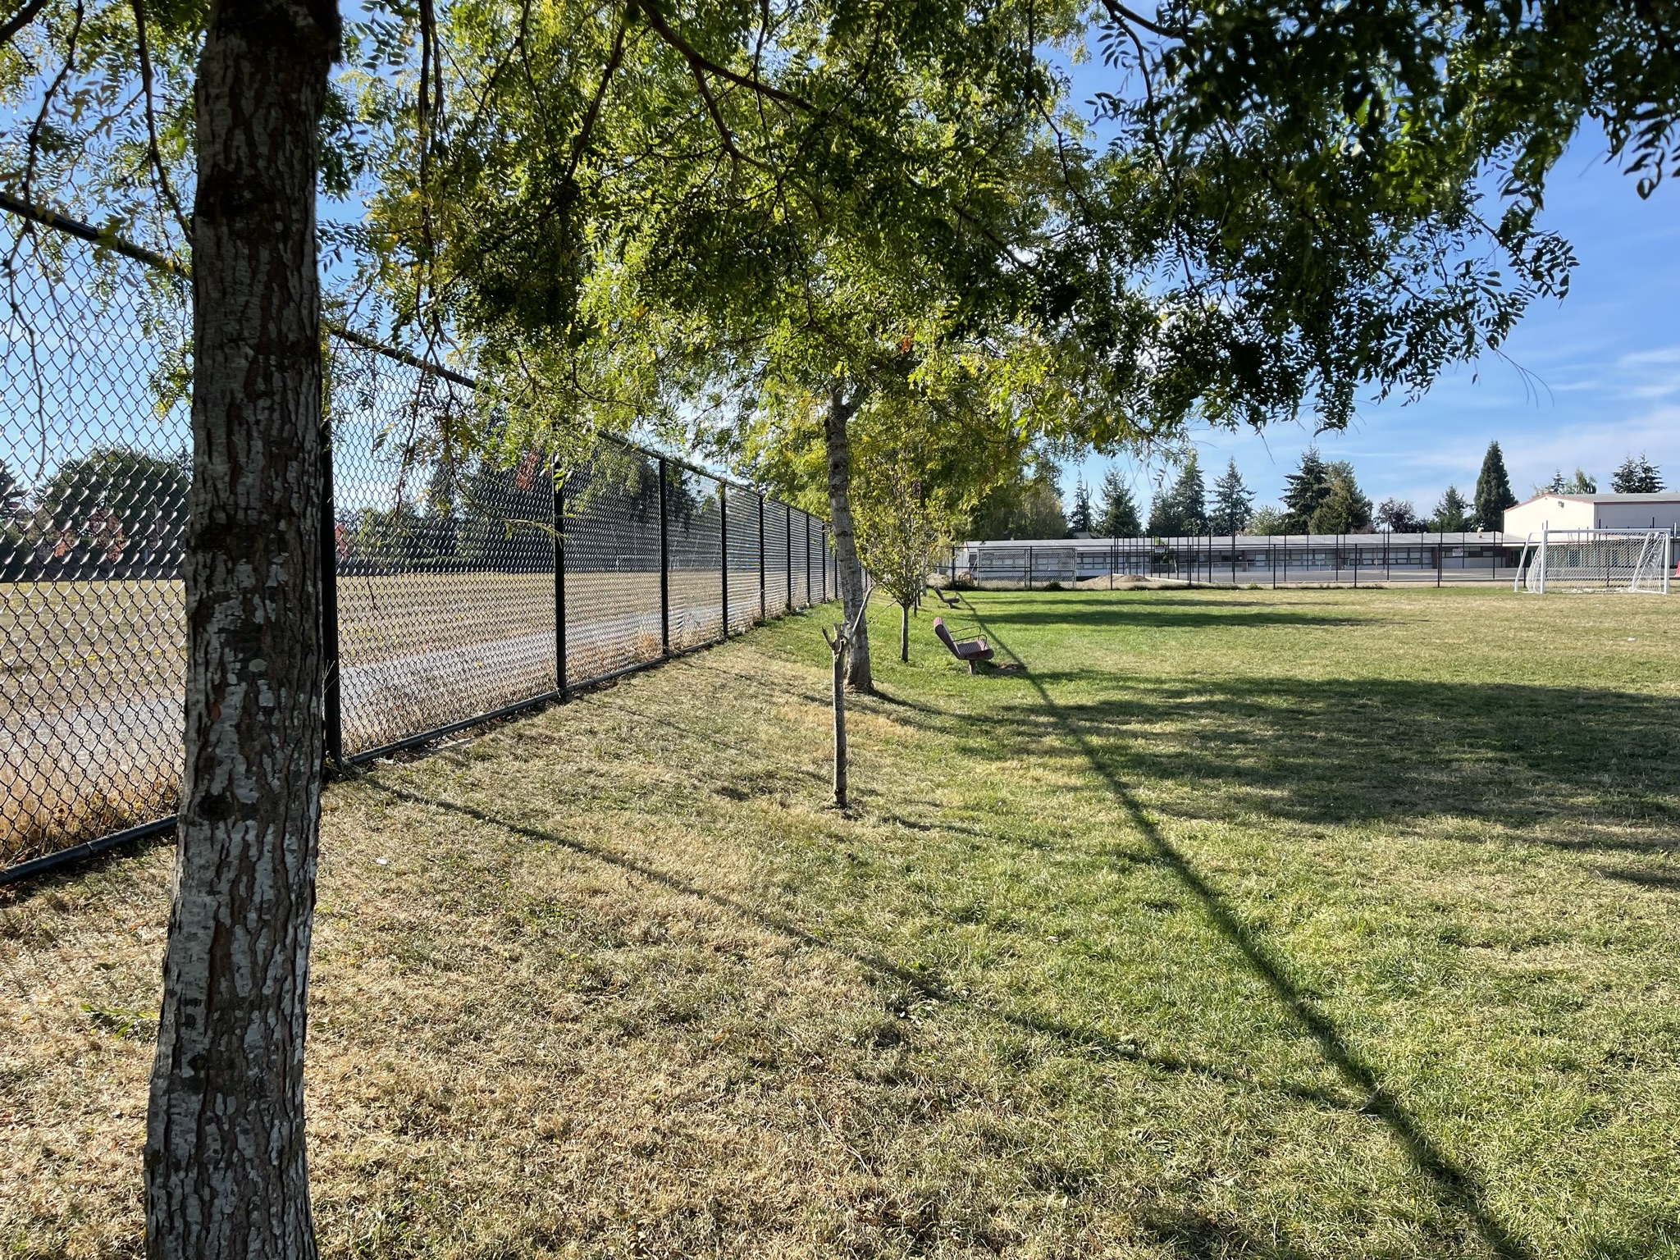
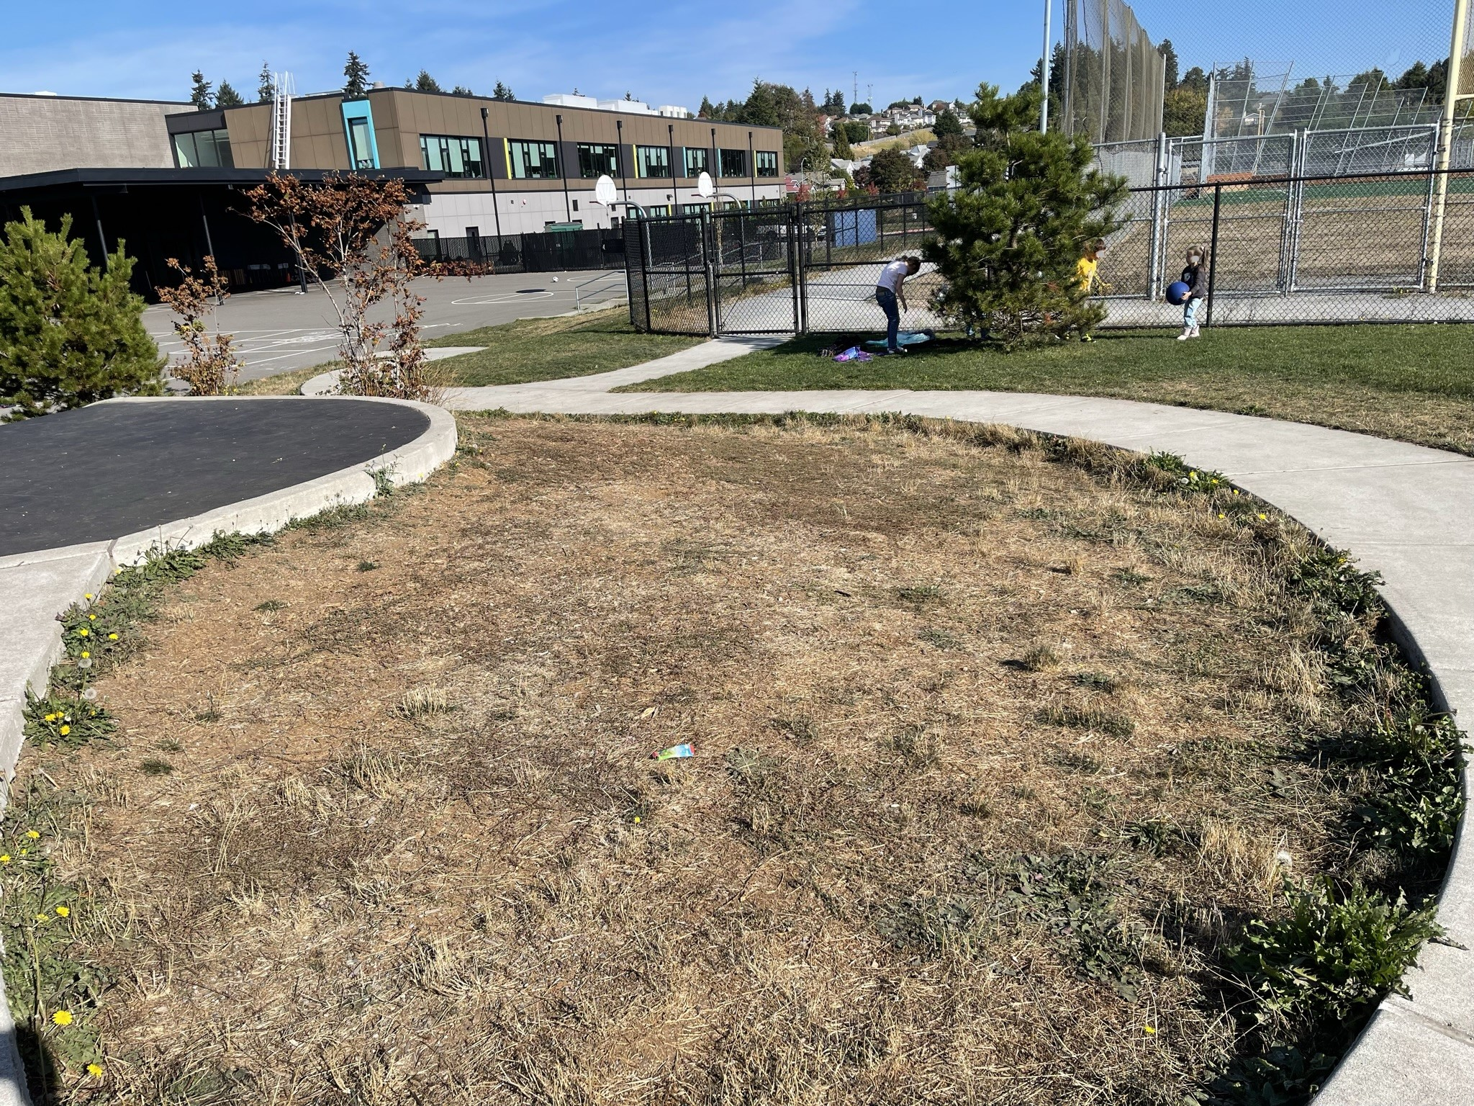
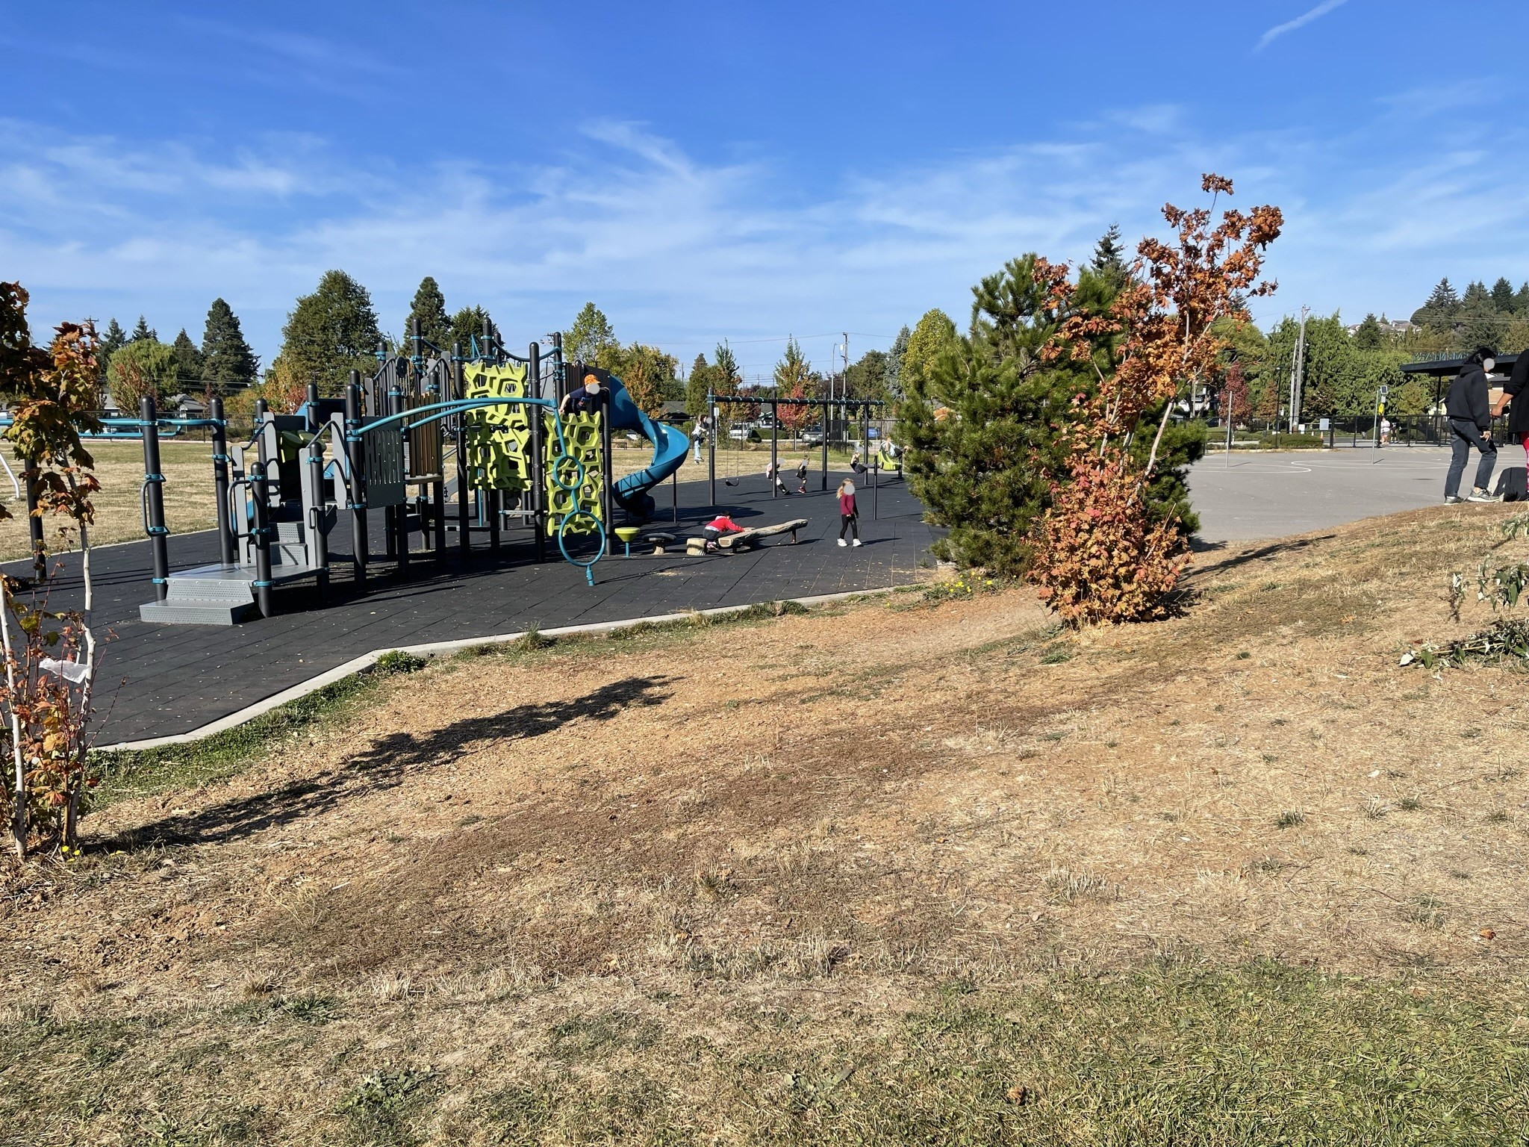
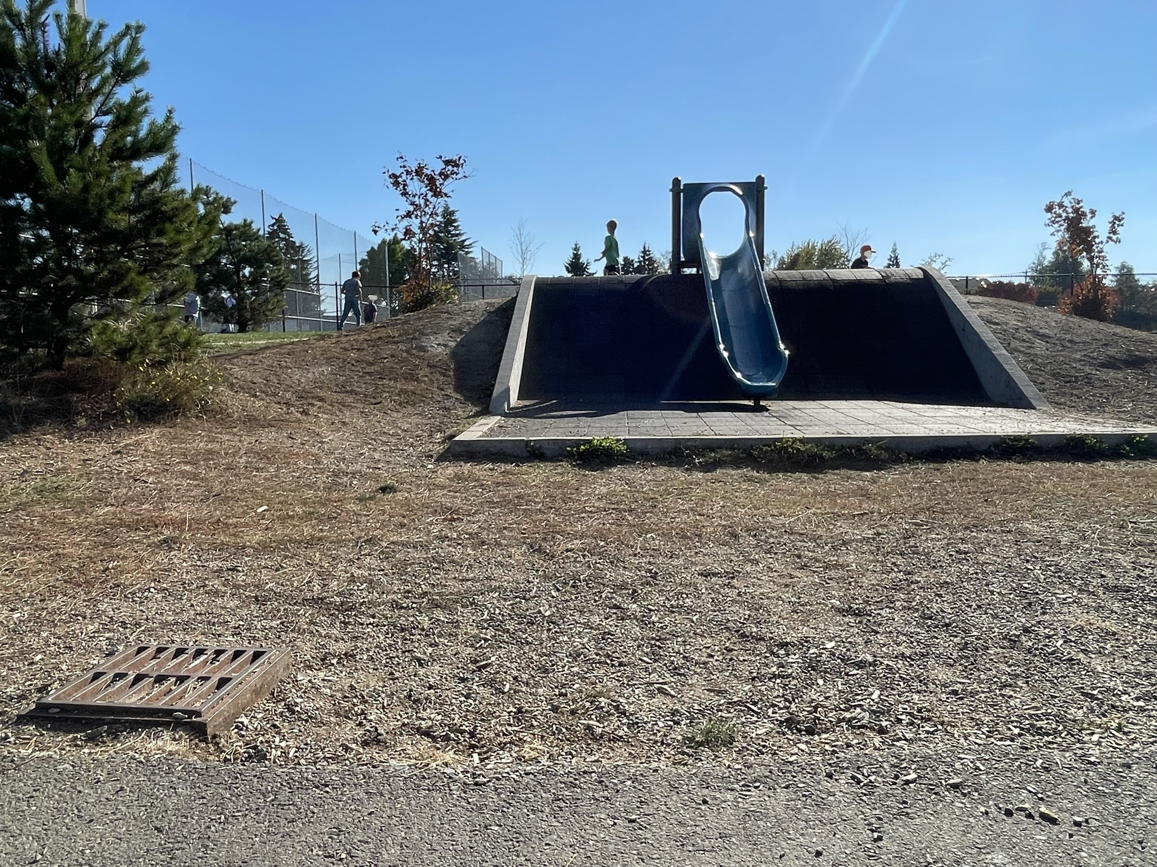
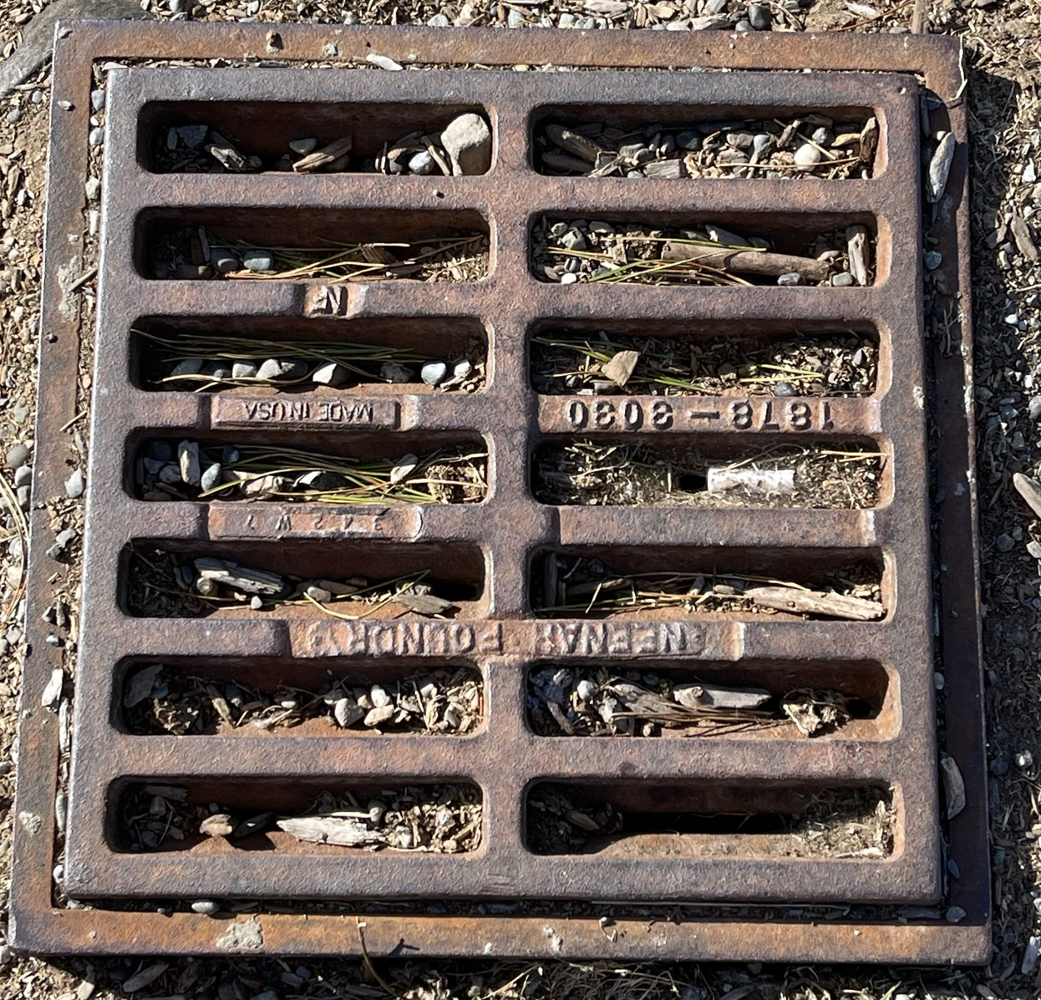
Schoolyard Stormwater Points of Interest
A. Slopes - How do these surfaces and vegetation affect the stormwater runoff here? How pervious is this surface? Does water collect here in a heavy rain? Does it cause any flooding problems or large puddles? ​
A
A
B. Storm drains - Notice the placement of this drain and the surfaces around it. Why might this drain have been put here? What might happen to stormwater here?
A
A
B

Slide 4
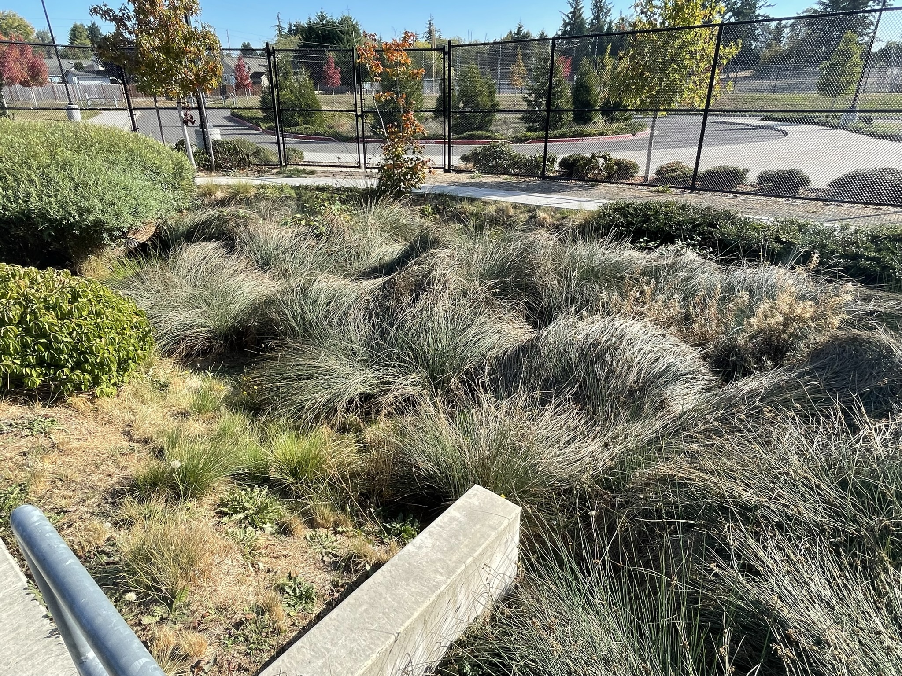
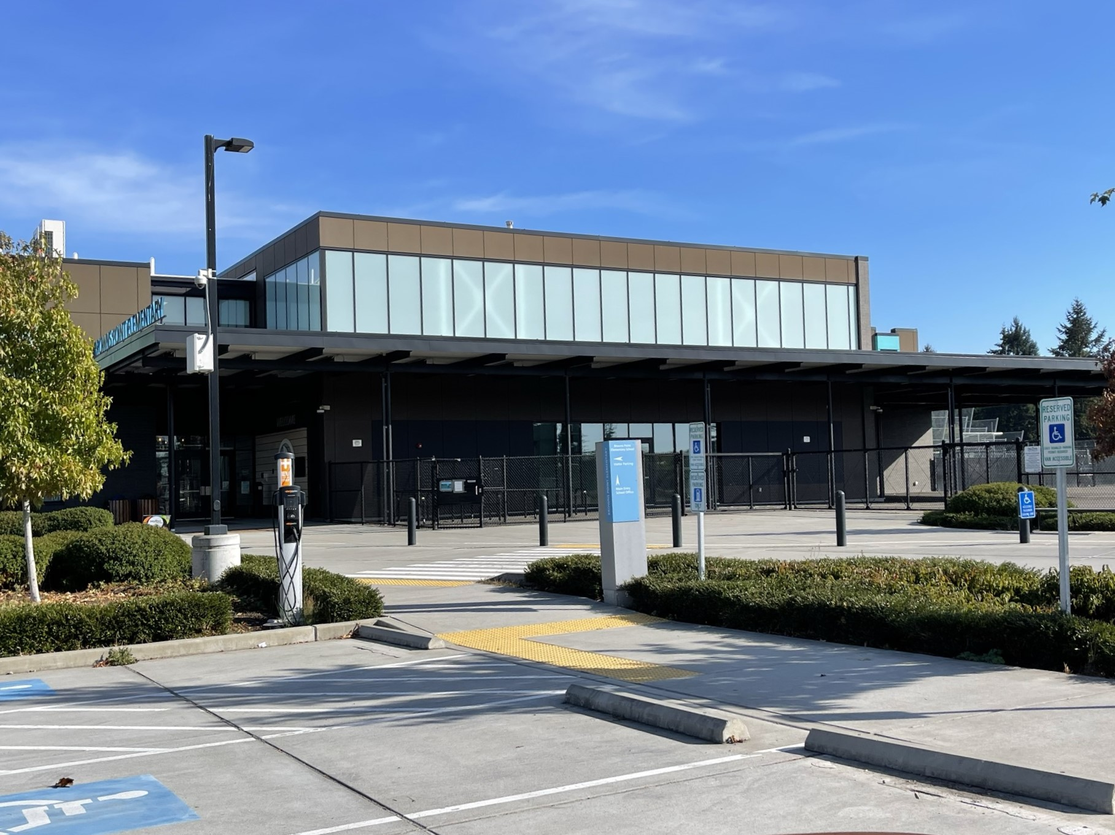
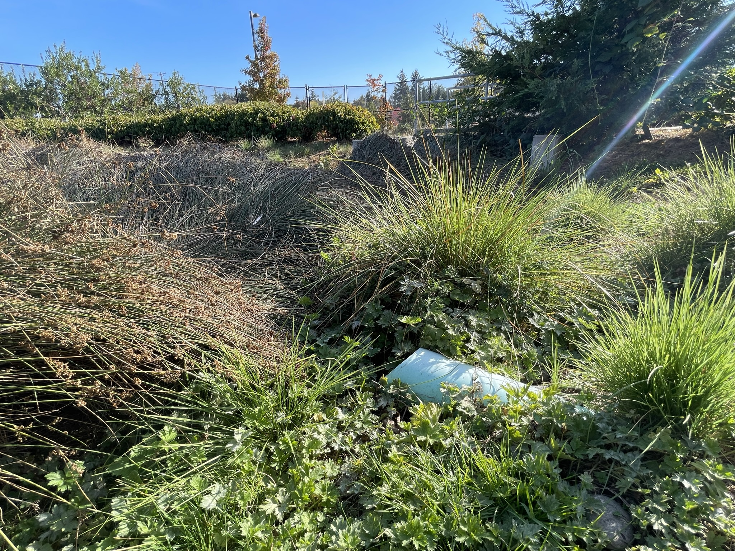
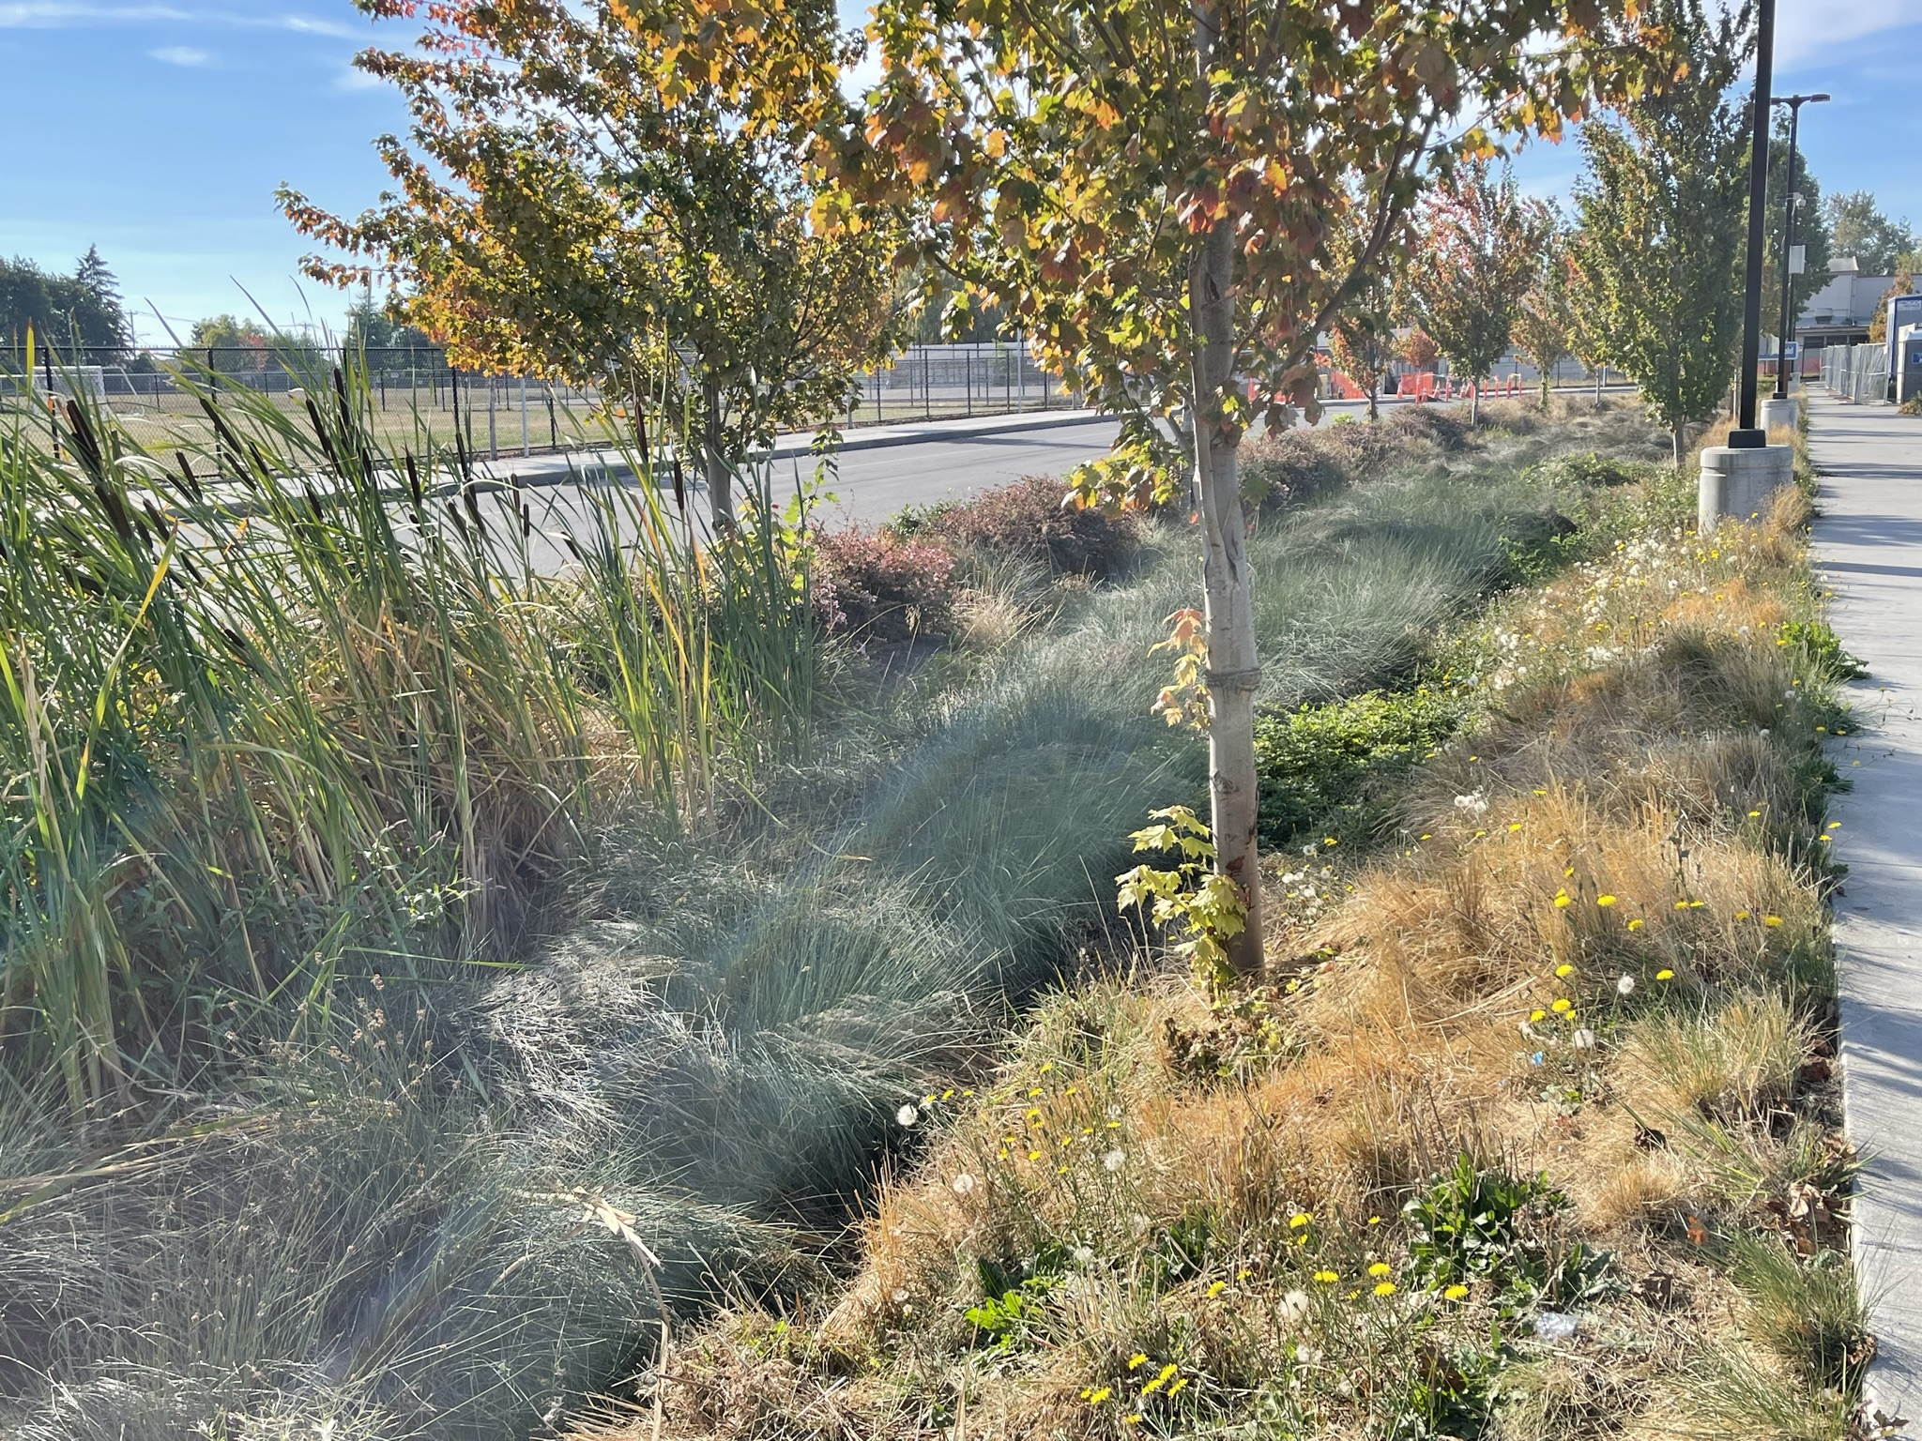
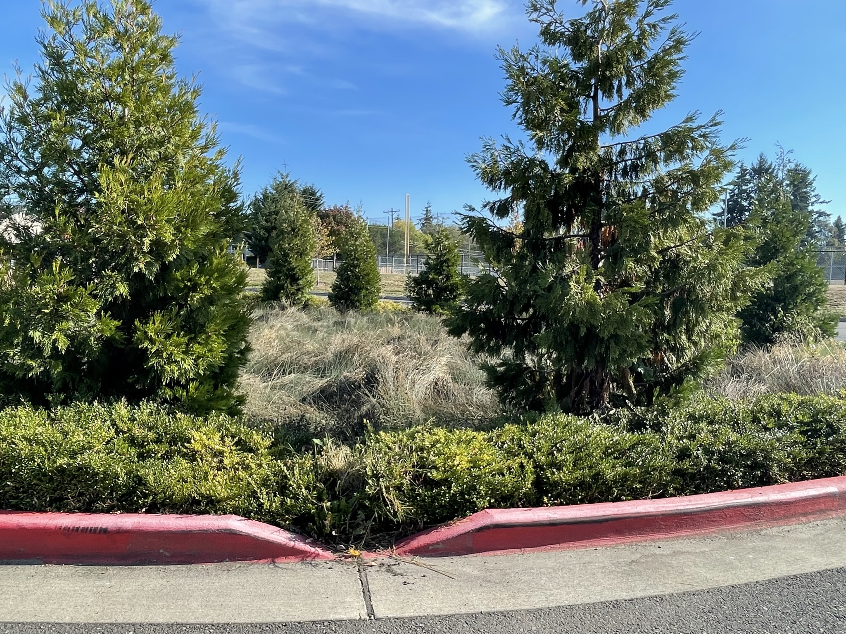
Schoolyard Stormwater Points of Interest
C. Bioswale - a bioswale catches and slows stormwater. What do you notice about the bioswale? What happens to water when it goes into the bioswale?
C
D. Parking lot surfaces – Notice the way this area is engineered.​​
Why are the rocks and plants there? What happens to water as it flows over these surfaces? Where does it go next?
D
C
C
D

Slide 5
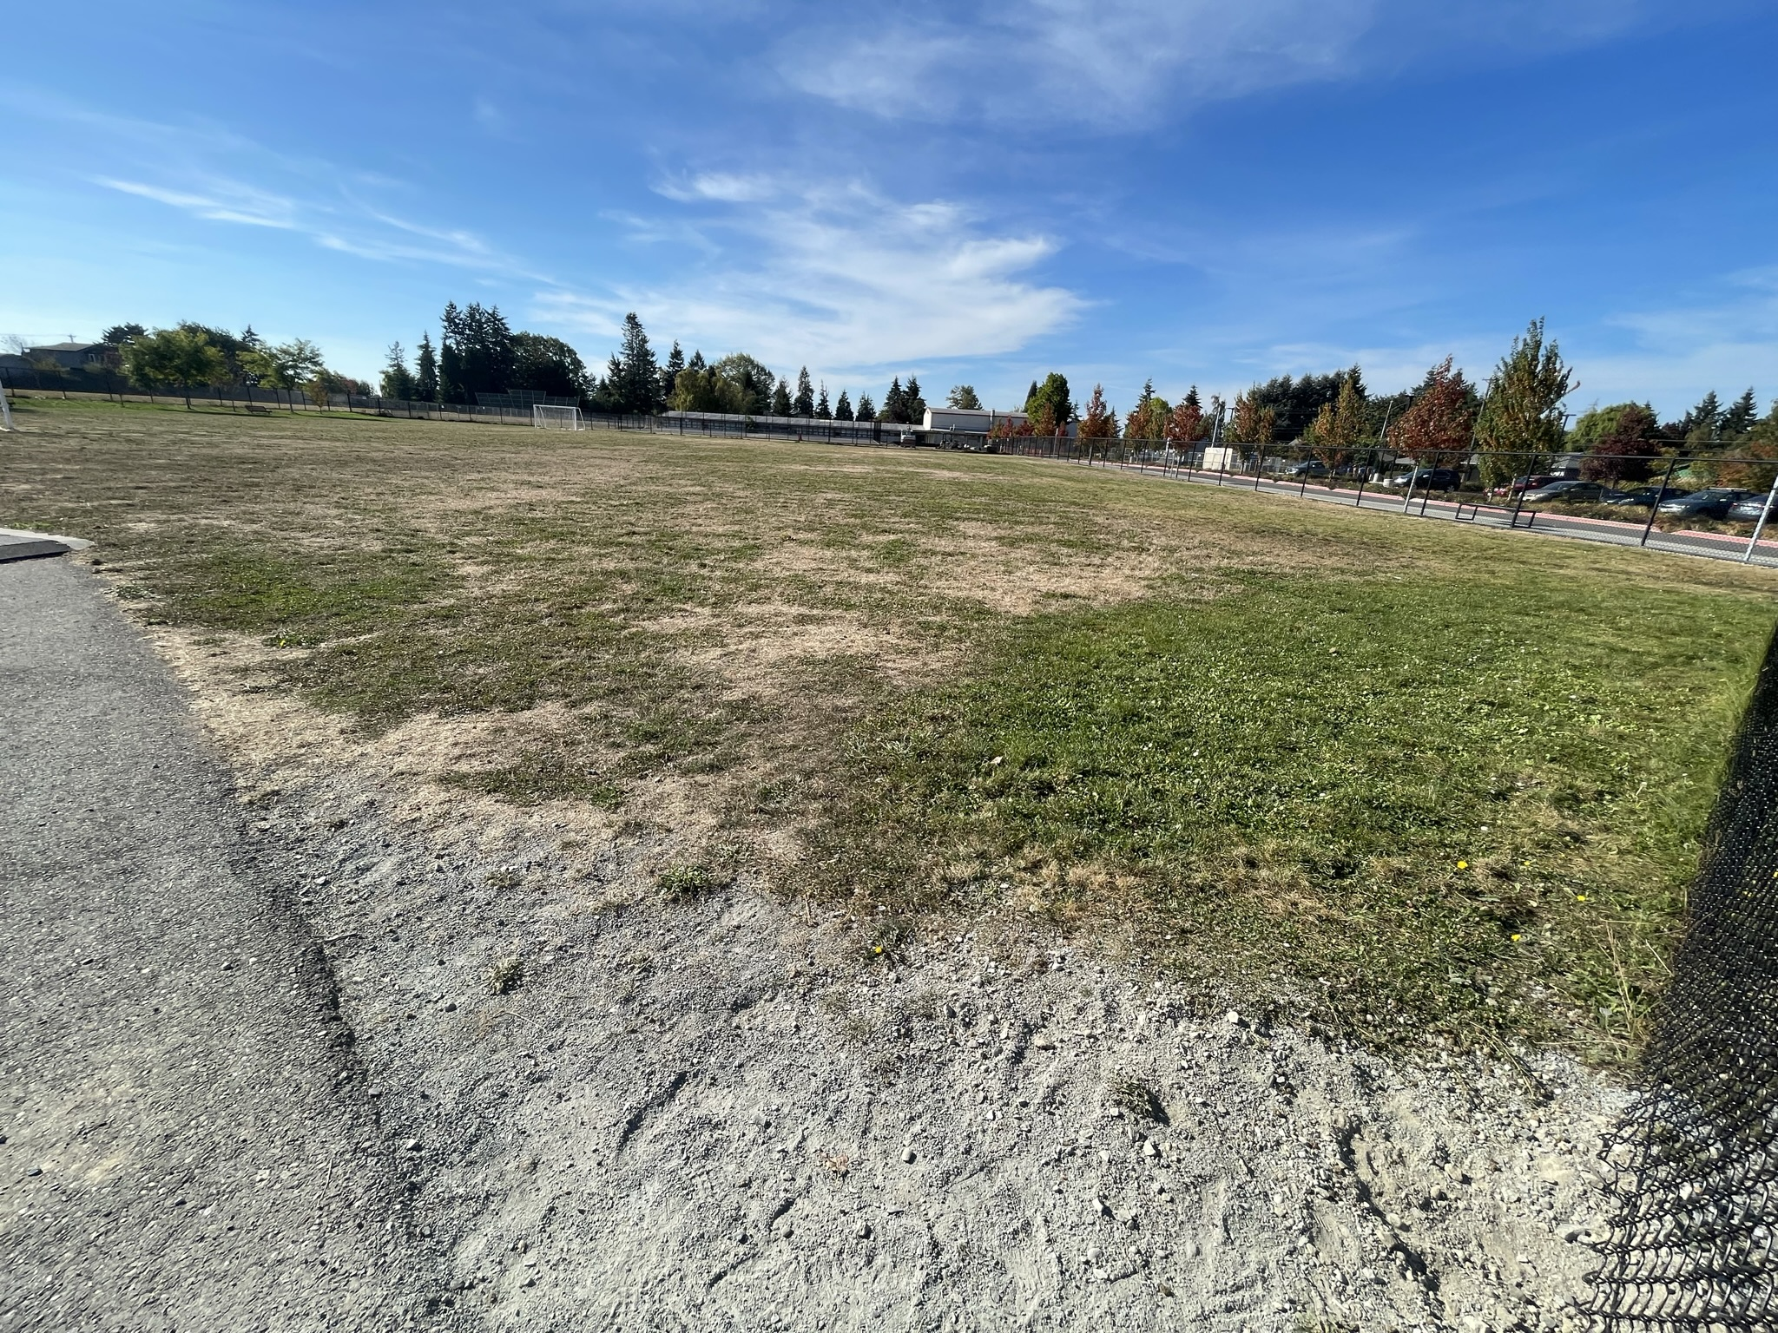
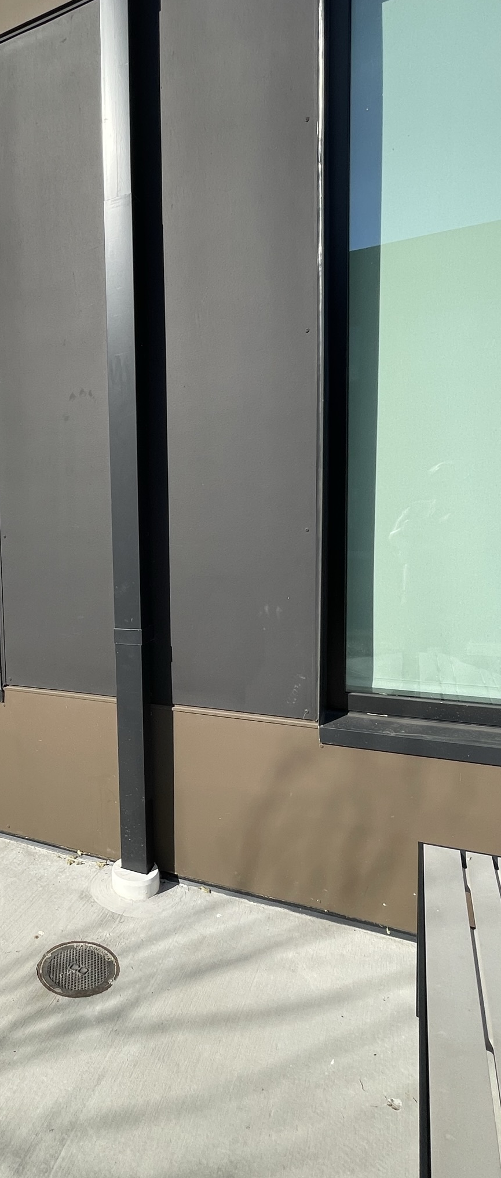
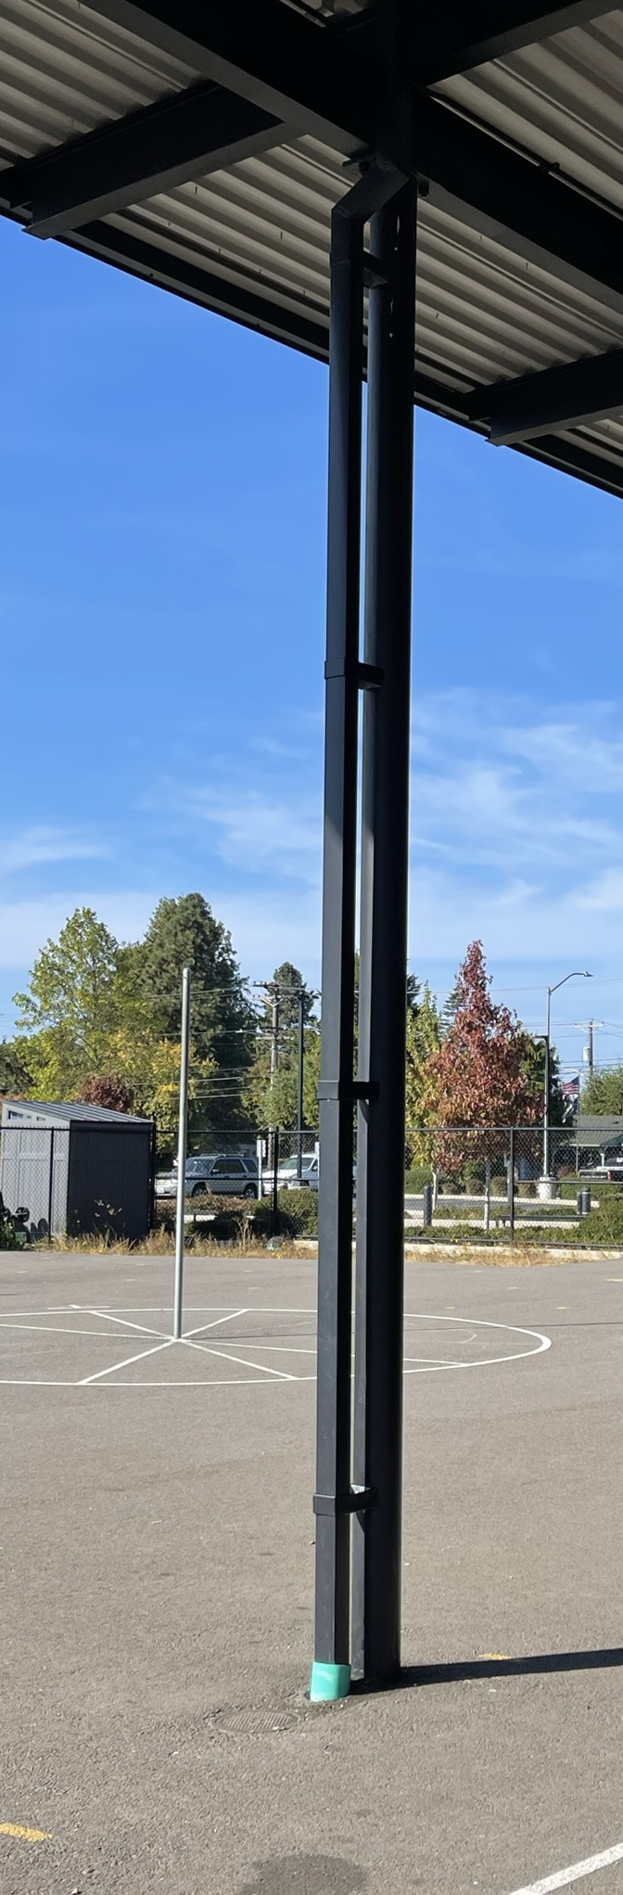
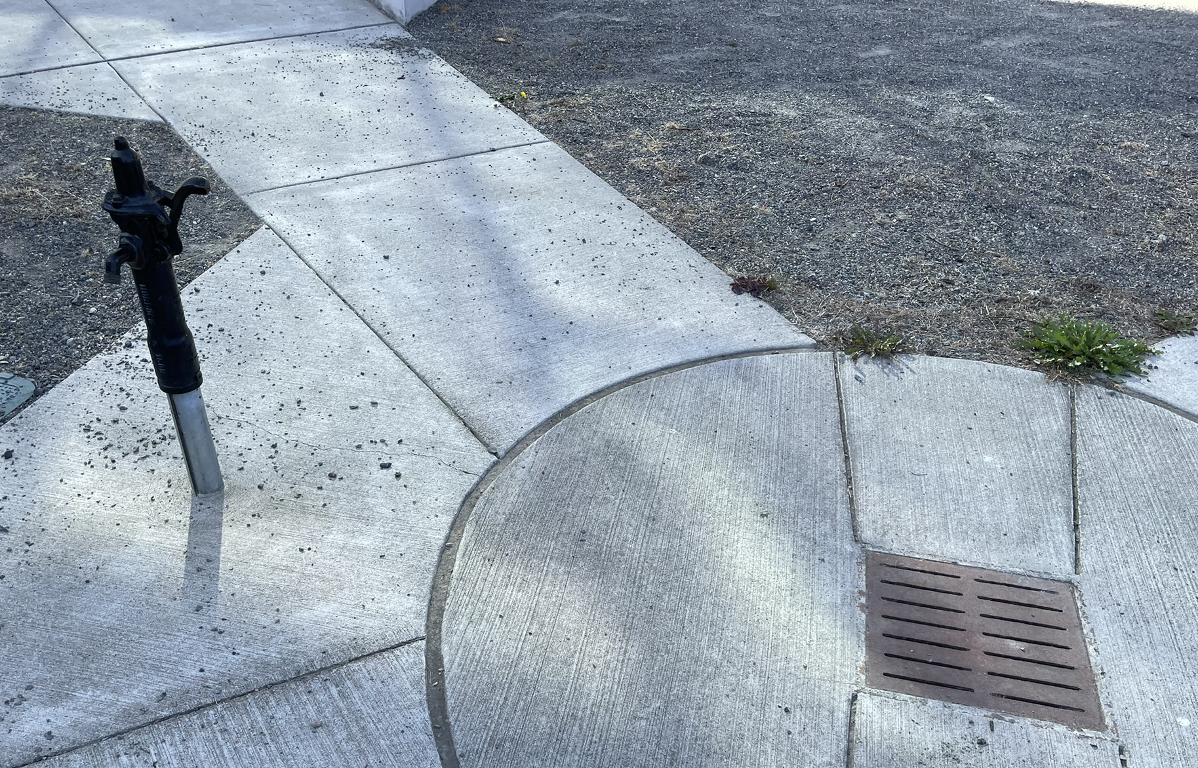
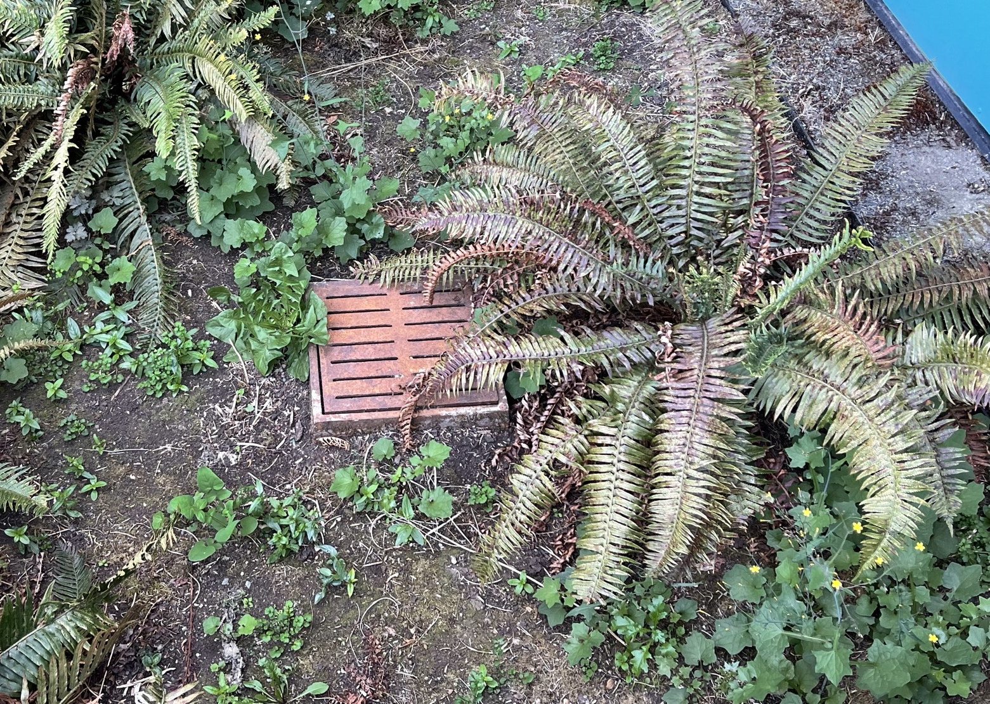
Schoolyard Stormwater Points of Interest
E. Downspouts - Where does water flowing through this downspout lead? Where does the water start? Where else can you find downspouts? ​
E
F
F. Surfaces - Notice the directions that water flows on these surfaces and where it ends up. What happens to rain as it falls here? Which surfaces are pervious or impervious? Test it out by pouring water on the surface!​
E
G
G
G. Storm drains - Notice the placement of this drain and the surfaces around it. Why might this drain have been put here? What might happen to stormwater here?​

Slide 6

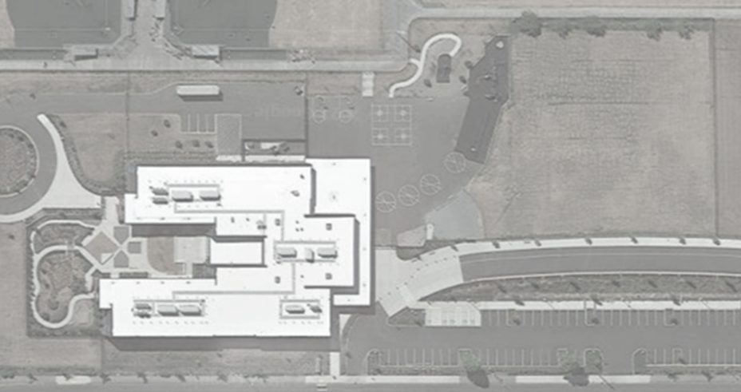

Mapping Your Schoolyard – Brown's Point Name: ____________ Date: _________
Include on your map:
Symbols from the Key including flow of water, erosion, and storm drains.
Show where you see any evidence of possible stormwater problems (this could be places where there's lots of erosion or big puddles, or oil from cars, etc).
Sketch larger plants and bushes if they are there.
Notes:
PRINT THIS PAGE for the STUDENT WORKSHEET

Slide 7
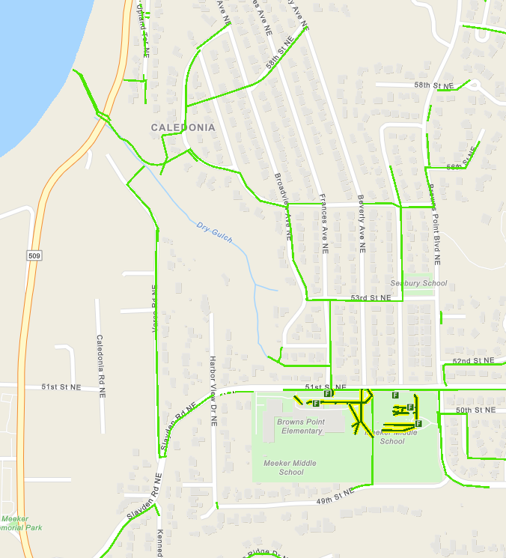


Local Stormwater Systems – teacher info
Brown's Point Elementary is in the Northeast Tacoma Watershed.
The storm drains at your school empty into stormwater pipes under the school and travel to Frances Ave NE where it flows north. The water may be discharged from pipes along Dry Gulch (yellow highlight)
OR
continue north and west under Frances Ave NE, 53rd St NE, and Broadview Ave NE. Following Sealawn Ave NE, the underground pipes continue under Overlook Ave NE a short distance before discharge into the Salish Sea near Dry Gulch (orange line).
The stormwater from your school ends up in the Salish Sea/Puget Sound!
Northeast Tacoma is a subwatershed within the Commencement Bay watershed. Covering 2,641 acres,
this subwatershed is mostly residential that has recently become the fastest growing area in the city.
(City of Tacoma website: https://www.cityoftacoma.org/cms/One.aspx?portalId=169&pageId=2860#Northeast%20Tacoma )

Slide 8
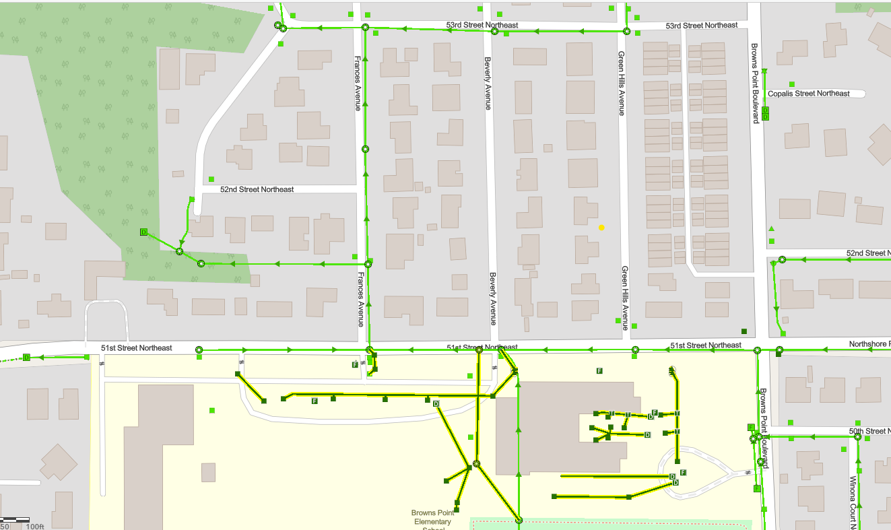
Brown's Point Elementary Where does your school’s stormwater go?
Follow the lines and arrows!
Dry Gulch

Slide 9
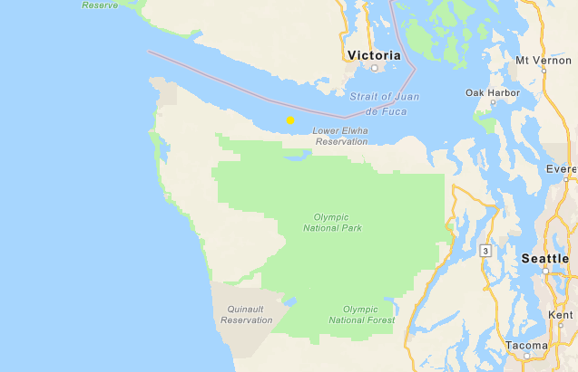


Pacific Ocean
Now follow the orange line away from your school (find your school by looking for the star) to see how it gets to the Salish Sea and then to the Pacific Ocean.

Slide 10


How did we figure this out?
To view this map on your own, go here:
https://tacoma.maps.arcgis.com/home/webmap/viewer.html?layers=23e9a402b47d46058193362cb6c27a9e
View in “Map Classic”
Check “Surfacewater Network” box
Put in the name of the school
Zoom IN to see the green lines

