Slide 1


Community Waters School Guide:
Birney Elementary School
How to Use This Guide
This School Guide supports the Community Waters Science Unit Teacher Manual with information, maps, and images specific to your school and neighborhood.
It is written for teachers - its goal is to provide a better understanding of what is happening with stormwater in and around your school.
All content within may change, and can be adapted as desired.
If you have any questions about these maps, accompanying lessons, or stormwater around your school, contact IslandWood staff at communitywaters@IslandWood.org.

Slide 2
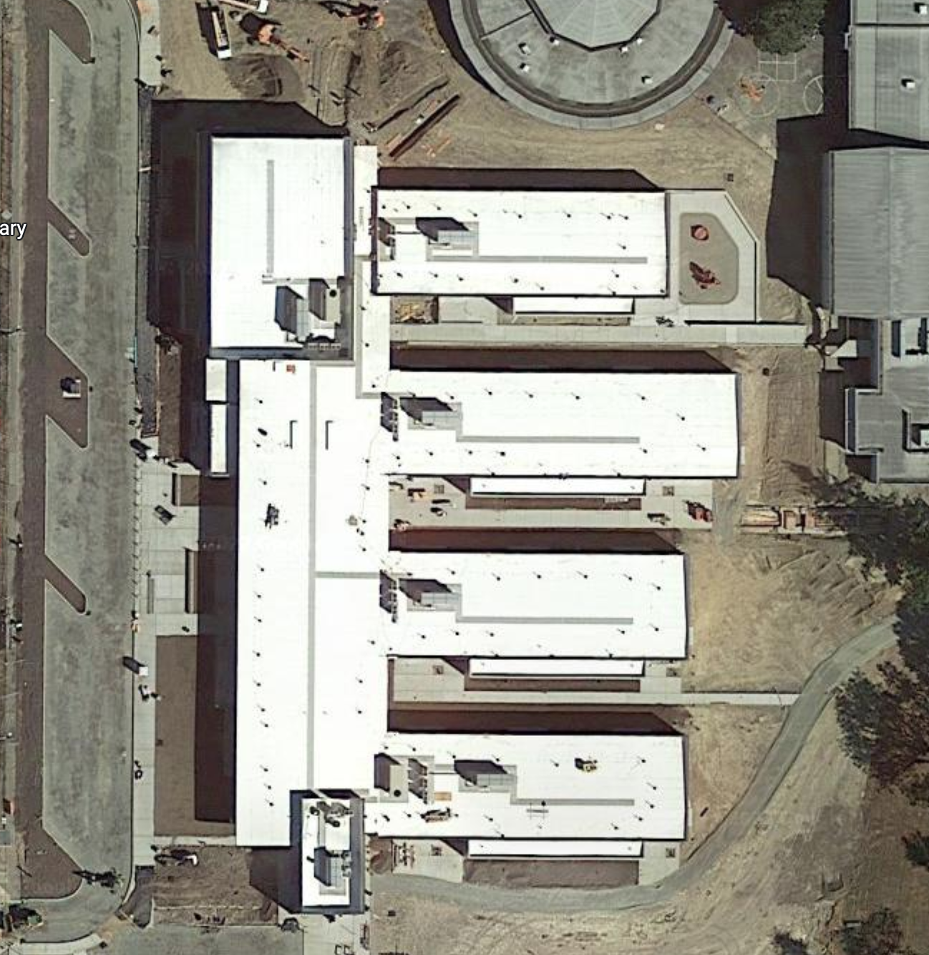
Stormwater in Our Schoolyard from Lesson 2
This map and points of interest (photos and info on next slides) can be used to guide your class’ exploration of the schoolyard. You will find the student worksheet for this lesson following the teacher guide version and as a separate PDF file. Please use the extra space on the pages to add your own notes and questions!
C
D

Slide 3
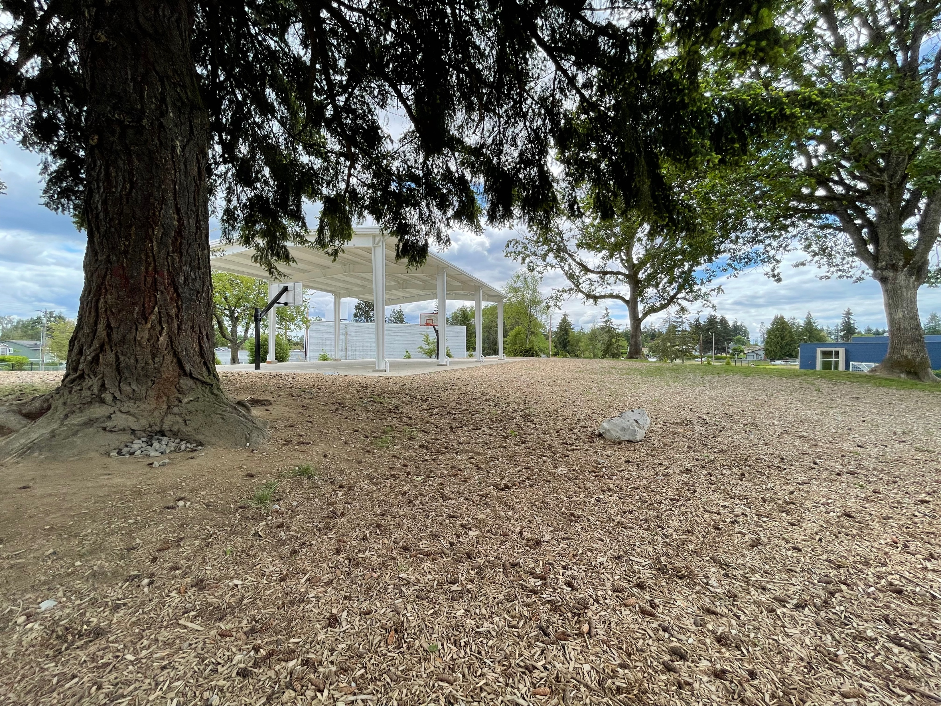
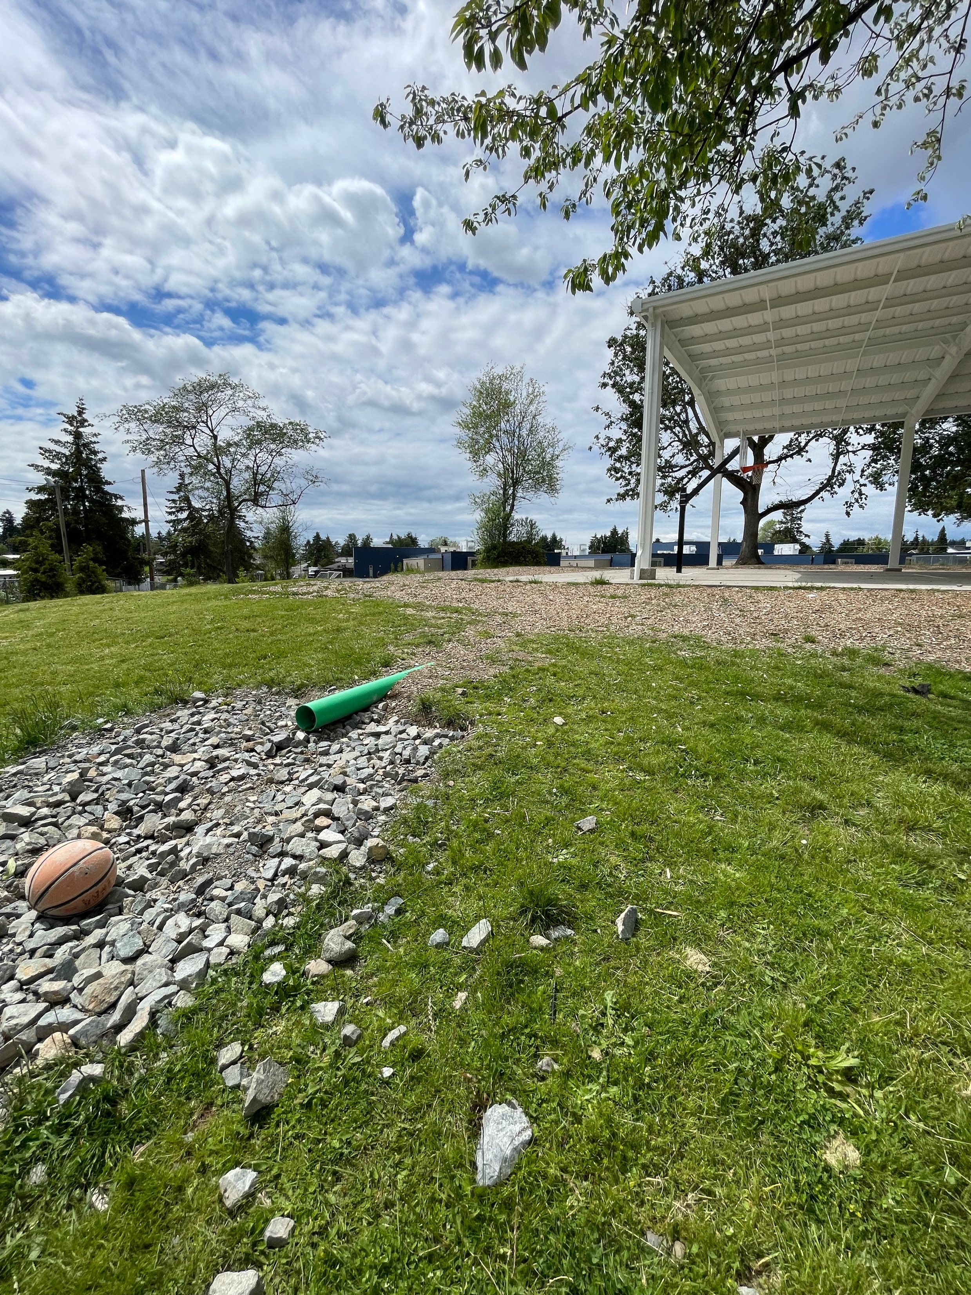
Schoolyard stormwater points of interest
A. Playground/recess surfaces – Note what directions water flows off these different surfaces. Are they pervious or impervious?
Can you find where the water would collect or puddle or drain in a heavy rain?

Slide 4
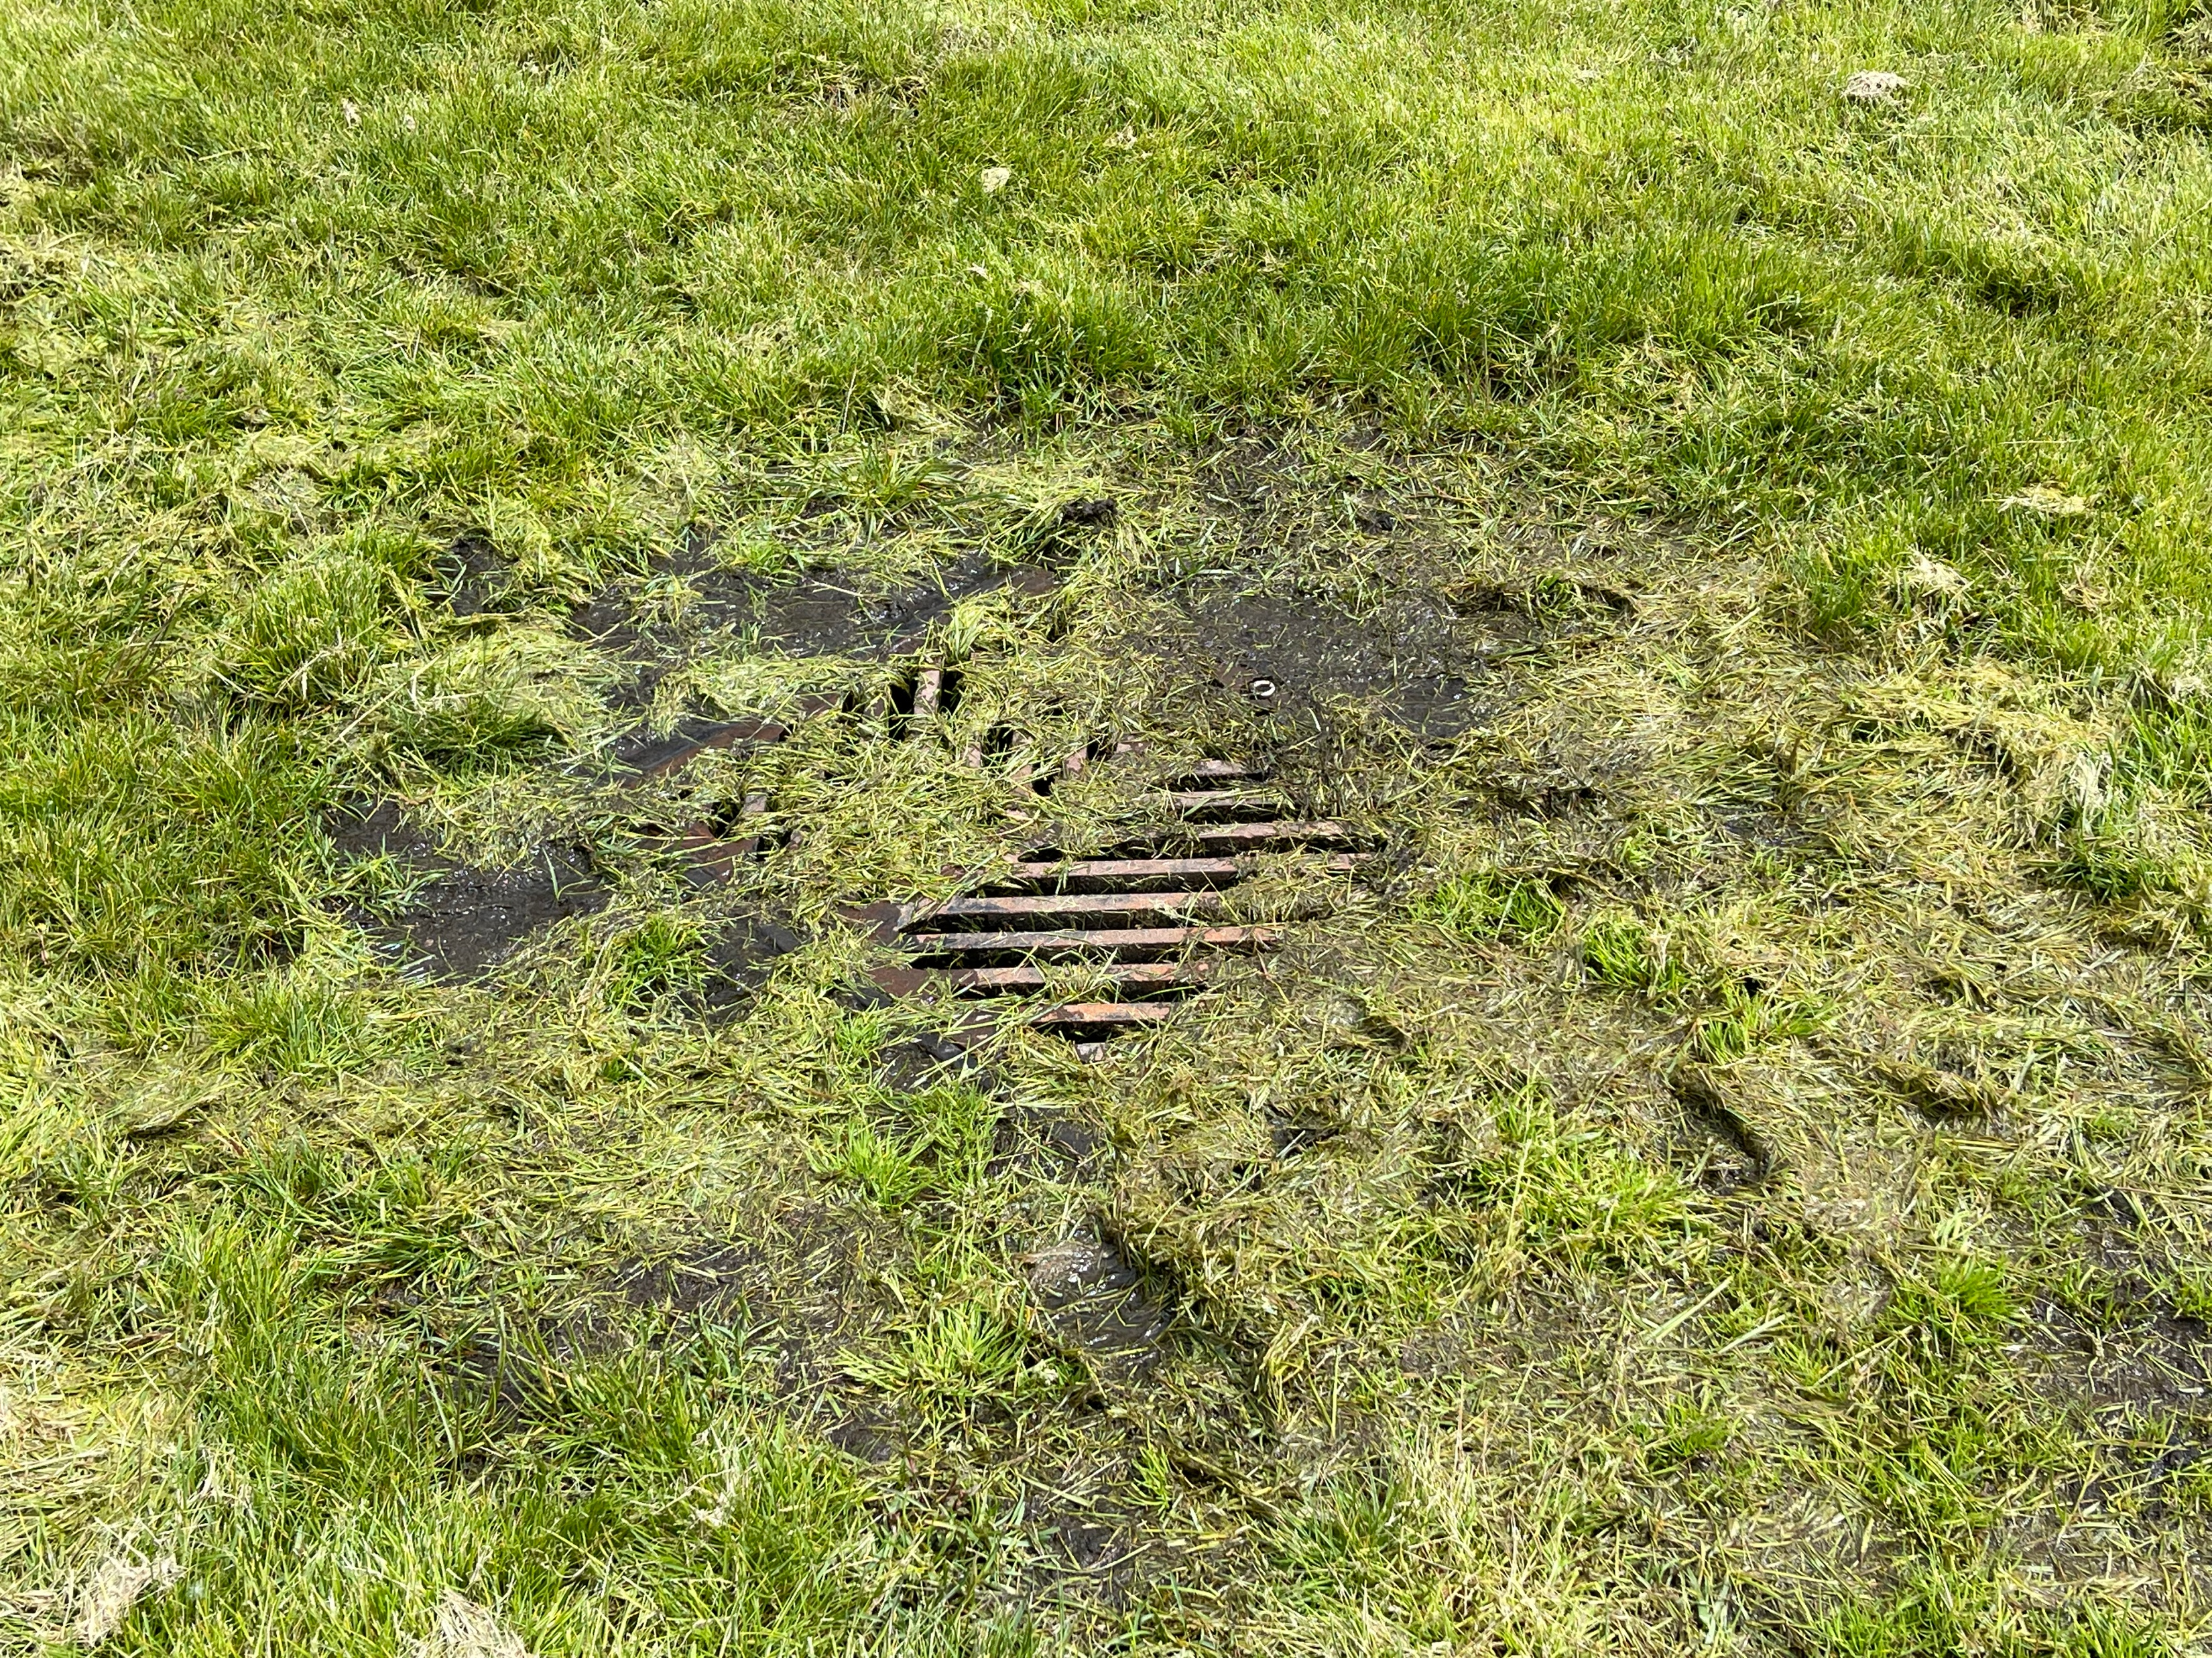
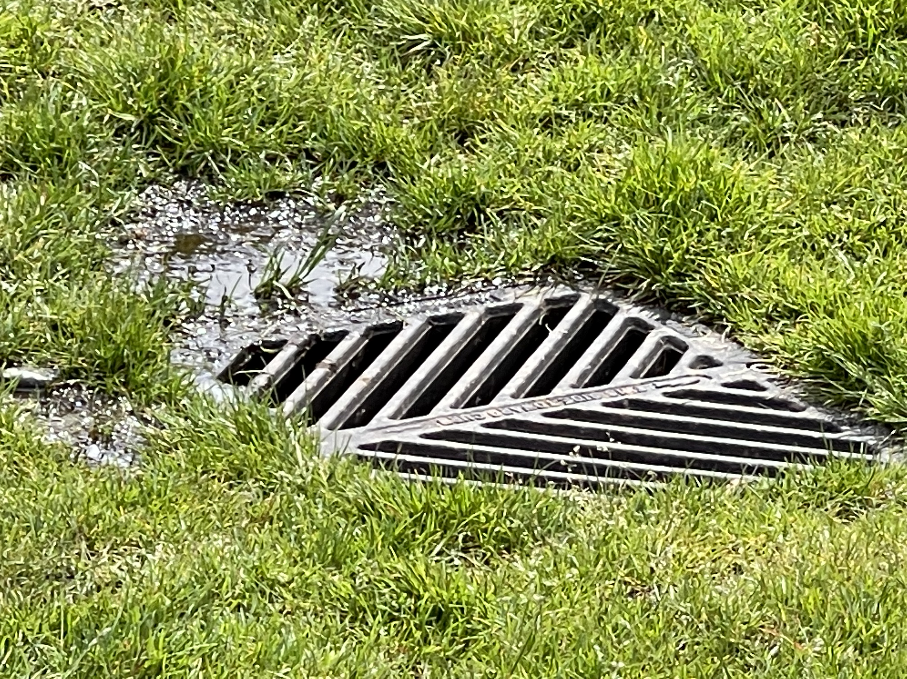
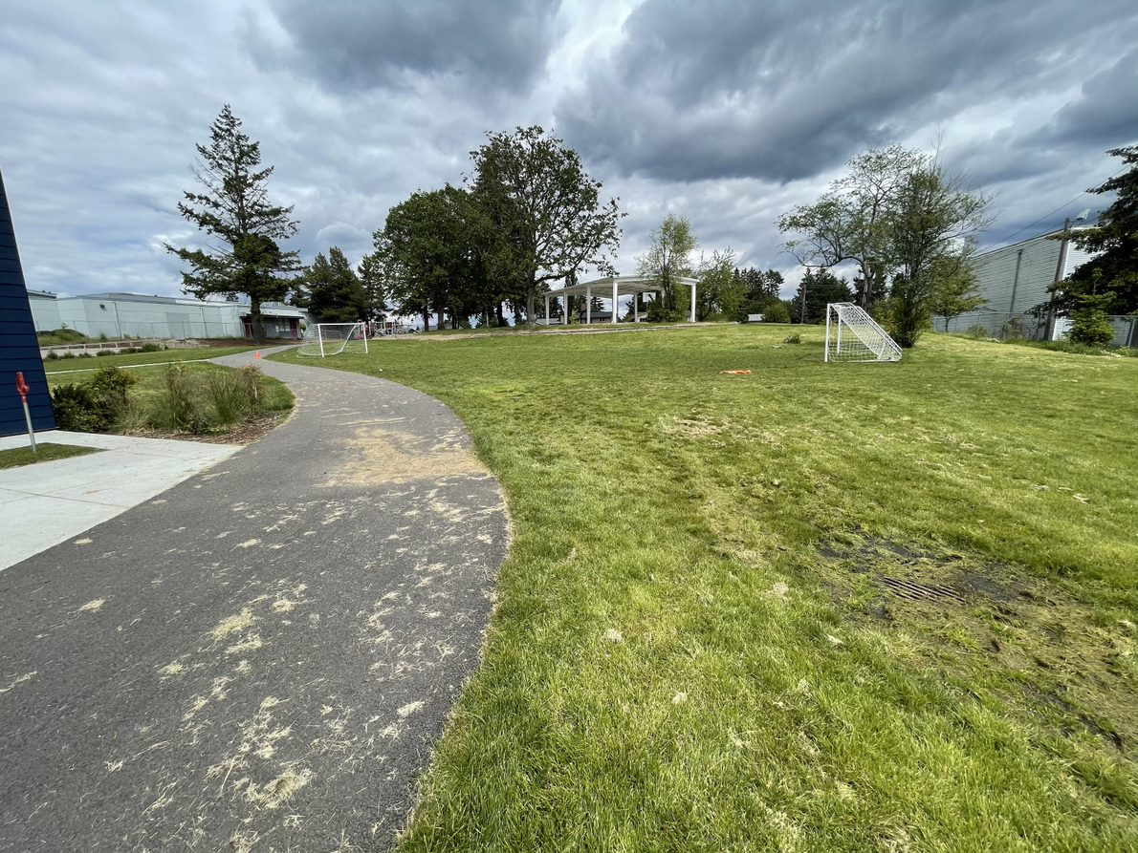
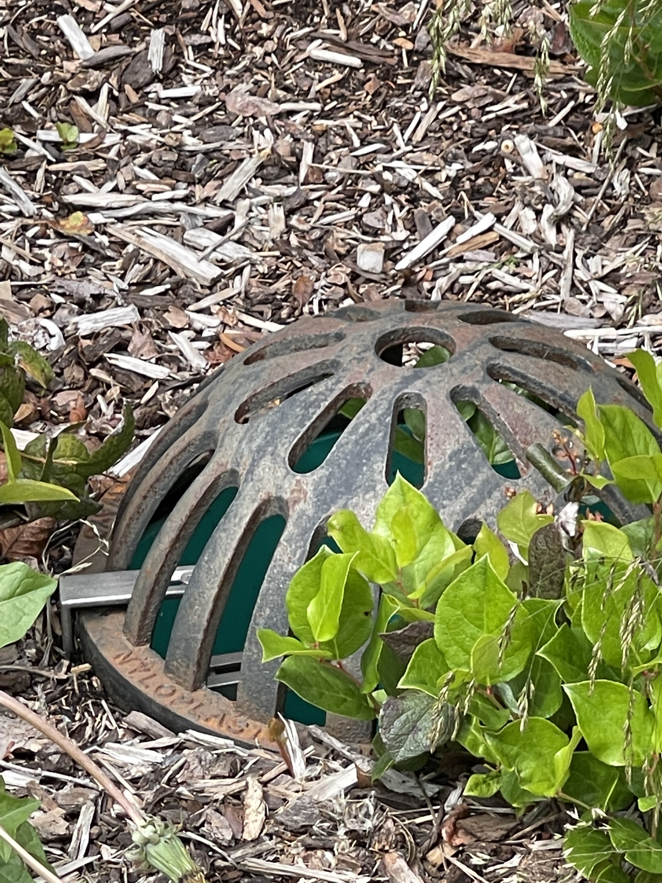


Schoolyard stormwater points of interest
B. Storm Drains – Note how this drain is surrounded by grass. Why might this drain have been put here? What might happen to stormwater here?
Where else can you find storm drains?

Slide 5
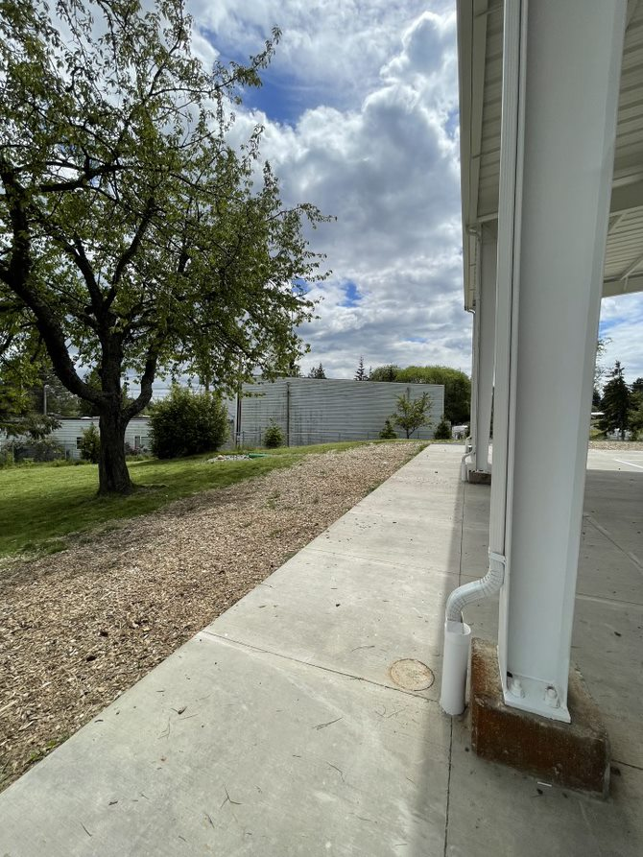
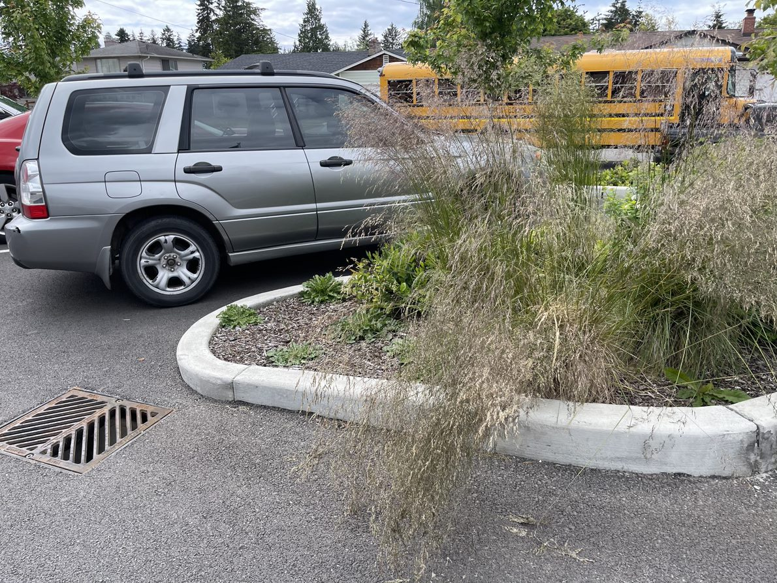
Notice the gutters and downspouts on the left – where does that stormwater go?
Another storm drain above!

Slide 6
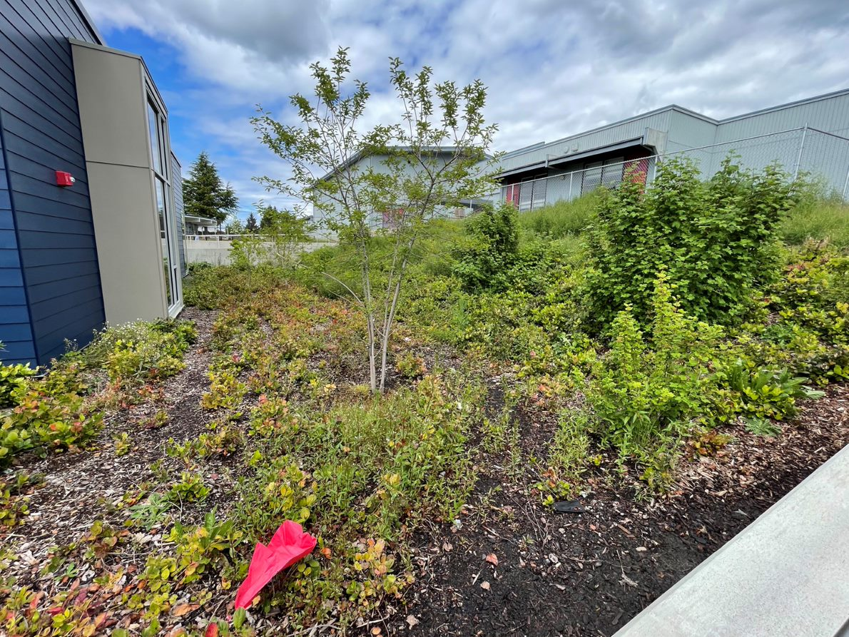
How does water interact with the plants, soils and other things in this space?

Slide 7
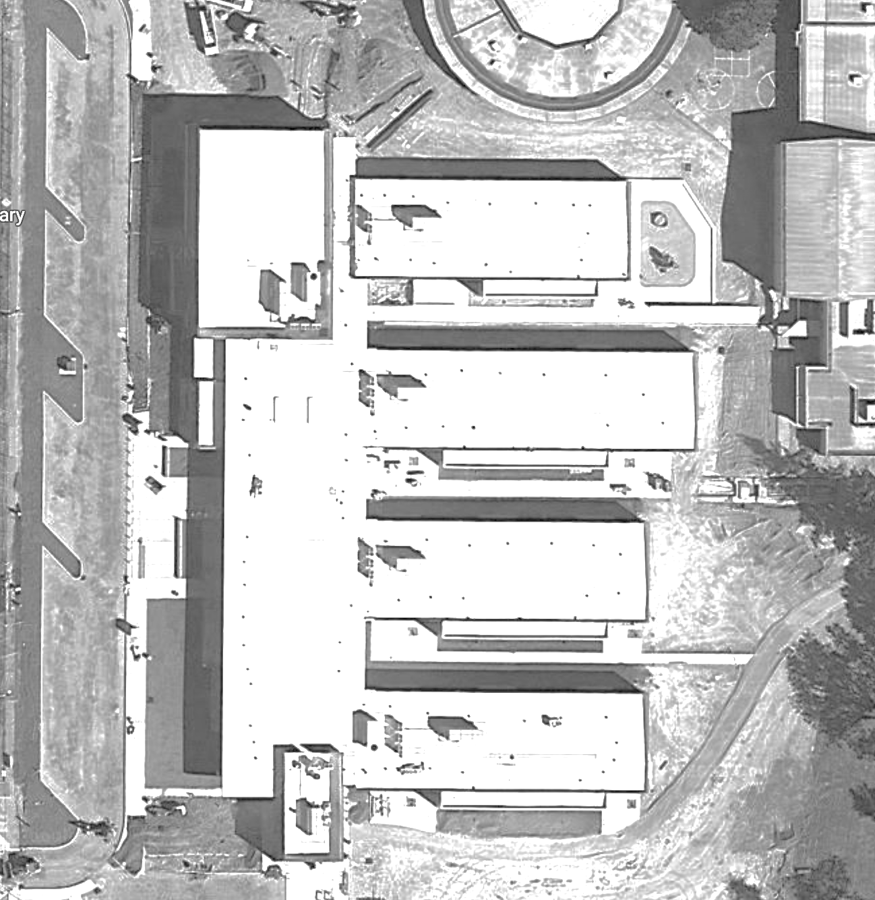


Mapping Your Schoolyard – Birney Elementary Name: ____________ Date: _________
Include on your map:
Symbols from the Key including flow of water, erosion, and storm drains.
Show where you see any evidence of possible stormwater problems (this could be places where there's lots of erosion or big puddles, or oil from cars, etc).
Add larger plants and bushes if they are there.
Insert map for students here
-grayscale, somewhat transparent
Notes:
PRINT THIS PAGE for the STUDENT WORKSHEET

Slide 8
Local Stormwater Systems
What happens with the stormwater around your school?
Where does your stormwater runoff end up?
The stormwater from your school ends up in Flett Pond.
Your school is in the Flett Creek Watershed
Stormwater on S 76th St., then travels north on S L St. and curves around Wapato Lake, it then travels south on Highway 5 where is discharges into Flett Pond. Finally, the stormwater follows along Chambers Creek and exits into Chambers Bay and/or Puget Sound.
Flett Creek covers 7,153 acres and is the second largest subwatershed in Tacoma and is mostly residential with light commercial and industrial areas.
Flett Creek subwatershed flows into Snake Lake and Wapato Lake. The Flett Creek surface water drains through a series of holding basins, including Hosmer, Ward’s Lake, a gravel holding basin just north of Ward’s Lake and the four Flett Creek holding basins in the west. At the last Flett Creek holding basin a pump station sends the water to the Flett Dairy wetlands, where it flows into Flett Creek. Downstream, Flett Creek flows into Chambers Creek, a salmonid-bearing stream, which discharges into Chambers Bay then to the Narrows. https://www.cityoftacoma.org/cms/One.aspx?portalId=169&pageId=2860#Flett%20Creek
Notes:
Please Note: The pipes information provided here is our best estimate of the stormwater flow in your community based on the information we have currently. If you encounter more information in the course of your investigation, please let us know so we can update future versions of this document.

Slide 9
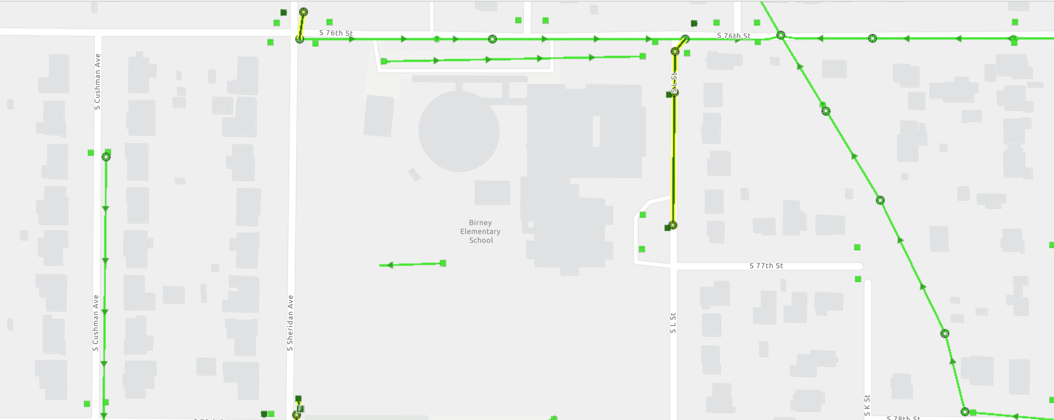
Birney Elementary Where does your school’s stormwater go?
Follow the lines and arrows!

Slide 10
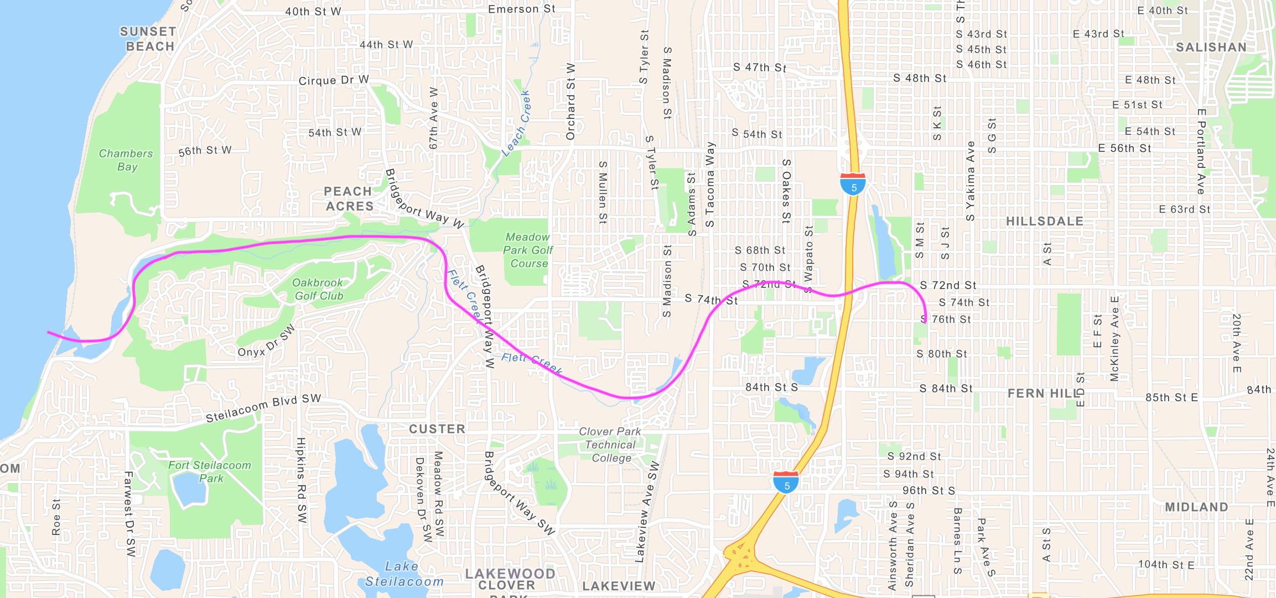
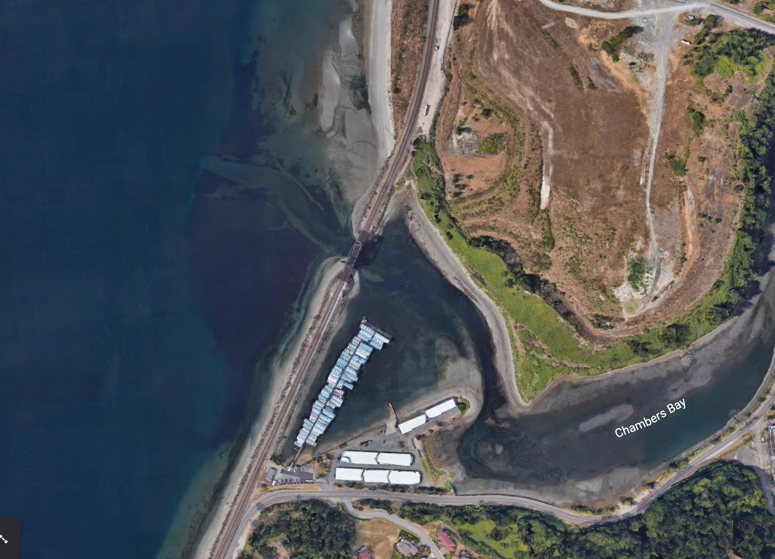
Now follow the pink line away from your school (find your school by looking for the star) to see how it gets to the Salish Sea!

